Slide 1

Firewall
Andrew Pickard
- 40315028 -

Slide 2
Controlled Access
SECURITY GOALS
Only allow who we want to connect to our network.
Hosts that are not to be blocked should not be negatively impacted by the system.
- Reduce Threats to the network, and subsequently the Attacks which are realised.
- Firewall as part of a multi-level security solution.
Availability

Slide 3
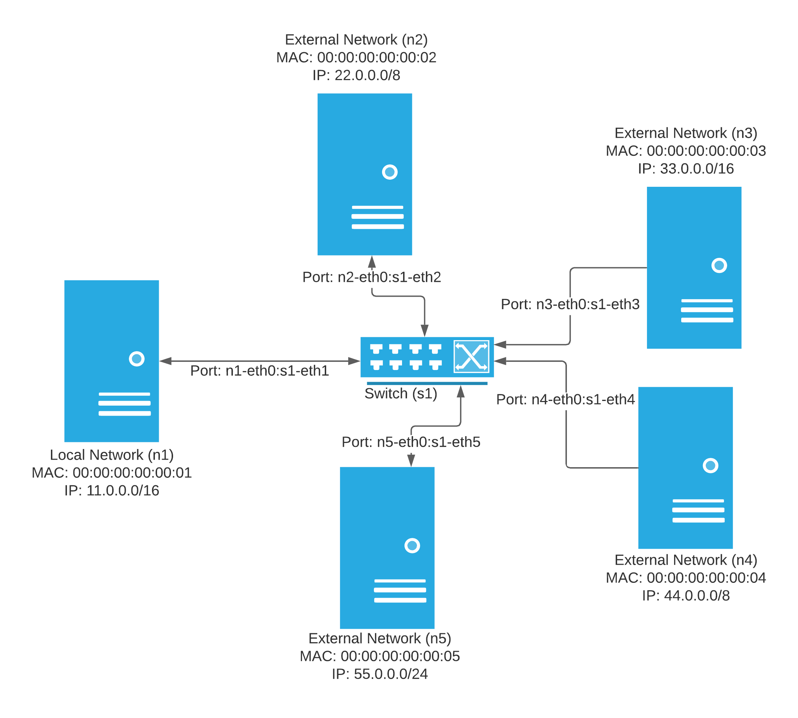
TOPOLOGY

