Slide 1
Dashboard Blueprint - Deliverable #2
Team 10, Food System Emissions

Slide 2
Outline
A blueprint for the dashboard is created and includes all of the following:
✓ Storyboard on Google Slide(s)
✓ Description of the tool(s) that will be used to create final dashboard
✓ Description of interactive element(s)

Slide 3
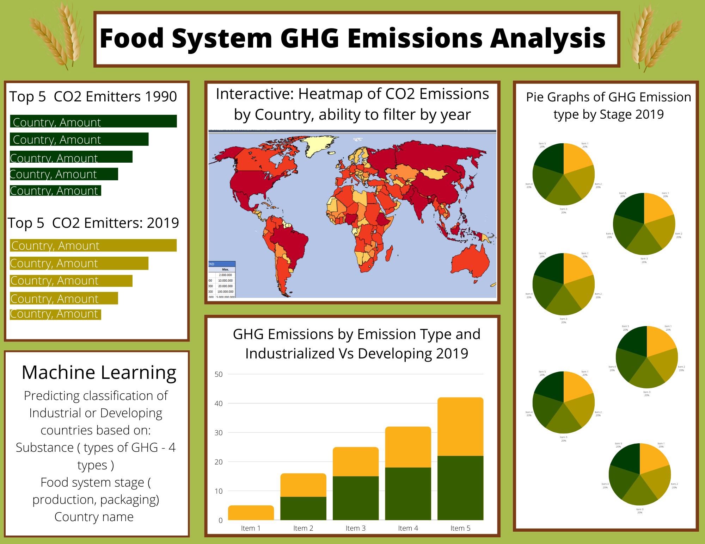
Storyboard Template

Slide 4
Description of Tools
Tools Used:
Excel – Raw data file saved as CSV for initial review
Python – Initial Data Cleaning
PG Admin, PostgresSQL – Table creation/ Storage
Tableau - Dashboard
Jupyter Notebook – Machine Learning Model and Data Analysis
AWS RDS – Data storage
Github – Project Files
Google Slides – Project Presentation

Slide 5
Description of Interactive Elements
The interactive element will be the heatmap of CO2 emissions. This will be a map with each country portrayed. You will be able to slide through the years 1990-2019 and see how CO2 emissions have changed over time. Red will be the most CO2 emissions, while blue will be the least CO2 emissions. The country colors will change as CO2 levels increase or decrease over time.

