Slide 1
👋
I’m Andy, thanks for inviting me

Slide 2
how we “get digital work done”
Andy Porter
I want to develop… Design lead

Slide 3
we’ve been told we have a great team culture, that
the team works really well, and,
can we talk about it?

Slide 4
Develop Land and Property - agile:
built private beta service in 3 sprints
programme board, showcase, sprints - with no Product Manager - for a month (un-noticed)
Business Gateway - waterfall:
fixed scope delivered early
Notes:
So, a lot of this stuff is agnostic to approach - it’s all about value. Maximising the work not done.

Slide 5
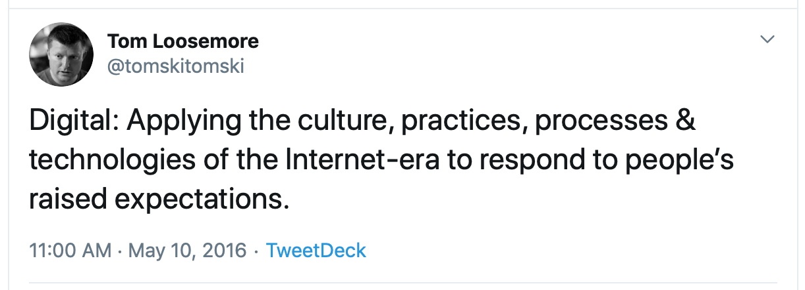
of the internet, not just on the internet
Notes:
https://tom.loosemore.com/about/
Of the internet - native to this era.
on the internet - paper based era, put on the the internet - like publishing a copy of a word doc/pdf.
CAR TAX (no q-ing in the post office with all your docs)
Driving license (hire car - hirer can check of you are eligible) Answers questions people need - in a modern way
So getting work done - same as pre internet…...

Slide 6
same outcomes wanted - great public services, value for money -
governance and assurance
new ways of doing

Slide 7
we didn’t just all have these skills
it doesn’t happen by accident
learn, practice, hone
Notes:
a strong core, that’s become self-sustaining
curated team - core chosen for attitude + aptitude (initiallty curated, and we continuously curate the team makeup/culture/vibe) - love your It’s ok.
initial investment - high quality coaching in team (coach) and digital programme leaders (coaching, feedback) (when the programme was small, we had lots of daily contact with programme leaders)
deliberate frequent practice, iterated and incremented
* principles & rules of thumb - that guide and enable * (these are very important)

Slide 8
some ways we work that may be of use
three of our principles

Slide 9
go for challenging goals
always be adding value, don’t stop moving toward the goal
Notes:
something that adds significant value
answers a significant question (the organisation learns something useful) (value)
solves a problem (for users or the organisation) (value)
forces you to push yourself a bit, to think of ways to solve the problem, to remove waste from the process.
It’s not about making individual people work harder, it’s about smarter working, solving things as a team.
set and agreed to by the team - not ‘a boss’
always different
everyone focused on the, clear, agreed, goal
only missed once
any barrier to achieving worked around or removed - own the problem, solve it yourself - remove external dependencies
own it / take responsibilty - if something goes wrong in a show and tell, or the service goes down - we take responsibility for it (we may not have done the work/set it up) - but we ‘own it’.
If something someone outside the team goes well - give credit to them.
when we do this, when we ‘own it’ and work our way, tasks take 2 days, when not true - e.g. dependency outside the team [things stop - different culture/working practices], tasks take over a week (avg) - that is waste, £🔥
we were able to run multiple goals (a secondary goal)
(how you might than split the team into 2. small teams, each with a clear mission, how you scale)
in fact everything we do has a goal, a clear purpose

Slide 10
remove barriers to collaboration - be open
in team, across the organisation, with users, gov and industry… just everyone
Notes:
remove barriers to collaboration.
show and tell
we always have one
talk about value, answers an organisational question (not what we did)
or solves a problem [user or organisational, societal]
invites questions, challenge and feedback
work together in the same document at same time
keep the card up to date, don’t work alone (no single person task), link to the source don’t make a copy
open tools (no barriers - eg licenses, access restrictions, installation)
remote people, not a secondary experience
Give credit to people, give useful feedback on improvement

Slide 11
iterate and improve daily
never delay making an improvement
Notes:
task playback at 25% done - enough to know where you are aiming, but not too much that you are reluctant to change.
review tasks at least daily
no task single person task
tasks have clear purpose, structure and improvement cycle built in
everyone always has a clear role (esp meetings)
non specialist work is rotated (facilitating, presenting, organising, e.g. retros, show and tells)
aim: making remote as good as in-room
meetings get stopped, reviewed and improved half way through
make it better for the next person, leave it as you would wish to find it.
don’t be afraid to try something that doesn’t work
Give credit to people, give useful feedback on improvement. - Design crits - asking for and giving feedback. (slide from other crit deck)

Slide 12
we have loads of this stuff
principles, practices, tips.
Notes:
not just about the team, but also about the service - the things you build reflect your culture
we’ve ‘levelled up’ people who’ve joined the team and
we’ve been exporting a lot of good practice and culture - to our communities, and other teams

Slide 13
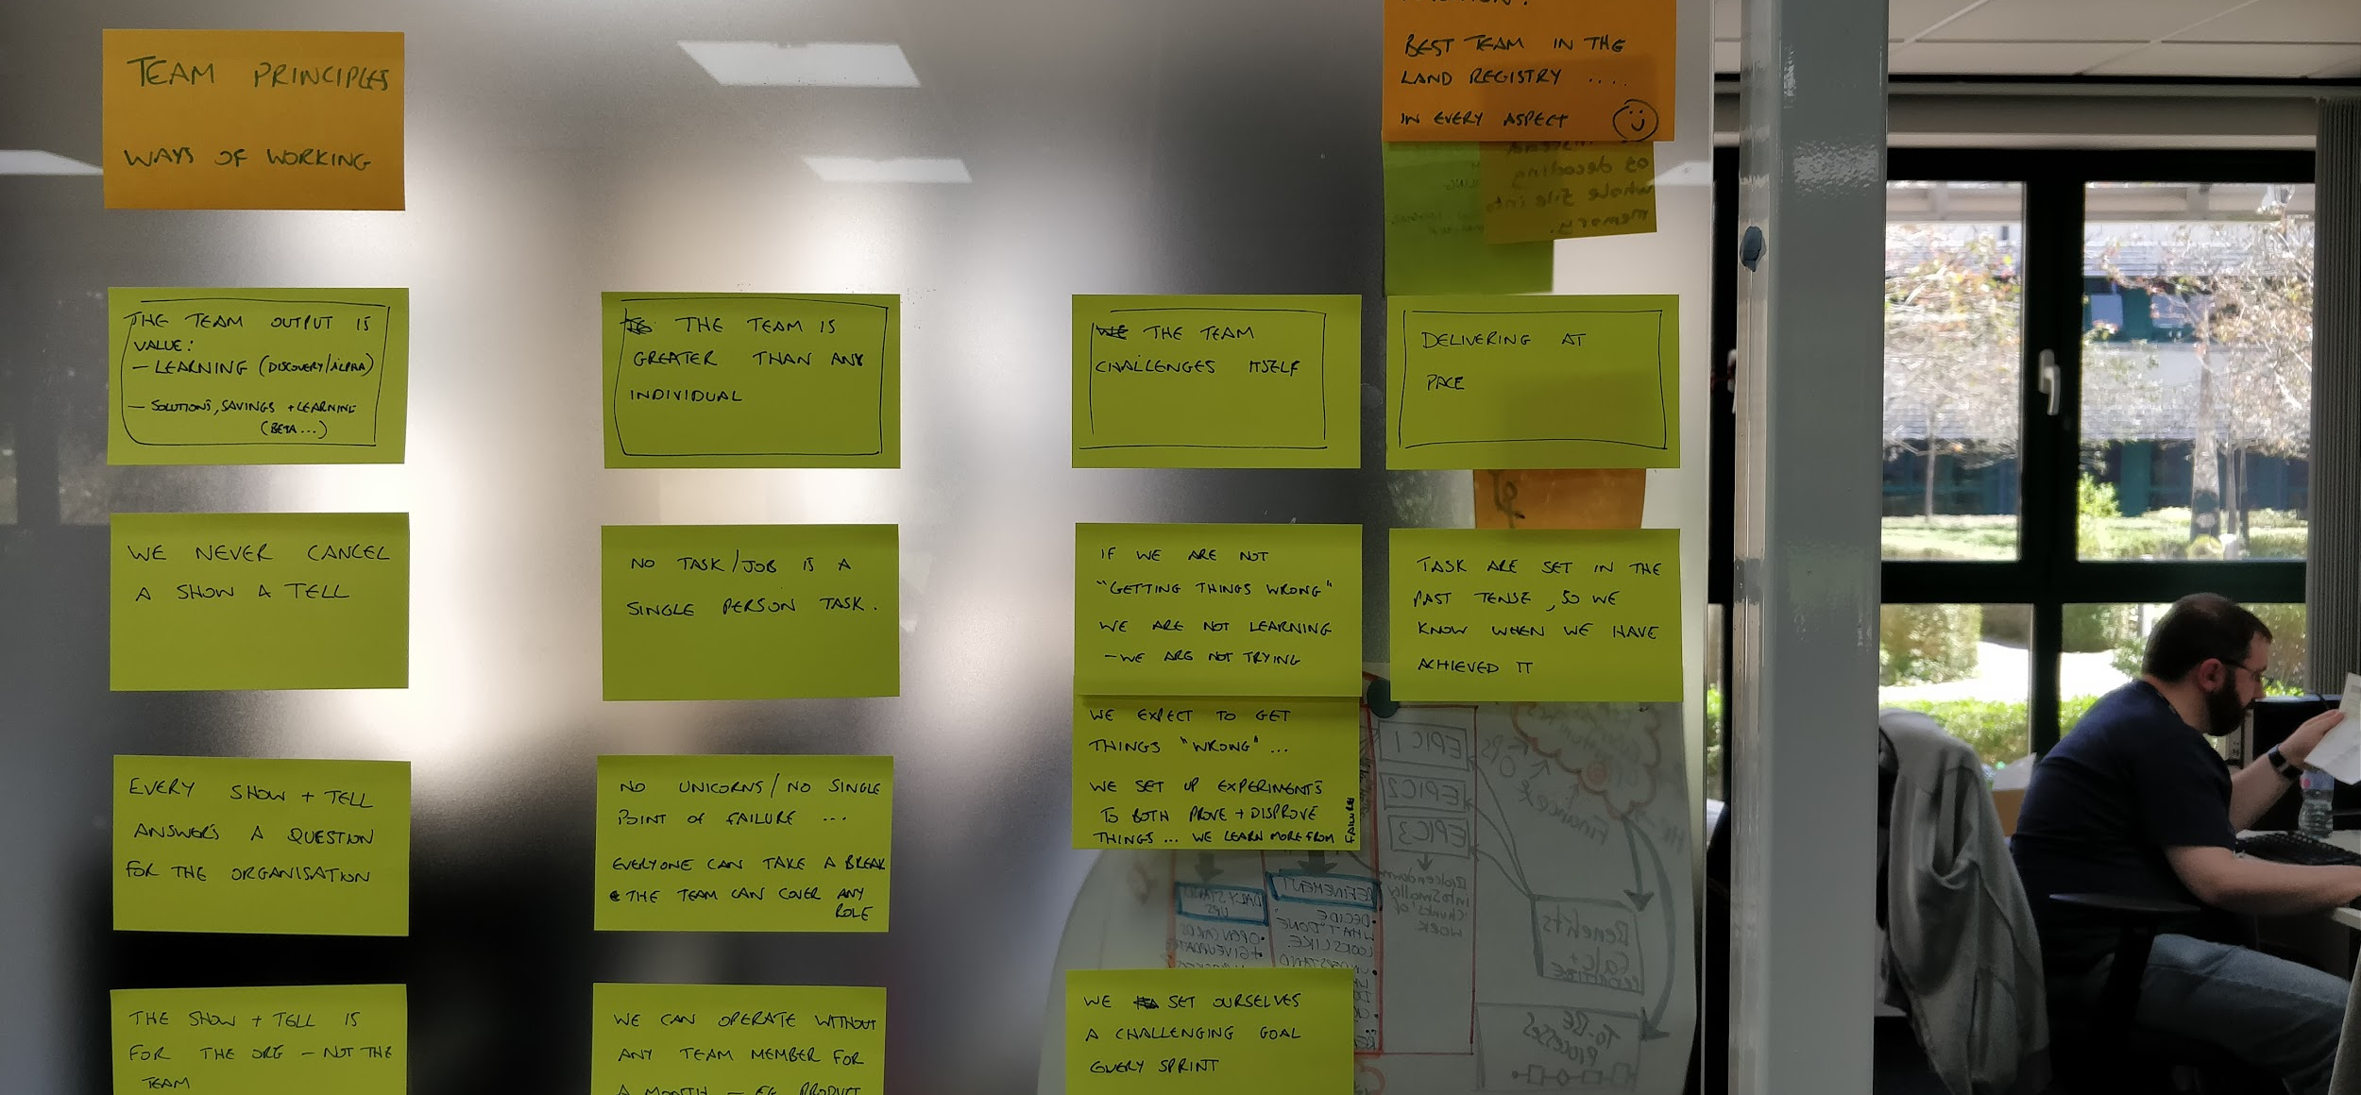
some of our guiding principles & rules of thumb

Slide 14
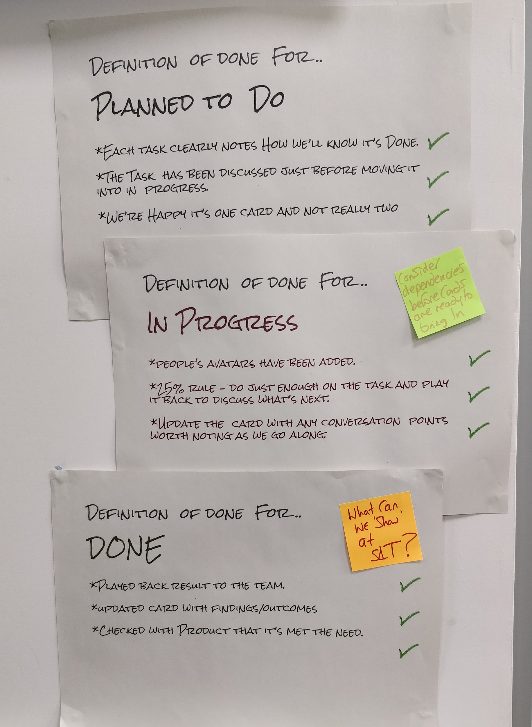
guide to making our work flow
simple - glance-able
clear
on the wall, where we meet
not a long checklist
people > processes
Notes:
process/rules of thumb + stand up (How to do it - how the board works - written down for new people, not because we need them daily)

Slide 15
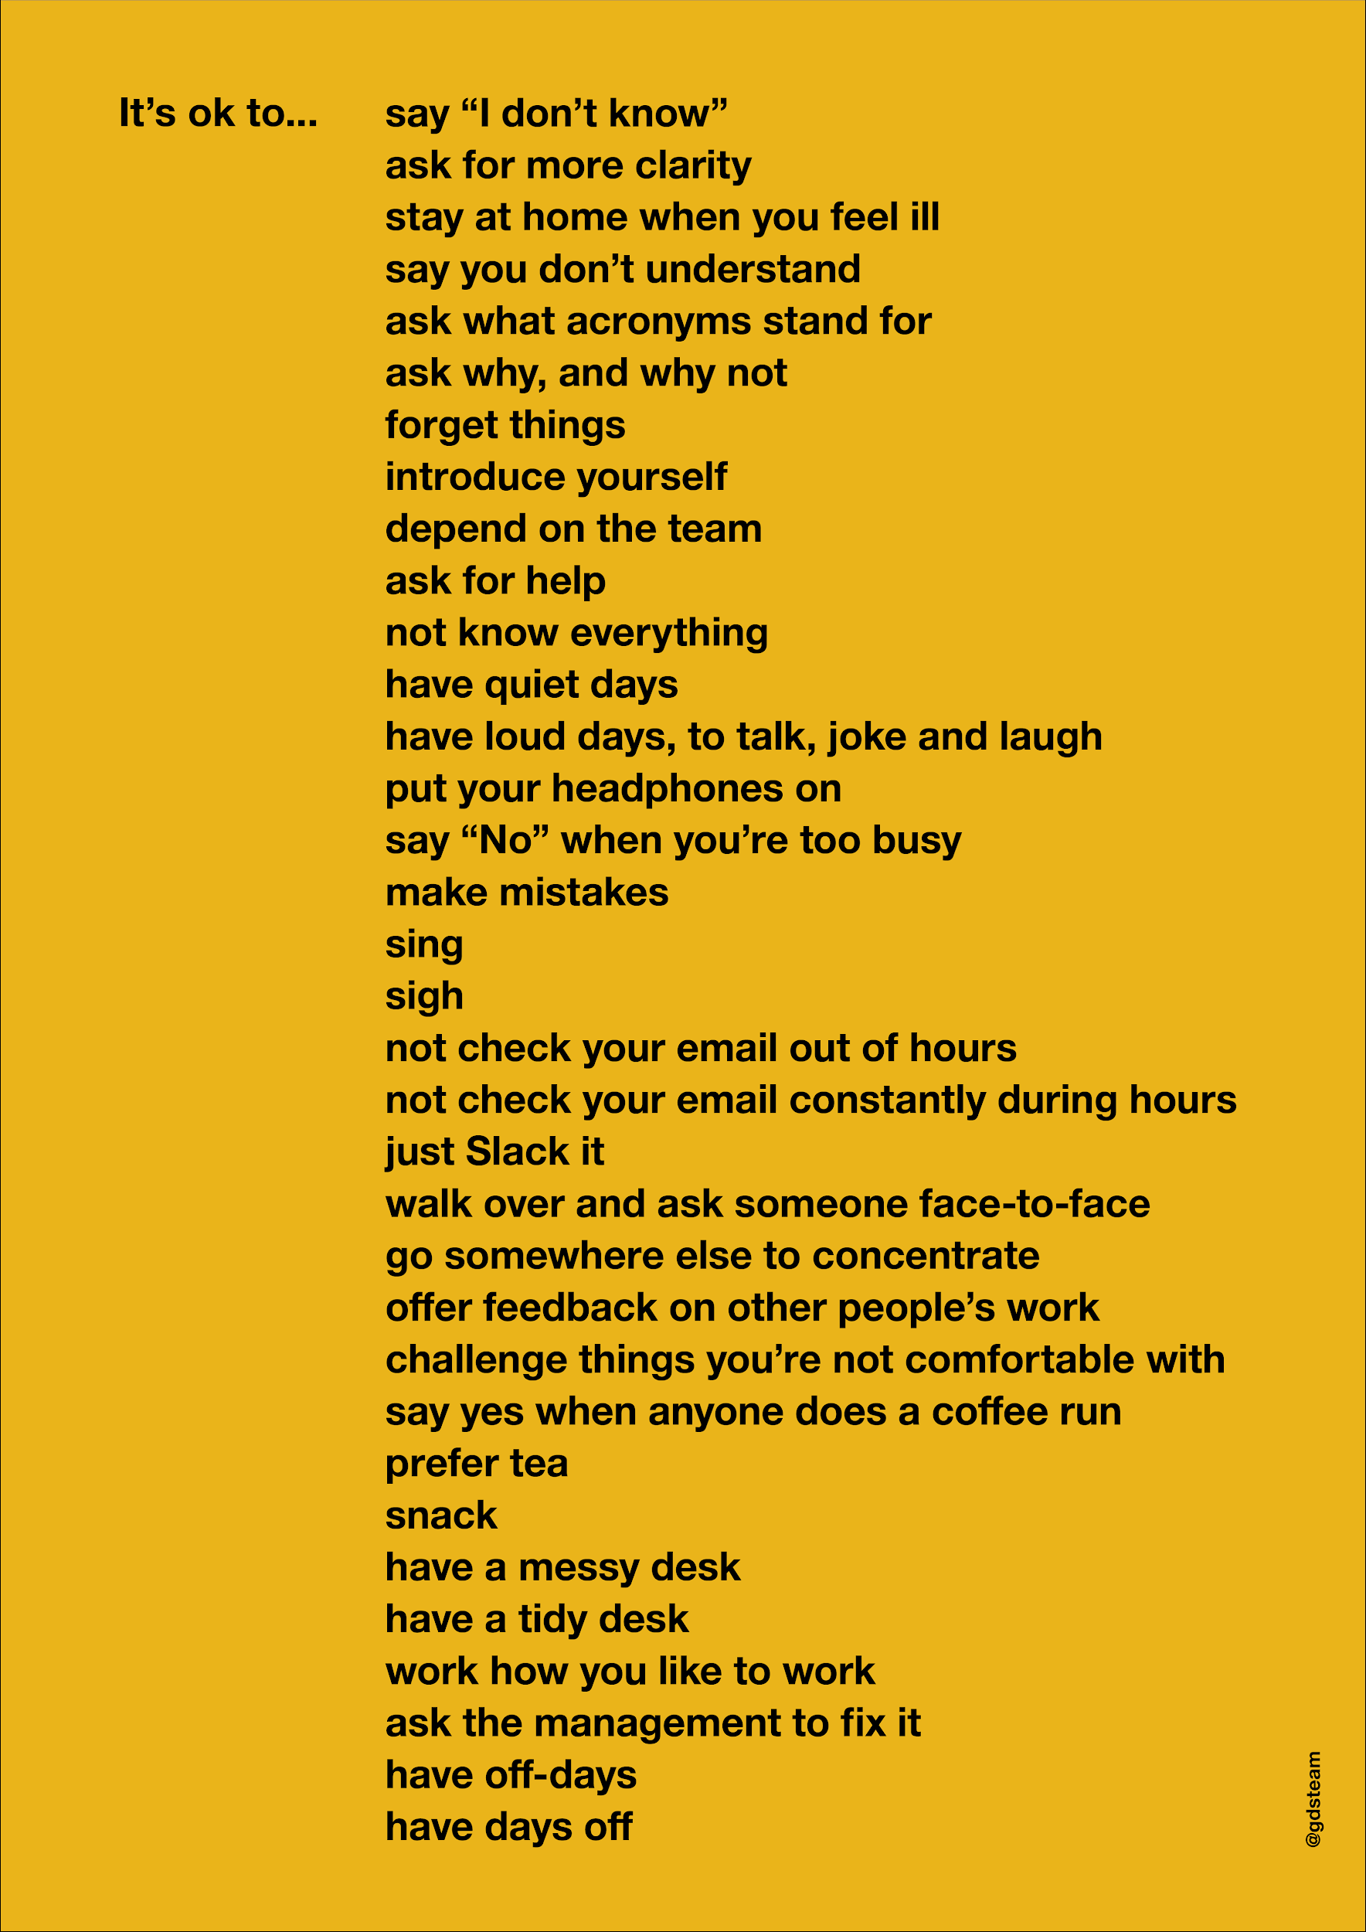
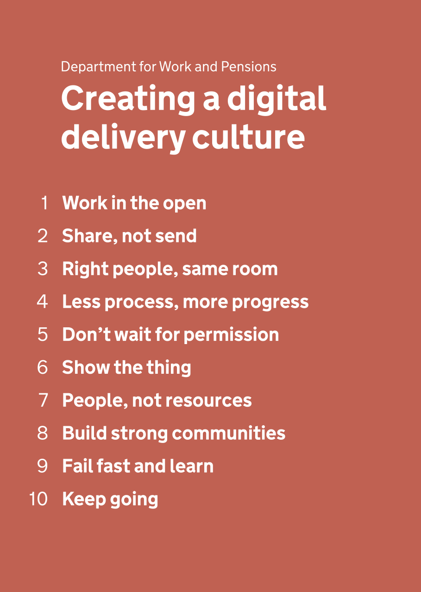
Notes:
we do all this to.
then we have all our principles and rules of thumb that sit in the middle
Giles Turnbull & Sonia Turcotte- it’s ok
https://gds.blog.gov.uk/2016/05/25/its-ok-to-say-whats-ok/
(link to poster at bottom of blogpost)
https://gilest.org/permission.html
DWP creating a digital delivery culture: Ben Holliday (Head of design/Design director DWP)
https://www.benjystanton.co.uk/blog/creating-a-digital-delivery-culture/
https://dwpdigital.blog.gov.uk/2017/07/07/building-a-digital-culture-in-dwp/ (edited)

Slide 16
one final thing
Notes:
standups
all meetings/group sessions
Do work in the meeting, not just there to agree how to split up work.

Slide 17
POST
our superpower - the process to maximise the output of a group session
Notes:
standups
all meetings/group sessions
like planning 2 weeks work
planning / writing show and tells
generating design ideas
keeps focus
Do work in the meeting, not just there to agree how to split up work.

Slide 18
Purpose - why are we having this meeting?
Objectives - what will the meeting achieve - what outputs?
Structure - how are we going about it, who’s doing what role? (everyone needs a role)
Timing - how long for each section of the meet?
Notes:
POST was the best thing we learnt - taught to us by an expert coach.
Like nearly everything - simple to understand, easy to use day to day to make your life easier, but hard to master (takes discipline and expert coaching).
Feels like it slows you down initially. Or does slow you down.
Enough structure to get the group working efficiently at the topic in hand, rather than thinking about how to do it.
Quickly agree how, start, review half way and adjust.
Turbocharge it with roles and retro halfway through
I can teach you the basics, which you’ll be able to then utilise yourself daily.
It’s a technique to maximise the output of a group ‘doing’ session.
Purpose - the why - why we are having this group session/meeting
Show and Tell preparation - 1st draft
Outcomes/Objectives - the what - the deliverables of the meeting - we need to do/make (by the end of the session we will)
Post-it the order of the slide deck
Know who is responsible for / presenting each part
Established if additional material required - video clips of users? Tech demo?
Established who’s doing non presenting roles - setting up the kit, monitoring for remote questions
Structure - how to go about it - techniques and roles, How will we make it work for remote people.
PM to lead discussion on the show and tell narrative and order, decide who is responsible for each section.
Scribe to make story section post-its and order on wall. Facilitator to ensure remote have a copy.
Collectively post-it note suggestions for content to make in each section One person to play back after post-its collected, to ensure group understanding.
Collective discussion -
Happy?
Anything new about this show and tell?
Anything to improve from last Show and Tell?
Timing - making it happen inside the timebox
15 mins
PM and reviewing tasks on the sprint
post it note an outline story
decide what is needed in each story section and who is doing it
Stop, review progress - . Does the show and tell seem like it flows well. Have we forgotten anything, are we now getting into too much detail. Is everyone happy?
15 mins more on,
More on the content - what’s needed / what to drop
Review - make sure everyone is clear what they need to do next, and when we will have our first run through.
The secret part (continuous improvement) - part of every good Structure/timing - the bit that really made it work for us - review after 15 mins
Timeboxed - so what agreed at start has to be completed at end.

Slide 19
example roles
Facilitator - maximise everyone’s contribution, keep things flowing, don’t let anyone dominate.
Timer - keep an eye on time, remind people of how long left / If spending too long on one topic.
Presenter - will playback at the end/to everyone else, What will you need?
Writer - who is collecting and organising the ideas - scribing them on the board, or collecting and organising the post-its
Idea generators - who is generating the ideas? How? alone - then collate, or take it in turns to say an idea? How long on this/each?
Jargon Buster - keeping it plain English, ensure everyone understands.

Slide 20
thank you

