Slide 1
scripted screenshotting
Andy
@hindsightery

Slide 2
obviously?
something useful
reflections

Slide 3
screenshots are brilliant
obviously
@hindsightery

Slide 4
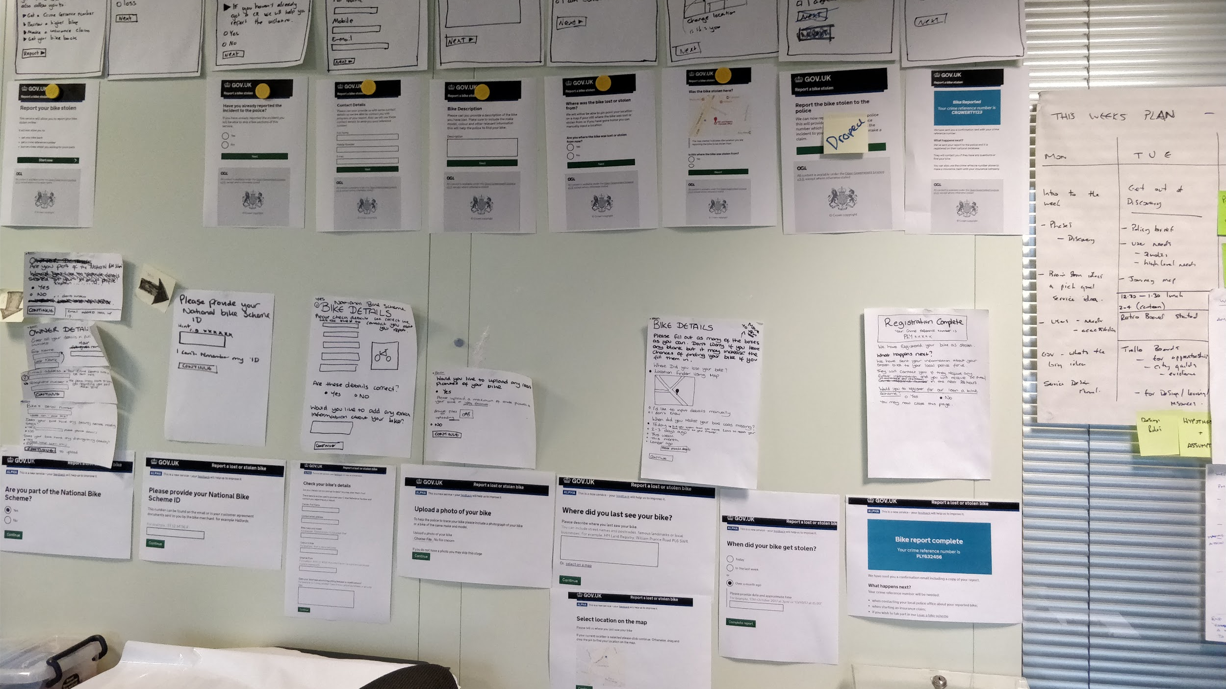
showing a service
obviously
Notes:
Showing ideas
Being able to see it all at once - consistency - in the way it’s hard screen by screen

Slide 5
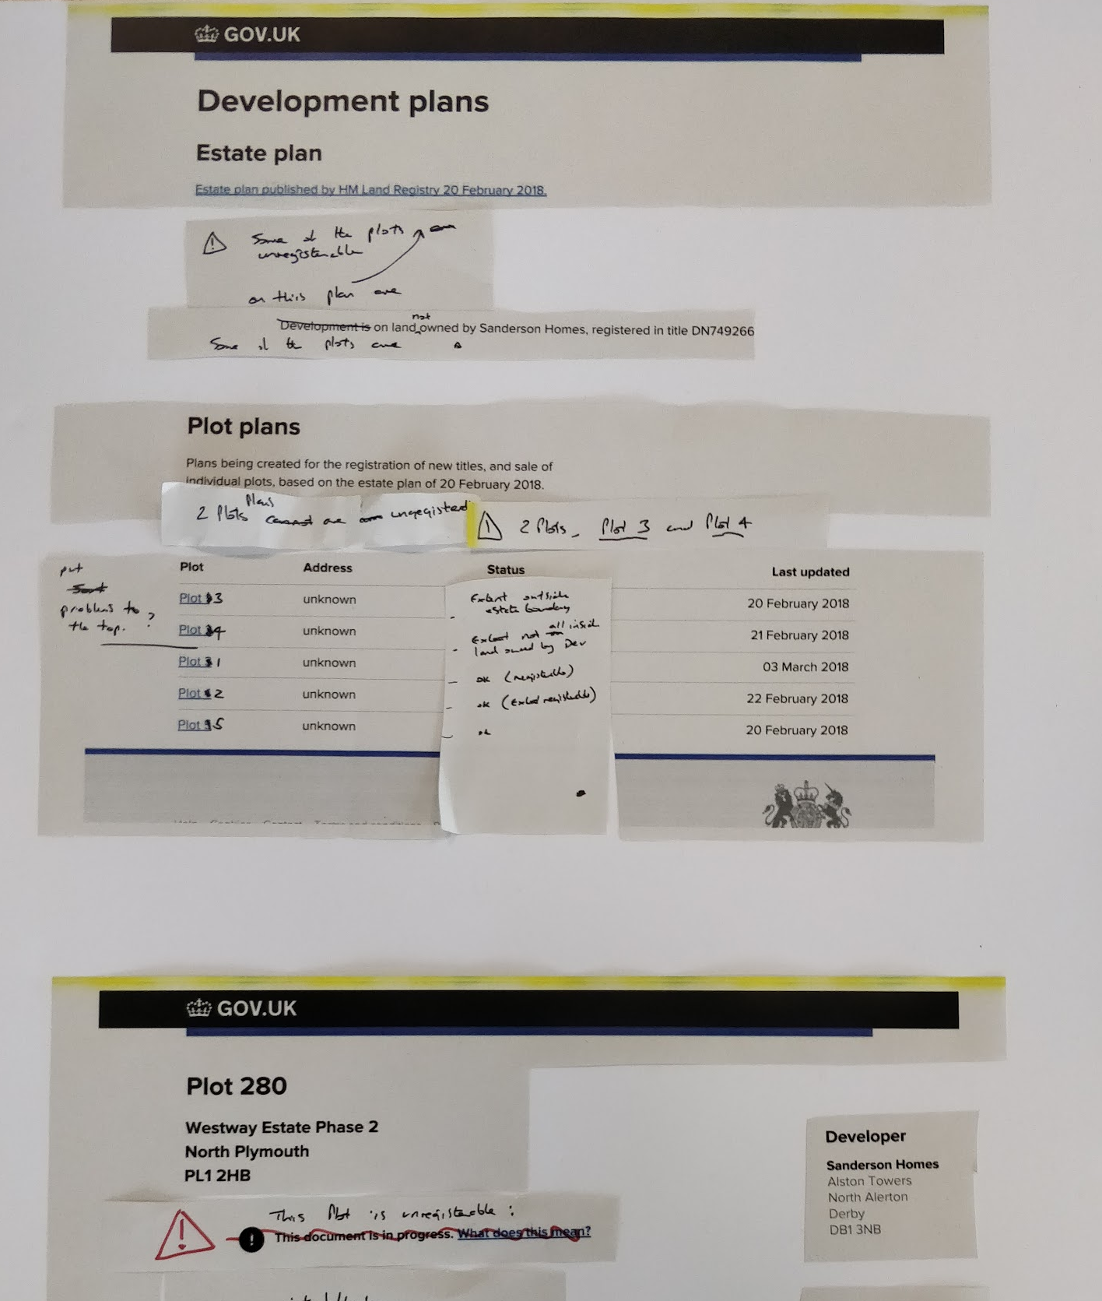
iterating
obviously
Notes:
Trying ideas - fast design and iteration - papercrafting

Slide 6
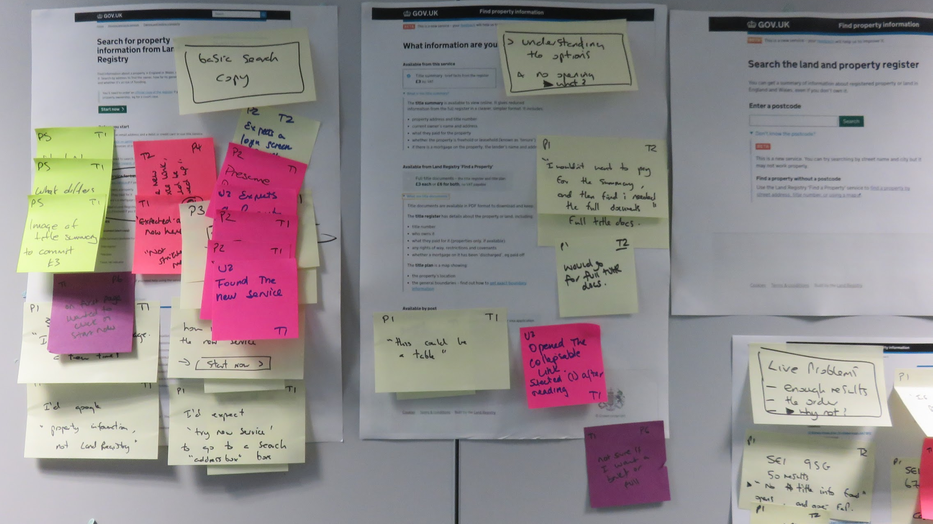
usability observations
obviously
Notes:
To use in (and write on) usability lab
Or draw on

Slide 7
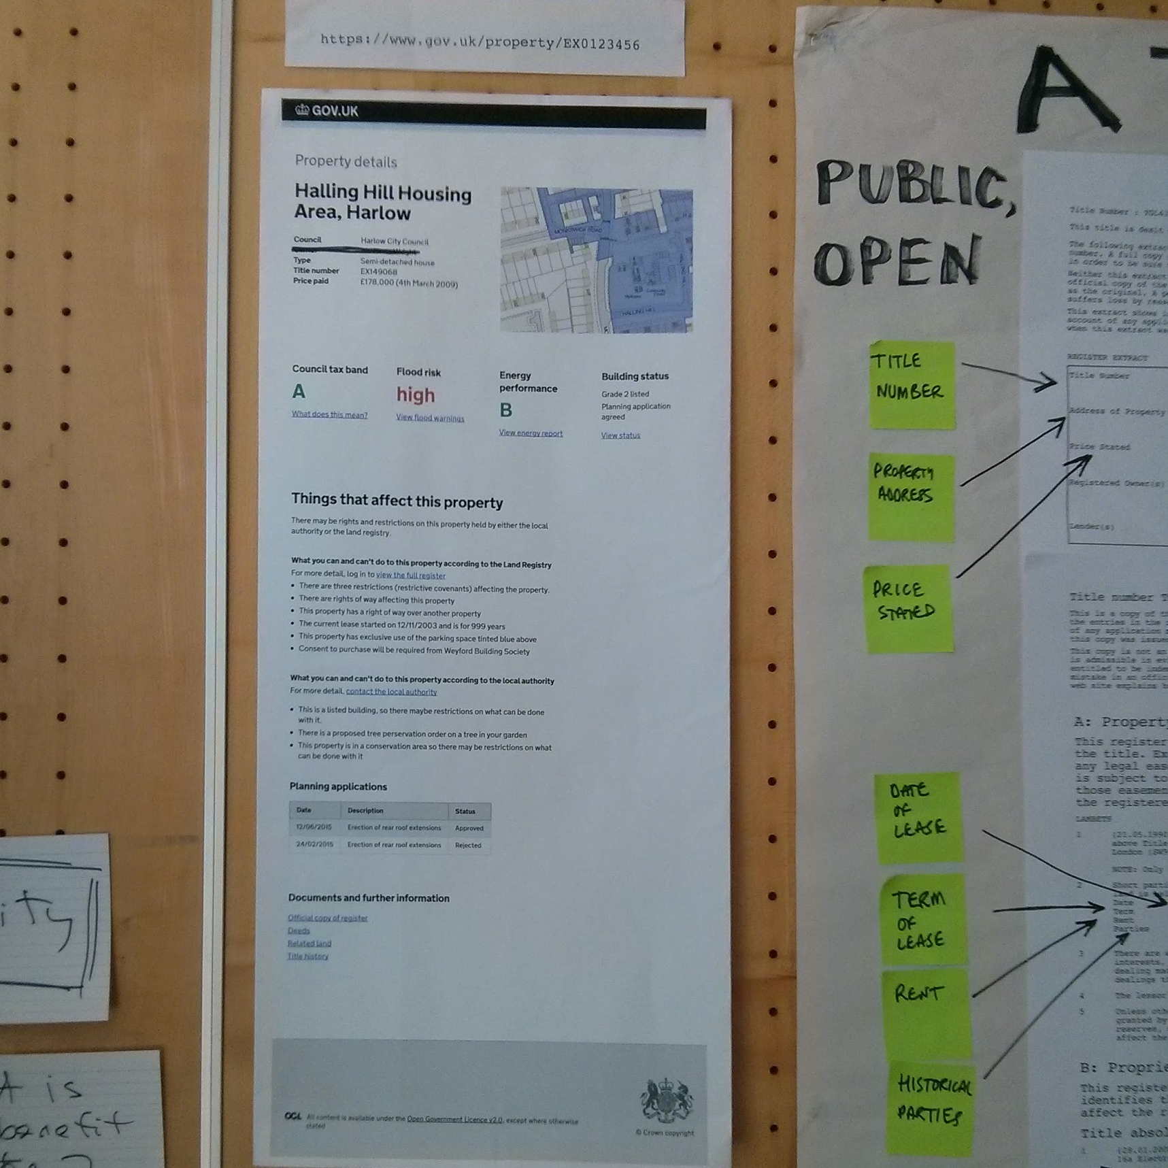
sharing ideas
obviously
Notes:
To put up ideas and concepts for everyone to see, and be able to comment on
Work in the open

Slide 8
one at a time, manually, sucks
obviously
@hindsightery

Slide 9
obviously?
something useful
reflections

Slide 10
> wshot urls.txt
something useful
https://www.npmjs.com/package/wshot

Slide 11
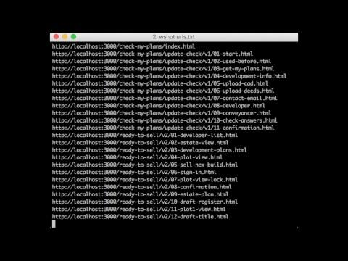

Slide 12
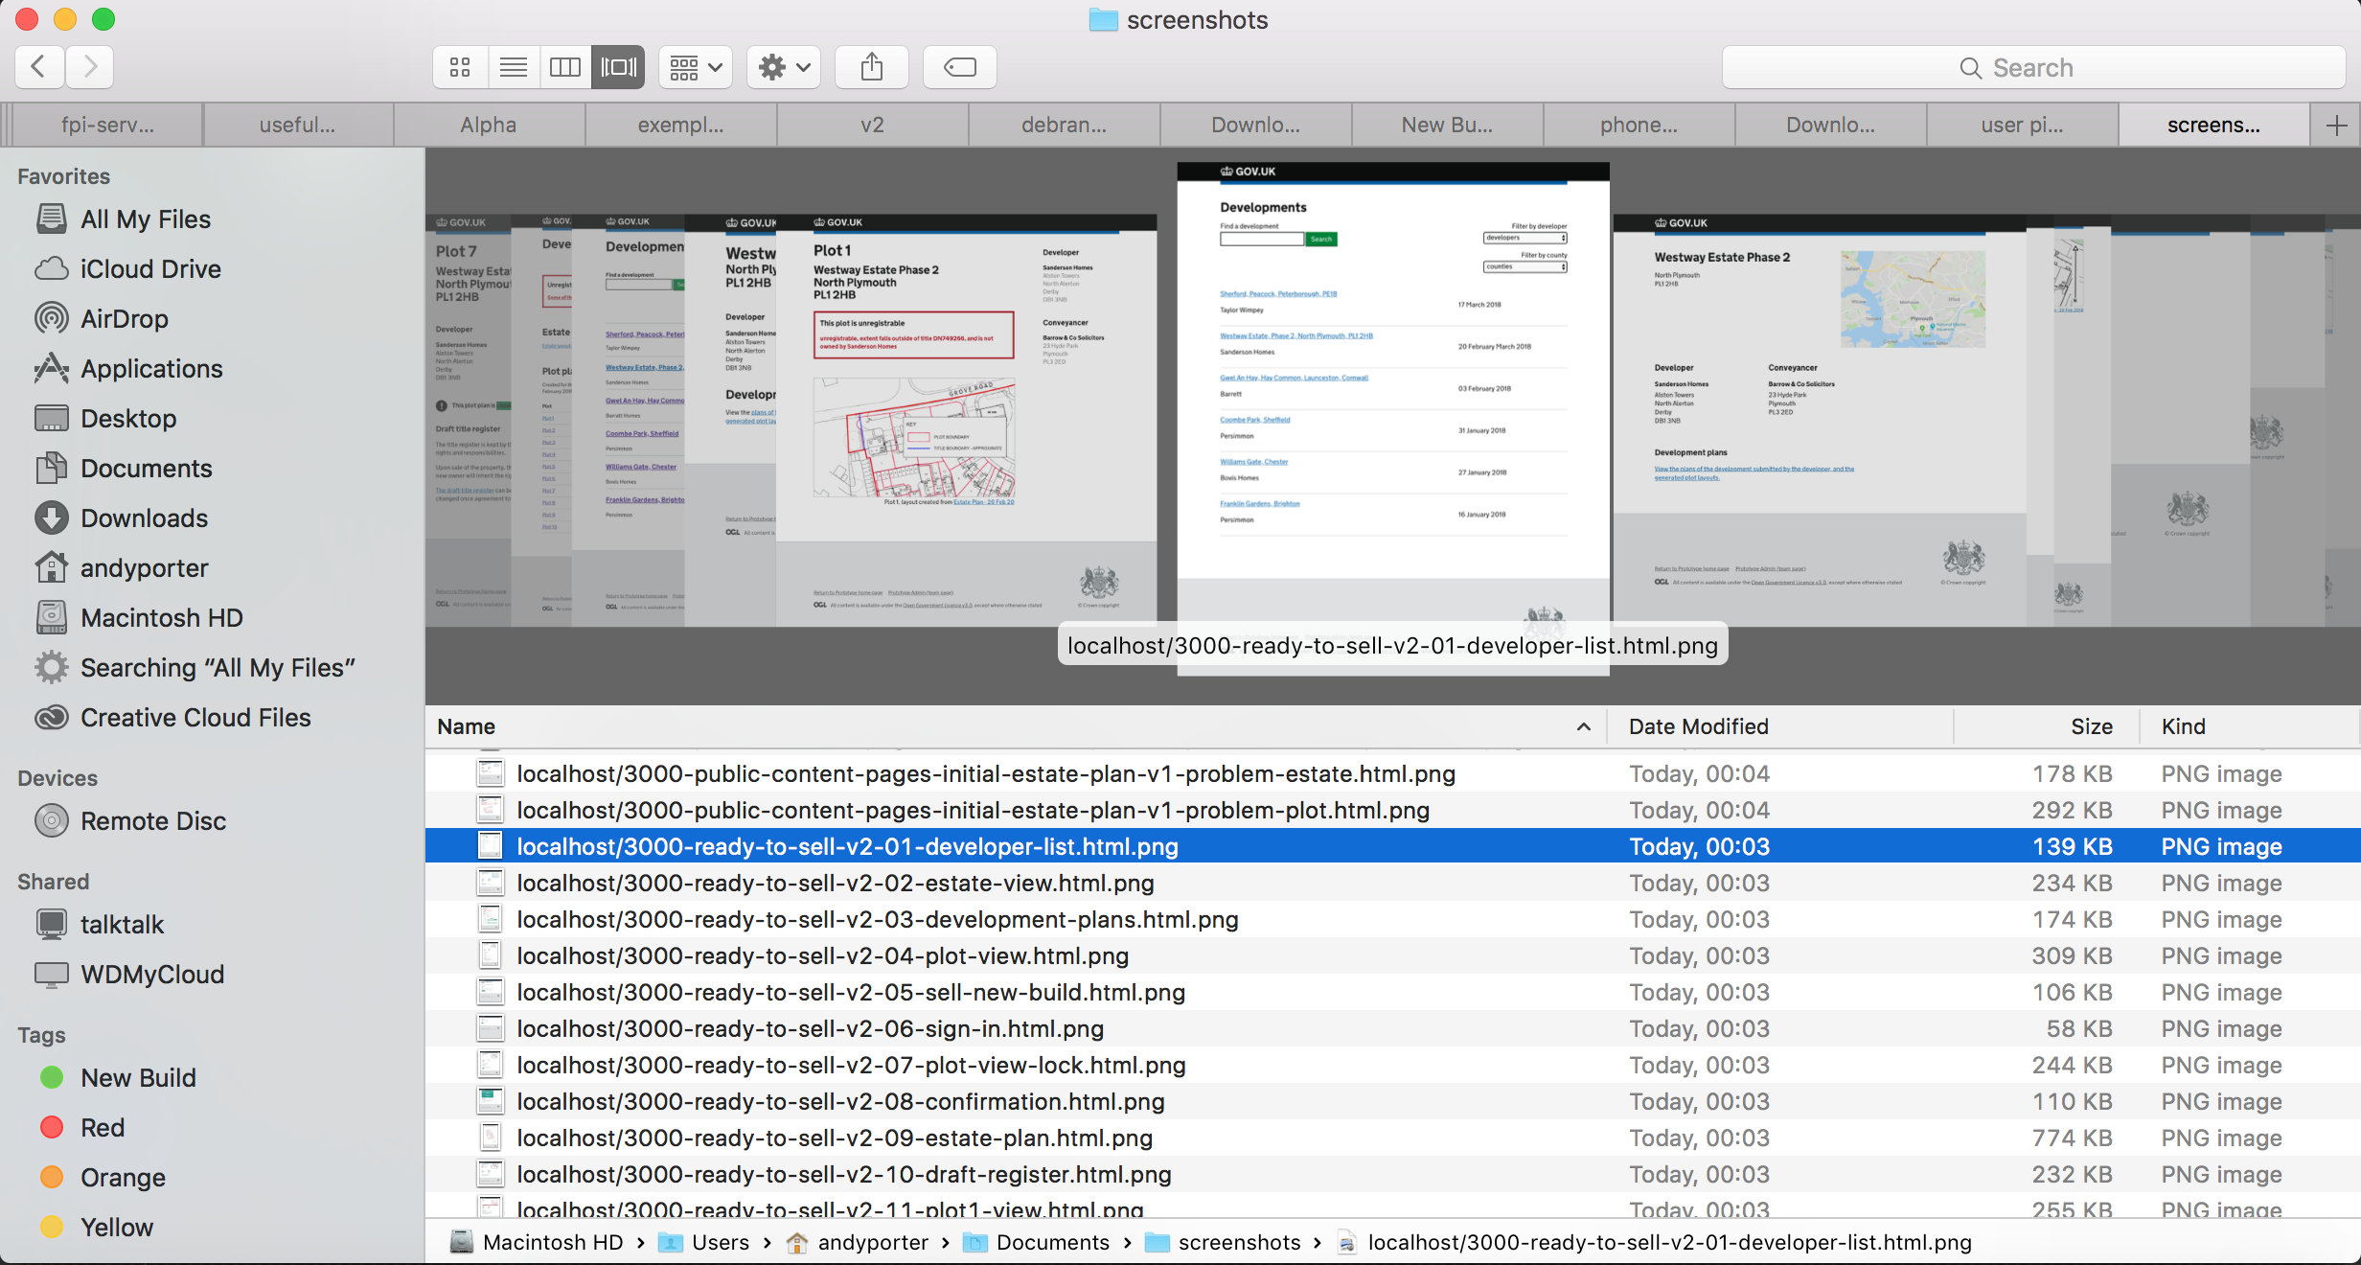
booyakasha!
something useful

Slide 13
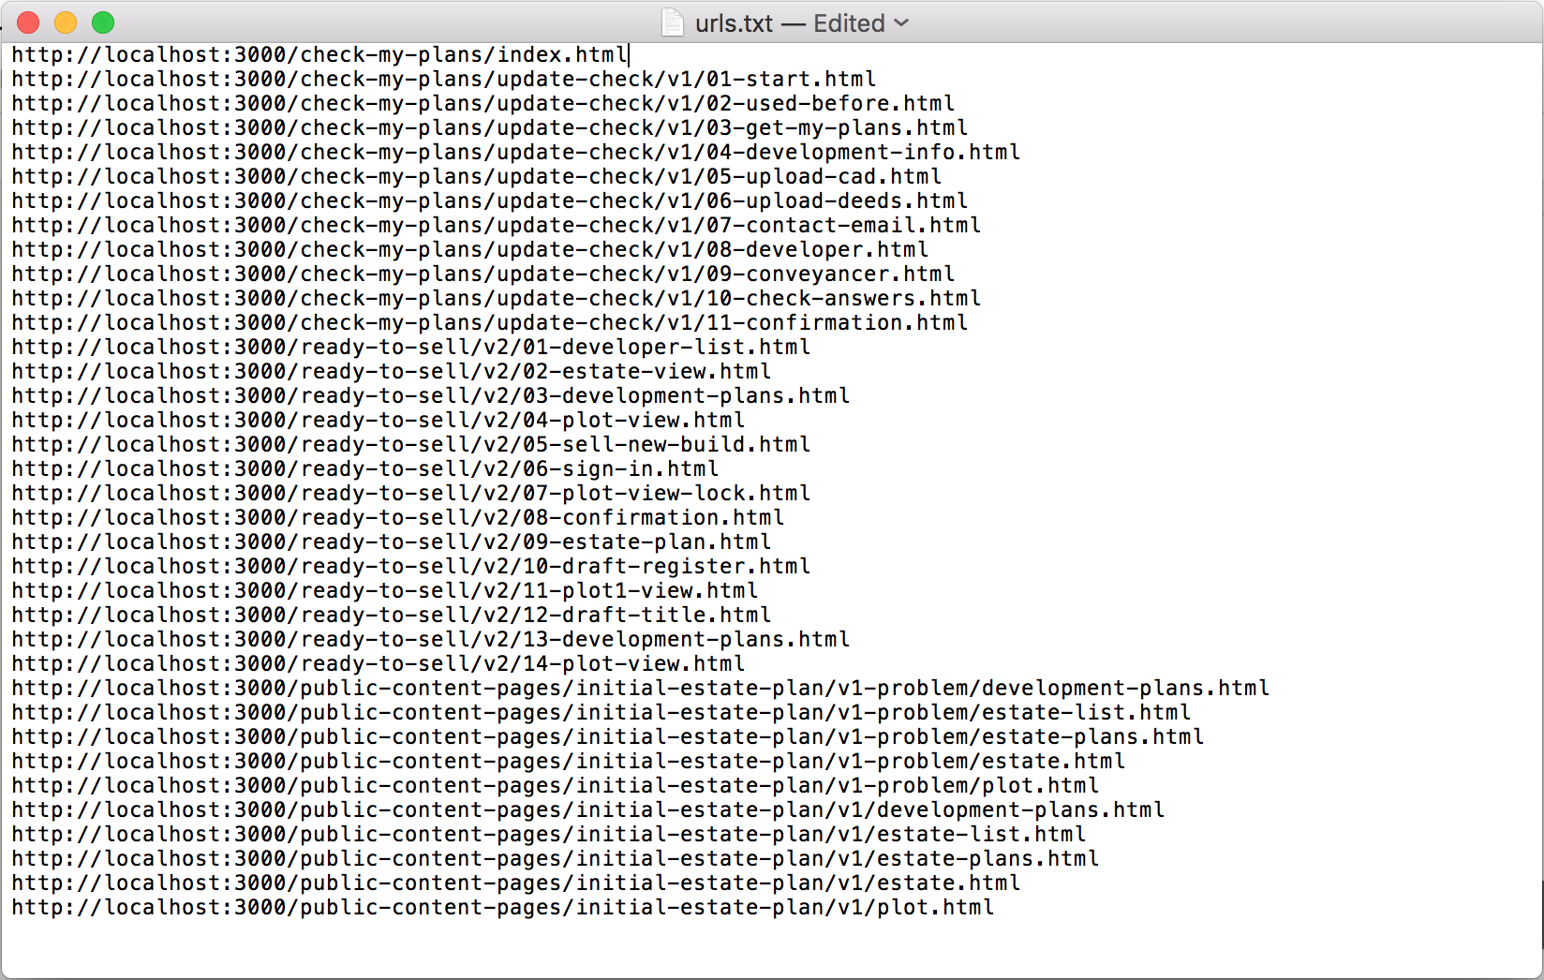
make url list
something useful
https://appleinsider.com/articles/18/02/27/tip-how-to-create-a-list-of-all-the-files-inside-a-macos-directory-in-seconds-with-textedit

Slide 14
demonstration
something useful
@hindsightery

Slide 15
obviously?
something useful
reflections

Slide 16
better
reflections
@hindsightery
Notes:
Better, not perfect

Slide 17
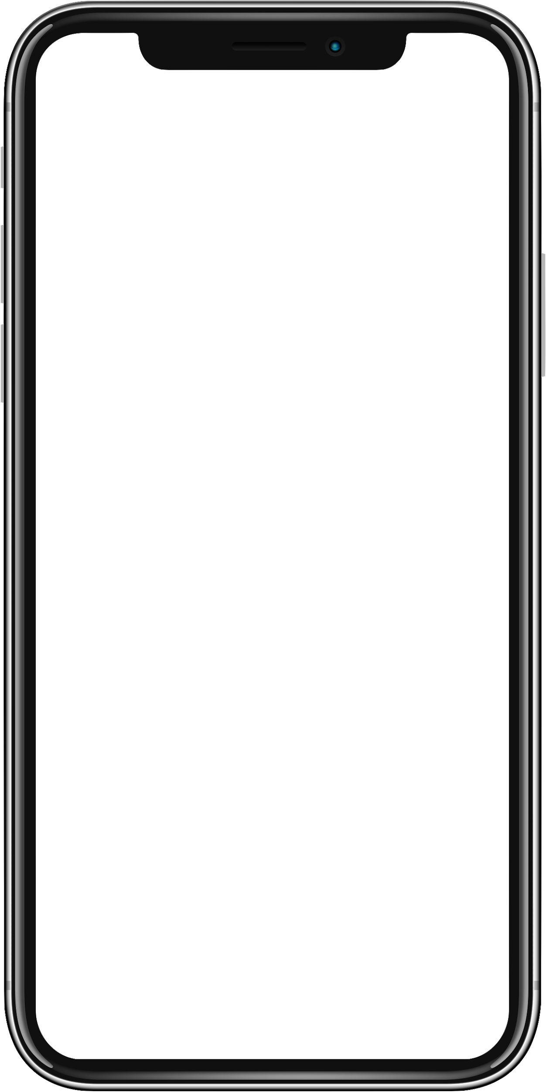

mobile phone
reflections
> wshot urls.txt --width 360

Slide 18
@joelanman 👍
reflections
https://www.npmjs.com/package/wshot

Slide 19
end
@hindsightery

