Slide 1

Throughput Maximization of Flexible Duplex Networks with an In-Band Full-Duplex UAV-BS
毕业论文汇报
Graduation Thesis Reports
Qian Ding, Yang Luo, and Chunbo Luo
Presenter: Dr. Jun Tong

Slide 2
Contents
Motivation and system model
Methods
Experiments and results
Conclusion and future works

Slide 3



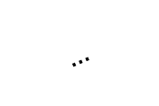







1. Motivation and system model
An innovative architecture: UAV-assisted flexible duplex networks
A full-duplex UAV acts as the base station.
Each half-duplex user can dynamically decide when to transmit and receive [1].
The objective function is system throughput.
The optimization variables are UAV trajectory, user states and power allocation.
Time slot $n$
Trajectory
Time slot $n−1$
UAV-BS
UAV-BS
Ground user $K$
Ground user 1
$$…$$
Ground user 2
Uplink channel at time slot $n−1$
Uplink channel at time slot $n$
Downlink channel at time slot $n−1$
Downlink channel at time slot $n$
Self-interference channel
[1] S. Dayarathna, R. Senanayake, and J. Evans, “Sum-Rate Optimization in Flexible Half-Duplex Networks With Transmitter/Receiver Scheduling,” IEEE Transactions on Wireless Communications, vol. 21, no. 7, pp. 4711–4724, 2022.
Notes:
In this paper, we propose an innovative architecture, that is, UAV-assisted flexible duplex networks. In this architecture, a full-duplex UAV acts as the base station and serves multiple half-duplex ground users. Each half-duplex ground user can dynamically decide when to transmit and receive.
Further, we formulate an optimization problem for this architecture. The objective function is system throughput and the optimization variables are UAV trajectory, user states and power allocation.

Slide 4
1. Motivation and system model
Advantages of the integrated network model are:
Improving the spectral efficiency compared with rigid orthogonal multiple access methods;
Providing additional duplex flexibility;
Combining trajectory design and user states in small time slots [2][3].
[2] M. Hua, L. Yang, Q. Wu, and A. L. Swindlehurst, “3D UAV trajectory and communication design for simultaneous uplink and downlink transmission,” IEEE Transactions on Communications, vol. 68, no. 9, pp. 5908–5923, 2020.
[3] M. Ghermezcheshmeh, M. M. Razlighi, V. Shah-Mansouri, and N. Zlatanov, “Centralized dynamic-time division duplex utilizing interference alignment,” IEEE Transactions on Wireless Communications, vol. 20, no. 10, pp. 6852–6866, 2021.
Notes:
The advantages of the integrated networks are as follows.
First, most existing works adopt rigid orthogonal multiple access methods when studying UAV-BS networks, which potentially decrease the bandwidth efficiency. This architecture could drastically improve the spectral efficiency, compared with those rigid orthogonal multiple access methods.
Second, the integration of full-duplex and flexible duplex provides additional duplex flexibility and improves the usage of communication resources.
Finally, both trajectory design of UAV and user state of flexible duplex networks are solved by dividing time period into small time slots, within which we can readily combine the optimization of UAV trajectory and user state decision.

Slide 5
2. Methods
Challenges:
Random association between UAVs and ground users would lead to poor performance (e.g. throughput) due to the existence of inter-user interference and self-interference.
It is crucial to optimize the user state, power allocation and UAV-BS trajectory jointly - joint optimization of these three factors is difficult since they are highly coupled.
Power allocation depends on the user states and channel quality.
Intuitively, more time and power should be allocated to the ground users near the UAV trajectory rather than those in a distance, but this depends on the user states as well.
Notes:
A direct or simple integration will probably not bring better performance due to the existence of inter-user interference and self-interference.
we propose to optimize the user state, power allocation and UAV-BS trajectory.
Such joint optimization of these three factors is difficult since they are highly coupled.
On the one hand, power allocation depends on the user states. For example, the UAV-BS should not allocate downlink transmit power to a pure uplink user.
On the other hand, when the UAV-BS follows a trajectory, it should adaptively schedule more time and allocate more power to the ground users nearby rather than those in a distance given that the LoS probability at this scenario is usually high.

Slide 6
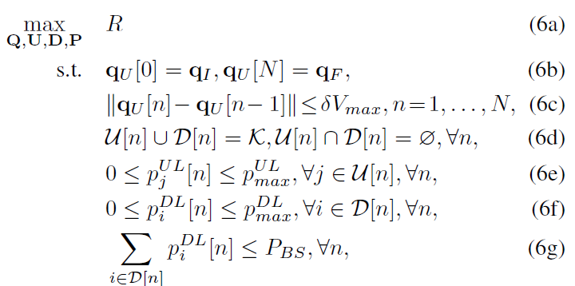
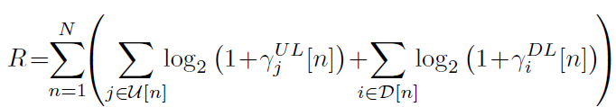


2. Methods
Optimization problem:
Optimize the total rate under the constraints on the total and peak power, trajectory and half-duplexing transmission.
Total rate:
Uplink SINR:
Downlink SINR:
Notes:
In order to solve the formulated highly non-convex problem, we adopt alternating optimization method. The idea of this method is to update each variable while fixing others and iterate the process until convergence. With the help of alternating optimization, we successfully decompose the original optimization problem into two sub-problems, namely, joint user state and power optimization & trajectory design.
For the first sub-problem, we simplify the problem with effective power and then apply sequential parametric convex approximation (SPCA) method. The introduced effective power is a combined form of user state and transmit power, for instance, if we use binary variables 𝑠 = 0,1 to represent the state of ground users: transmit (𝑠=1) and receive (𝑠=0), the uplink and downlink transmit power of a transmitter is 𝑝_𝑈𝐿×𝑠=𝑝_𝑈𝐿 and 𝑝_𝐷𝐿×(1−𝑠)=0, respectively. Thus the effective uplink and downlink transmit power is defined as 𝑝 bar _𝑈𝐿=𝑝_𝑈𝐿×𝑠 and 𝑝 bar_𝐷𝐿=𝑝_𝐷𝐿×(1−𝑠).
Then, for the second sub-problem, we introduce new slack variables and apply the widely used successive convex approximation (SCA) method.

Slide 7
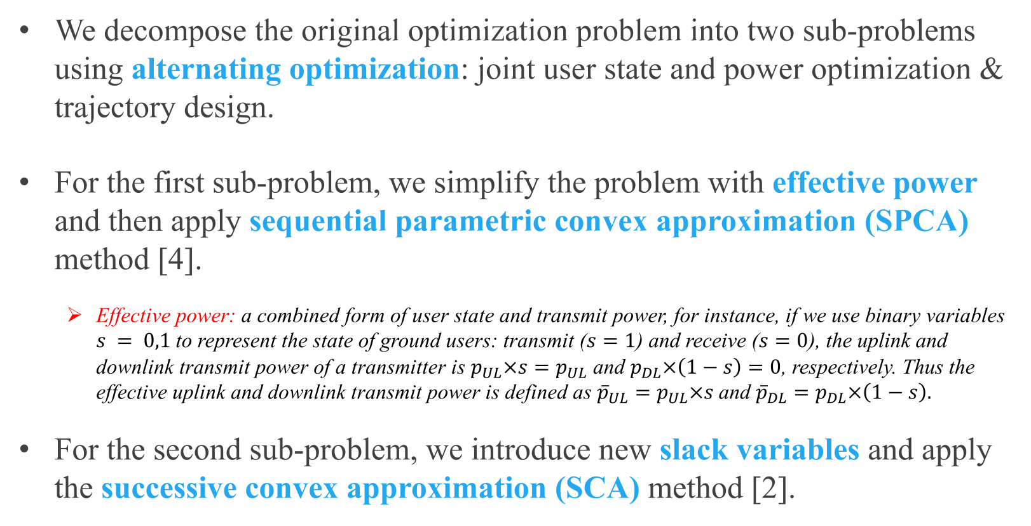
2. Methods
We decompose the original optimization problem into two sub-problems using alternating optimization: joint user state and power optimization & trajectory design.
For the first sub-problem, we simplify the problem with effective power and then apply sequential parametric convex approximation (SPCA) method [4].
Effective power: a combined form of user state and transmit power, for instance, if we use binary variables $s = 0,1$to represent the state of ground users: transmit ($s=1$) and receive ($s=0$), the uplink and downlink transmit power of a transmitter is $p_{UL}×s=p_{UL}$ and $p_{DL}×\left(1−s\right)=0$, respectively. Thus the effective uplink and downlink transmit power is defined as ${{\overline{p}}_{UL}=p}_{UL}×s$and ${{\overline{p}}_{DL}=p}_{DL}×\left(1−s\right).$
For the second sub-problem, we introduce new slack variables and apply the successive convex approximation (SCA) method [2].
[4] L.-N. Tran, M. F. Hanif, A. Tolli, and M. Juntti, “Fast converging algorithm for weighted sum rate maximization in multicell MISO downlink,” IEEE Signal Processing Letters, vol. 19, no. 12, pp. 872–875, 2012.
Notes:
In order to solve the formulated highly non-convex problem, we adopt alternating optimization method. The idea of this method is to update each variable while fixing others and iterate the process until convergence. With the help of alternating optimization, we successfully decompose the original optimization problem into two sub-problems, namely, joint user state and power optimization & trajectory design.
For the first sub-problem, we simplify the problem with effective power and then apply sequential parametric convex approximation (SPCA) method. The introduced effective power is a combined form of user state and transmit power, for instance, if we use binary variables 𝑠 = 0,1 to represent the state of ground users: transmit (𝑠=1) and receive (𝑠=0), the uplink and downlink transmit power of a transmitter is 𝑝_𝑈𝐿×𝑠=𝑝_𝑈𝐿 and 𝑝_𝐷𝐿×(1−𝑠)=0, respectively. Thus the effective uplink and downlink transmit power is defined as 𝑝 bar _𝑈𝐿=𝑝_𝑈𝐿×𝑠 and 𝑝 bar_𝐷𝐿=𝑝_𝐷𝐿×(1−𝑠).
Then, for the second sub-problem, we introduce new slack variables and apply the widely used successive convex approximation (SCA) method.

Slide 8
2. Methods
We decompose the original optimization problem into two sub-problems using alternating optimization: joint user state and power optimization & trajectory design.
For the first sub-problem, we simplify the problem with effective power and then apply sequential parametric convex approximation (SPCA) method [4].
Effective power: a combined form of user state and transmit power, for instance, if we use binary variables $s = 0,1$to represent the state of ground users: transmit ($s=1$) and receive ($s=0$), the uplink and downlink transmit power of a transmitter is $p_{UL}×s=p_{UL}$ and $p_{DL}×\left(1−s\right)=0$, respectively. Thus the effective uplink and downlink transmit power is defined as ${{\overline{p}}_{UL}=p}_{UL}×s$and ${{\overline{p}}_{DL}=p}_{DL}×\left(1−s\right).$
For the second sub-problem, we introduce new slack variables and apply the successive convex approximation (SCA) method [2].
[4] L.-N. Tran, M. F. Hanif, A. Tolli, and M. Juntti, “Fast converging algorithm for weighted sum rate maximization in multicell MISO downlink,” IEEE Signal Processing Letters, vol. 19, no. 12, pp. 872–875, 2012.
Notes:
In order to solve the formulated highly non-convex problem, we adopt alternating optimization method. The idea of this method is to update each variable while fixing others and iterate the process until convergence. With the help of alternating optimization, we successfully decompose the original optimization problem into two sub-problems, namely, joint user state and power optimization & trajectory design.
For the first sub-problem, we simplify the problem with effective power and then apply sequential parametric convex approximation (SPCA) method. The introduced effective power is a combined form of user state and transmit power, for instance, if we use binary variables 𝑠 = 0,1 to represent the state of ground users: transmit (𝑠=1) and receive (𝑠=0), the uplink and downlink transmit power of a transmitter is 𝑝_𝑈𝐿×𝑠=𝑝_𝑈𝐿 and 𝑝_𝐷𝐿×(1−𝑠)=0, respectively. Thus the effective uplink and downlink transmit power is defined as 𝑝 bar _𝑈𝐿=𝑝_𝑈𝐿×𝑠 and 𝑝 bar_𝐷𝐿=𝑝_𝐷𝐿×(1−𝑠).
Then, for the second sub-problem, we introduce new slack variables and apply the widely used successive convex approximation (SCA) method.

Slide 9
3. Results
Methods adopted for comparison:
No trajectory design: the UAV-BS follows a straight flight
TDMA method: the UAV-BS communicates with at most one uplink user and one downlink user
Random UL and DL: user states are randomly generated
Half-duplex: the UAV-BS operates in half-duplex mode
Notes:
In our numerical simulations, four competitive benchmarks are considered.
No trajectory optimization means the UAV-BS flies straight from the initial position to the final position at a uniform velocity.
In TDMA method, two ground users with the two highest SINRs are selected to be the uplink and downlink users, respectively and transmit with maximum power.
In random UL and DL, ground users are randomly selected to be the uplink and downlink users and transmit with maximum power.
In the half-duplex case, the UAV-BS spends half the time transmitting and half the time receiving with no self-interference.

Slide 10
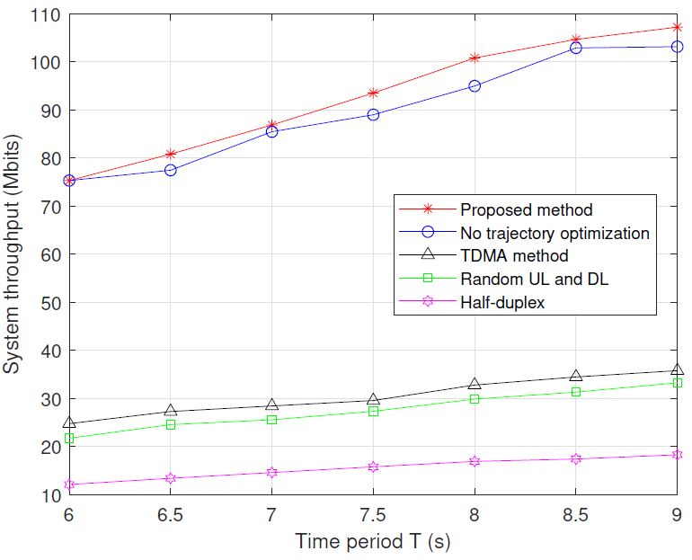
3. Results
The system throughput increases with time period
The proposed method outperforms the benchmarks
Notes:
In this figure, system throughput versus time period T is plotted. It is observed that system throughput of all designs increases with T and our method outperforms other approaches under all time periods. No trajectory optimization results in a slight performance loss compared to the optimized trajectory. Particularly, TDMA method is undesirable in the considered scenario due to limited number of served ground users. Random UL and DL’s performance has been significantly impacted by the severe interference. Finally, half-duplex fails to fully utilize the available communication resources and thus performs the worst in the experiment setup.

Slide 11
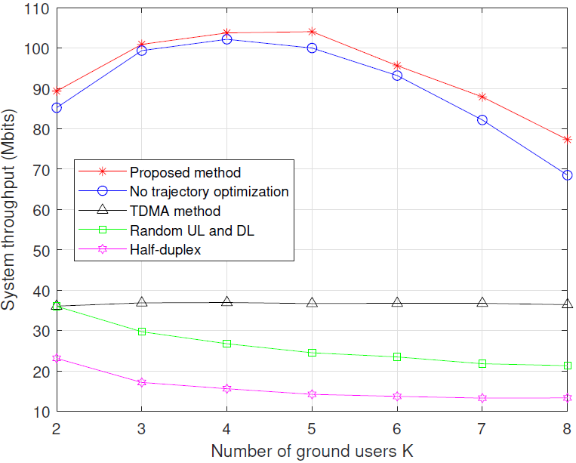
3. Results
Our method first increases due to increased number of ground users and gradually decreases due to severe inter-user interference and self-interference.
Notes:
In the second figure, the number of ground users K versus system throughput under different designs is illustrated. As K becomes larger, the system throughput of the proposed method first increases and peaks at K = 5. Then, it declines due to increasing interference such as inter-user interference and self-interference but still outperforms other approaches. Similarly, the curve of no trajectory optimization has the parabolic trend with around 10Mbits less system throughput than the proposed method. Both random UL and DL and half-duplex perform worse with larger K. Differently, the curve of TDMA method remains roughly unchanged because the increase of K would not increase the number of served users.

Slide 12
4. Conclusion
This paper proposes an innovative architecture where a full-duplex UAV assisted flexible duplex networks.
In order to maximize the throughput of the communication system, the user state, power allocation and UAV trajectory are jointly optimized.
Numerical simulation results confirm the advantages of our method.
Notes:
To conclude, we employ an IBFD UAV-BS to provide communication services for the flexible duplex networks composed of multiple ground users. In order to maximize the throughput of the communication system, the user state, power allocation and UAV trajectory are jointly optimized. In addition, numerical simulation results confirm the advantages of our method.

Slide 13
5. Future works
The future works will be focusing on:
Considering more general flexible networks comprised of full-duplex ground users, e.g. user states may include: transmit, receive, simultaneously transmit and receive and silence;
Applying the model to more practical scenarios where scheduling and handovers etc. to be considered;
Improving our methods and further analyzing the corresponding convergence and complexity.
Notes:
The future works will be focusing on the following aspects.
First, we can consider more general flexible networks comprised of full-duplex ground users whose user states including: transmit, receive, simultaneously transmit and receive and be silent;
Second, we will consider the more practical settings where scheduling and handovers may affect the performance of the proposed model.
Finally, the convergence and complexity of the proposed algorithms remain to be analyzed.

Slide 14
Thank you!
Further questions and contact:
Qian Ding: dingqian@std.uestc.edu.cn,
Yang Luo: luoyang@uestc.edu.cn,
Chunbo Luo: c.luo@ieee.org

