Slide 1

Joint Deployment, Beamforming and Power Allocation of MmWave Full-Duplex UAV-BS
Speaker: Qian Ding

Slide 2
Motivation
UAV has shown some advantages such as flexibility and mobility.
Millimeter-wave (mmWave) communications provides abundant spectrum resources from 30 GHz to 300 GHz.
The combination of above two technologies has some inherent advantages
Short wavelength of mmWave enables the equipment of large-scale antenna arrays on the UAV platforms which are weight and size constrained.
UAV can move flexibly to guarantee an LoS path with ground users which is typically much stronger than NLoS paths.
Multiple UAVs can cooperate to expand the coverage of mmWave communications, attenuating the impact of high path loss.

Slide 3
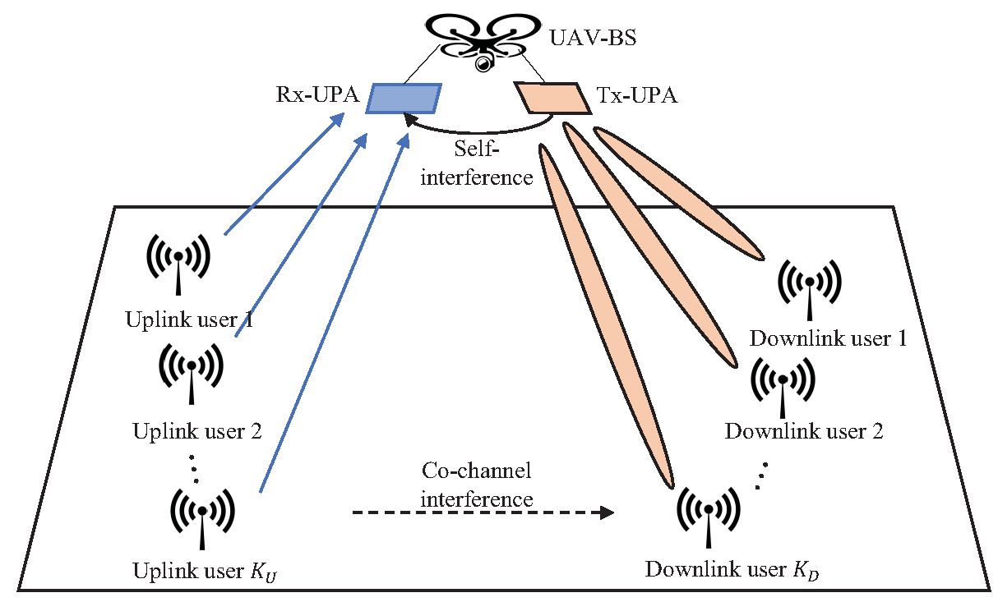
Contributions
In this paper, we
Employ a full-duplex UAV serving as a base station (BS) to assist mmWave networks, communicating with several single-antenna uplink and downlink ground users,
Two uniform planar arrays (UPAs), namely Tx-UPA and Rx-UPA, are deployed at the UAV-BS, performing hybrid beamforming,
Model the air-to-ground, ground-to-ground and self-interference channels in detail,
Jointly optimize deployment, beamforming and power allocation for the system,
Show the superiority of our method through simulations

Slide 4
Main difficulties
Full-duplex mode and sharing the same time and frequency resources will incur severe self-interference, multiuser interference and co-channel interference.
Both channel gains and steering vectors are determined by the position of the UAV-BS, and they are further coupled in mmWave channel models.
Constant modulus (CM) constraint induced by analog beamformer is a non-convex constraint and hard to be tackled.
With the statements above, the formulated optimization problem is non-trivial.

Slide 5
Our method
We decompose the formulated problem into three sub-problems and solve each sequentially to obtain a near-optimal solution.
Firstly, we determine the optimal deployment of the UAV-BS with given beamforming vectors and power allocation.
An assumption is proposed to eliminate the multiuser interference and NLoS paths (the rationality of this assumption is experimentally verified in our future work).
Successive convex approximation (SCA) algorithm is adopted due to the fact that a convex function is lower bounded by its first-order Taylor expansion.
Secondly, we jointly optimize beamforming vectors and power allocation with the UAV-BS hovering at the identified position.
Rank-1 and CM constraints are omitted.
SCA algorithm is adopted.
Thirdly, we ensure the feasibility of the solution by complementing the rank-1 and CM constraints.

Slide 6
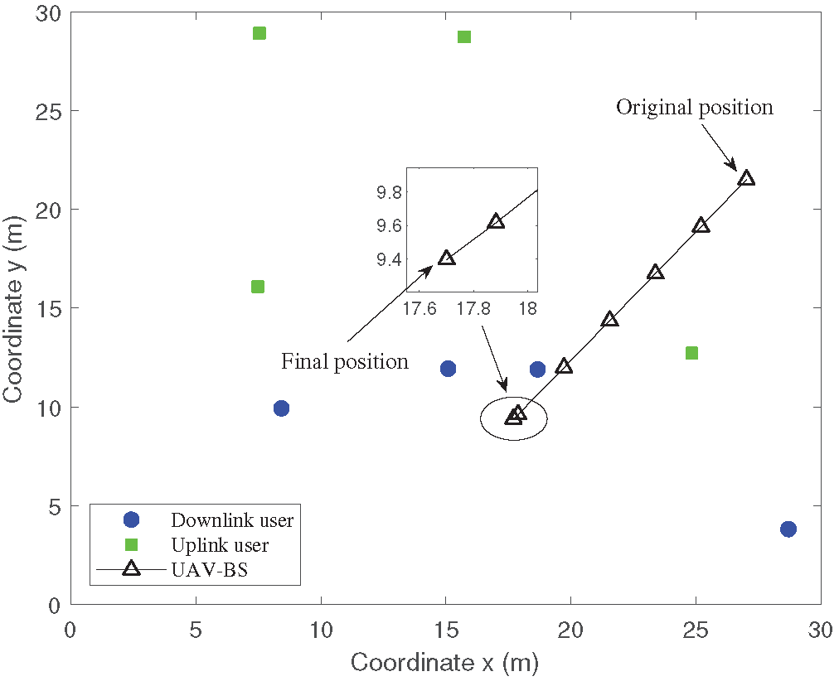
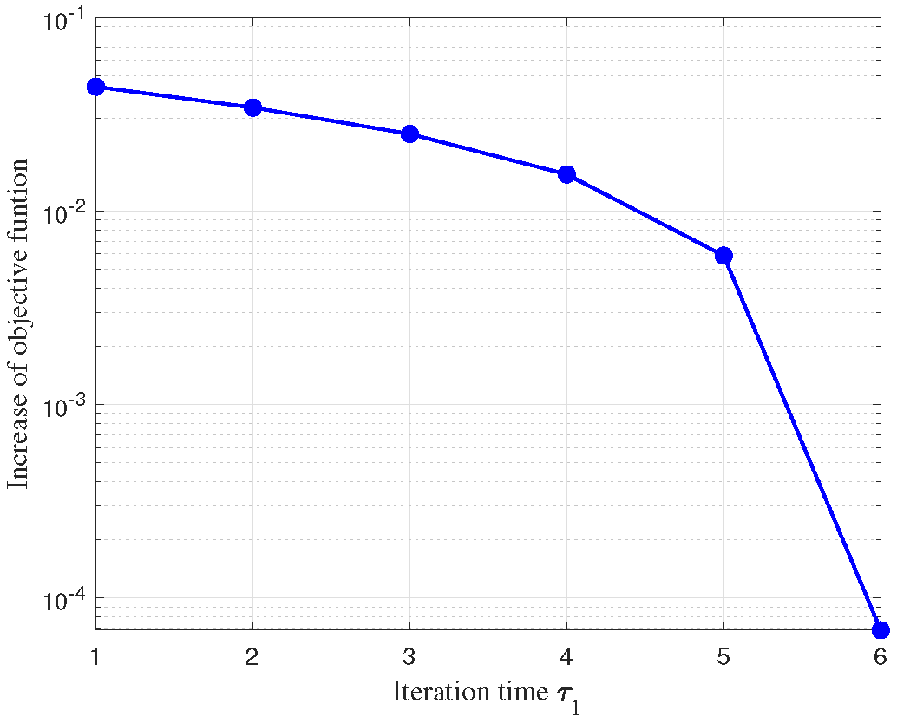
Main results
The illustration of the UAV-BS deployment

Slide 7
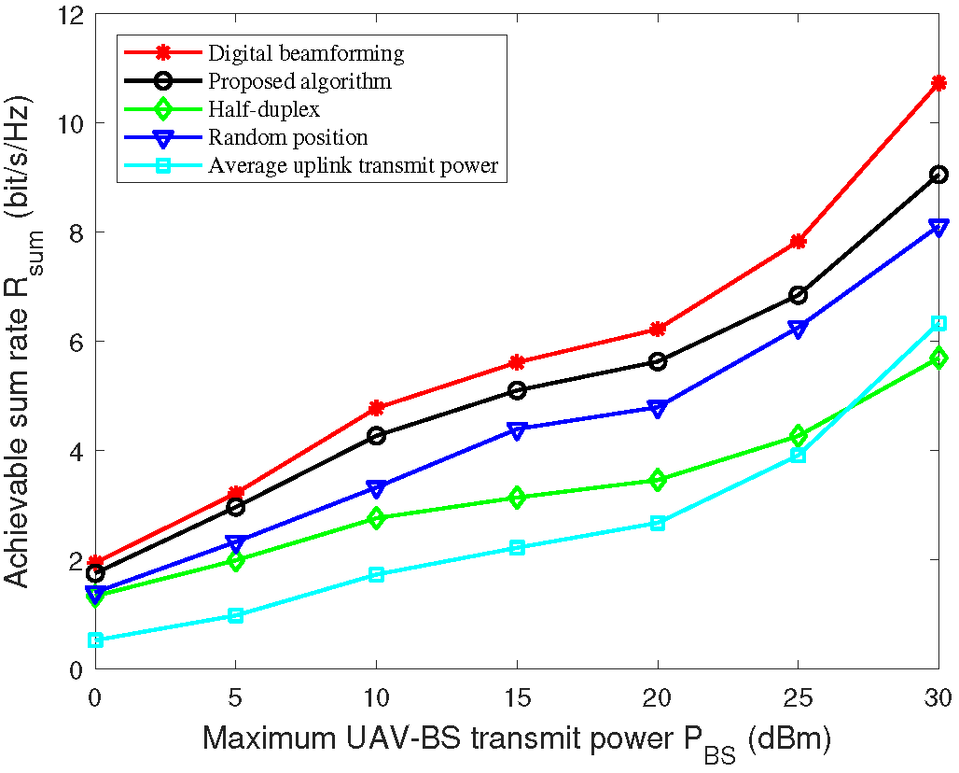
Main results
Achievable sum rate of different designs versus maximum UAV-BS transmit power $P_{BS}$

Slide 8
Some future work
Some future work can be concluded as follows.
The assumption made in the first sub-problem is strong and need to be relaxed if possible.
Hybrid beamforming is energy-efficient compared to digital beamforming. It is persuasive to show our method outperforms digital beamforming in terms of energy efficiency.
Our method is computationally complex when size of antenna arrays becomes large. Therefore, a modified method need to be designed for large antenna arrays.

Slide 9
Thanks for listening!
Speaker: Qian Ding

