Slide 1
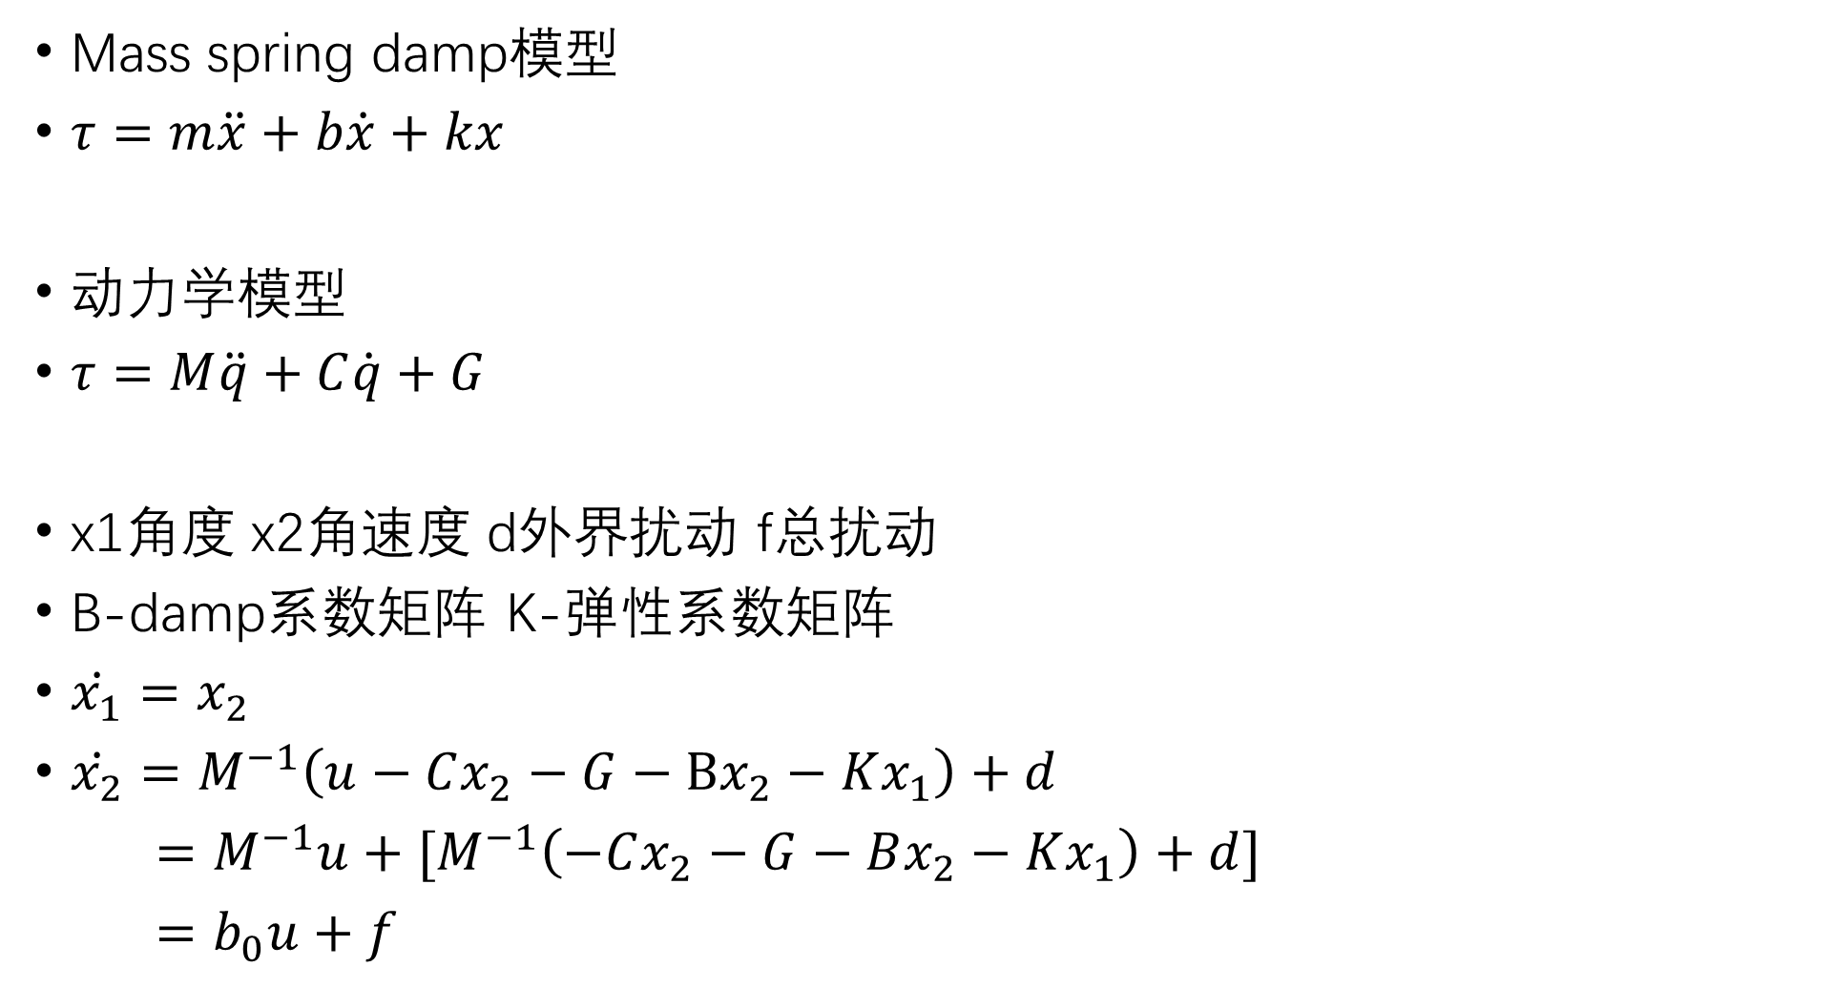
Mass spring damp模型
$τ=m\ddot{x}+b\dot{x}+kx$
动力学模型
$τ=M\ddot{q}+C\dot{q}+G$
x1角度 x2角速度 d外界扰动 f总扰动
B-damp系数矩阵 K-弹性系数矩阵
$\dot{x_{1}}=x_{2}$
$\dot{x_{2}}=M^{−1}\left(u−Cx_{2}−G−Bx_{2}−Kx_{1}\right)+d$
$=M^{−1}u+{[M}^{−1}\left(−Cx_{2}−G−Bx_{2}−Kx_{1}\right)+d]$
$=b_{0}u+f$

