Slide 1


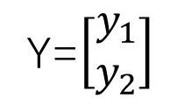

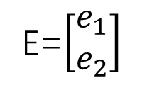
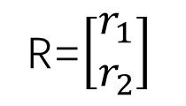

R=$\left[\begin{matrix}r_{1} \\ r_{2}\end{matrix}\right]$
E=$\left[\begin{matrix}e_{1} \\ e_{2}\end{matrix}\right]$
Y=$\left[\begin{matrix}y_{1} \\ y_{2}\end{matrix}\right]$
-
$$G_{c}$$
$G_{p}^{−1}$ (U-model)
+
$$G_{p}$$
$G_{sm}^{−1}$ (SMC)

Slide 2
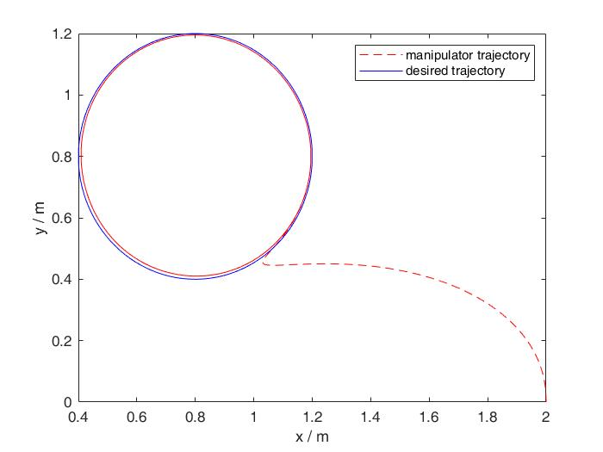

Slide 3


r
y
-
$$G_{c}$$
$$G_{p}^{−1}$$
$$G_{p}$$

Slide 4
Month | Mar | April | May | June | July | Aug
Literature Review
Learn GIN & MAPPO
Environment Setup
Implement GIN
Implmenet MAPPO
Testing & Improving
Ajustable Periods
Writing & Revising
Submission

