Slide 1
Weather

Slide 2
What it does
Texts me the weather every morning at 5:30.
Time of text can be changed to wherever
Location can be changed

Slide 3

imports
SMTP for gmail connection. Urllib.request and JSON for getting the weather

Slide 4
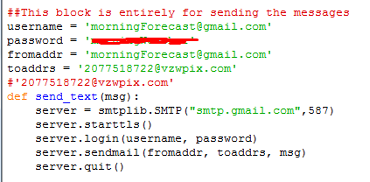

Slide 5
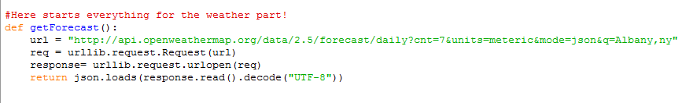
Alternative to XML. JavaScript Object Notation
Used for storing and exchanging data.

Slide 6
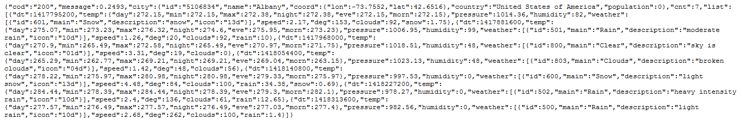

Slide 7
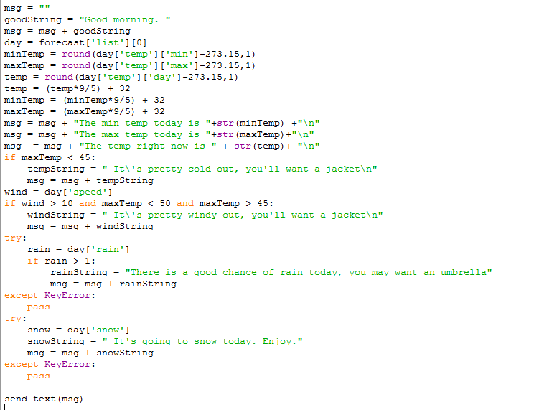

Slide 8
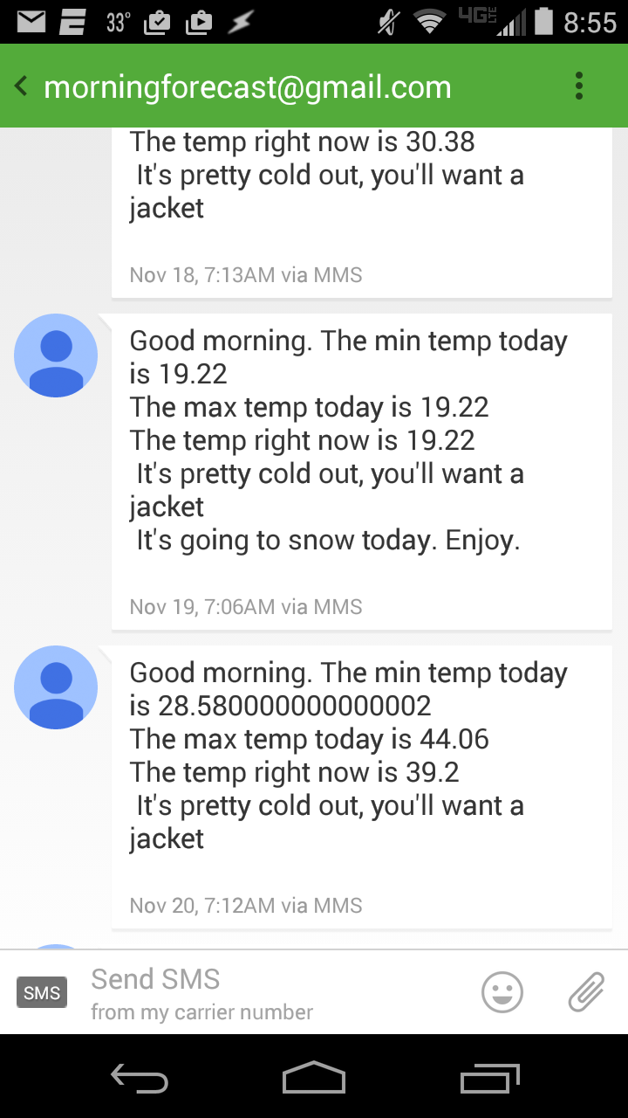
One issue has been it seeing the min, max, and
Current temp all as the same.

