Slide 1
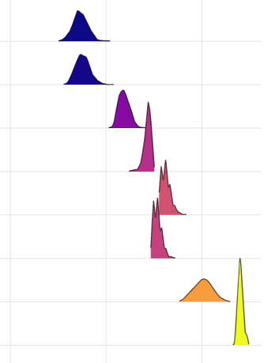
Trustworthy
Expert opinion
Untrustworthy
Training set
N = 5249
Test set resolution convolved
N = 1310
Experimental data (PCSMO)
N = 1
Test set resolution unconvolved
N = 1310
Negative control
N = 1
Simulated data (Rb₂MnF₄)
N = 15
Animals
N = 15
Digits
N = 15
0k
100k
200k
Wasserstein distance

