Slide 1
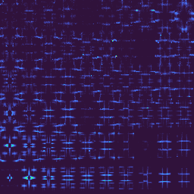
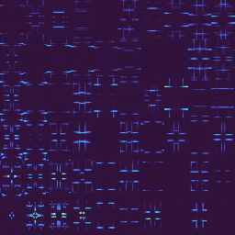
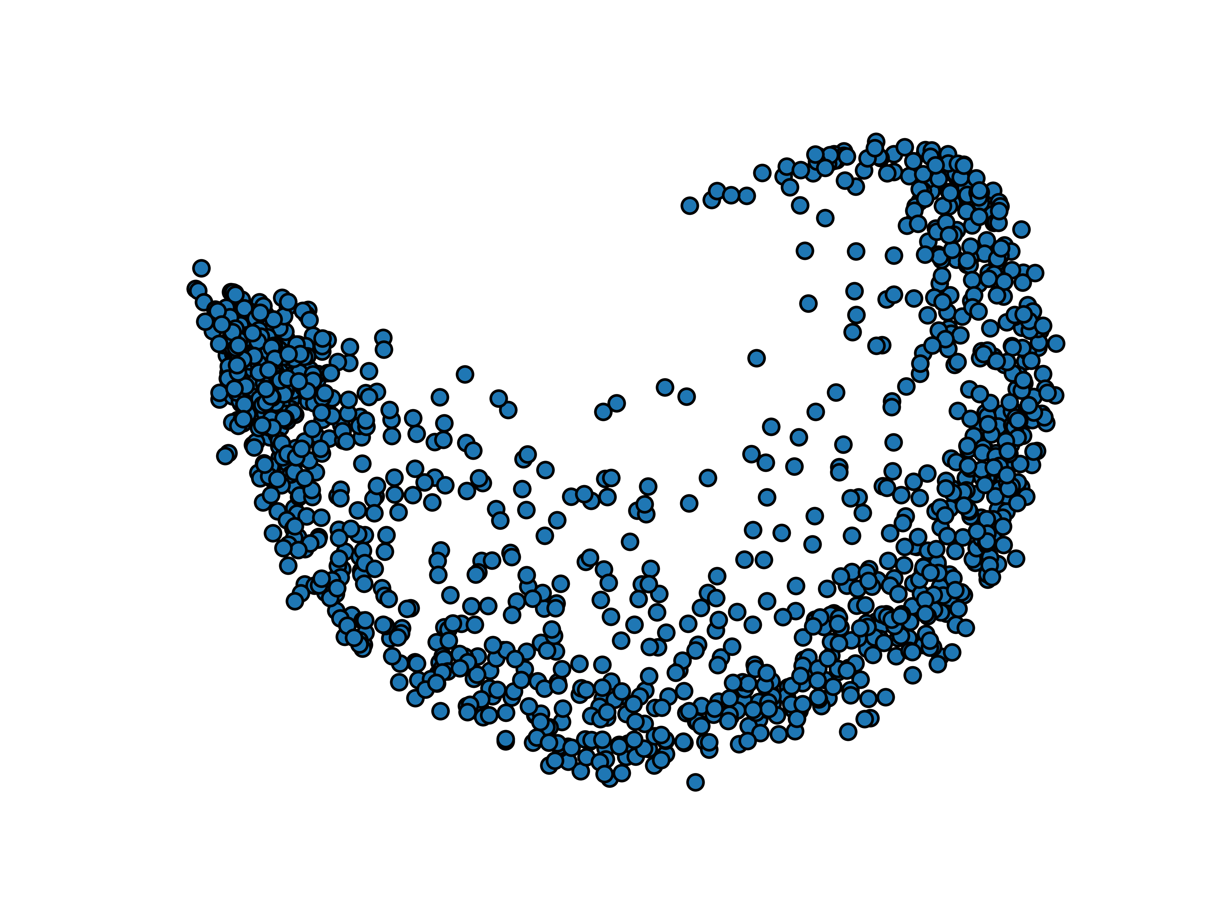
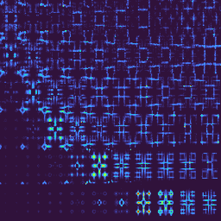
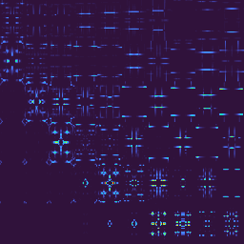
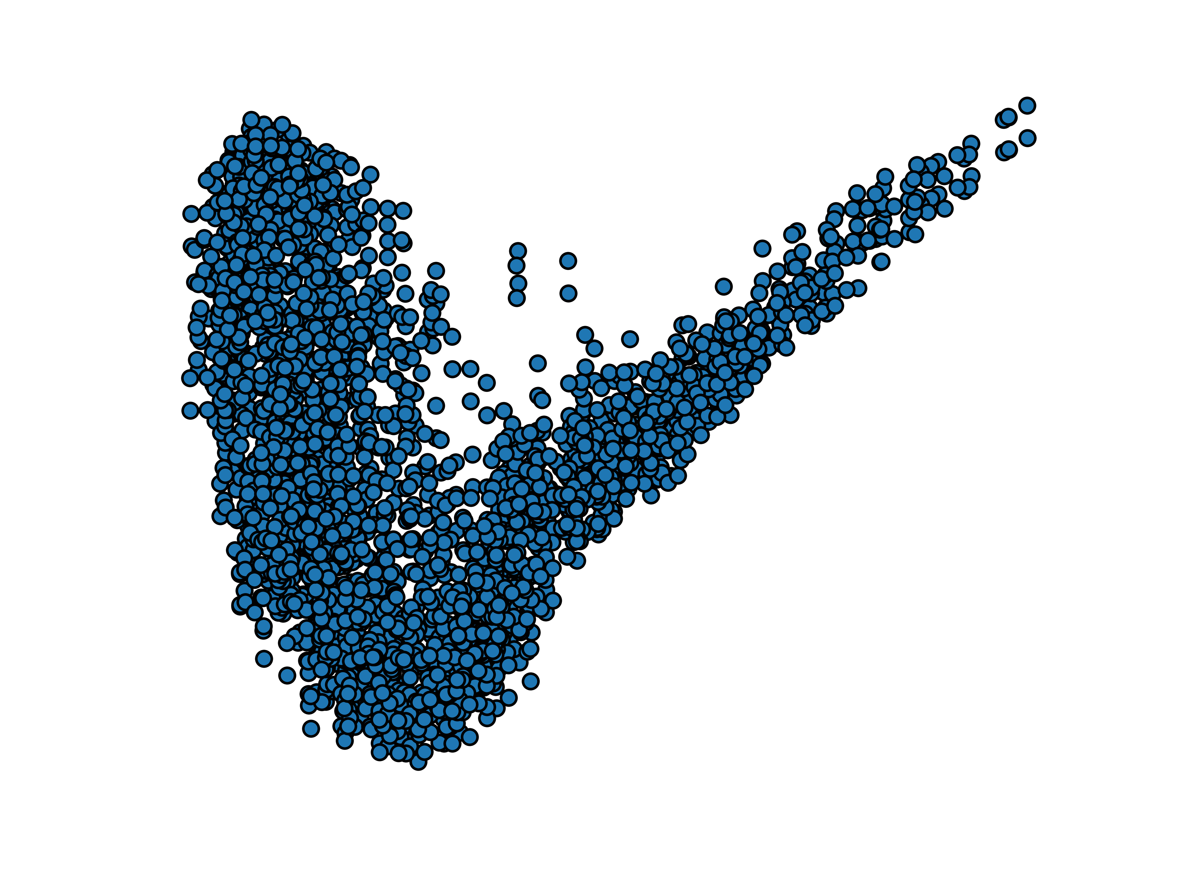
Embedding Exp
Embedding Sim
NCE_{Exp} loss
H_{Exp}
H_{Sim}
Exp2Sim_{Encoder}
Sim2Exp_{Encoder}
Auxiliary loss
Exp2Sim_{network}
Auxiliary loss
Exp2Sim_{Encoder}
Exp2Sim_{Decoder}
Exp2Sim_{Featurespace}
D_{Exp}
Experimental
Simulated
D_{Sim}
Sim2Exp_{network}
Sim2Exp_{Decoder}
Sim2Exp_{Encoder}
GAN loss
GAN loss
Sim2Exp_{Featurespace}
Exp2Sim_{Encoder}
NCE_{Sim} loss
Sim2Exp_{Encoder}
H_{Exp}
H_{Sim}
Embedding Exp
Embedding Sim
Notes:
To do so we need to add one more generator, from domain y back to domain x. Thus for different domains, we can assign its unique encoder and projection head. And we also need to add the discriminator for both X and Y domains. We name our method DCLGAN, where dcl is short for dual contrastive learning. And images inside one domain should share a similar style regardless of whether it's generated or real. Thus, we add a similarity loss to encourage images with one domain to have some similarities in deep features. We name this one as SimDCL where sim is short for similarity.

