Slide 1
Remote Weather Station
Andrew Schaaf, Adam Baldwin, hieu Luong

Slide 2
Introduction
We will be extending the Remote XBee Weather Station project, started in the started in 2009 by Brad Konert and last worked on by Sergio Pais in Spring 2015. We will be creating an Android app to display weather information. The weather will be read via a sensor on the Arduino board. The sensor will transmit data to the board via XBee. The server will use an Amazon RDS database to store long term data and will be able to connect to multiple clients (Android phones) via the internet.

Slide 3
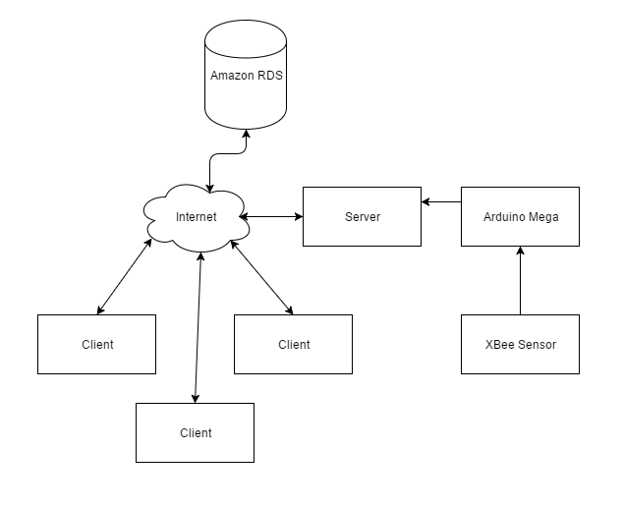
Physical diagram

Slide 4
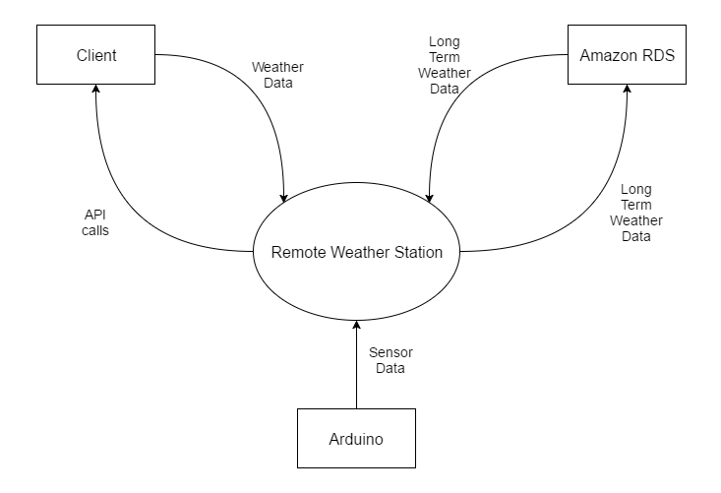
Context diagram

Slide 5
Project development plan
Configure the weather sensor to connect to the Arduino Board
Configure the Arduino board to send data to the server
Design database system to hold long term weather data
Build server to send data to the Amazon RDS database
Build Android application which communicates with the server and to the Amazon database

