Slide 1
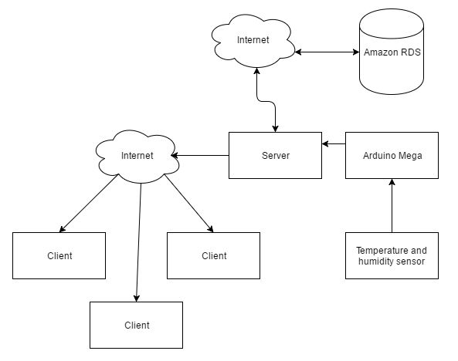
Cloud-enabled Xbee weather station app by Andrew Schaaf, Adam Baldwin, and Hieu luong
We would like to extend the Remote Xbee Weather Station project by creating an Android app to display weather information. The app would connect to a server supported by Amazon RDS over the cloud. The server would also handle writes to the Amazon database from the Arduino microcontroller.

Slide 2
Technology
Writing to the Arduino microcontroller will be done in the Arduino IDE and be written in C
The client will be an Android app written in Java
An Amazon RDS Cloud database will be implemented to connect to a server which connects to the client program.

