Slide 1
Path in a cyclic graph
Start
a
b
end

Slide 2
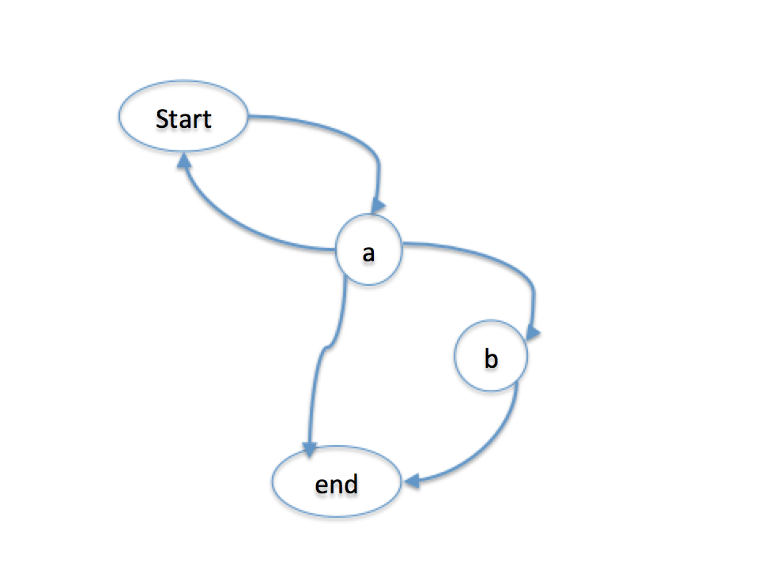
Path
edge(start,a).
edge(a,start).
edge(a,b).
edge(a,end).
edge(b,end).
% This predicate could lead to infinite recursion
path(X,X).
path(X,Y) :-
edge(X,Z),
path(Z,Y).

Slide 3
Path
edge(start,a).
edge(a,start).
edge(a,b).
edge(a,end).
edge(b,end).
% This predicate avoids nontermination by tracking seen nodes
ncpath(X,_Seen,X).
ncpath(X,Seen,Z) :-
edge(X,Y),
\+ member(Y,Seen),
ncpath(Y,[X|Seen],Z).
?- ncpath(start,[],end).
a->b->end->

Slide 4
Path
edge(start,a).
edge(a,start).
edge(a,b).
edge(a,end).
edge(b,end).
% This predicate builds up the (non-cyclic) path to the destination
pathto(X,_Seen,[X],X).
pathto(X,Seen,[X|Path],Z) :-
edge(X,Y),
\+ member(Y,Seen),
pathto(Y,[X|Seen],Path,Z).
?- pathto(start,[],P,end).
P = [start, a, b, end] ;
P = [start, a, end] ;
false.

Slide 5
Path
edge(start,a).
edge(a,start).
edge(a,b).
edge(a,end).
edge(b,end).
% This predicate gathers all (non-cyclic) paths from X to Y
allpaths(X,Y,Paths) :-
findall(C,pathto(X,[],C,Y),Paths).
?- allpaths(start,end,P).
P = [[start, a, b, end], [start, a, end]].

