Slide 1

Web Development Tools
JavaScript fundamentals

Slide 2
The Open Web Development Stack
Integrated Development Environments and Enhanced Text Editors
Debugging Tools
Using third-party Packages and dependency management
Automation support and Continuous Development
Version control and package management
Working with the Command Line and Terminal
Continuous Development and a DevOps Methodology
INTRODUCTION

Slide 3
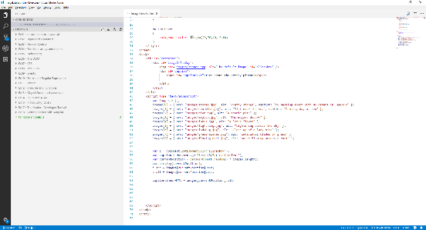
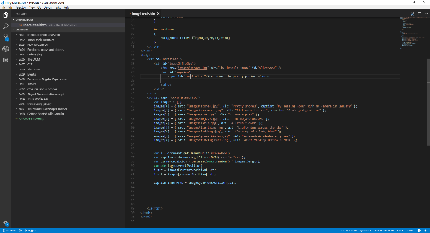
Walkthrough – using Visual Studio Code
Visual Studio Code is a free, open source enhanced text editor and it was built using JavaScript!
Not to be confused with Visual Studio (a paid-for, full IDE designed specifically for .NET development)

Slide 4
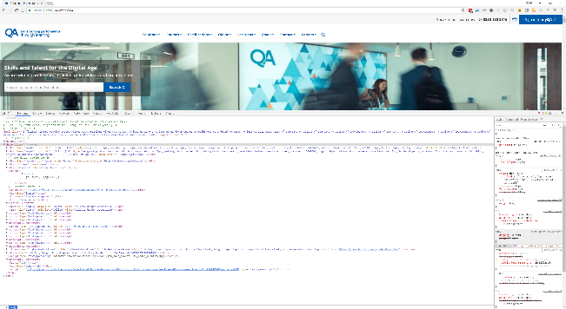
Walkthrough – Chrome development tools
Most browsers have development and debugging tools
Incredibly useful for testing and management

Slide 5
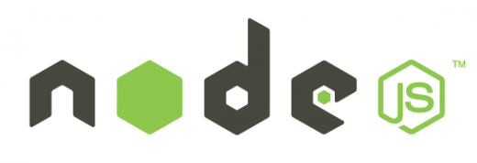

Node & NPM
Node.js is an open source command line tool for server side JS.
The script is executed by the V8 JavaScript engine.
NPM manages dependencies for an application via the command line.
Notes:
Install and check node version

Slide 6

What is Babel?
A JavaScript compiler
Can be used on its own, or with a task runner/module bundler
JavaScript in – JavaScript Out
Use tomorrow’s JavaScript – yesterday
Only transforms syntax – so for new globals (Set) and methods (Object.assign) we need to use Babel’s Polyfill
Notes:
Babel transpiles ES2015+ Syntax back to ES3+ syntax and they have created a polyfill to create the new globals and methods found in ES2015+. This means that tomorrow’s JavaScript works in yesterday’s browsers!

Slide 7
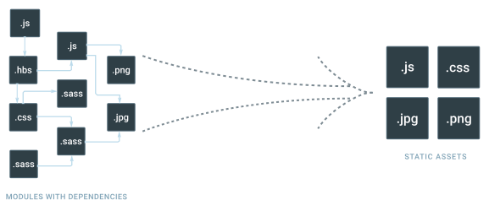

webpack
webpack is a module bundler for modern JavaScript applications
Entry points define where webpack starts. From here it builds a graph of your applications dependencies
Output tells webpack where to emit the bundled code
Loaders teach webpack how to handle assets that aren’t JavaScript
Plugins are used to perform actions and add custom functionality for our bundled code

Slide 8
CONCLUSION
The Open Web Development Stack
Integrated Development Environments and Enhanced Text Editors
Debugging Tools
Using third-party Packages and dependency management
Automation support and Continuous Development
Version control and package management
Working with the Command Line and Terminal
Continuous Development and a DevOps Methodology

