Slide 1

ERROR HANDLING & DEBUGGING JavaScript Fundamentals

Slide 2
Why you must debug
Understanding the Error object
The Inbuilt Error types
Creating resilient code using try/catch statements
Throwing Errors
In Browser Debugging
Examples with Developer Tools for Chrome
Console Debugging
Logging to the console
Breakpoints
INTRODUCTION

Slide 3
When things go wrong….
Every modern desktop browser comes with the ability to debug
As do many IDEs
There are also testing frameworks
We will investigate these later in the course

Slide 4
The error object
If an exception occurs, an object representing the error is created
If this error object is not caught, the program fails
The Error type is used to represent generic exceptions
It has two properties
name – specifics the type of the exception
message – detailed exception information
The above code declares an Error object where:
name is error
message is "My error message"
let error = new Error("My error message");
Notes:
When a JavaScript statement generates an error, it is said to throw an exception. Instead of proceeding to the next statement, the JavaScript interpreter checks for exception handling code. If there is no exception handler, then the program returns from whatever function threw the exception. This is repeated for each function on the call stack until an exception handler is found or until the top level function is reached, causing the program to terminate.
The “Error” type is used to represent generic exceptions. This type of exception is most often used for implementing user defined exceptions. The topic of creating user-defined exceptions will be revisited later in this article. “Error” objects are instantiated by calling their constructor as shown in the following example:
let error = new Error("error message");
“Error” objects contain two properties: “name” and “message”. The “name” property specifies the type of exception (in this case “Error”). The “message” property provides a more detailed description of the exception. The “message” gets its value from the string passed to the exception’s constructor. The remaining exception types represent more specific types of errors, but they are all used in the same fashion as the generic “Error” type.

Slide 5
Common Errors
There are a series of common errors built in, including:
Range Error
Reference Error
Syntax Error
Type Error
let pi = 3.14159;
pi.toFixed(100000); // RangeError
function foo() {
bar++; // ReferenceError
}
if (foo) { // SyntaxError - the closing curly brace is missing
const foo = {};
foo.bar(); // TypeError
Notes:
RangeError
Are generated by numbers that fall outside of a specified range. In the code above, the argument is expected to be between 0 and 20 (although some browsers support a wider range). If the value of “digits” is outside of this range, then a “RangeError” is thrown.
ReferenceError
Is thrown when a non-existent variable is accessed. These exceptions commonly occur when an existing variable name is misspelled. In the example above, a “ReferenceError” occurs when “bar” is accessed. Note that this example assumes that “bar” does not exist in any active scope when the increment operation is attempted.
SyntaxError
Occurs when the rules of the JavaScript language are broken. Developers who are familiar with languages, such as C and Java are used to encountering syntax errors during the compilation process. However, because JavaScript is an interpreted language, syntax errors are not identified until the code is executed. Syntax errors are unique as they are the only type of exception that cannot be recovered from. The following example generates a syntax error because the “if” statement is missing a closing curly brace.

Slide 6
Handling Errors – try, catch and finally (1)C
An unhandled error can cause a program to fail
With error handling, we can cause the program to degrade gracefully
JavaScript supports a try ... catch ... finally block
Watch for exceptions thrown within the try block
If an errors occurs, the catch block runs
The finally block always runs
You then throw an error object to the catch block
Setting the error’s message and name
Notes:
The try...catch...finally block is common to most modern languages. Processing proceeds as follows:
within the try block, if no exceptions are thrown, the finally block is run.
If an exception is thrown, the catch block is run followed by the finally block.
Please note that the finally block runs, even if the try or catch blocks return out of the current function.
Both the catch and the finally blocks are optional: you do not need to catch the exceptions, you do not need to have code that runs after the try ... catch. If the exception is not caught, it is thrown to calling function. If the exception is not caught at any level, then browser will log the error.

Slide 7
Handling Errors – try, catch and finally (2)C
Try to execute the code
try {
let x = parseInt(prompt("Enter a number number", ""));
if (isNaN(x)) {
let e = new Error();
e.message = "That wasn't a number";
throw e;
}
}
catch (e) {
alert(`Something went wrong: ${e.message}`);
}
finally {
...
}
Check the input
Create a new error object
Throw the error
Catch the thrown error
Handle the error
Finally executes on success or failure
Notes:
The above code takes us through an error handling scenario using try catch and finally. It also introduces us to the JavaScript error object. The Error object represents a runtime error allowing a developer to wrap up useful information about what went wrong. As we can see above, it was possible to provide a message and even name the error.

Slide 8
Throwing Exceptions
When things go wrong meaningful messages help
We have seen there are inbuilt Error objects
JavaScript allows programmers to throw their own exceptions
The throw keyword deliberately causes an error
Very useful when the function cannot solve the error itself
Any type can be thrown but the inbuilt error types are more useful
if (devisor === 0){
throw new RangeError("Attempted division by zero!");
}
Notes:
JavaScript allows programmers to throw their own exceptions via the appropriately named “throw” statement. This concept can be somewhat confusing to inexperienced developers. After all, developers strive to write code that is free of errors, yet the “throw” statement intentionally introduces them. However, intentionally throwing exceptions can actually lead to code that is easier to debug and maintain. For example, by creating meaningful error messages, it becomes easier to identify and resolve problems.

Slide 9
Things to remember
The “try…catch…finally” statement is used to handle exceptions
The “try” clause identifies code that could generate exceptions
The “catch” clause is only executed when an exception occurs
The “finally” clause is always executed, no matter what
The “throw” statement is used to generate exceptions

Slide 10
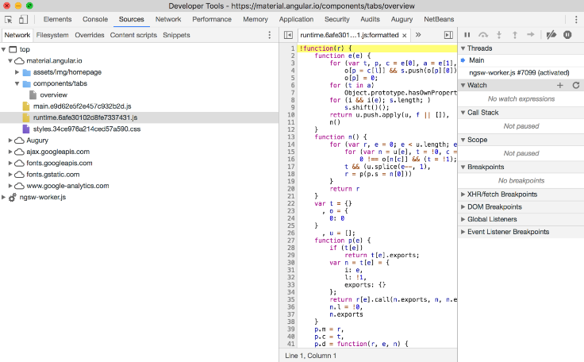
Debugging Demonstration
Contains a JavaScript Console
DOM explorer
Console
CSS style browser
Can debug
Command line interface
Not trivial
Notes:
Your instructor may choose to give a demonstration of using a browser’s debug tools.

Slide 11
Debugging – Console debugging
Learning to debug with a console is essential
Console API partially supported in most browsers
Full implementation in Chrome, Firebug and Safari
IE9 has good support, 8 some 7 little, 6 none
Opera supports some but went its own way
Different commands same concepts
Never use alert function calls to debug your script
They are intrusive modal commands
That freeze the UI but not the runtime
Timers and AJAX calls are still executing
Notes:
As a client side developer, you need to learn to debug and test. As we have discovered so far, JavaScript is an amazingly powerful programming language, but things can easily go wrong and you will need to identify how and why.
Some developers use alert calls to test a function is being called. One simple piece of advice: DON'T! Debugging with alerts holds the UI in a state of limbo, but does not hold any asynchronous operations, such as timers or AJAX feeds.

Slide 12
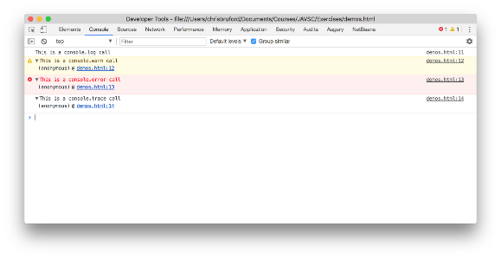
Debugging – Console logging
The console API has a number of useful functions
Function | Description
console.log() | Writes a message to the console.
console.warn() | As above with visual "warning" icon
console.error() | As above with visual "error" icon
console.trace() | As above with a call trace

Slide 13
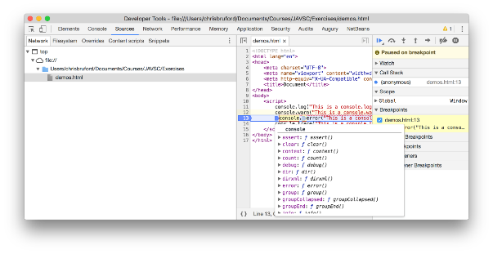
Debugging – breakpoints
Breakpoints pauses the code allowing examination and debugging
From the developer tools select the sources panel and select from a JavaScript source file
Set breakpoint by clicking in the gutter of the line you want to pause execution at
Hover over the source code to inspect variables and functions
Delete the breakpoint by clicking the blue tag breakpoint indicator

Slide 14
REVIEW
Why you must debug
Understanding the Error object
The Inbuilt Error types
Creating resilient code using try/catch statements
Throwing Errors
In Browser Debugging
Examples with Developer Tools for Chrome
Console Debugging
Logging to the console
Breakpoints

