Slide 1

Web Development Tools
JavaScript fundamentals

Slide 2
The Open Web Development Stack
Using third-party Packages and dependency management
Automation support and Continuous Development
Version control and package management
Working with the Command Line and Terminal
Continuous Development and a DevOps Methodology
INTRODUCTION

Slide 3
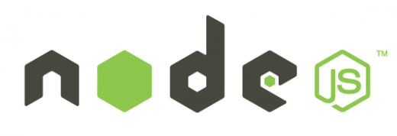

Node & NPM
Node.js is an open source command line tool for server side JS.
The script is executed by the V8 JavaScript engine.
NPM manages dependencies for an application via the command line.

Slide 4
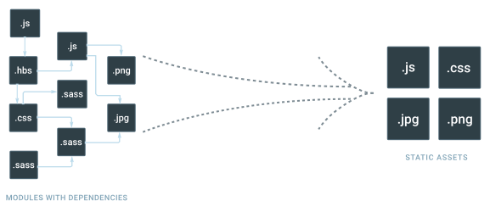

webpack
webpack is a module bundler for modern JavaScript applications
Entry points define where webpack starts. From here it builds a graph of your applications dependencies
Output tells webpack where to emit the bundled code
Loaders teach webpack how to handle assets that aren’t JavaScript
Plugins are used to perform actions and add custom functionality for our bundled code

Slide 5
What is Core-js?
A JavaScript transpiler
JavaScript in : JavaScript Out – Used for “polyfills”
It implements modern features in older, less capable browsers
Not required, but still used by companies (namely Apple) and some government organizations
Good to know how to use it as many companies still rely on older browsers
Notes:
Core-js transpiles ES2015+ Syntax back to ES3+ syntax and they have created a polyfill to create the new globals and methods found in ES2015+. This means that tomorrow’s JavaScript works in yesterday’s browsers!

Slide 6
QuickLab 15 – Create a webpack deployment
Use NPM and webpack to prepare JavaScript to be deployed

Slide 7
CONCLUSION
The Open Web Development Stack
Integrated Development Environments and Enhanced Text Editors
Debugging Tools
Using third-party Packages and dependency management
Automation support and Continuous Development
Version control and package management
Working with the Command Line and Terminal
Continuous Development and a DevOps Methodology

