Slide 1
ADVANCED REACT
Pagination

Slide 2
OBJECTIVES
In this module, you will
Understand how to split content up into manageable chunks for user consumption
Test features with dummy data
Style the features to allow for efficient user navigation of the content

Slide 3
Pagination

Slide 4
You would have seen this on many sites. Namely, Amazon and virtually all e-commerce sites will allow you to perform a search and will then return the bulk result.
This can be hundreds of products, and pagination allows consumers to manage the movement through this daunting list
Rational

Slide 5
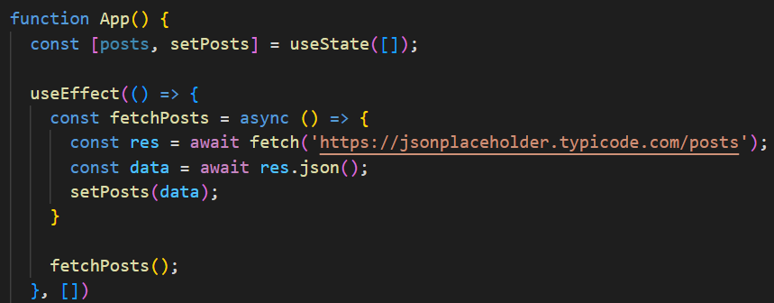
Drag in the data from jsonplaceholder and set the posts state as what is collected in App.js
Pull in the mock data

Slide 6
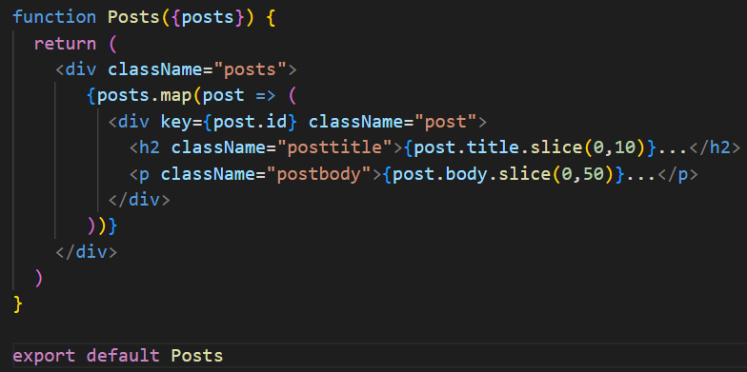
This is a simple functional component that accepts the posts prop and then maps it to return each individual post.
Note the slice, this ensure that all posts remain the same size once rendered
Create a Posts component

Slide 7
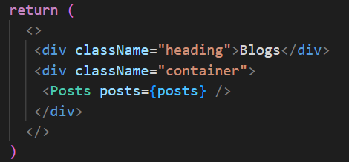
In the return, create a call to posts, which passes the dummy data for processing as a prop
Call the data into App.js

Slide 8
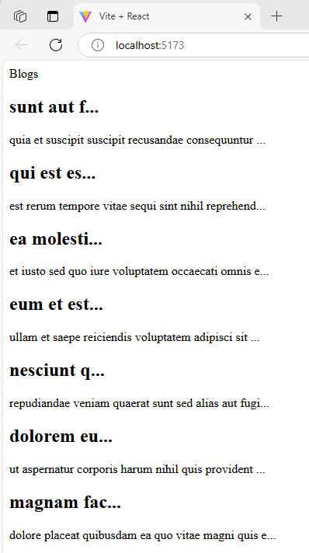
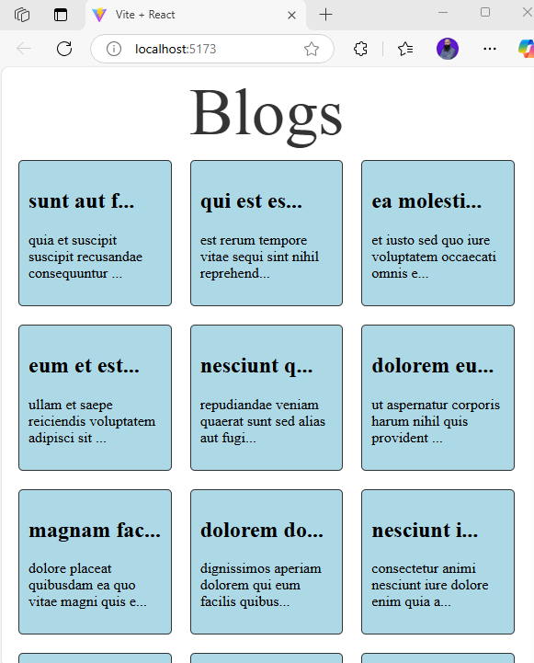
Add a little styling
The data is being called in
Notes:
.heading {
font-size: 72px;
color: #333;
text-align: center;
}
.post {
margin: 10px;
padding: 10px;
border: 1px solid #333;
border-radius: 5px;
background-color: lightblue;
flex: 1 1 calc(33.333% - 20px); /* Adjust the width of the squares */
box-sizing: border-box;
}
.posts {
display: flex;
flex-wrap: wrap;
justify-content: space-between;
}

Slide 9
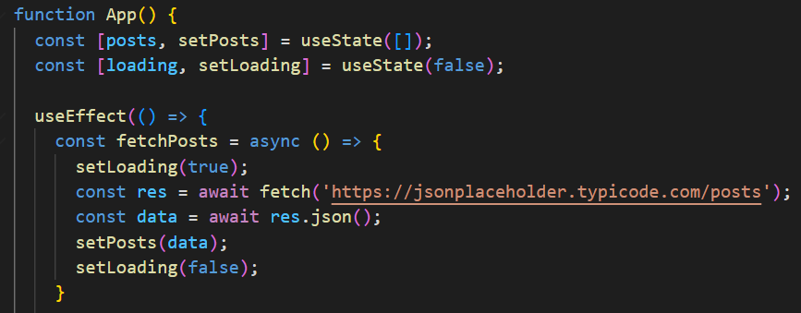
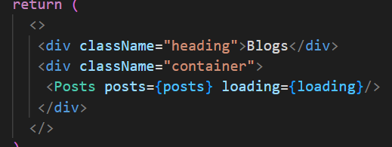
Simple loading
Creating a loading state lets us tell the user something is happening. Passing it as another prop to the call lets us use it.

Slide 10
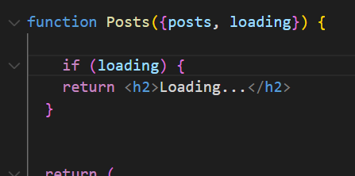
Creating a loading state lets us tell the user something is happening. Passing it as another prop to the call lets us use it.
Simple loading

Slide 11
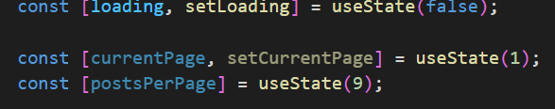

We need to create some new state. This will set which page to start on, and will let us change which page is being viewed.
We also need to set how many items are in view on each page
Paginate logic
This allows us to pass the posts we want to render to a component

Slide 12
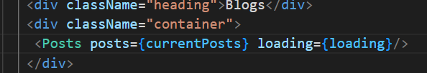
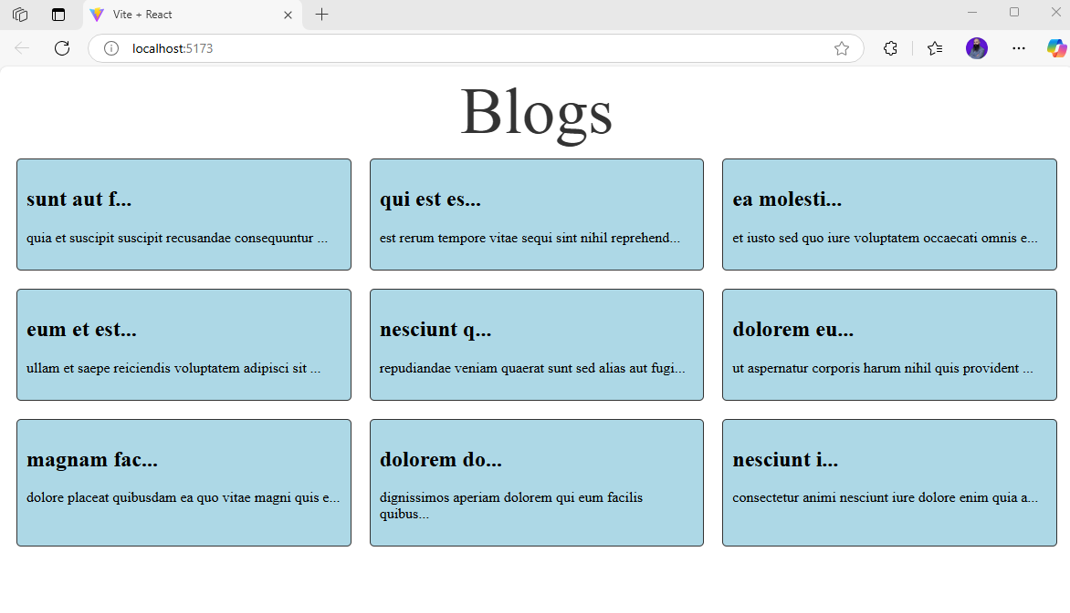
We can now pass the slice to the Posts call and make sure only those are rendered
Paginate logic
Notes:
We can change the number of items per page and change the render if we wanted

Slide 13
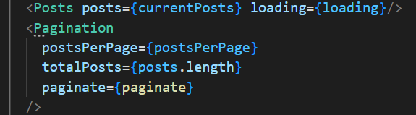
In preparation for the component rendering the correct number of pages, we can create a call for the pagination component.
Passing the logic created in the last section
Paginate component

Slide 14
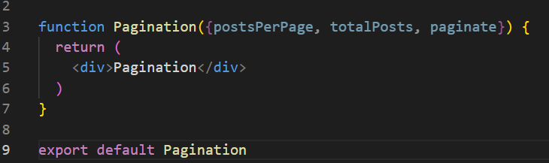
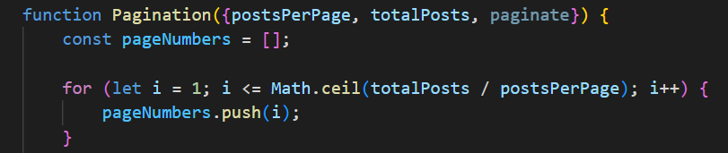
Pagination.jsx will accept the props in the function call
Paginate component
This logic calculates how many pager there will be and creates an array for the page links

Slide 15
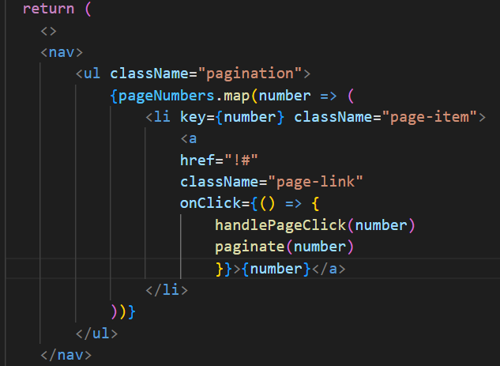
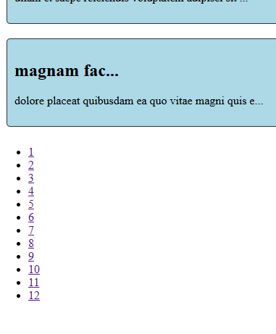
Now map through the pageNumbers array
Paginate component

Slide 16
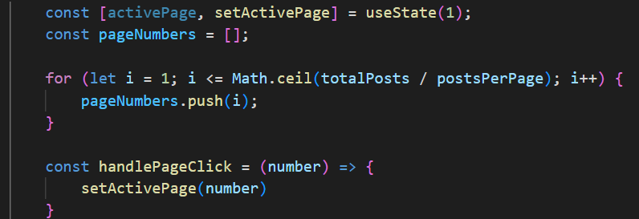
Prepare for some styling with some new state
Paginate component

Slide 17
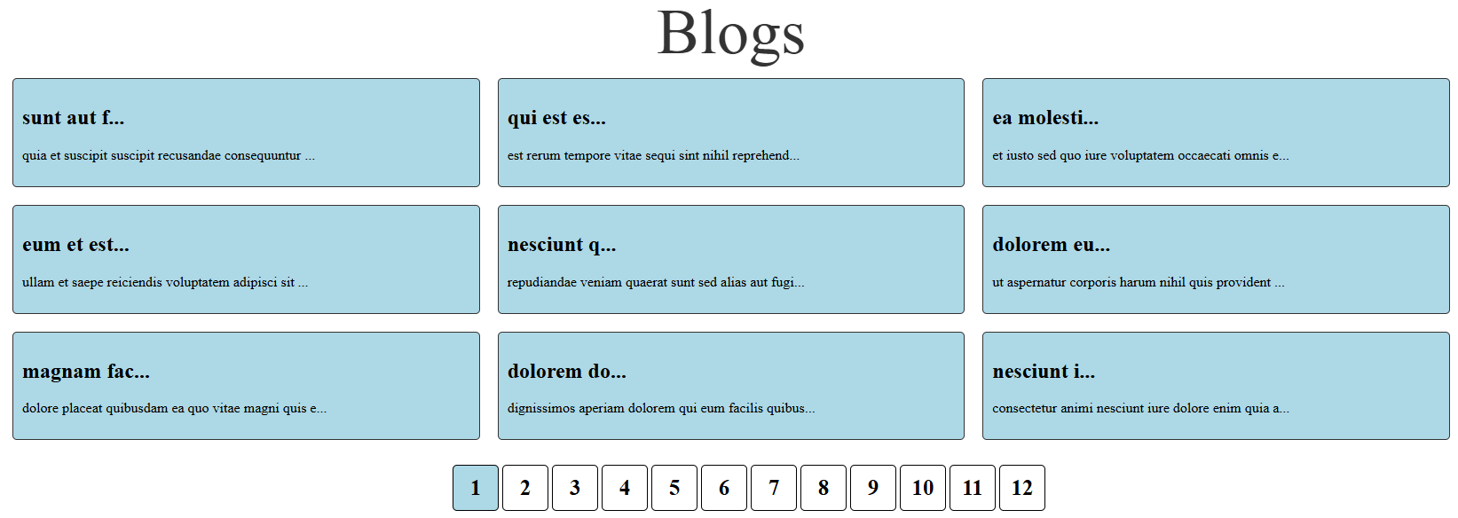
Styled
Notes:
.pagination {
display: flex;
flex-wrap: nowrap;
text-align: center;
justify-content: center;
}
li {
list-style-type: none;
width: 50px;
height: 50px;
margin: 2px;
display: flex;
align-items: center;
justify-content: center;
border: 1px solid black;
border-radius: 5px;
text-align: center;
}
li a {
text-decoration: none;
font-size: 25px;
color: black;
font-weight: 900;
}
.active {
background-color: lightblue;
}

