Slide 1
ADVANCED REACT
Coding Patterns and Best Practice

Slide 2
OBJECTIVES
In this module, you will
Understand the concepts of clean code in React
Identify common Design Patterns
Global data Sharing
Higher-order Component pattern
Render Props Component pattern
State reducer pattern
The Provider Pattern
Compound Component pattern
Presentational and container Component pattern
Hooks pattern

Slide 3
Clean Code and Best Practice

Slide 4
We would have looked at these throughout the course and you have all demonstrated good coding practice.
Looking and identifying the good practice explicitly will help you understand why you have done what you have done, how you have done it
Recaps

Slide 5
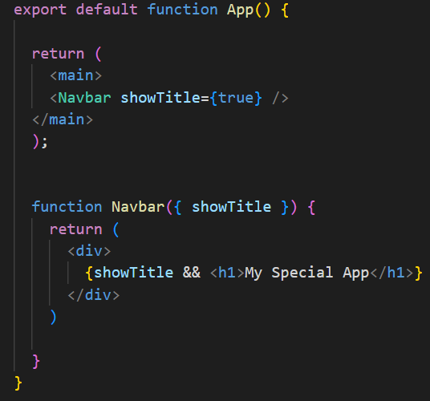
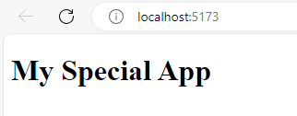
Passing the value of True to a prop can be done implicitly. In the example, when the Navbar component is called, the value of true has been supplied. This works as the && shorthand has been used to check if it is true
Make use of JSX shorthands

Slide 6
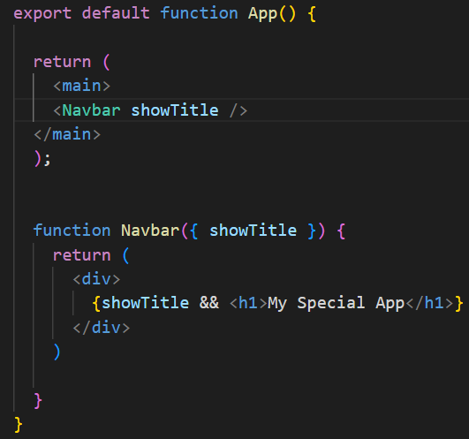
Removing ={true} allows the code to function identically as showTitle is passed so it must exist and hence must be true
Make use of JSX shorthands

Slide 7
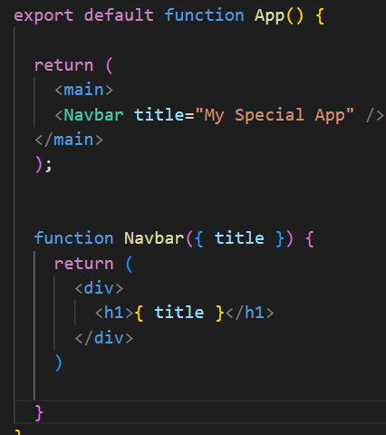
You can also pass prop values in the call as saw back on day 1, which can allow our content to be dynamic based on which components are being called
Make use of JSX shorthands

Slide 8
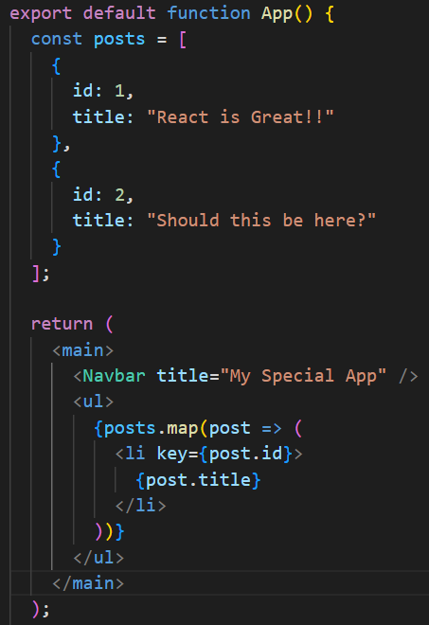
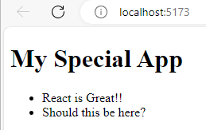
Its important that components are as pure as possible. They should perform one function only
Here, the posts const has been put into the App components. It works, but is much better placed in its own component. Not only for security, but for maintainability
Abstract code to separate components

Slide 9
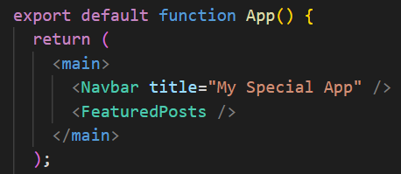
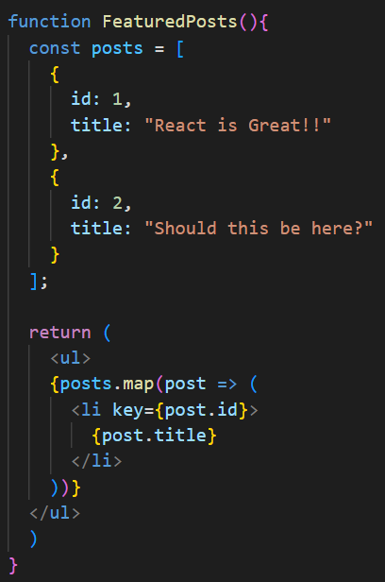
Dropping the functionality into a new Component / Function allows us to let App do its job and display the content, not process the content
Abstract code to separate components

Slide 10
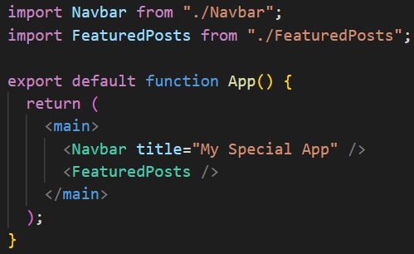
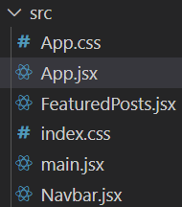
Even better would be to separate all functionality into a file that is called when needed
Create separate JSX files

Slide 11
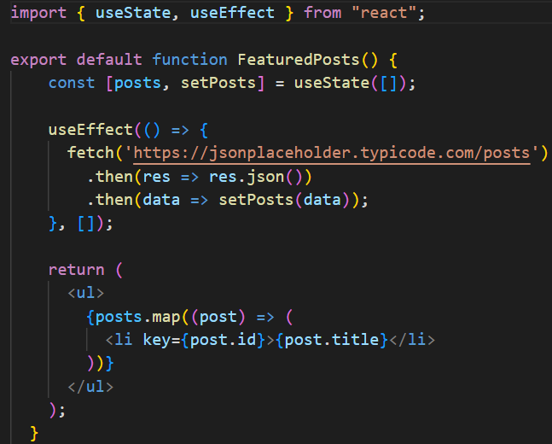
You created custom hooks earlier in the course. When you can repeat this functionality and use it in multiple components, you have granular control
Create hooks when you can share functionality
Notes:
This code contains 2 hooks, which can be resused across our app to pull data in.

Slide 12
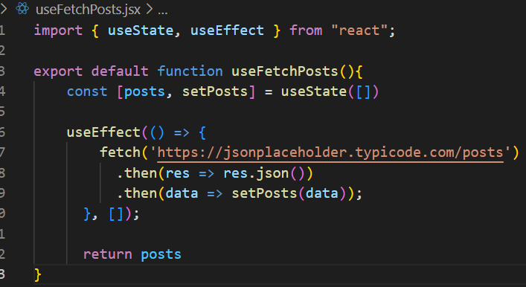
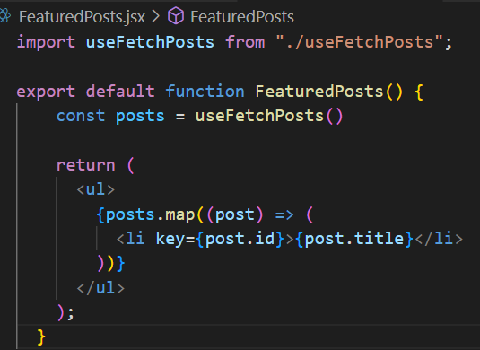
Putting the functionality in our own hook allows us to use it in multiple places, saving on maintenance and complexity
Create hooks when you can share functionality
Notes:
Now the complexity is outside the component

Slide 13
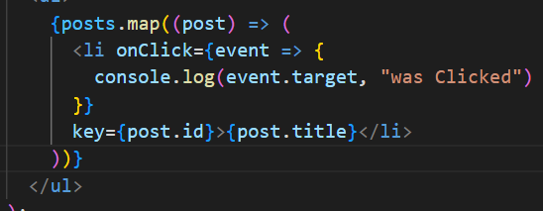
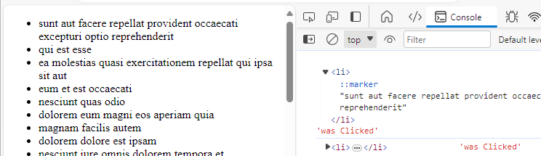
Regularly, we drop JS into the JSX return. If possible, this can be avoided by dropping it into the function before the return and then calling it in. e.g
The JS event handler was put into the return
Remove JS from JSX returns

Slide 14
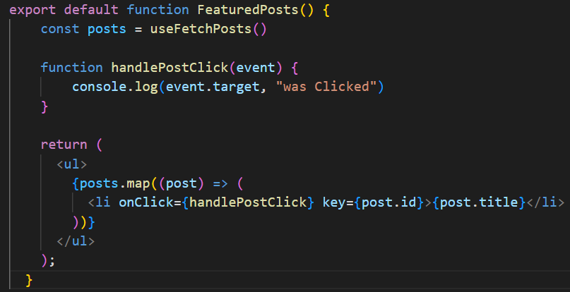
Much more efficient would be to put the click functionality into a separate function and then call the function into the JSX
Remove JS from JSX returns

Slide 15
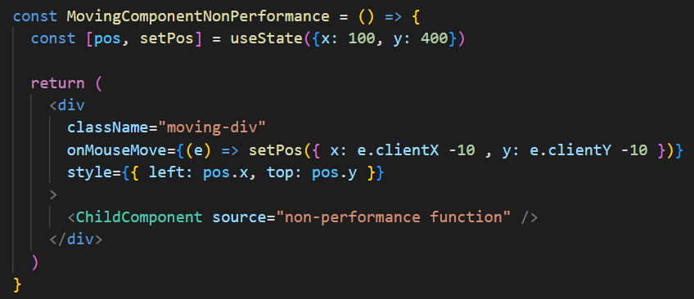
Whenever a component has state that changes, it re-renders. When this happens, all Child components are re-rendered too
This component creates state and returns a div. whenever the mouse moves over the div, it changes the position of that div on the screen.
The child component is called within this component
Remember those re-renders
Notes:
Create this code with the group

Slide 16
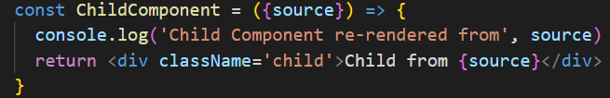
Create a child component with a console log.
This will log every time the component is re-rendered
Which will happen every time the div from the parent component is moved
Remember those re-renders
Notes:
Create this code with the group

Slide 17
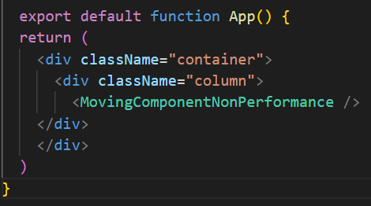
Dropping the component into the App results in a potential performance issue
Remember those re-renders
Notes:
Create this code with the group

Slide 18
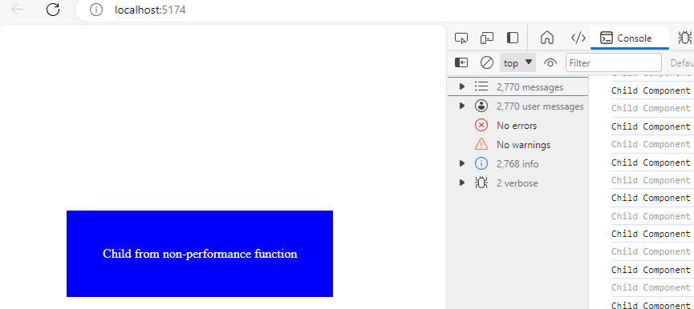
The child component takes in the source prop and logs when it was re-rendered
Because the child component is called inside the movingComponent, it is rerendered every time the mouse moves the div
Remember those re-renders
Notes:
This can cause huge performance issues

Slide 19
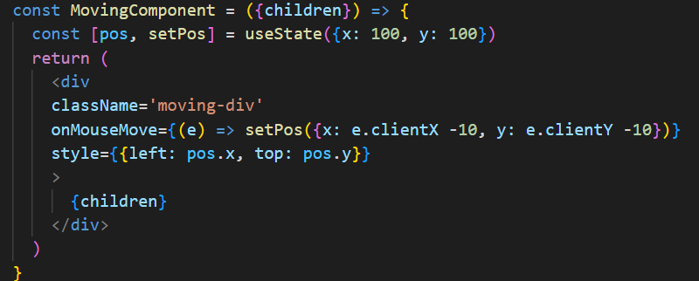
To solve this, we can create a new moving component, almost identical to the first
Notice however that the child component isn’t called inside. The children are mapped as an output style call
Remember those re-renders
Notes:
This can cause huge performance issues

Slide 20
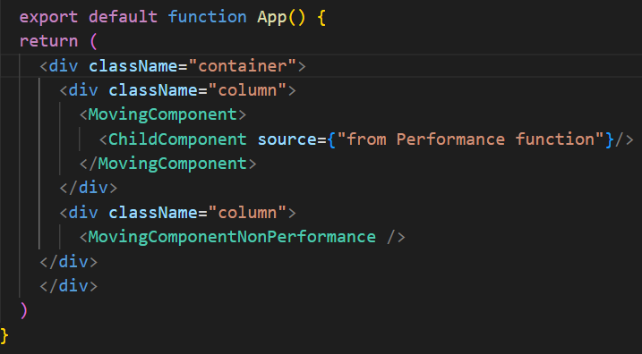
Nesting the child component as one of the { children } means its not re-rendered on parent state change
Remember those re-renders
Notes:
This can cause huge performance issues

Slide 21
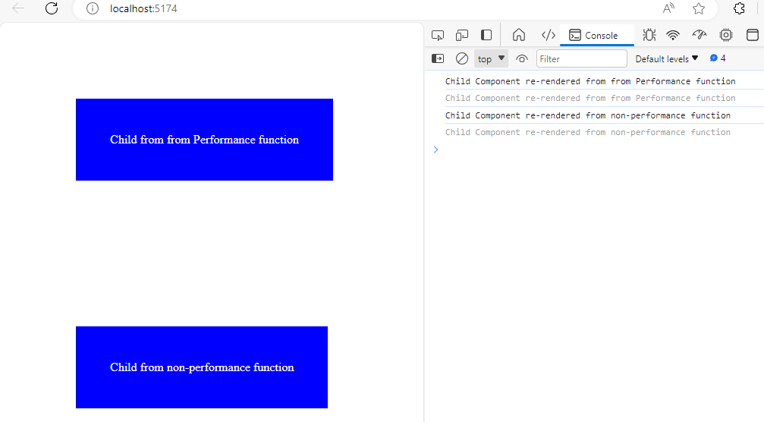
Nesting the child component as one of the { children } means its not re-rendered on parent state change
Both are rendered initially but there is no logging when the performance div is moved
Remember those re-renders
Notes:
Try it out

Slide 22
Redux will make your lives easier when it comes to managing larger creations.
In smaller apps, useContext might be more appropriate as it contains less overheads
Decide when to use state management

Slide 23
Common Design Patterns

Slide 24
We have become used to passing data into a component call via props this week.
Render props is a pattern in React that allows you to share code between components using a prop whose value is a function. This function is used to tell a component what to render.
Render Props Pattern

Slide 25
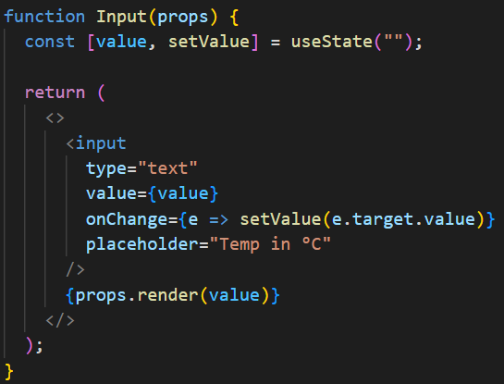
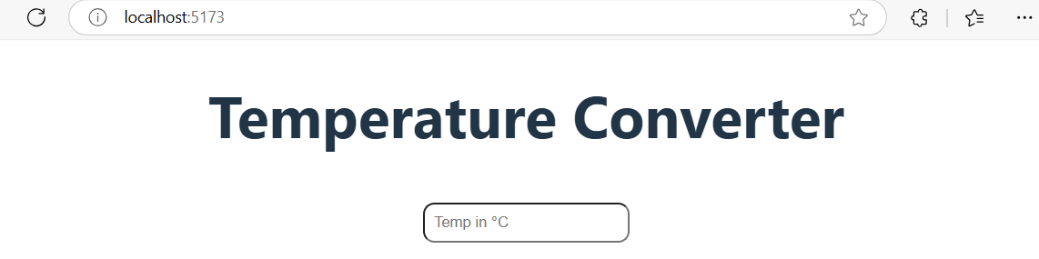
In this example, we have an input box which takes temperature in Celsius
Render Props Pattern

Slide 26
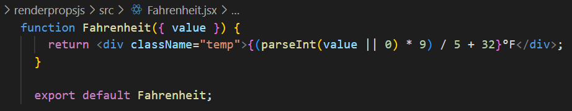
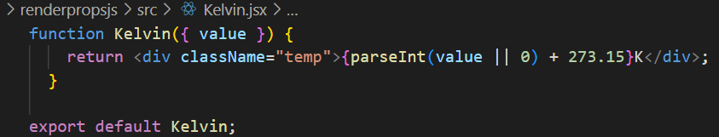
There are 2 almost identical components, one which takes a value and converts it to Fahrenheit, the other to Kelvin
Render Props Pattern

Slide 27
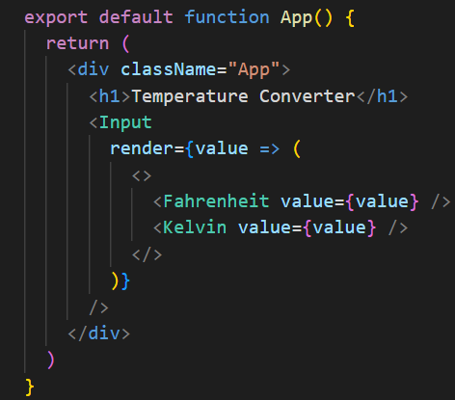
In App.js, the input is taken from the user and then passed to each of the components, which then performs the function and returns the render.
Render Props Pattern

Slide 28
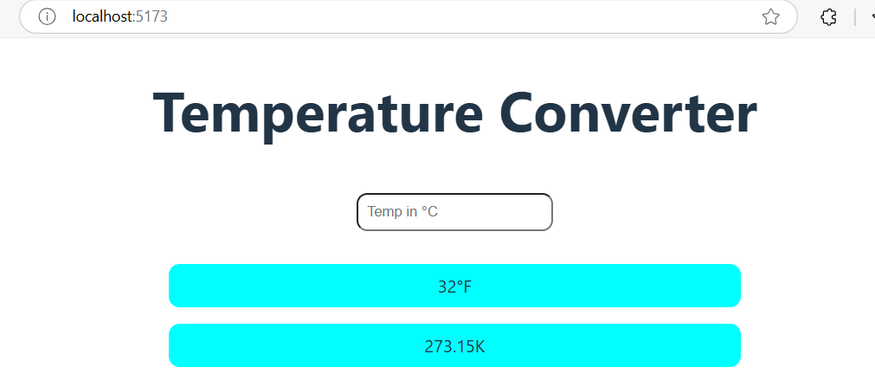
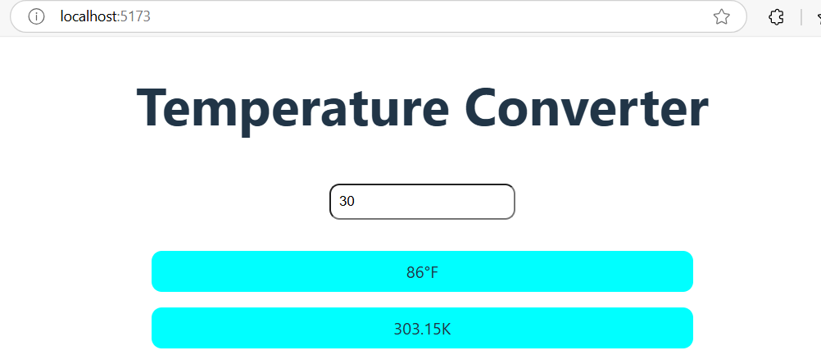
Render Props Pattern

Slide 29
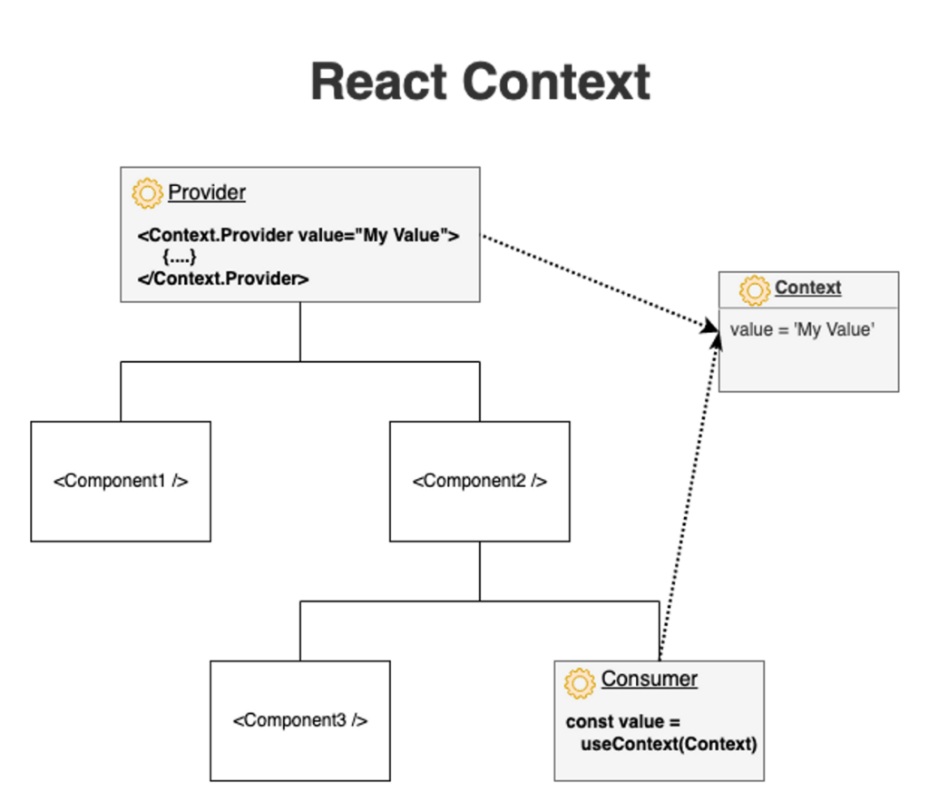
Although it may seem obvious, finding a method to avoid ‘prop drilling’ is something regularly overlooked
We have looked in depth at both useContext and Redux to manage the availability of specific bits of information only for the components that need it
Global Data Sharing
Notes:
Img - React useContext: The Best Way to Manage States - CopyCat Blog

Slide 30
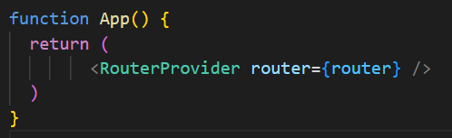
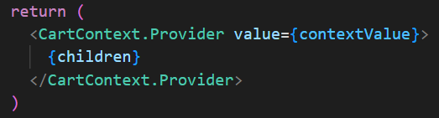
This feeds nicely into the idea that we can have a provider and consumer.
Again, we have looked at this in several contexts this week, from Routing to State
Provider pattern
Notes:
Provider and Consumer is a very important concept in React

Slide 31
These are not regularly used in modern react (React that is not class based)
But they were helpful for creating new components without mutating the original component.
This was effectively solved using React Hooks giving us the…….
Higher-Order Component Pattern

Slide 32
Very simply, this pattern allows us to control the essence of react Apps including props, state, context, refs, and lifecycle
The concept is one of putting functionality into callable blocks of code which are predictable, manageable and customizable
You have created custom hooks this week which will give you an idea of why it’s such a useful and popular pattern of development
Hooks Pattern

Slide 33
‘The one with hooks’ (16.8) was a major shift in React development.
useReducer() was one of the hooks that shipped with this version. We have looked at this in detail this week.
What spawned from this was the pattern by which we pass in not only the state, but what action we want to perform on that state
This has led to much cleaner and reusable code throughout development
State Reducer Pattern

Slide 34
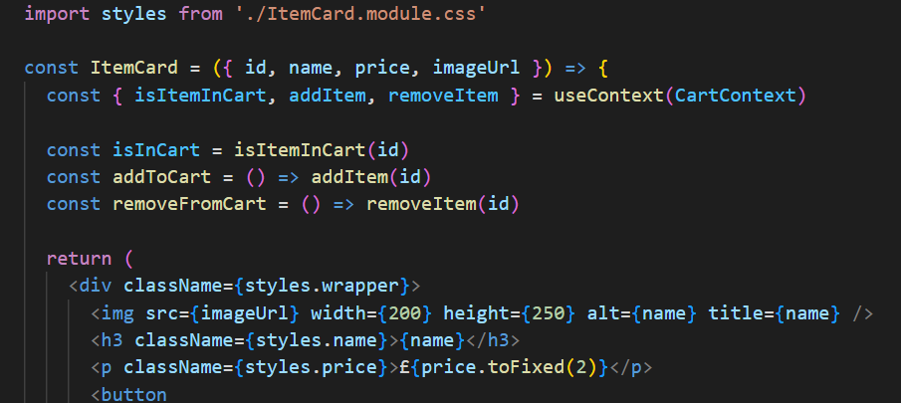
We used this heavily this week when we built our plant shop shopping cart
In this instance, we imported styles, having created an individual module for css and then use parts on our app
Compound Components Pattern

Slide 35
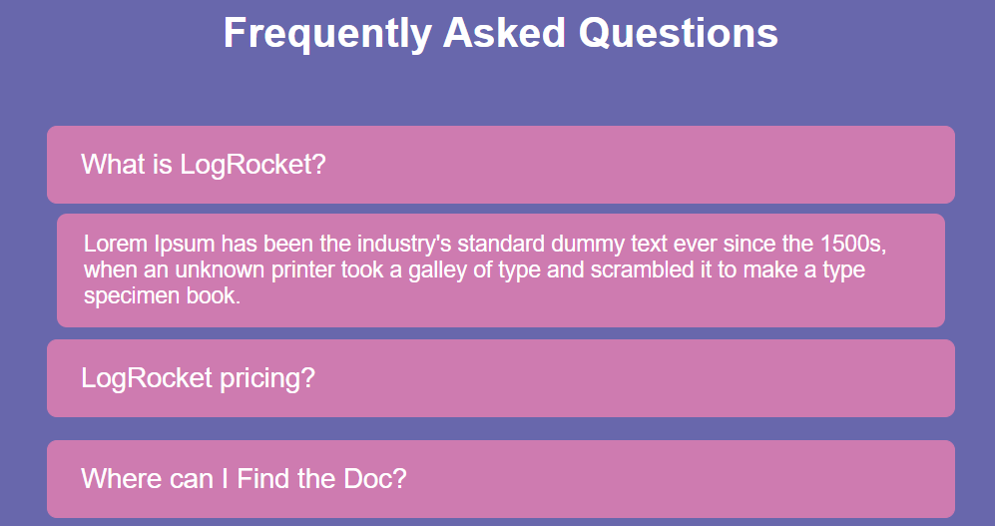
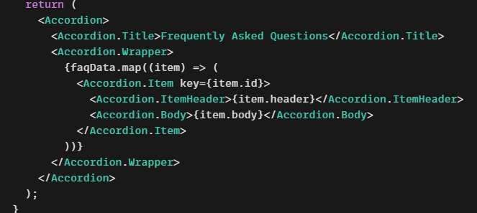
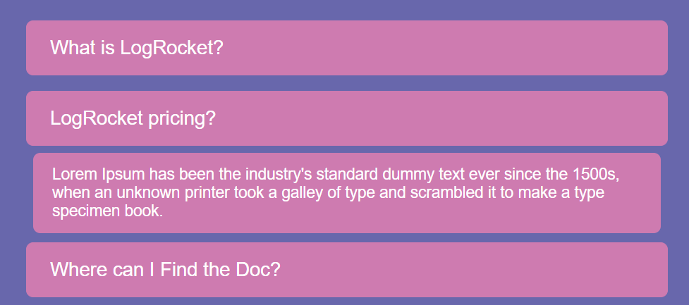
We used this for styling, but it could equally have been used to share functionality between different elements. e.g. this accordion functionality can be passes to each child component
Compound Components Pattern

Slide 36
We have looked at many different ways of structing the components and files this week.
Best practice is to try and split up concerns as much as possible
i.e. each component or block of functionality should have its own parental folder in the component tree.
This pattern originally served to split up the part of the component which delt with rendering from the logic that sits behind it. Now, we call in child components or hooks and drop the presentation in the return() statement
Presentation – container pattern

Slide 37
Anti-Patterns

Slide 38
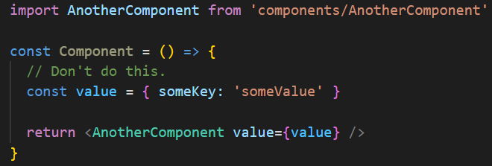
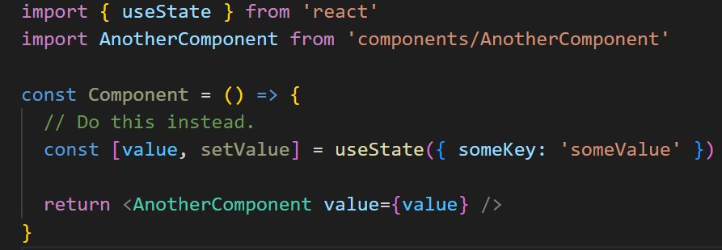
Use state over variables
Don’t
Do

Slide 39
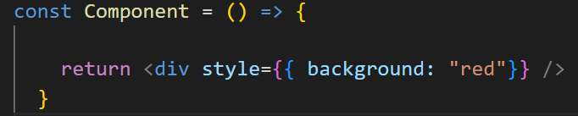
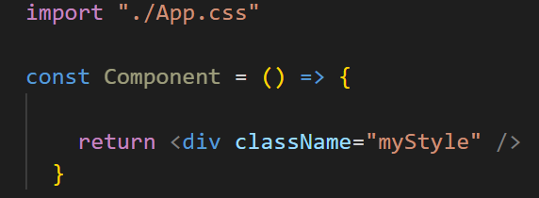
Declare CSS outside Components
Don’t
Do
Notes:
Whenever a functional React component is rerendered, it will recreate all normal functions in the component. React provided a useCallback hook that can be used to avoid that. useCallback will keep the old instance of the function between renders as long as its dependencies doesn't change.

Slide 40
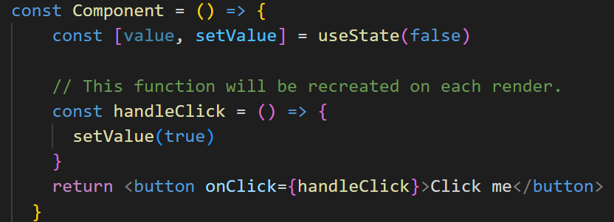
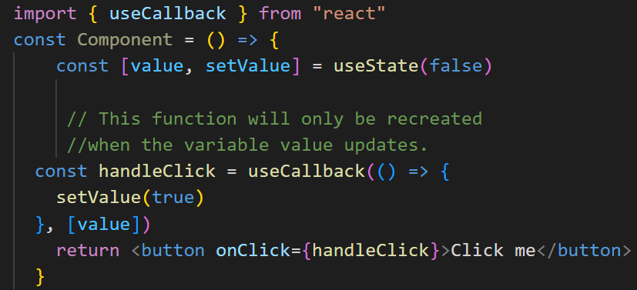
Use useCallbcak to prevent function recreation
Don’t
Do
Notes:
Whenever a functional React component is rerendered, it will recreate all normal functions in the component. React provided a useCallback hook that can be used to avoid that. useCallback will keep the old instance of the function between renders as long as its dependencies doesn't change.

Slide 41
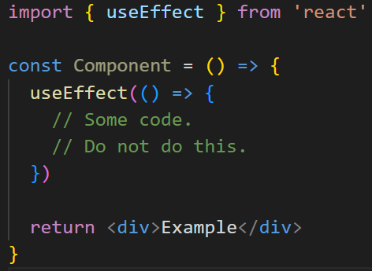
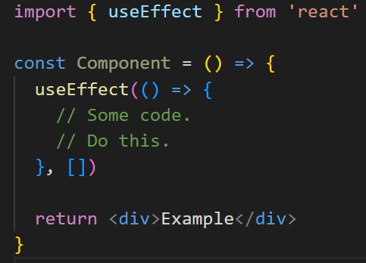
Add an empty list to useEffect when no Dependencies are required
Don’t
Do
Notes:
If you have an effect which isn't dependent on any variables, make sure to an empty dependency list as the second argument to useEffect. If you don't do that, the effect will run on every render.

Slide 42
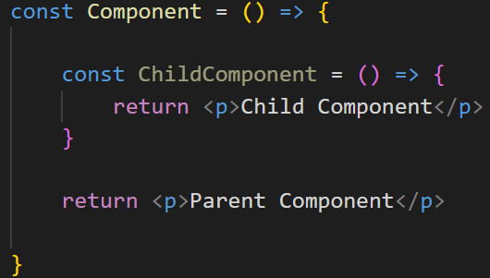
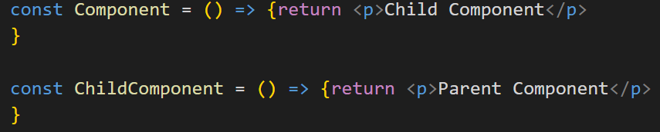
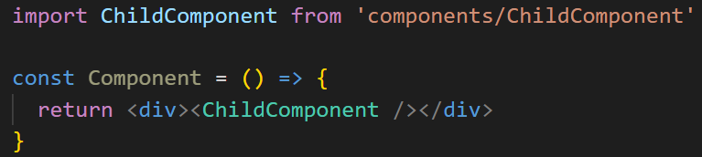
Do not declare components within other components
Don’t
Do
Or
Notes:
What is the problem with it? The problem is that you are misusing React. As discussed before, variables declared within a component will be redeclared every time the component renders. In this case, it means that the functional child component has to be recreated every time the parent rerenders.

Slide 43
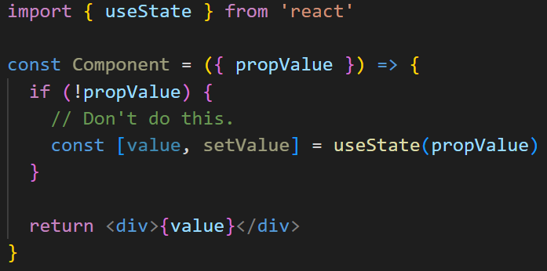
Do not use Hooks in If statements (no Conditional Hooks)
Don’t
Notes:
React Documentation. One should never write conditional hooks, simply as that.

Slide 44
Final Challenge

Slide 45
In your pairs, create your own version of the QA Estate Agent website
You will be given the data. Note that when you run the server, it serves up different data for different endpoints.
Create some documentation on how this app functions. Identify the hooks, components, layouts, patterns, features
Estate Agent
Notes:
Pluto (QA Estate Agent repo): AndySmithQA/QAEstate (github.com)

