Slide 1
ADVANCED REACT
Hooks

Slide 2
OBJECTIVES
In this module, you will
Be introduced to the concepts and motivations behind using Hooks
Understand and use the most common hooks in React
useState, useEffect, useRef, useCallback, useReducer, useMemo, useContext
Build your own custom hooks with your own functionality

Slide 3
Hooks are nothing more than named blocks of functionality, designed to make it easier to create efficiently coded web pages.
The built-in hooks can be generally split into categories
State Hooks useState and useReducer
Performance Hooks useMemo and useCallback
Reference Hooks useRef and useImperativeHandle
What are they?

Slide 4
Hooks have to be imported into any component that needs to use them.
As the hooks are not the default import, we need to import them as objects, hence the curly braces
We can separate multiple hook imports with a comma.
How do we use them?

Slide 5
3 general rules of use:
Only call Hooks at the top level. Don’t call Hooks inside loops, conditions, or nested functions
Only call Hooks from React function components
Don’t call Hooks from regular JavaScript functions
General Rules

Slide 6
useState()

Slide 7


When you create a ‘variable’ with use state, you need to create a const, then within an array, specify the name of the const followed by the setterName.
This second element allows you to update the state value
state name setter function name
Inside the parenthesis, you need to specify the initial value of this state
useState()

Slide 8
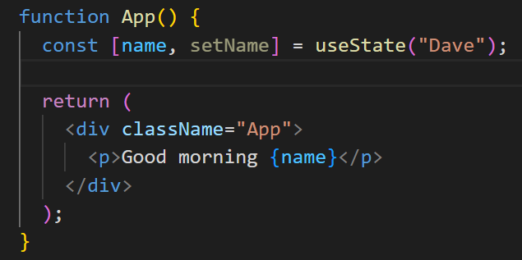

In the JSX return, we can now dynamically output the state value
useState()

Slide 9
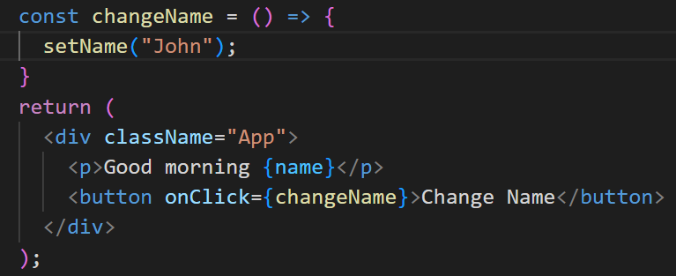
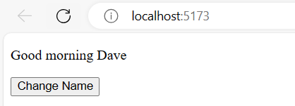
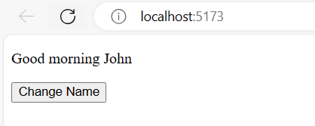
To update the value, we need to create a function.
The most common way is to create a button which calls the setter function
useState()

Slide 10
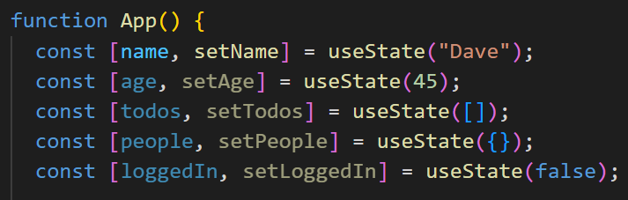

State can be set as string, numbers, arrays, objects and Boolean values
They can also be set to null, where they are instantiated but not assigned
useState()

Slide 11
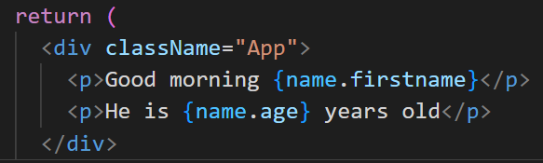
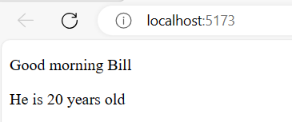
Objects held within state can be accessed like props, with dot notation
useState()

Slide 12
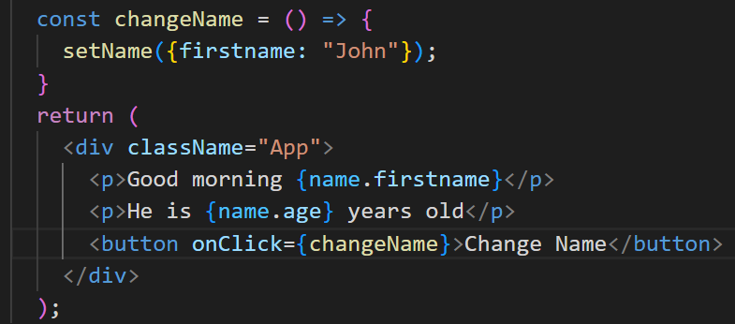
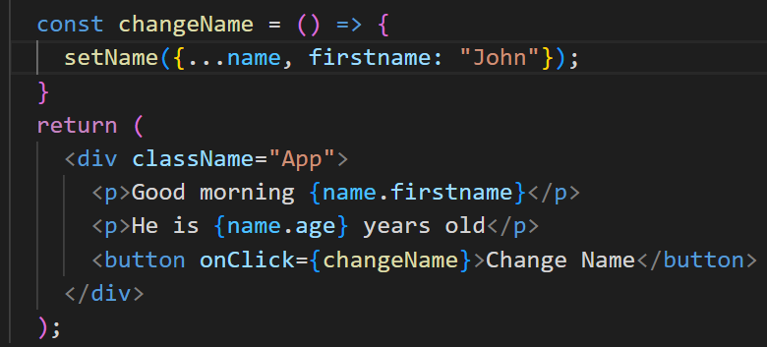
You can still change the object with functions, you just need to identify which key to change when the function is called
This is bad practice as it would have removed the second property from the state. We get round this by using the spread operator (…)
useState()

Slide 13
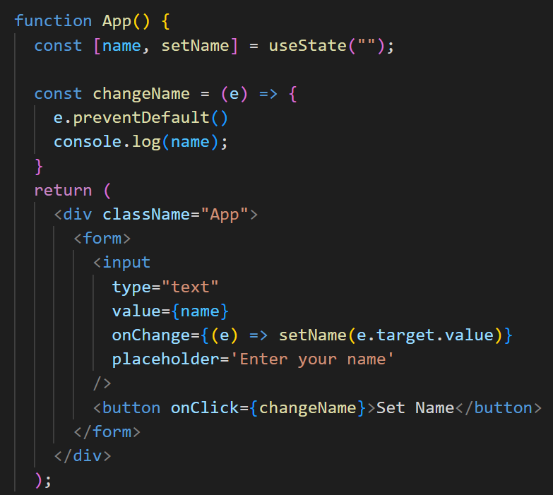
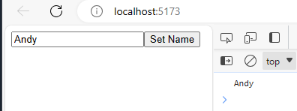
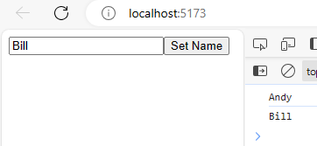
The user can set the value by using a form input and updating the state whenever the user changes the data
useState()

Slide 14
useEffect()

Slide 15
Replaced the 3 different lifecycles
componentDidMount
componentDidUpdate
componentWillUnmount
useEffect()

Slide 16
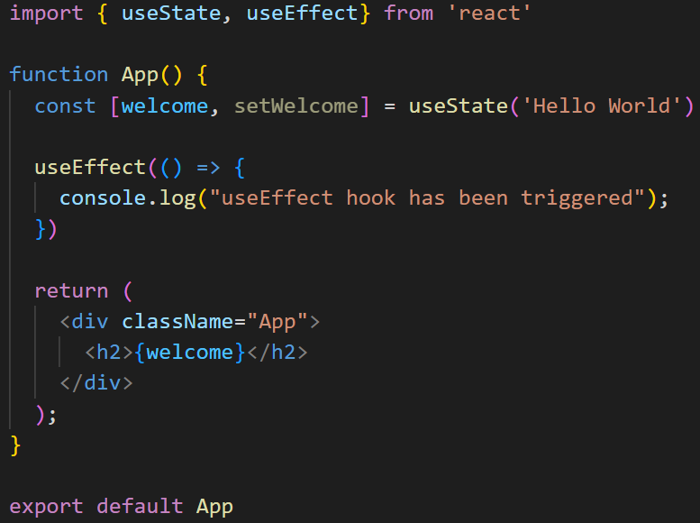
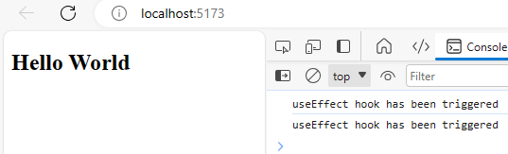
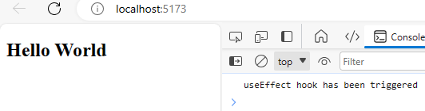
When you build a useEffect hook, the first argument is the handler function.
This takes care of any side effect
useEffect()
It renders twice because the strictMode is wrapping the App in main.jsx. (we will take this off for this example)
Notes:
It renders twice because the strictMode is wrapping the App in main.jsx.

Slide 17
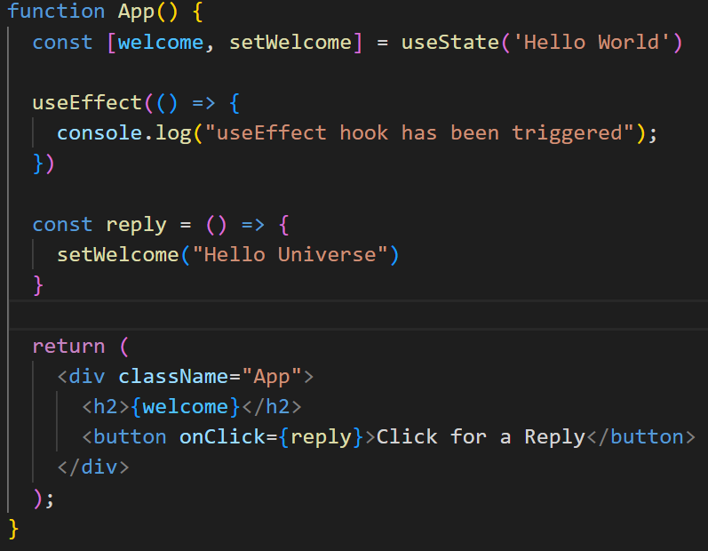
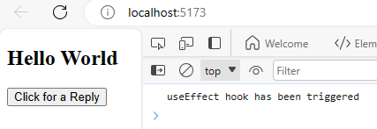
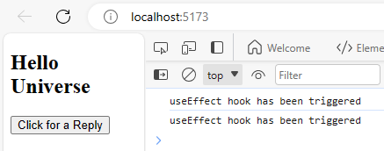
We can also demonstrate the componentDidUpdate by changing the state within the component
useEffect()

Slide 18
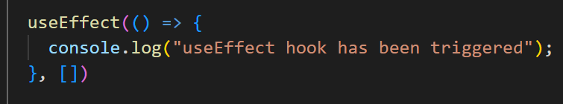
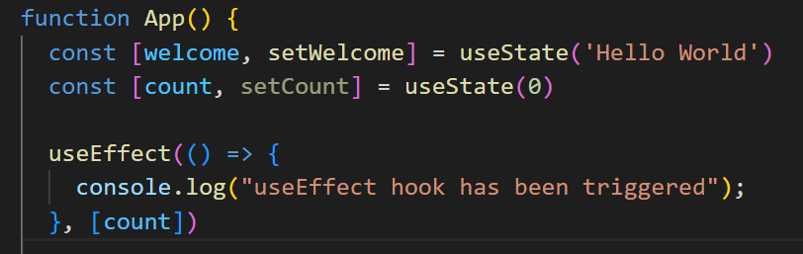
This behaviour can be prevented by adding a second argument to the useEffect hook.
Adding an empty array will tell the hook to only triggered on mounting
This is a dependency and it tells the hook which state changes should trigger a rerender
This would now only trigger when the count state was updated
useEffect()

Slide 19
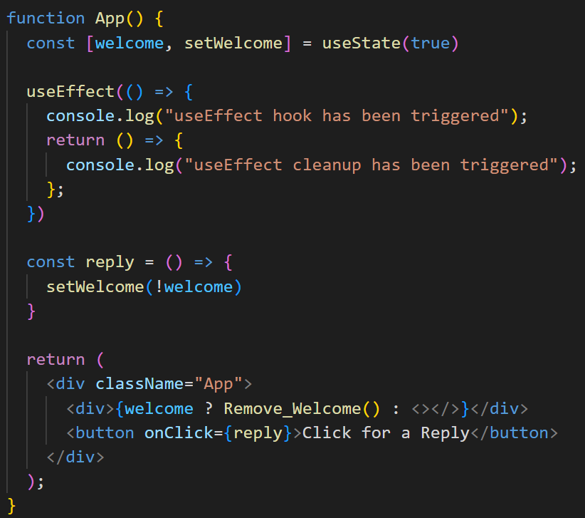
The last of the component lifecycle stages can be demonstrated within useEffect also
Welcome state has been set to true
Reply sets the state to false
Ternary operator to check if welcome is true
useEffect()

Slide 20
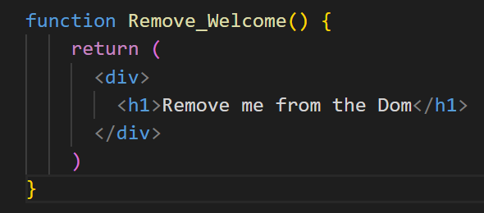
The last of the component lifecycle stages can be demonstrated within useEffect also
When the element is removed from the DOM, the return is triggered
useEffect()

Slide 21
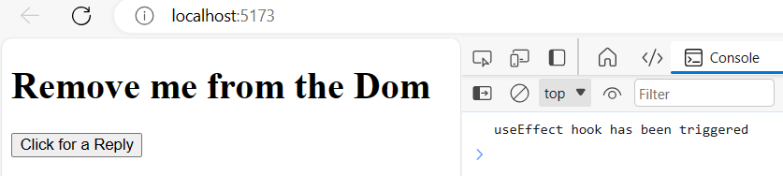
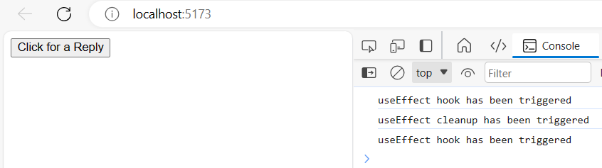
Element is loaded to the DOM and the useEffect is triggered
When the button is clicked, the element is removed from the DOM and the return is triggered
As the state was changed, the useEffect was then triggered again
useEffect()

Slide 22
useContext()

Slide 23
This hook makes it easier to pass data throughout the whole of your component tree, without the need to pass props from parent to child.
We will investigate this in more detail when we look at state management later in the week
We have useContext to avoid the issue of propDrilling between multiple levels of parent and child components
useContext()

Slide 24
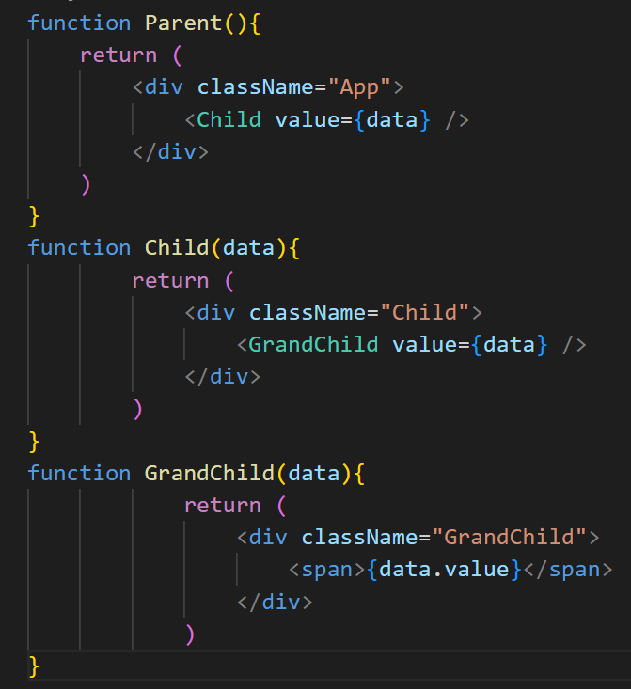
It might look like this with multiple levels, and much worse. We want to be able to pass data by traversing components
useContext()

Slide 25
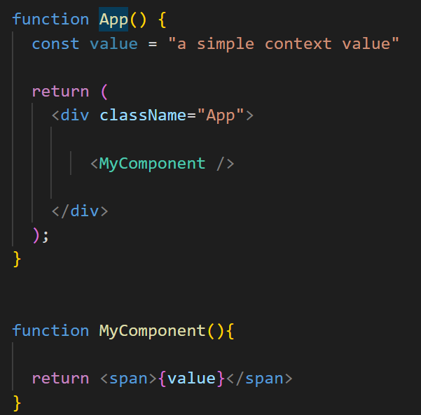
Imported from react like all other hooks
CreateContext and useContext are both needed because we need to provide and use the context to send and receive data
useContext()

Slide 26
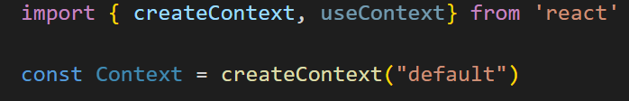
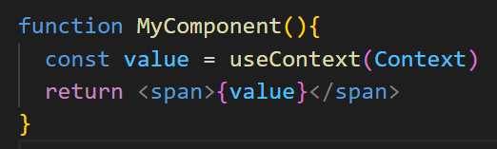
First, we create the context
This names the context of the data to be passed through the component tree
We need to utilise the useContext hook in any component we want to pass the data into
useContext()

Slide 27
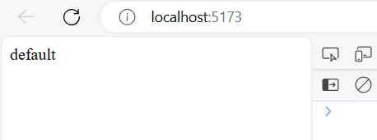
This will display in the child component despite not being mentioned in the parent component
useContext()

Slide 28
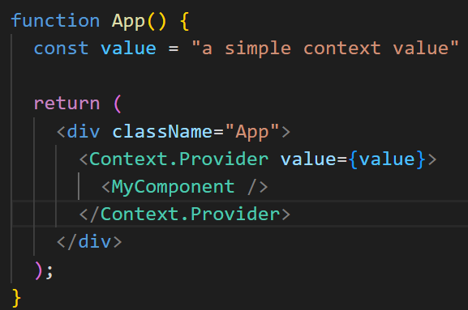
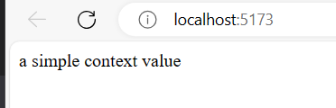
We can use Context.Provider inside the parent app to change the value of the context before it is passed to the child.
This allows us to send different context to different children anywhere in the tree, based on state requirements
useContext()

Slide 29
useReducer()

Slide 30
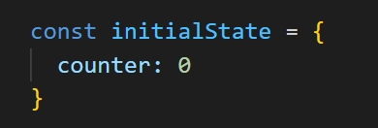
This shipped with react v16 and is an alternative to useState(). It is used to store and update states
Like useEffect, it takes in 2 arguments, but looks like useState when it is written
Initial state is a simple value that the state is assigned with. This can be created separately, or dropped into the creation
useReducer()

Slide 31
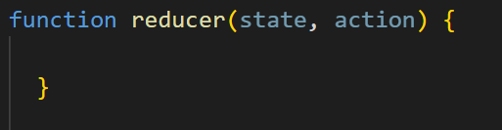
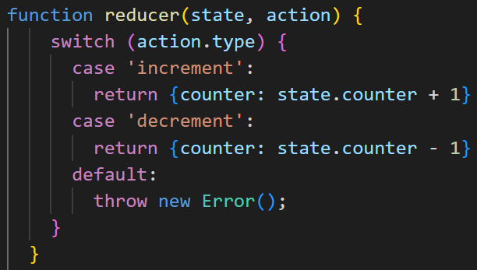
You need to create the reducer function too.
Based on the action, the function returns updated state
Based on which action we pass into the reducer call, we move through a switch statement to see how to change the state
useReducer()

Slide 32
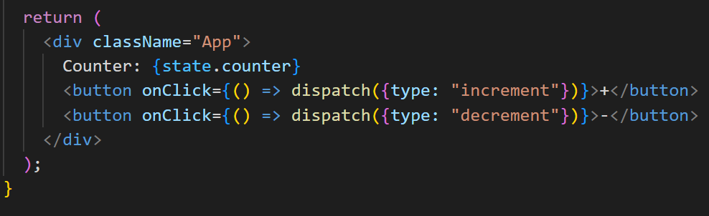
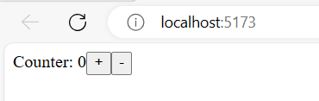
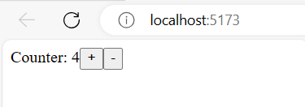
Inside the return, you need to identify the state and create some functions which call the reducer, but identify the type of action
useReducer()

Slide 33
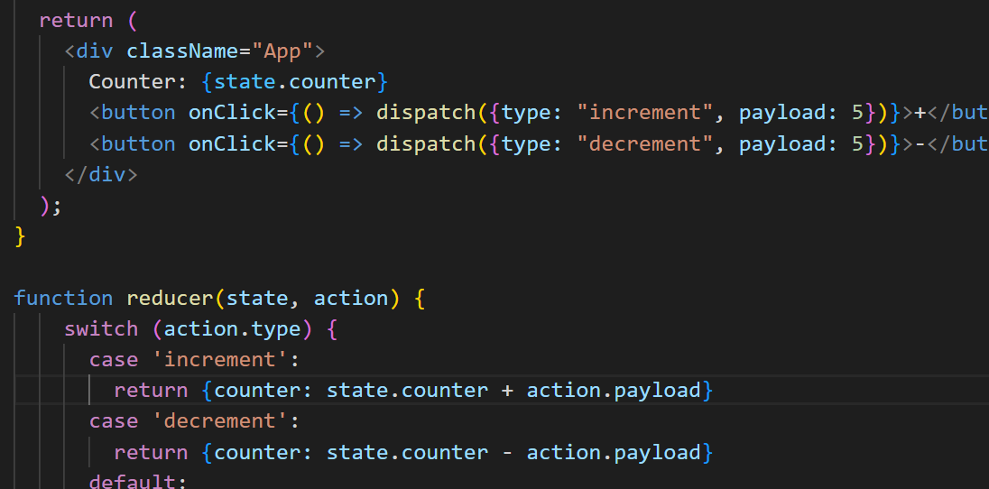
You can also use a ‘payload’ property to change how many the counter should increment and decrement by
useReducer()

Slide 34
useRef()

Slide 35
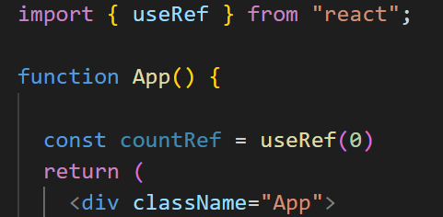
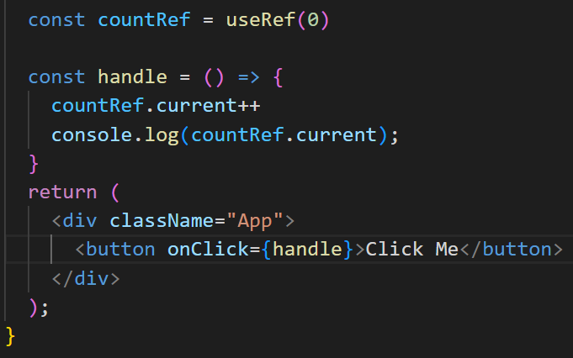
This built in hook accepts one argument as an initial value and returns the reference.
Syntax is simple (useRef is mutable)
You can update the value with a function
useRef()

Slide 36
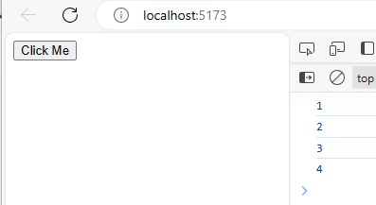
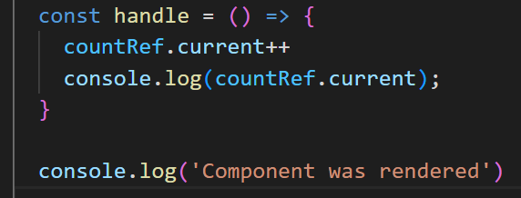
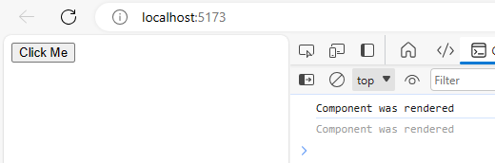
Each time the button is clicked, it updates the ref and passes it to the console
The component was rendered initially but…..
useRef()

Slide 37
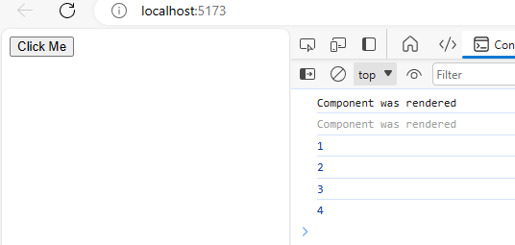
As the useRef is not a state change, it doesn’t trigger a re-rendering of the component
useRef()

Slide 38
useCallback()

Slide 39
useCallback will return the memorised version of a function that only changes when one of the dependencies has changed.
Memorisation is a way to cache results so they don’t have to be calculated again.
useMemo is similar, but useCallback is for functions, not values
useCallback()

Slide 40
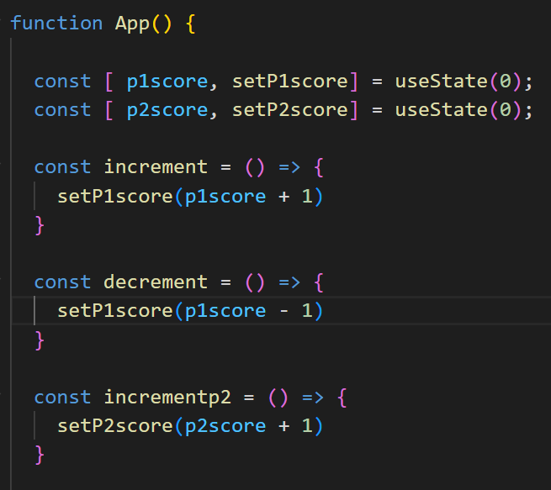
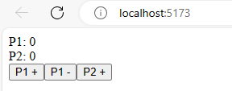
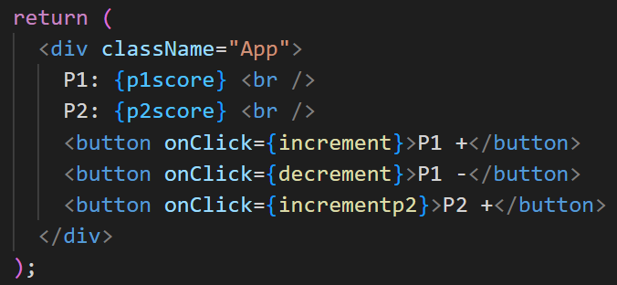
It is easier to understand when to use this hook when you see how not using it causes a problem
useCallback()
Every time this component re-renders, every function inside this component is recreated. Hence the function references change between renders

Slide 41

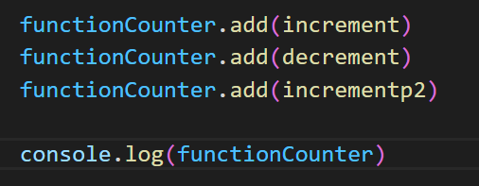
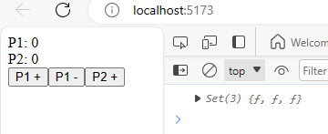
If we create a set(), we can see this in real time
The initial render of this component shows that 3 functions have been created.
useCallback()

Slide 42
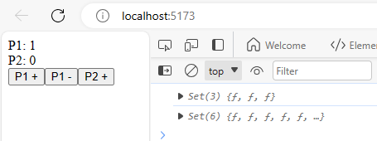
If I click a button, the subsequent state change and re render creates the 3 functions again, but with different references
This could add a huge performance issue. This is where useCallback will come in handy.
Similarly to other hooks, it takes 2 arguments. The function and the dependencies
useCallback()

Slide 43

By adding useCallback, we can determine which functions are recreated on re-render
Increment is only recreated when p1score is updated
Incrementp2 is only recreated when p2score is updated
useCallback()

Slide 44



This time, we still get 3 function references in the initial render
If I press P1+, it increments to 5, not 6
If I press P2+, it increments only one more reference as only one function needs to be recreated
useCallback()

Slide 45

useCallback()

Slide 46


Best practice is to try and remove the dependencies. This will ensure that the only rendering of these functions is at the initial render
useCallback()

Slide 47
useMemo()

Slide 48
Essential for improving performance and speed by caching output in memory, then returning that value when the same input is given
useMemo is called and accepts 2 arguments.
The first is the function (compute), the second is the dependencies
Similar to useCallback, but used for values rather than functions
useMemo()

Slide 49




Another problem that needs a solution
Every time the button is
clicked, it re-renders both
parent and child components
useMemo()

Slide 50


With useMemo we can store the value of the function and as long as it doesn’t change, the child will never be re-rendered
useMemo()

Slide 51



Lets add new state and include that as a dependency in the useMemo for the child component
The child component is only rerendered when newState is updated
useMemo()

Slide 52
Custom Hooks

Slide 53
Sometimes we write our own blocks of functionality that are useful to our codeblocks.
Regularly, these can be used over again with multiple components.
We may be tempted to save these as functions and then export them. However, React allows us to create our own hooks, this has a major benefit.
Once you create a hook which starts with the word ‘use’, it allows the linter to find bugs in the hook.
Custom Hooks

Slide 54
It is important to note that the general rules of react hooks also apply to custom hooks
Just in case…
Only call Hooks at the top level. Don’t call Hooks inside loops, conditions, or nested functions
Only call Hooks from React function components
Don’t call Hooks from regular JavaScript functions
Custom Hooks

Slide 55

When it comes to the storage of session keys and other snippets of information we might need to use.
Let’s build a custom hook that lets us use this persistent storage
When we type into the box and refresh, the data is lost.
We can easily change this to store the value locally, i.e inside the browser
Using local storage

Slide 56


Create a new component called useLocalStorage.jsx. We want this to work similarly to useState, in that it will return a value and a function that lets you set a value.
Inside our component, we now call this custom hook in, rather than useState
Using local storage

Slide 57


If we prime our hook to accept the initial value, it can then utilize useState within the hook and change the functionality
We can now create the logic for persisting local data. In our component, we need to pass the key into our hook. name is the key we will use
Using local storage

Slide 58

As local storage uses JSON, we need to create a function that allows our hook to check if a local value exists.
When the page is refreshed, it will run and the return the local value into the text box
As useState can accept a function, we need to check if a function has been passed in (in which case it returns whatever was passed to it)
Using local storage

Slide 59

Now, we need to call the getLocalVariable function based on what is passed on refresh.
The best way to update the local storage is to apply useEffect as this will re-run automatically on re-render.
Returning the value will populate the textbox with anything that already exists in localStorage
Using local storage

Slide 60


The result is a key of name being put into Local storage when the page is rendered
This is then updated when a name is entered into the text input
Using local storage

Slide 61
Upon page refresh and subsequent re-render, this is stored and put into the text input automatically
See live demo
Using local storage

Slide 62


Logging is something that is regularly used across many components.
We can create a new useLog hook which records changes to the console
Another example

Slide 63

Now we have 2 blocks of functionality outside the main App.jsx.
Not only is the complexity removed from the component, it is completely reusable for all other components too
Another example

Slide 64
Labs and Activities

Slide 65
Create a custom hook called useFetch which accepts a URL as a parameter to instantiate an API call and return the data
Create a custom hook called useEventListener to an element of a webpage
Challenges

