Slide 1
ADVANCED REACT
Authentication using external resources
Google Firebase

Slide 2
OBJECTIVES
In this module, you will
Create a Project in Firebase that authenticates users with an email address
Understand how to set up a React app to access Firebase resources
Allow users to register and log in using Firebase Authentication

Slide 3
Firebase Project

Slide 4
We would have looked at these throughout the course and you have all demonstrated good coding practice.
Looking and identifying the good practice explicitly will help you understand why you have done what you have done, how you have done it
Recaps

Slide 5

Google Firebase is a cloud platform that provides services for modern app development.
There are of course many alternatives, but the integration of Firebase into React apps is pleasing to complete
Firebase

Slide 6
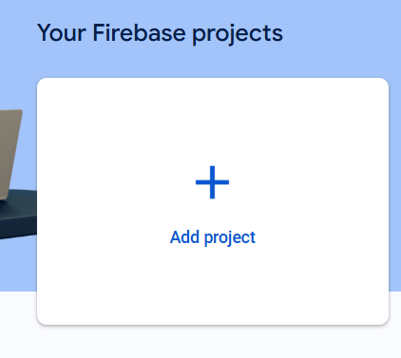
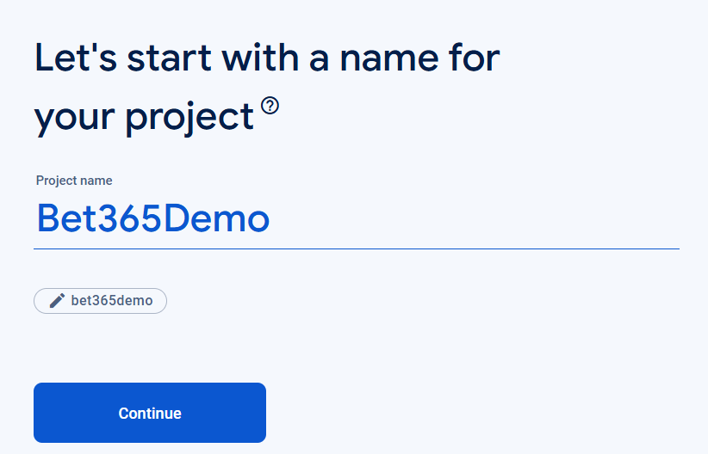
Ensure you have an account created and then go to the console in firebase
Click Add Project
Name it
Firebase

Slide 7
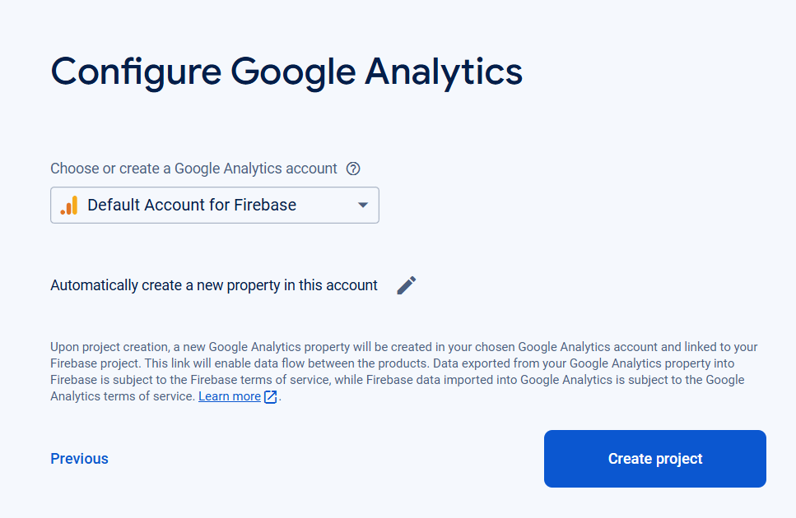
Ensure you have an account created and then go to the console in firebase
Configure Analytics
Create Project
Firebase

Slide 8
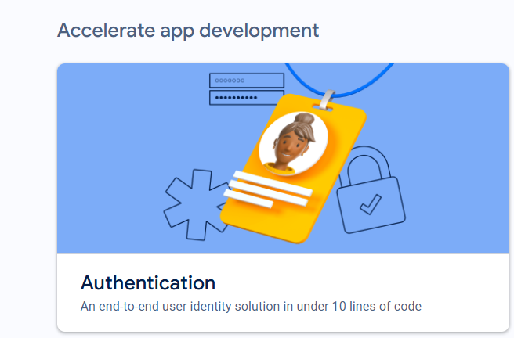
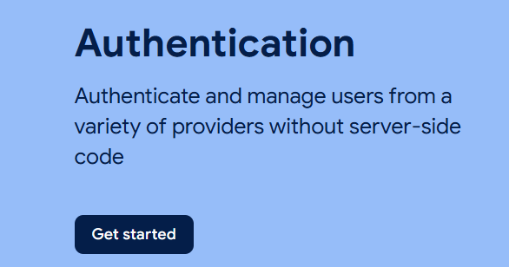
Once your project has been created, you can select which authentication you want to allow
Firebase
Authentication

Slide 9
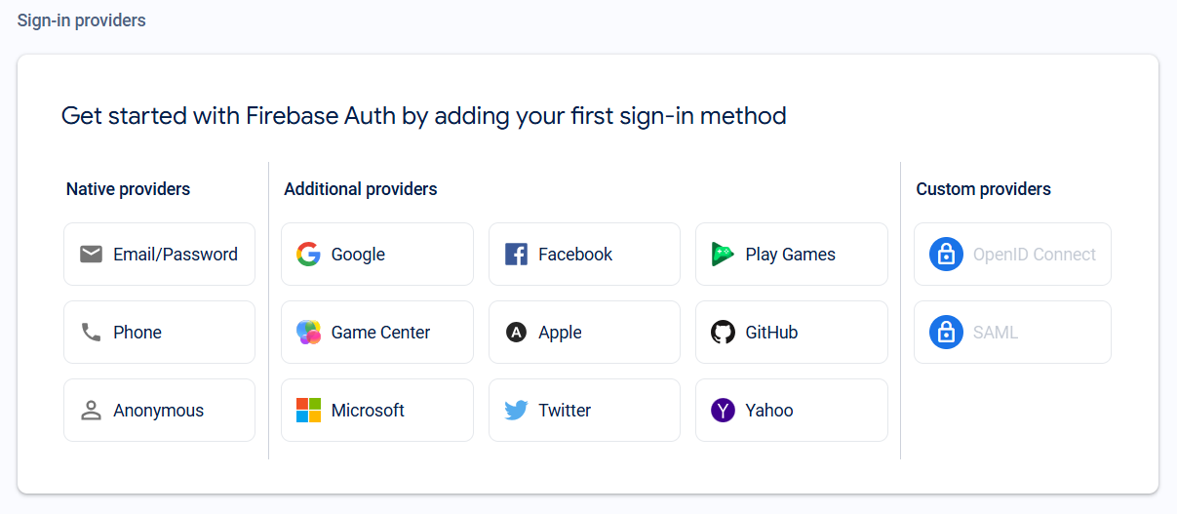
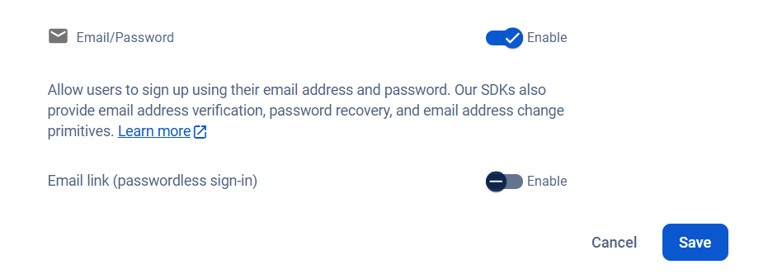
You will see many integrated options. For this Demo we will choose Email/Password
Firebase
Authentication

Slide 10
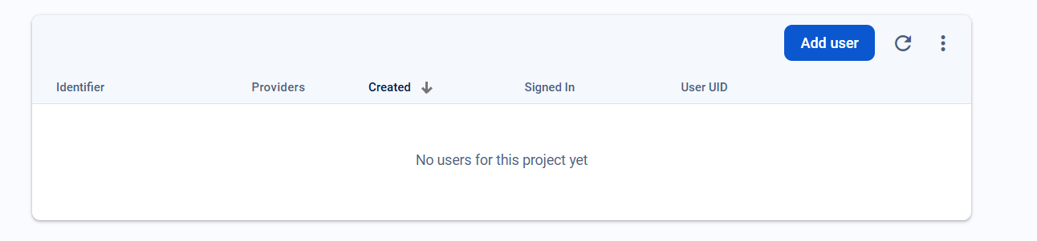
If you click Users, you will see there are none yet created
Let's create a React App to utilize the Firebase External Authentication
Firebase
Authentication

Slide 11
Start as usual
Install firebase
Install Router-dom (for ease)
Firebase
Authentication

Slide 12
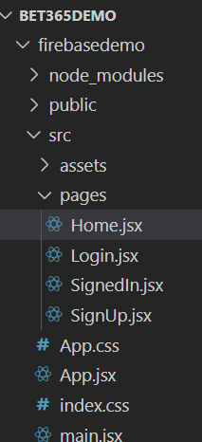
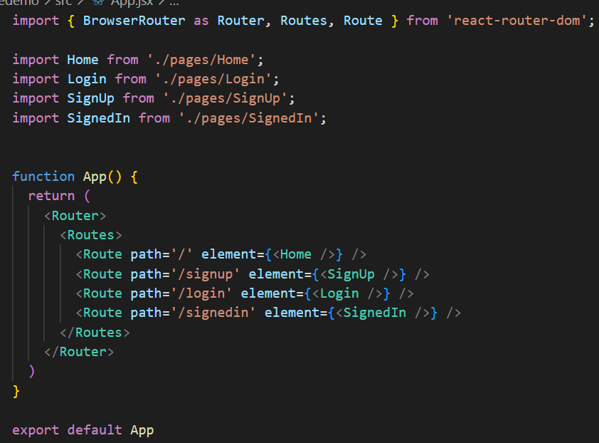
Create a structure
Firebase
Authentication

Slide 13
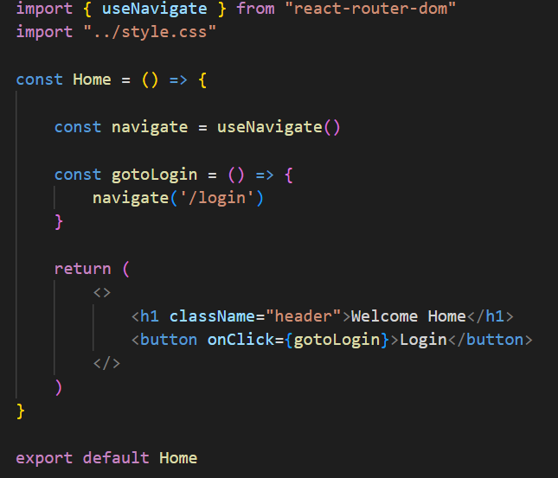
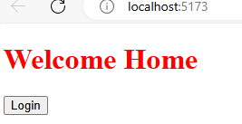
Build a landing page
Firebase
Authentication

Slide 14
Build a Sign up page
Firebase
Authentication

Slide 15
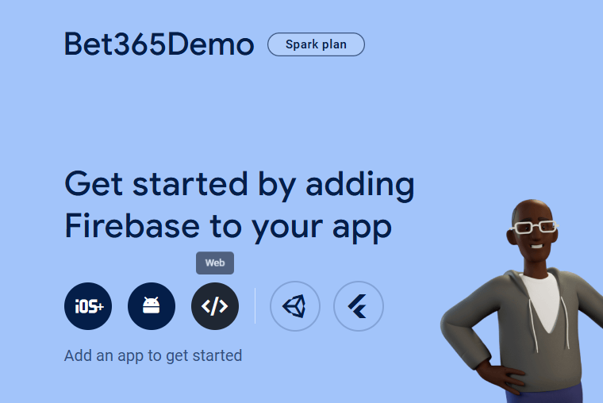
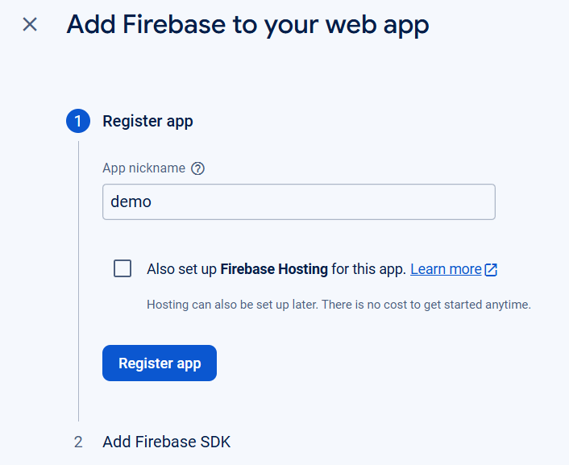
To start using the Firebase features, you need to create a new file called firebase.js and point it to your firebase project
The easiest way to do this is to create a new app in your project - web
Firebase
Authentication

Slide 16
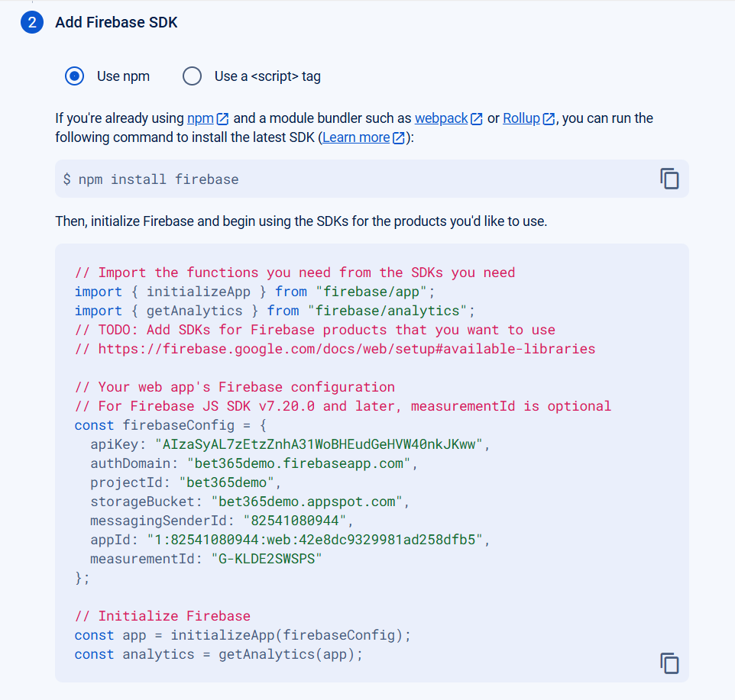
That provides the SDK which you can populate your firebase.js file
Firebase
Authentication

Slide 17
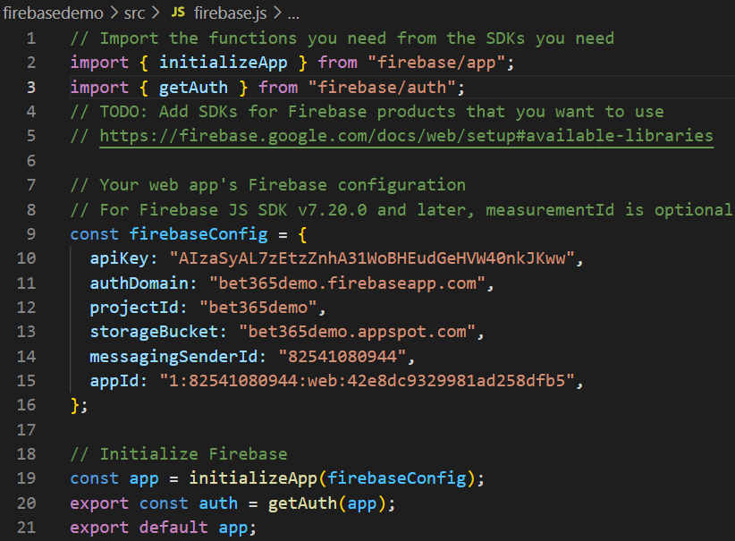
That provides the SDK which you can populate your firebase.js file
change
Firebase
Authentication

Slide 18
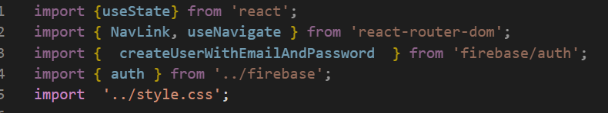
Create a signup script
Notice the creative function name for creating a user with an email and password
Firebase
Authentication

Slide 19
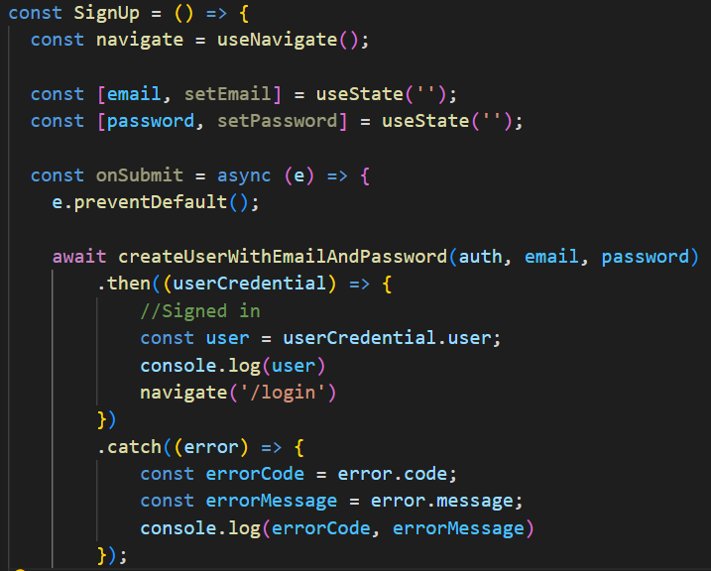
Pass the api key and supplied email and password to Firebase, catching any errors.
Firebase
Authentication

Slide 20
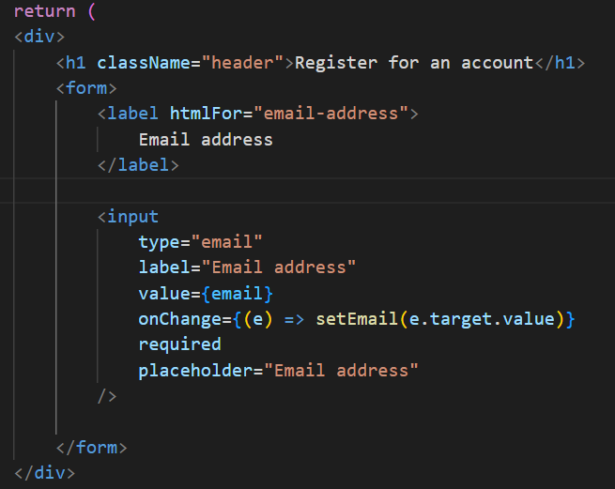
Build the JSX.
Catch the email
Firebase
Authentication

Slide 21
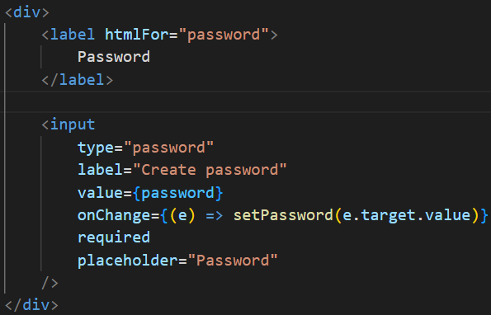
Build the JSX.
Catch the password
Firebase
Authentication

Slide 22
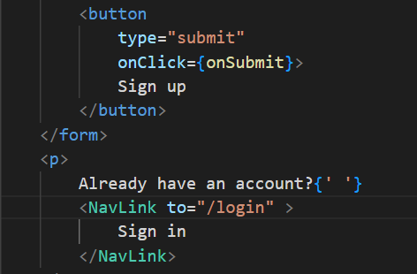
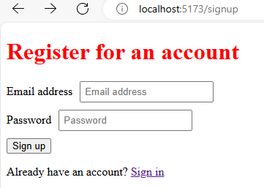
Build the JSX.
Submit button and link to login page
Firebase
Authentication

Slide 23
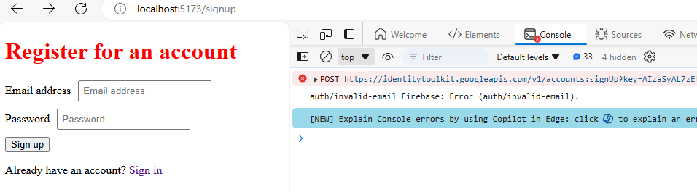
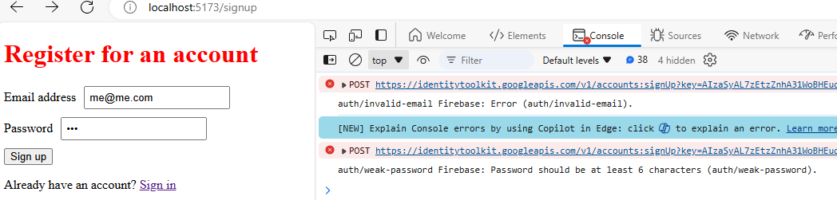
Quick Connection tests
Trying to sign up without email logs the error to the console
Weak passwords also kick up an error
Firebase
Authentication

Slide 24
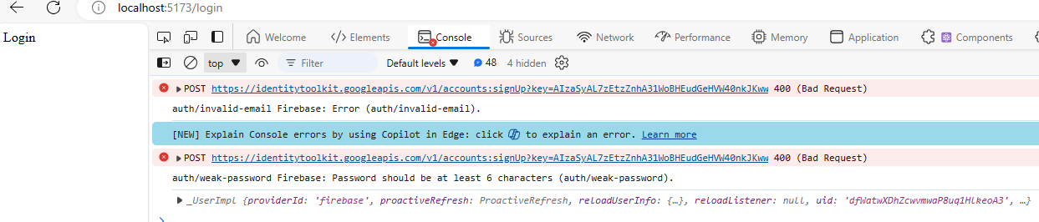
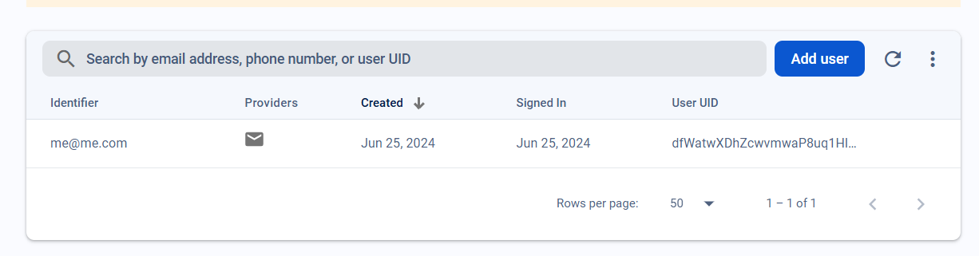
When successful, it redirects us to the login page
And our user is created in Firebase
Firebase
Authentication

Slide 25
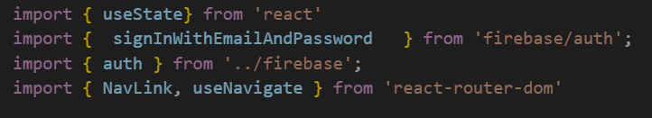
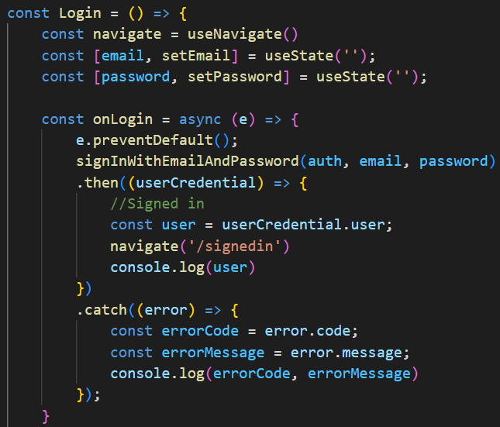
Login page – another great function name!
Firebase
Authentication

Slide 26
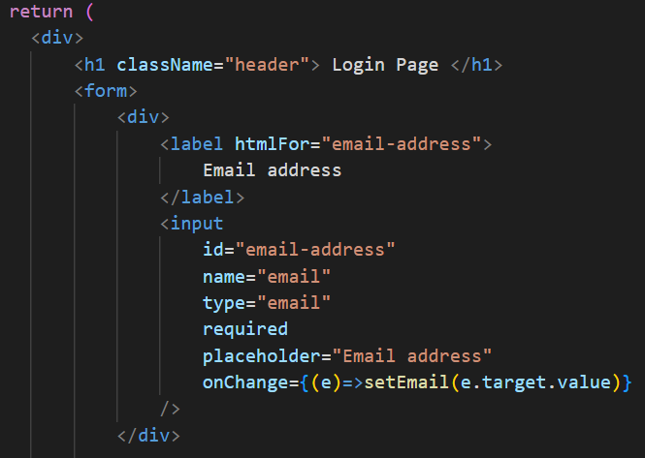
Build the JSX!
Firebase
Authentication

Slide 27
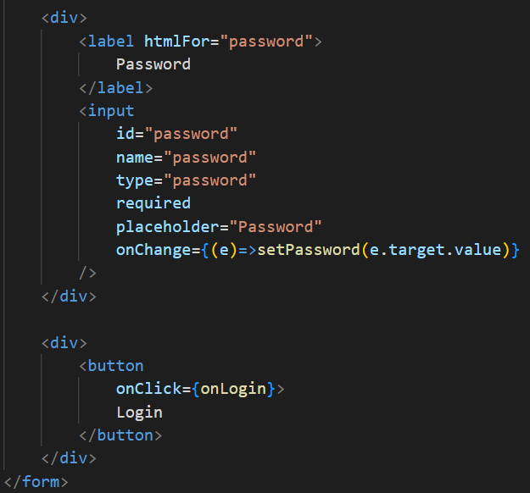
Build the JSX!
Firebase
Authentication

Slide 28
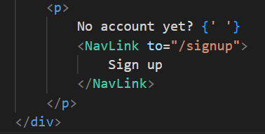
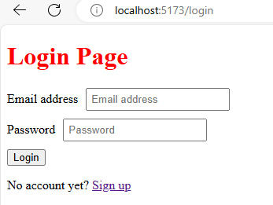
Build the JSX!
Firebase
Authentication

Slide 29
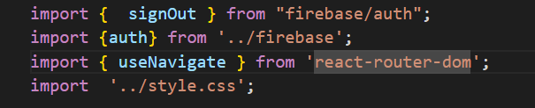
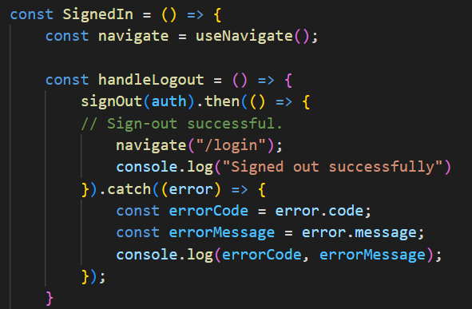
Log Out Functionality
Firebase
Authentication

Slide 30
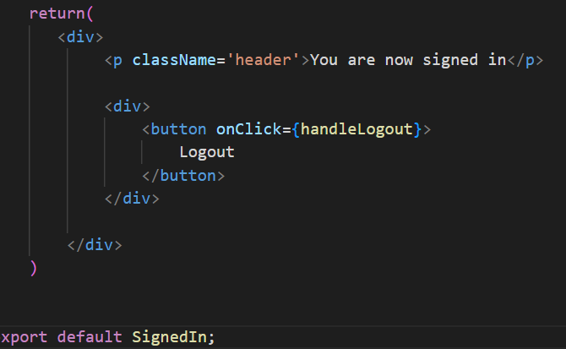
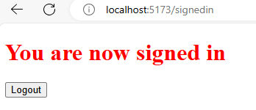
Log Out Functionality
Firebase
Authentication

Slide 31
Environmental Variables

Slide 32
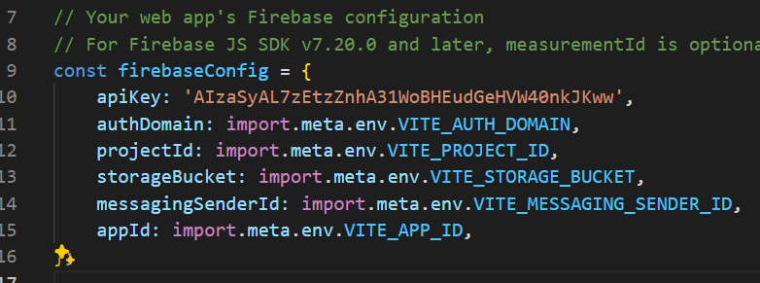
Environment variables in React are crucial for managing sensitive data and configuring your application for different environments, such as development, staging, and production.
They allow you to store data like API keys outside of your codebase, enhancing the security of your application.
Environmental Variables

Slide 33
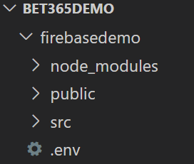
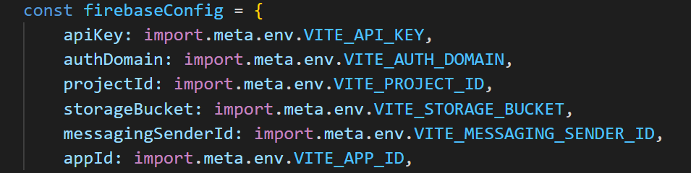
Creating a .env file
Define the name in the env file
Update your firebase.js file
Environmental Variables

