Slide 1
Introduction
Programming With TypeScript

Slide 2
Overview
Objectives
To explain the aims and objectives of the course
Contents
Course administration
Course objectives and assumptions
Introductions
Any questions?
Exercises
Locate the exercises
Locate the help files

Slide 3



Administration
Front door security
Name card
Chairs
Fire exits
Toilets
Coffee room
Timing
Breaks
Lunch
Downloads and viruses
Admin/support
Messages
Taxis
Trains/coaches
Hotels
First Aid
Telephones/Mobiles
Notes:
We need to deal with practical matters right at the beginning.
Above all, please ask if you have any problems regarding the course or practical arrangements. If we know early on that something is wrong, we have the chance to fix it. If you tell us after the course, it's too late! We ask you to fill in an evaluation form at the end of the course. If you alert us to a problem for the first time on the feedback form at the end of the course, we won’t have had the opportunity to put it right.
If this course is being held at your company's site, much of this will not apply or will be outside our control.

Slide 4
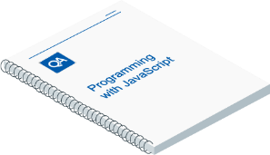
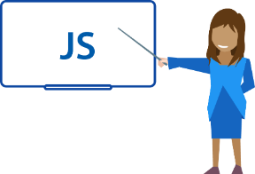


Course delivery
Lecture material
Course workbooks
Hear and Forget
See and Remember
Do and Understand
Notes:
The course will be made up of lecture material coupled with the course workbook, informal questions and exercises, and structured practical sessions. Together, these different teaching techniques will help you absorb and understand the material in the most effective way.
The course notebooks contain all the overhead foils that will be shown, so you do not need to copy them. In addition, there are extra textual comments (like these) below the foils, which are there to amplify the foils and provide further information. Hopefully, these notes mean you will not need to write too much and can listen and observe during the lectures. There is, however, space to make your own annotations too.
The appendices cover material that is beyond the scope of the course, together with some help and guidelines. There are also appendices on bibliography and Internet resources to help you find more information after the course.
In the practical exercise sessions, you will be given the opportunity to experiment and consolidate what has been taught during the lecture sessions. Please tell the instructor if you are having difficulty in these sessions. It is sometimes difficult to see that someone is struggling, so please be direct.

Slide 5

A training experience
A course should be:
A two-way process
A group process
An individual experience
Notes:
The best courses are not those where the instructor spends all of his/her time pontificating at the front of the class. Things get more interesting if there is dialogue, so please feel free to make comments or ask questions. At the same time, the instructor has to think of the whole group, so if you have many queries, you might be asked to deal with them off-line.
Work with other people during practical exercise sessions. The person next to you may have the answer, or you may know the remedy for them. Obviously do not simply 'copy from' or 'jump-in on' your neighbour, but group collaboration can help with the enjoyment of a course.
We are also individuals. We work at different paces and may have special interests in particular topics. The aim of the course is to provide a broad picture for all. Do not be dismayed if you do not appear to complete exercises as fast as the next person. The practical exercises are there to give plenty of practical opportunities; they do not have to be finished and you may even choose to focus for a long period on the topic that most interests you. Indeed, there will be parts labelled 'if time allows' that you may wish to save until later to give yourself time to read and absorb the course notes. If you have finished early, there is a great deal to investigate. Such “’hacking’ time is valuable. You may not get the opportunity to do it back in the office!

Slide 6
Course aims and objectives
By the end of the course, you’ll be able to:
Set up a scalable development environment for using TypeScript
Apply appropriate types to variables
Create and use classes, inheritance, access modifiers, abstracts and static
Create and use interfaces
Implement generics with functions, classes, constraints and interfaces
Use JavaScript modules within TypeScript development
Understand and use decorators

Slide 7
Assumptions
This course assumes the following prerequisites:
JavaScript experience equivalent to the skills covered in Web Development Fundamentals - JavaScript
If there are any issues, please tell your instructor now.
Notes:
If you are not sure of any of these, please inform the instructor as soon as you can and they will do their best to help you.

Slide 8
Introductions
Please say a few words about yourself.
What’s your name and job?
What’s your current experience of
Computing?
Programming?
Web development?
What’s your main objective for attending the course?
Notes:
One of the great benefits of courses is meeting other people. They may have similar interests, have encountered similar problems and may even have found the solution to yours. The contacts made on the course can be very useful.
It is useful for us all to be aware of levels of experience. It will help the instructor judge the level of depth to go into and the analogies to make to help you understand a topic. People in the group may have specialised experience that will be helpful to others.
It is worth highlighting particular interests, as we may be able to address them during the course. However, it is a general course that aims to cover a broad range of topics, so the instructor may have to deal with some areas during a coffee break or over lunch.

Slide 9
Any questions?
Golden Rule
"There is no such thing as a stupid question"
First amendment to the Golden Rule
"... even when asked by an instructor"
Result of the Golden Rule
"A question never resides in a single mind"
Notes:
Please feel free to ask questions.
Teaching is a much more enjoyable and productive process if it is interactive. You will no doubt think of questions during the course. If so, ask them!

Slide 10
Introduction
Programming With TypeScript

Slide 11
Objectives
To understand what TypeScript is and why you should use it
To identify the tools needed to have a scalable development environment
To be able to set up a scalable development environment

Slide 12
What is TypeScript?
A TYPED superset of the JavaScript language
Compiles to plain JavaScript
ECMAScript 3 by default or newer environments
Static type checking
Types are optional and inferred
Maintained by an open source community (keeps up to date with JavaScript developments)
TypeScript compiler implemented in TypeScript – can be used in any JavaScript host
Held on GitHub – specification
TypeScript is a trademark of Microsoft Corporation

Slide 13
Why use TypeScript?
Enable IDEs to provide a richer environment for spotting common errors
Compiler can catch errors during development rather than have things fail at run time
Use modern JavaScript in projects immediately while still providing the broadest browser support
Types are optional! Rename your .js files to .ts now and you’ll still get back valid .js
Migrating to TypeScript can be done gradually
Types help document your code for the next developer (maybe you!)
Used as an integral part of Angular development
Can also be used in React and other libraries and frameworks

Slide 14
TypeScript – THE ONLY LESSON!
TypeScript is a developer’s tool to help make more type-safe JavaScript applications
Valid JavaScript in TypeScript produces valid JavaScript when compiled
Compilation and IDE errors are only visible to the developer
Ignoring the compilation and IDE errors when valid JavaScript is produced is counter-productive!

Slide 15




The ToolSet – Node, NPM, TS and Webpack
Most projects are managed by npm via node.js.
The TypeScript compiler converts the .ts files to plain JavaScript
Webpack bundles the compiled JavaScript modules into a single, distributable file and can provide a live development environment via its development server
Notes:
Node.js is an open source command line tool for server side JS
The script is executed by the V8 Javascript engine
NPM manages decencies for an application via the command line

Slide 16
Installing TypeScript
Installing TypeScript is as simple as running an npm command
Compiling our TypeScript files can then be as simple as running the TypeScript compiler from the command line
This command takes our intro.ts file and compiles it to intro.js
npm install –g typescript
tsc intro.ts
//intro.ts
function hello(name) {
console.log(`Hello ${name}`);
}
hello(`World`);
//intro.js
function hello(name) {
console.log("Hello " + name);
}
hello("World");

Slide 17
QuickLab 1a – “Hello World” TypeScript
Write your first TypeScript Application
Install the typescript CLI
Write a Hello World application
Compile your .ts file to .js using the TypeScript compiler
Run the JavaScript using NodeJS

Slide 18
{
"compilerOptions": {
"target": "es6",
"module": "commonjs",
"strict": true,
"esModuleInterop": true,
"skipLibCheck": true,
"forceConsistentCasingInFileNames": true
},
"include": ["src/**/*"],
"exclude": ["node_modules"]
}
TypeScript Config
Config stored in tsconig.json
Generated with tsc --init
Allows configuration of the compiler and for the location of the files to include/exclude
Notes:
Including: Any files in the src folder and any files in project root
Excluding: Node_modules (dependency folder)
Compiler Options:
target: Which version of JS to compile to
module: whether to use require or import/export
strict: enables strict mode (enables Strict Bind Call Apply, strictBuiltinIteratorReturn, Strict Function Types, Strict Null Checks, Strict Property Initialization and Use Unknown In Catch Variables)
esModuleInterop: fixes problems that arise when converting between ES6 and CommonJS modules
skipLibCheck: Skips the type checking of declaration files
forceConsistentCasingInFileNames: Any references to files in the project must match the exact case of the file(s)

Slide 19
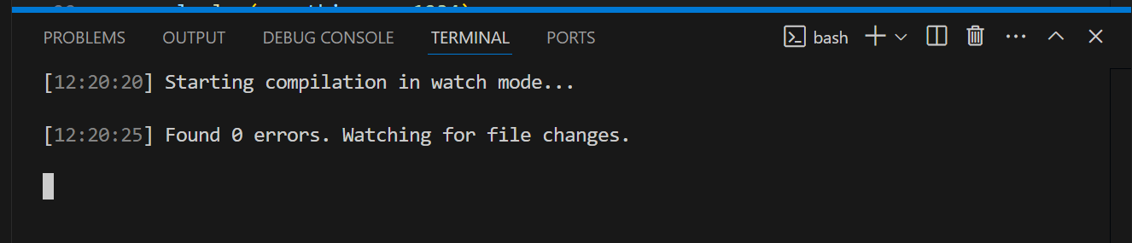
TypeScript Development
Can compile the .ts files as you develop
This saves you from having to run tsc every time you change a .js file
Once compiled it’s very simple to execute the compiled code with node
tsc --watch
node <filename>

Slide 20
Objectives
To understand what TypeScript is and why you should use it
To identify the tools needed to have a scalable development environment
To be able to set up a scalable development environment

