Slide 1





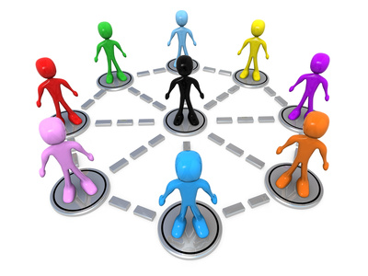




Sample tools
Gherkin
Java
Cucumber
Selenium
Pickles
Agile
BDD
Jenkins CI
SVN

Slide 2
0
Process
(BDD/TDD)
Draft tests
Finalise tests (parameterised step templates)
Start to Build Code
Automate tests
Continue to Build Code
Run tests
Examine test results
1
2
Tasks
Use plain English (structured);
Write for Component level; Page level; Journey level – will vary from project to project/application to application
Interprets & runs the feature files;
Drives the actions from the automated test tool
Watch passed tests on CI with a smile; check for failed tests
Test Engineer/BA
Dev
Test Specialist/ Dev
(once done, check with Test Engineer/BA as required)
Dev
CI Server
Test Engineer
People
Before the 3 Amigos meeting
During the 3 Amigos meeting
After 3 Amigos meeting
Starts after 3 Amigos meeting, tests written and code stable enough to execute on; but can’t finish until all code built
After tests automated
When code committed to CI server
When automated tests completed
When
3
Good agile practice
Well documented framework
Can set up test on the CI
Easier to maintain tests
Easier for business to understand
Difficult to introduce defects
No manual tests to maintain – straight to automation
Improved collaboration between dev & test
In Dev Testing (before check-in)
Faster feedback loop
Faster fix time
Find Challenging /Obscure Defects Early
Vast safety net
Increased Tester Focus
Benefits
0 – At start of project build the skeleton automation framework
1 - Depending on the project - either BA prepares the base stories or test engineer prepares the drafts based on stories; but good agile practice is to collaborate & talk to each other often (not as a separate task)
2 - 99% of time it's more practical to build code first, automate tests later - with an overlap; automate tests sometimes could start when build of code starts, sometimes later
3 - After 3 amigos, you can tag the tests with appropriate annotation, and have them executed on the CI in a separate job (for example "Work In progress), so from a progress perspective it is clear how much work is still to be completed in-sprint.
4 - Cucumber/Java,Twist, Cucumber/Ruby, Capybara, C# etc. are all options here, depending on technologies, skills, budgets, etc
Gherkin (a business readable DSL; few rules, keyword driven)
Cucumber (for Java) - parses & executes Gherkin commands
Selenium Webdriver (for Java) creates robust, browser-based automation,& can scale /distribute scripts across many environments
CI plug-ins
To present results Pickles (Parses the results of the successful tests)
Example Tools
4

Slide 3

Data Provision
Project Requirements
Data Requirements Identification
Data Transfer Request
Test Environment Design
Test Environment Request
Test Environment Provision
Deletion / Refresh
Extraction / Creation
Decommission
Commission
Support
Prove
Acceptance

Slide 4
