Slide 1
SDOH Challenge Scoring
December 2, 2021

Slide 2
Data
Gold standard annotations
Provided to participants in BRAT format (*.ann & *.txt files)
Predictions
Submitted by participants in BRAT format

Slide 3
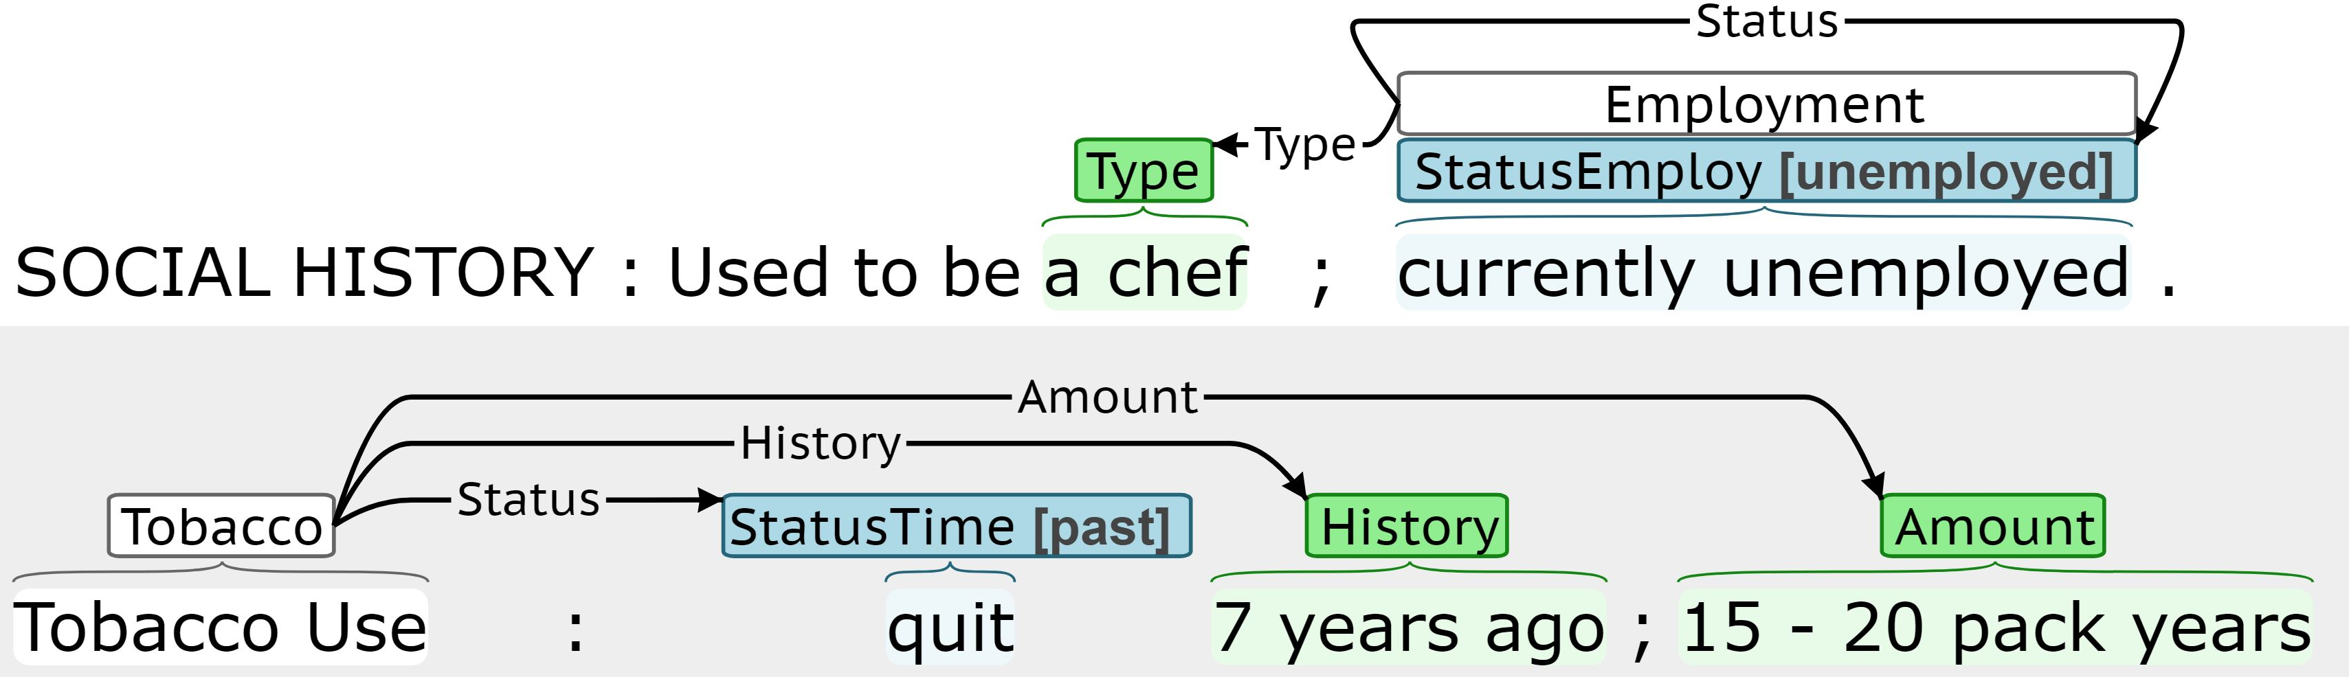
Event-based Annotation
Argument roles
Essentially binary connectors
Role name does not add any information
Characterize determinants across multiple dimensions
e.g. status, extent, and temporality
Trigger
Anchors and disambiguate events
Double (event type, span)
Span-with-value arguments
Triple (argument type, span, subtype)
Subtype normalizes span to fixed set of classes
Span-only arguments
Double (argument type, span)
Span not easily normalized

Slide 4
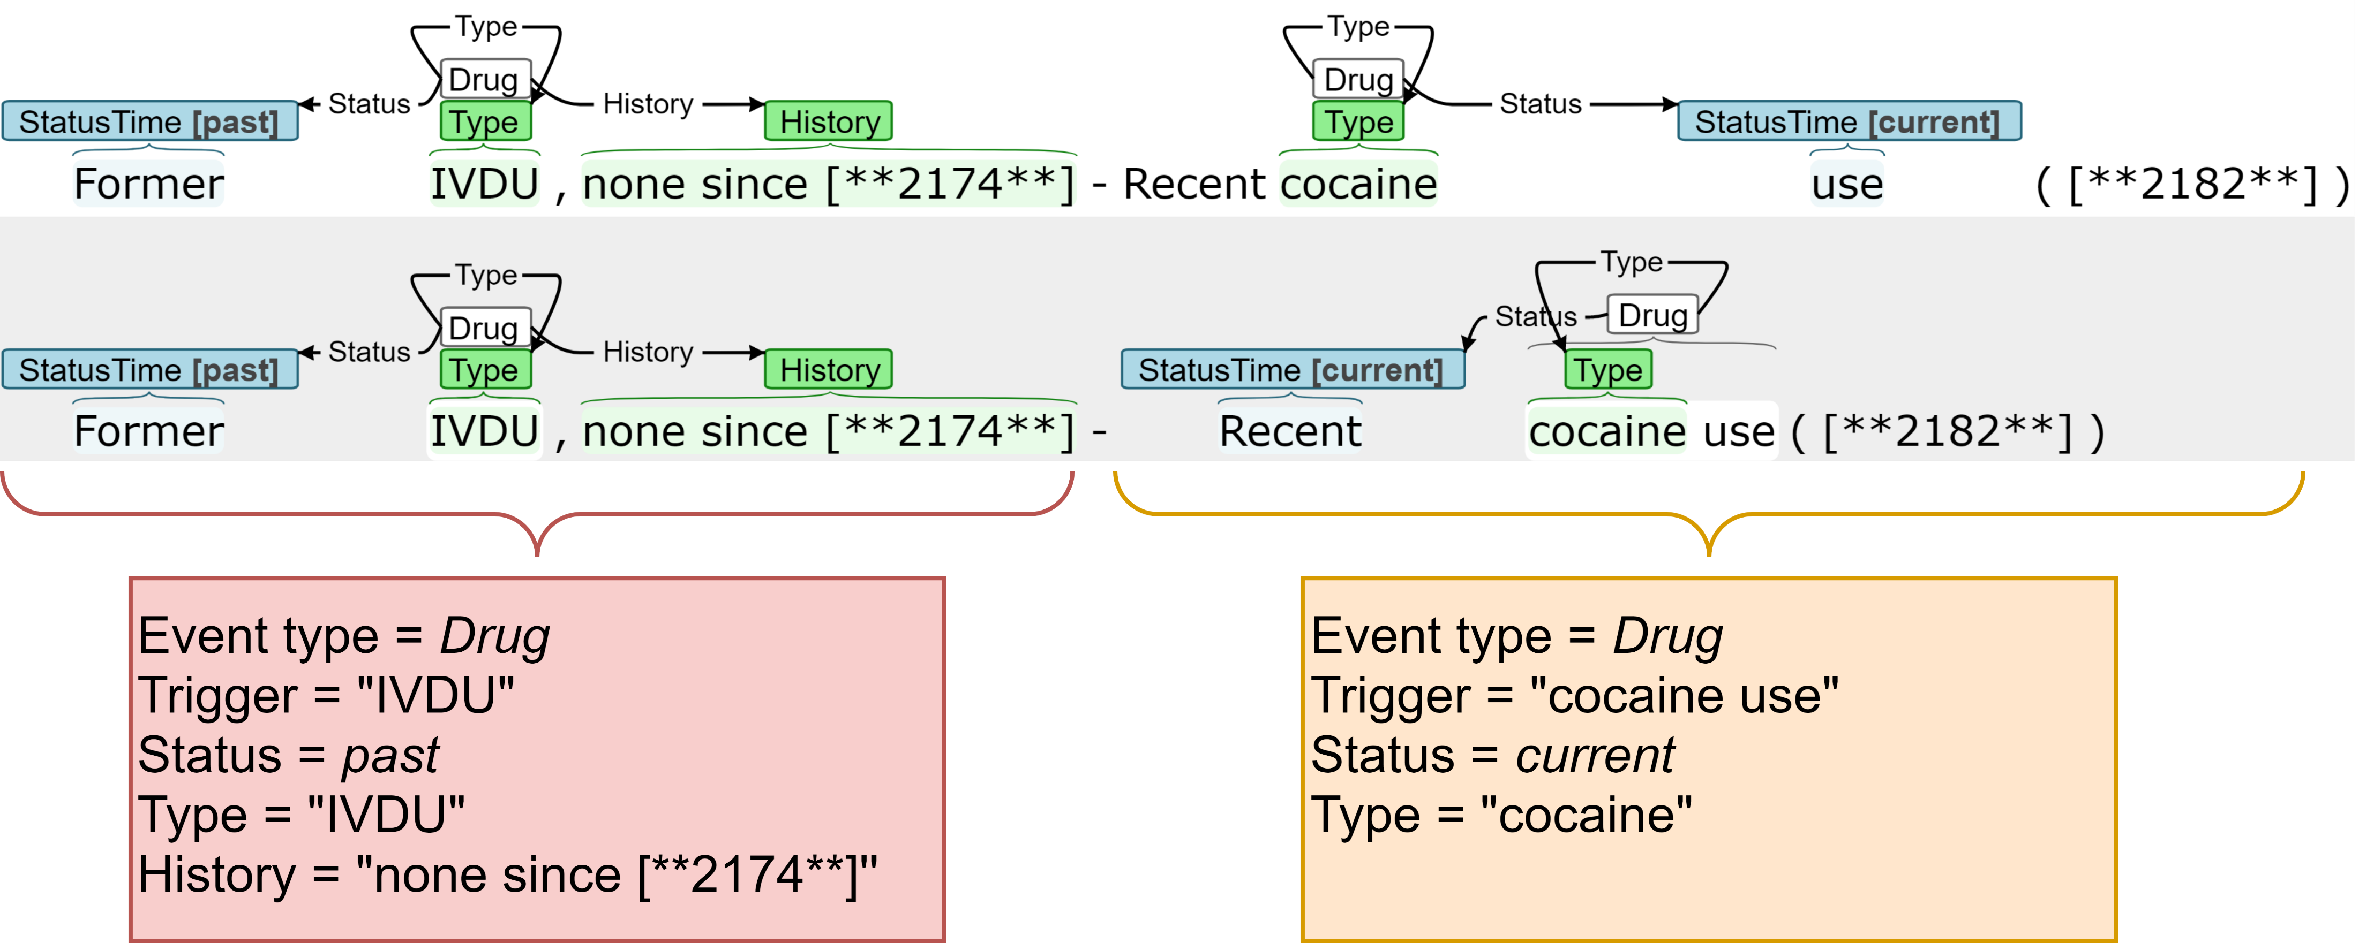
Extraction task as slot filling task
NOTE: Phrases in slot for example have associated characters indices

Slide 5
Evaluation
Focused on events performance, not individual entity extraction
Each events can be deconstructed into a set of trigger-argument pairs
All argument roles (links) are essentially binary connectors

Slide 6
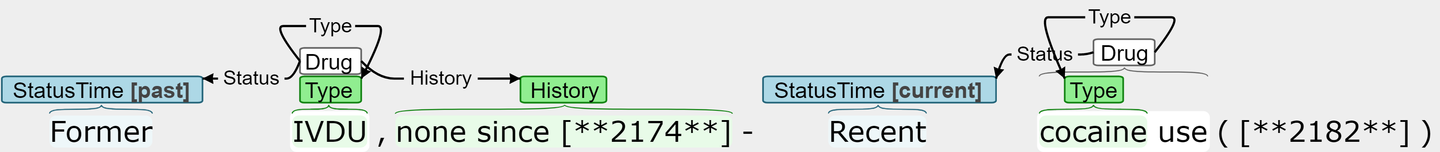
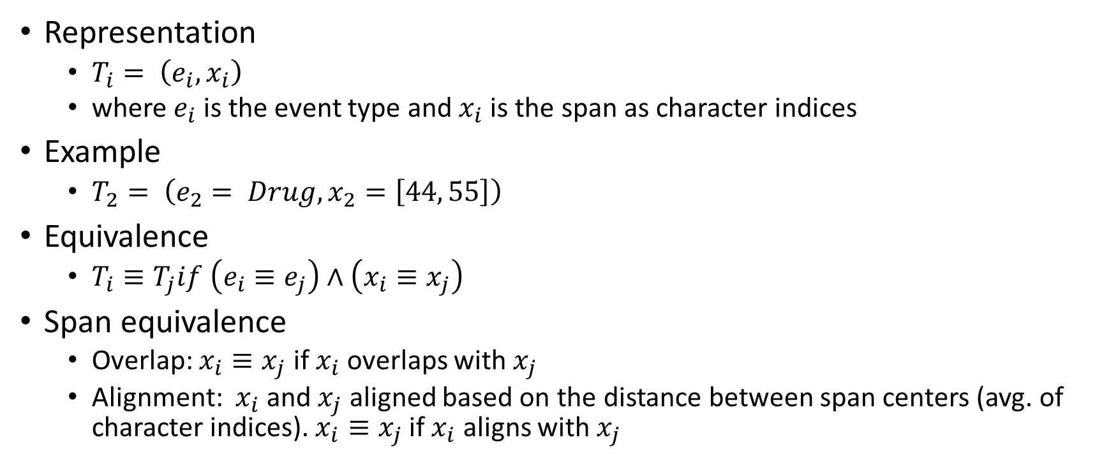
Triggers
Representation
$T_{i}= \left(e_{i}, x_{i}\right)$
where $e_{i}$ is the event type and $x_{i}$ is the span as character indices
Example
$T_{2}= \left(e_{2}= Drug, x_{2}=\left[44, 55\right]\right)$
Equivalence
$T_{i}≡T_{j}if \left(e_{i}≡e_{j}\right)∧\left(x_{i}≡x_{j}\right)$
Span equivalence
Overlap: $x_{i}≡x_{j}$ if $x_{i}$ overlaps with $x_{j}$
Alignment: $x_{i}$ and $x_{j}$ aligned based on the distance between span centers (avg. of character indices). $x_{i}≡x_{j}$ if $x_{i}$ aligns with $x_{j}$

Slide 7
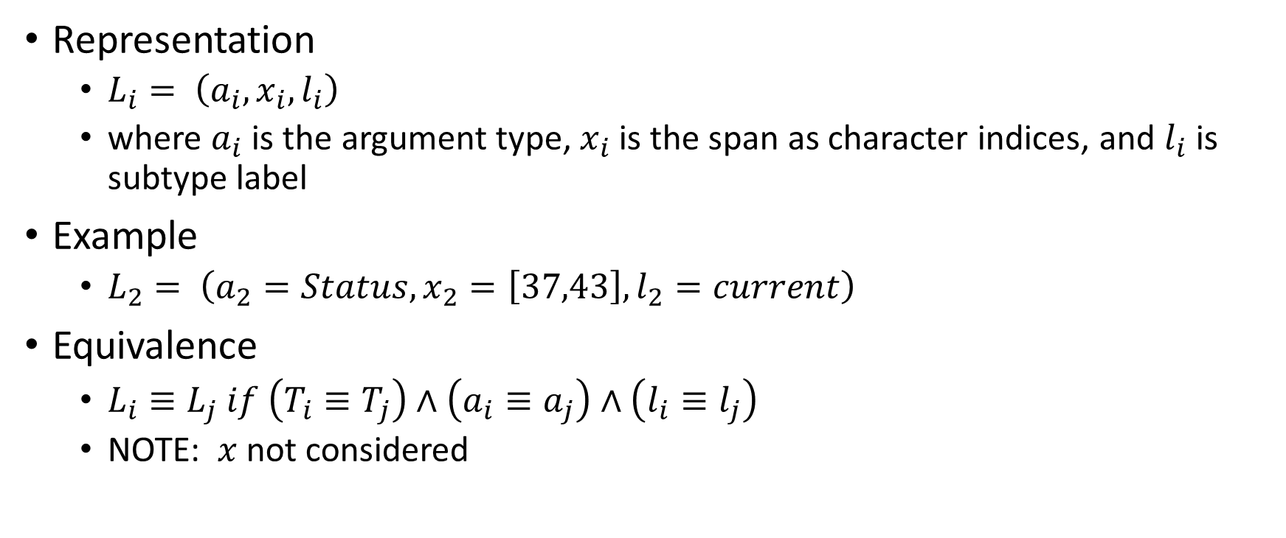
Span-with-value arguments
Representation
$L_{i}= \left(a_{i}, x_{i},l_{i}\right)$
where $a_{i}$ is the argument type, $x_{i}$ is the span as character indices, and $l_{i}$ is subtype label
Example
$L_{2}= \left(a_{2}=Status, x_{2}=\left[37,43\right],l_{2}=current\right)$
Equivalence
$L_{i}≡L_{j} if \left(T_{i}≡T_{j}\right)∧\left(a_{i}≡a_{j}\right)∧\left(l_{i}≡l_{j}\right)$
NOTE: $x$ not considered

Slide 8
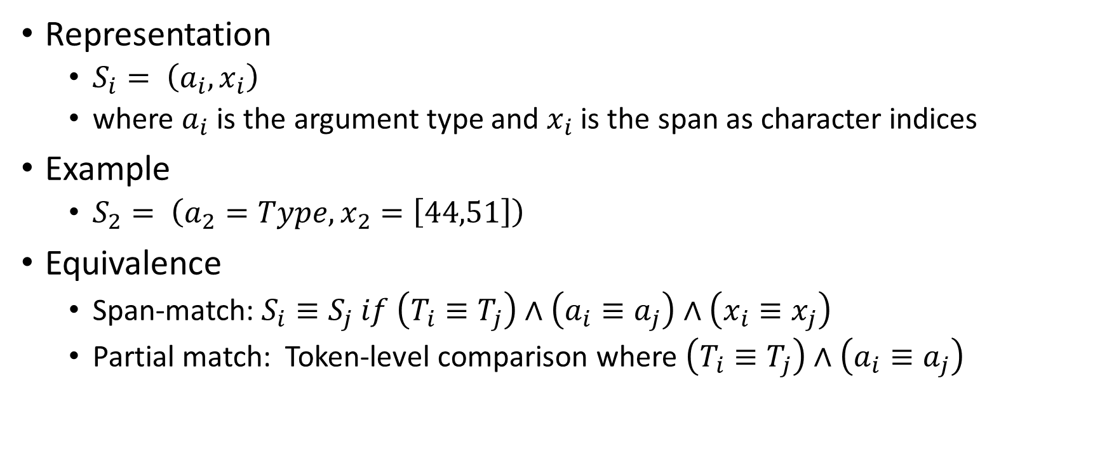
Span-only arguments
Representation
$S_{i}= \left(a_{i}, x_{i}\right)$
where $a_{i}$ is the argument type and $x_{i}$ is the span as character indices
Example
$S_{2}= \left(a_{2}=Type, x_{2}=\left[44,51\right]\right)$
Equivalence
Span-match: $S_{i}≡S_{j} if \left(T_{i}≡T_{j}\right)∧\left(a_{i}≡a_{j}\right)∧\left(x_{i}≡x_{j}\right)$
Partial match: Token-level comparison where $\left(T_{i}≡T_{j}\right)∧\left(a_{i}≡a_{j}\right)$

