Slide 1
Fuzzy C Means Clustering
DM / Sem 1, 2018

Slide 2
Introduction
developed by J.C. Dunn in 1973, and improved by J.C. Bezdek in 1981
FCM is a K-Means extension
fuzzy clustering algorithm – data points can belong to more then one clustering
in hard clustering data is divided into clusters, where each data point can only belong to exactly one cluster. In fuzzy clustering, data points can potentially belong to multiple clusters.

Slide 3
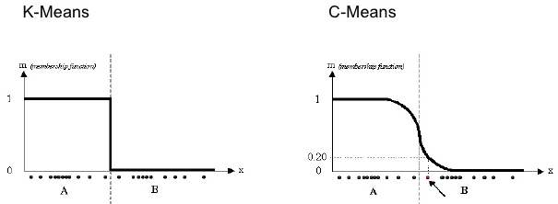
Introduction
Fuzzy C-Means vs K-Means
Membership function
K-means had clustering vs fuzzy clustering for 1 dimensional matrix

Slide 4
Description
FCM, similar to K-Means aims to partition a finite collection of n elements into a collection of c fuzzy clusters with respect of a given criterion
membership to a cluster → we assign membership grades to each data point
membership grades = the degree to which data points belong to each cluster → data points at the edge of the cluster may belong to a lesser degree

Slide 5
Steps
Choose the number of clusters
assign data points randomly to clusters
compute centroid for each cluster
for each data point compute coefficient of being in the clusters
repeat until change is less then ε (sensitivity threshold)

Slide 6
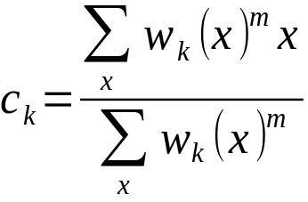
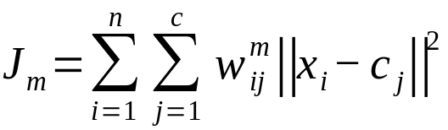
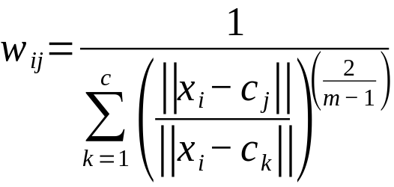

Some formulas ...
Centroid:
Objective function:
Degree of membership
m is the hyper-parameter for the clustering → determines how fuzzy the clustering will be
m high → fuzzyness high

Slide 7
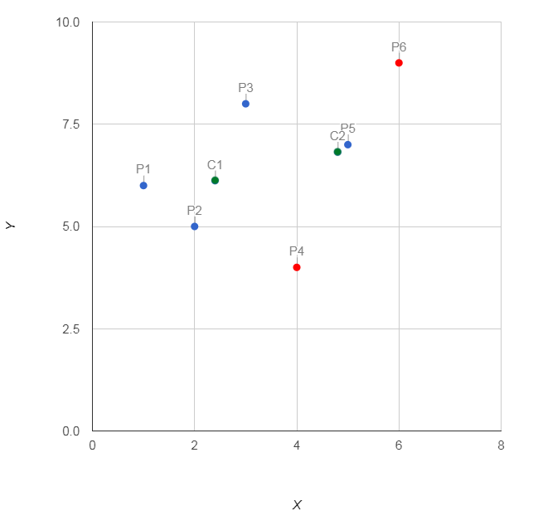
Show me the data..
n=6
c=2
m=2
Example:
X | Y | w1 | w2 | D1 | D2
1 | 6 | 0.8 | 0.2 | 1.40 | 3.88
2 | 5 | 0.9 | 0.1 | 1.17 | 3.32
3 | 8 | 0.7 | 0.3 | 1.99 | 2.16
4 | 4 | 0.3 | 0.7 | 2.64 | 2.91
5 | 7 | 0.5 | 0.5 | 2.75 | 0.28
6 | 9 | 0.2 | 0.8 | 4.62 | 2.50
C1 (2.4 , 6.1) C2 (4.8 , 6.8)
We begin by random seeding the coefficients C1,C2

