Slide 1

Machine Learning For Medical Science And Preventative Care
Andy Then

Slide 2

About Heart Disease
Heart is enclosed in three layers of tissue
- epicardium (outer layer)
- middle layer (myocardium)
Inner layer (endocardium)
Heart disease includes all disorders in every part of the heart
Notes:
Coronary disease accumulates plaque

Slide 3
Background
Heart disease remains the most fatal cause of mortality worldwide
Heart disease manifests from various risk factors
Modifiable Risks factors
Non-Modifiable
Medical Conditions
Lifestyle and Environmental
Rare or Indirect causes

Slide 4
Modifiable
In this category we observe treatable factors such as lifestyle and medications
Diet
Smoking
Exercise
Diabetes
Blood pressure
Cholesterol
Stress
Sleep

Slide 5
Non-modifiable
In this category we observe factors that cannot be treated
Genetics
Ethnicity
Age
Sex

Slide 6
Medical Conditions
Certain conditions can cause heart disease. The causes may be direct or indirect
Heart Arrhythmias
Heart Valve Disease
Heart Defects
Atherosclerosis
Autoimmune Disease

Slide 7
Lifestyle/Environmental
Habits that contribute to overall negative health. Also, location can be significant
Pollution
Lack of Movement
Mental Health
Socioeconomic Background

Slide 8
Others
Thyroid Disfunction
Hormonal Therapy
Genetic Disorders
Radiation Therapy
Genetic Disorders

Slide 9

Problem Statement
Which factors contribute the most to heart disease risk, and how can they be prioritized for preventive care strategies?

Slide 10
Dataset
Heart disease, can be found on Kaggle
Contains 13 predictors
Age
Sex
Chest Pain Type ( 4 values)
Resting Blood Pressure
Serum Cholesterol in mg/dl
Fasting Blood Sugar > 120 mg/dl
Resting Electrocardiographic Results (values 0,1,2)
Maximum Heart Rate Achieved
Exercise-Induced Angina
Old peak = ST Depression Induced by Exercise Relative to Rest of the Slope of The Peak Exercise ST Segment
Number of Major Vessels (0-3) Colored by Fluoroscopy
Thallium: 0 = normal; 1 = fixed defect; 2 = reversable defect
The Slope of The Peak Exercise ST Segment

Slide 11
Methodology
Naïve Bayes
XGBoost
KNN
Logistic Regression
SVM
Compare Accuracy of Model
Understand Why The Model Was Accurate

Slide 12
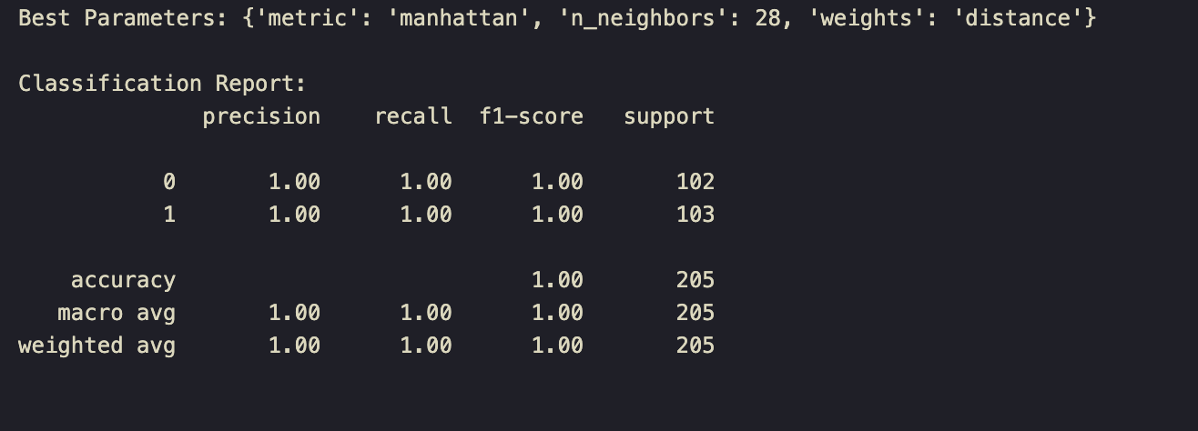
Results
Logistic Regression: 80%
Naïve Bayes: 81%
SVM : 89%
XGBoost: 99%
KNN: 100%

Slide 13
KNN Methodology
Split the data set into 80% training and 20% subsets
Feature Scaling
Visualization of Feature Importance
Learning Curve
Recommendations Map

Slide 14
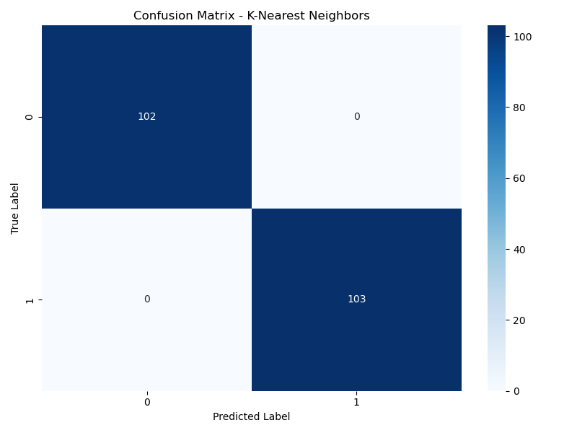
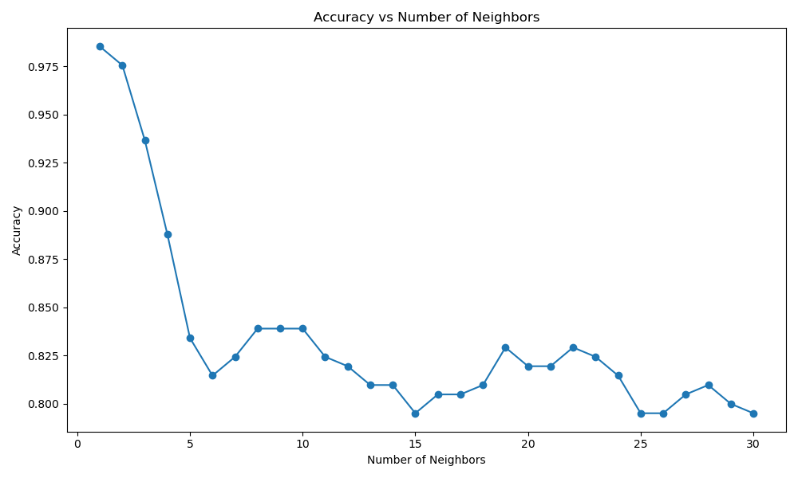
Learning Curve

Slide 15
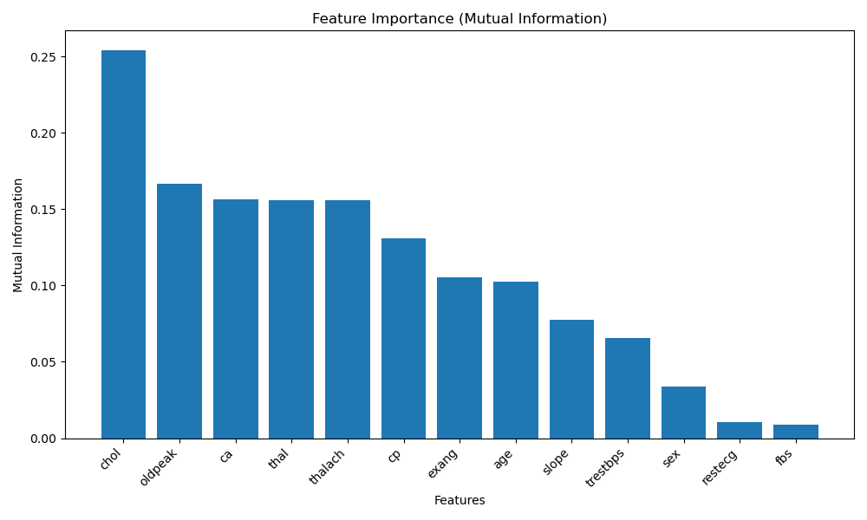
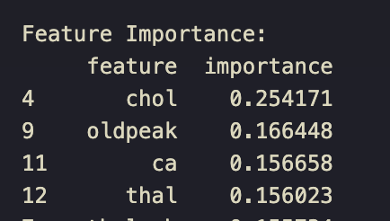
Preventative Care Recommendations (Features)
Cholesterol
Exercise-Induced Stress
Cardiovascular Assessment
Thalassemia – Blood Oxygen in Circulation

Slide 16

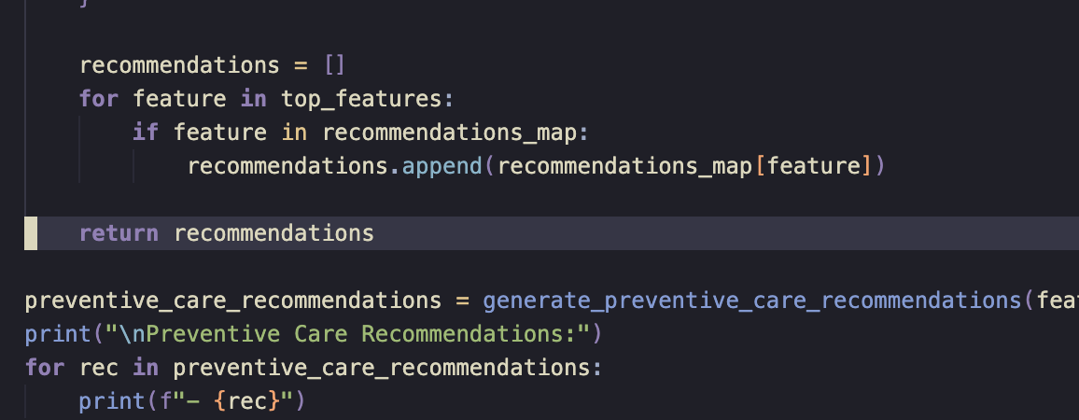
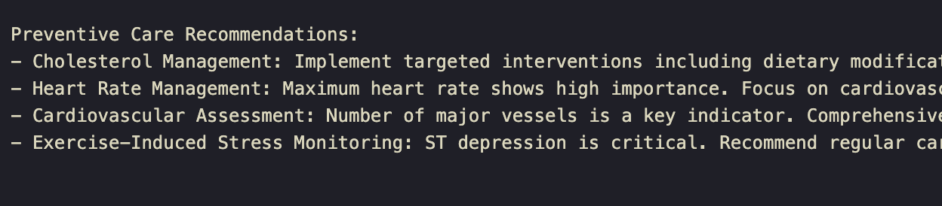
Recommendations Map
-Based On the Most Significant Features

Slide 17

Possible Configurations
Data Quality
Feature Selection
Model Selection
Choice of k

Slide 18
References
[1] A. Barragán-Montero, U. Javaid, G. Valdés, D. Nguyen, P. Desbordes, B. Macq, S. Willems, L. Vandewinckele, M. Holmström, F. Löfman, S. Michiels, K. Souris, E. Sterpin, and J. A. Lee, "Artificial intelligence and machine learning for medical imaging: A technology review," Physica Medica: PM, vol. 83, pp. 242–256, 2021, doi: 10.1016/j.ejmp.2021.04.016.
[2] M. I. Hossain, M. H. Maruf, M. A. R. Khan, F. S. Prity, S. Fatema, M. S. Ejaz, and M. A. S. Khan, "Heart disease prediction using distinct artificial intelligence techniques: Performance analysis and comparison," Iran Journal of Computer Science, pp. 1–21, 2023, Advance online publication, doi: 10.1007/s42044-023-00148-7.
[3] M. Hajiarbabi, "Assistant Professor, Computer Science Department, Purdue University, Fort Wayne," JMAI, doi: 10.21037/jmai-23-152, published online: June 26, 2024. [Online]. Available: https://dx.doi.org/10.21037/jmai-23-152.
[4] K. Bakshi et al., "Advancements in heart disease diagnosis: Harnessing predictive modeling techniques for cardiovascular health management," Advances in Public Health, vol. 2024, pp. 1–11, Sep. 2024, doi: 10.1155/2024/5300908.

