Slide 1

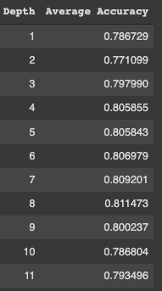
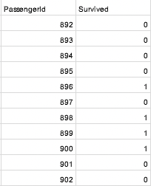
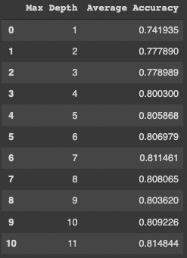
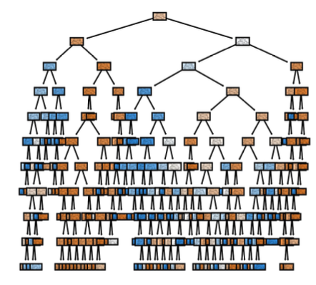
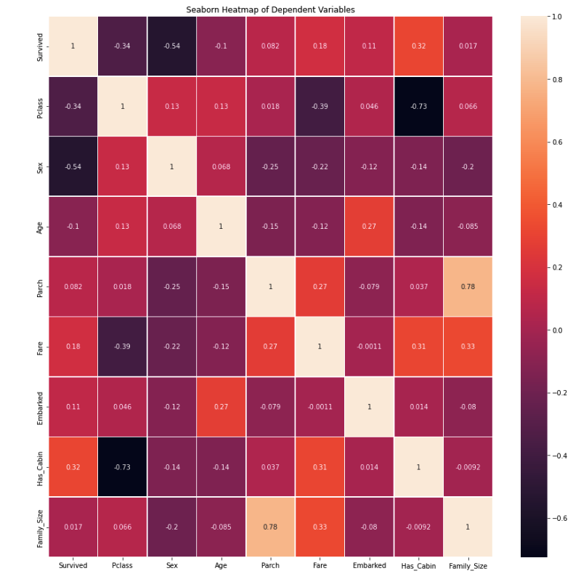
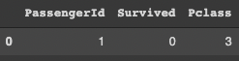
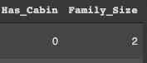
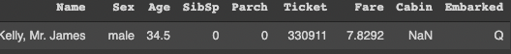
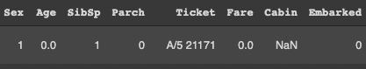
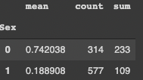
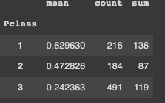
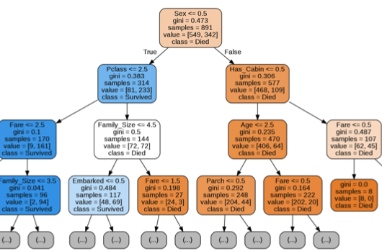
Computer Science Department
Final Project: Titanic Dataset
Course: Introduction to AI (CS156)
Course Instructor: Yulia Newton, Ph.D.
Andy Luong
Introduction/Background
Methodology
Analysis and Results
Test (also training) results are outputted to a csv of just columns Passengerid and Survived. Cross-validation is also the same (7) and Random Forest Classifier generates the maximum depth of a tree. Tree correlates to Gini Impurity or finding the max depth that works best for the tree via cross-validation.
The problem is the Titanic was a historical ship that sank with most of its passengers not surviving. The prediction problem is to build a predictive model that answers the question “what sorts of people were more likely to survive the Titanic sinking?” It is interesting because it will help practice applying my skills to real world problems, familiarize myself with the Kaggle platform, and launch my Kaggle journey.
It is important to solve because it will help predict and give feedback on what factors are more important than others when considering health and safety precautions. There have been other previous solutions like custom pipeline, logistic regression, SVM, Random Forest, SVC, and more. Other individuals attempt to arrive at a solution for this problem because this dataset is from a machine learning competition.
By applying to my own, it will help Improve my score by learning more about the data, experiment, and learn from other’s code and ideas. I agree mostly with the approach since there are multiple ways to design/create some new features, try different preprocessing, try different types of ML models, and combine multiple models (ensemble).
Algorithm
I am using supervised machine learning because there is a target/outcome/dependent variable. This will be produced from the set of predictors/independent variables. The set of variables will generate a function that is able to map the inputs to the desired outputs. The process will keep training until the model gets the ideal level o accuracy form the training data. I will be using the Decision Tree and Random Forest. Decision Tree will split the sample into multiple sets based on the input, showing all possible outcomes. Random Forest will take multiple decision trees and decide which works with the output.
Validation/cross-validation results
Cross validation will help prevent over-
Fitting and find the best max tree depth. It
finds the depth with the best accuracy by
splitting training data into folds. From this
case, depth 7 shows to be most accurate.
Training results
The Seaborn Heatmap showed that one is more likely to survive by being female, 1st class, and having a cabin with the rest being more minor. Over-fitting can occur and some features do not have a direct relationships.
Summary/Conclusions
My model did well with my Decision Tree reaching 87% & Random Forest with 89% accuracy. I could improve it by increasing the folds, make more columns, and only accepting binary for all columns. But, interpretation is up to the individual as one can easily (not) survive events like the Titanic regardless of variables.
This project determine what factors can help one survive the Titanic. With more time, I would like to factor in names like Mr., Duke, & Miss as they are both similar and different to gender, and exploring with other algorithms.
Figures From
Left To Right
Dataset description
Figure 1: Train DF Has Survived Column
Figure 2: Add Columns IF Cabin & # of Family
Figure 3: Test DF Has Higher ID, No Survived
Figure 4: Convert Sex, Age, Fare, & Embarked To Binary Categorical
Figure 5: Females Have Higher Survival Rate
Figure 6: 1st Class Has Higher Survival Rate
The Titanic dataset consists of the training set and test set. The training set will provide the result truth for each passenger including the features. The test set compares how well the model performs when the data is not yet known. Since test doesn’t have the outcome, the model being trained will help predict if the passengers are likely to survive or not survive the Titanic sinking. Source: https://www.kaggle.com/competitions/titanic/data?select=train.csv Was able to download this dataset. The process is accept the rules and join the competition, download the data (from the data tab of the competition page), understand the problem, EDA ( Exploratory Data Analysis), train, tune and ensemble machine learning models, and upload my prediction as a submission on Kaggle and receive an accuracy score. Survival is simply 0 for no and 1 for yes. It can be binary categorical.
The dependent variable is whether or not the person could survive. It is the variable in my solution model that I will be predicting. The dependent variable will convert from categorical to numerical mapped mostly to 0 or 1 but more depending on size of data.
Since there is no validation dataset, I will be using a cross-validation approach. I will stratify my split because there is a gender column and the sample results given are only for females. The hyperparameters/not being used will be passenger ID and name because they are just used for identification and doesn’t affect the survival rates. Pandas, sklearn, training test split, crossing val score, seaboard, and confusion matrix will be used throughout the code.
[1] Kaggle, “Titanic - Machine Learning from Disaster” 2022.
Sites Mentioned In TermProjectSubmission.ipynb, TermProjectSubmission.pdf
Key References
Application to the project
IF/ELSE All values, map values, plt & sis, fill in null values, graphviz, check call & Image, and Google Colab Input/Output are the techniques I researched to implement the data & algorithm. In order of code, I load the data where test does not know survival that train has. Has_Cabin is 1 if cabin has a name & Family_Size are a combination of SibSp and Parch. Next, variables sex, Embarked, fare, and age are mapped with fare and age using min, quantiles, median, and max. Id, name, ticket, cabin, and SibSp are then riddance variables to be removed, and null values are replaces with estimates or default values (Emarked = ’S’. Fare & age = median). Loc is used in place of while loops and groupby.agg() is used to find mean, count, and sum of each column. Graphviz is used to export dot into a png Image to display Tree Set. Tree has built in score to find accuracy, as well as using 10 folds across the 12 total depths the tree has. In this dataset, training and test results can mostly be used interchangeably.
Test results
The Decision Tree predicted from that the majority of people won’t survive in the test file. But those that do would fall in the scenario of female, better class, bought a more expensive ticket, & less family.
Acknowledgements
Assignment 8 (flowers), Assignment 6 (digits), Assignment 5 (airline), and Assignment 4 (RNA) helped with knowledge on plotting categorical/numerical data, dropping columns, and using csv files. Classmates and Professor Newton helped me understand machine learning, and its need and use in the real world.

