Slide 1
An OncomiR Regulatory Network Based on OncomiR and Target Genes Expression Modules
Notes:
基于Oncomir和靶基因表达模块的oncomir调控网络

Slide 2
overview
Given the expression signals of
candidate oncomiRs and their respective target genes
in cancer tissues and the adjacent normal tissues
get the significant oncomiRs and their corresponding regulatory networks
directly from the expression profile
Notes:
概括：
给定候选的Mir及它们各自的靶基因在癌症组织和相邻正常组织中的表达信号
从数据出发，直接从表达谱中获得significant的oncomir以及它们对应的调控网络

Slide 3
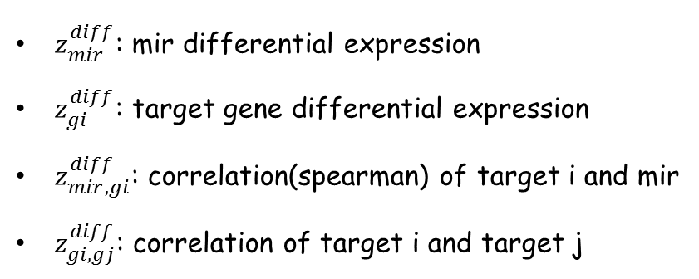
model
network model:
miR
local factors: differential expression ; correlation
$z_{mir}^{diff}$: mir differential expression
$z_{gi}^{diff}$: target gene differential expression
$z_{mir,gi}^{diff}$: correlation(spearman) of target i and mir
$z_{gi,gj}^{diff}$: correlation of target i and target j
target genes
Notes:
首先是网络模型，我们可以从表达谱中至少获得两类信息，一是在癌症和正常中表达量的差异，另一个就是表达量的相关性
包括：
Microrna的差异表达信息
Target gene的差异表达信息
Microrna和target gene 的差异共表达信息
Target gene的差异共表达信息
直观上看，差异越大可能越是起作用，一个调控网络内部的相关性越强
模型中希望能够合理的整合这四方面的信息

Slide 4
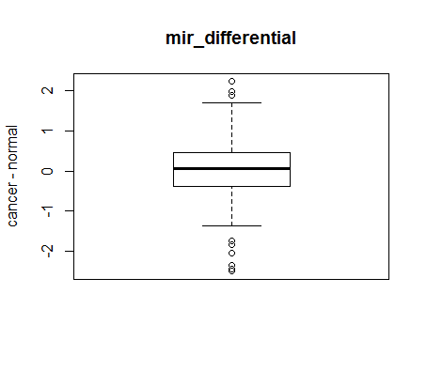
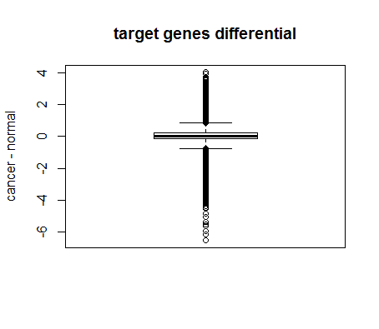
n: 182
median: 0.07
lower quartile: - 0.39
upper quartile: 0.45
min: -2.51
max: 2.23
n: 22130
median: 0.004
lower quartile: - 0.156
upper quartile: 0.246
min: -6.543
max: 4.019
Samples: 96 TU with their corresponding AN
Notes:
数据分析：
mir / target genes differential expression
mir 分布均匀？两者变化范围不同？
中位数都在0附近？（一半表达量增加，一半减少？）

Slide 5
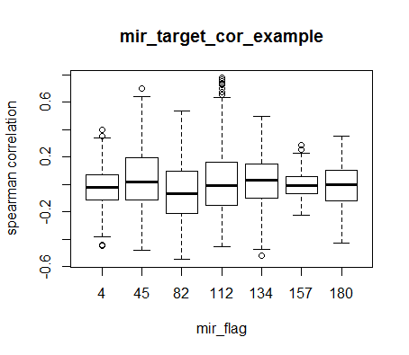
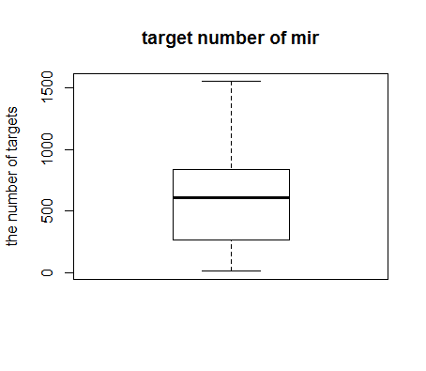
n: 182
median: 605.5
lower quartile: 268
upper quartile: 835
min: 9
max: 1553
Spearman’s rank correlation : [-1,1]
Notes:
Spearman correlation: [-1, 1] perfect 单调关系
不同信息的尺度不同，统一转换成符合正态分布的zscore
不同mir的靶基因数目差异较大

Slide 6
model
MRF and Gibbs distribution
miR
1. search a sub-network to maximize a network score
2. the mir with a significant score will be selected and
its corresponding sub-network will be regarded as a
regulatory network
target genes
Notes:
用MRF的理论整合四个local factors的信息
根据MRF和Gibbs分布，某个configuration的概率相对大小可以由网络中所有clique factors的和反映
忽略三阶以上的clique，并把上面四种信息分别作为一阶 二阶clique则得到下面的表达式
系数是由fisher’s method 整合得来的 Stouffer's Z-score method

Slide 7
flow diagram
input
input: mir_signal target_signal
data preprocess
for every mir i
compare with experimental results
statistical significance
no
yes
search the best sub-network[i]
output
the best
sub-networks
output: mirs and corresponding
perturbed regulatory networks

Slide 8

flow diagram for greedy searching
input
for every net[i]
i <= 5
no
yes
$z_{mir}^{diff} z_{gi}^{diff} z_{mir,gi}^{diff} z_{gi,gj}^{diff}$ absolute value
current_size = 1
i++
current_size < 20
output
select the best 5 target genes as 5 initial candidate network
no
yes
from all left genes, select one which will make the improvement greatest
current_size ++
select the best as the final network
Notes:
1. 对于micrna_zscore > 0 表达量增加 or 减小 + target_gene 增加or 减小 （取绝对值 表示差异较大？）+ spearman 相关性强 + spearman 相关性强 （取绝对值）
2. current_size = 20? 固定网络大小 or 不断增加直到改善不大(选出的五个子网的大小不均等，不同microrna网络大小不均等 没有可比性？) 如何确定合适的网络大小？尺度？
3. 对于网络大小<20的microrna忽略不计

Slide 9
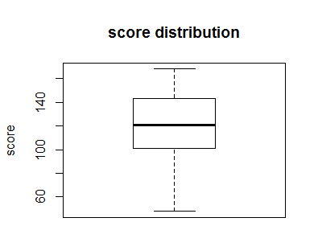
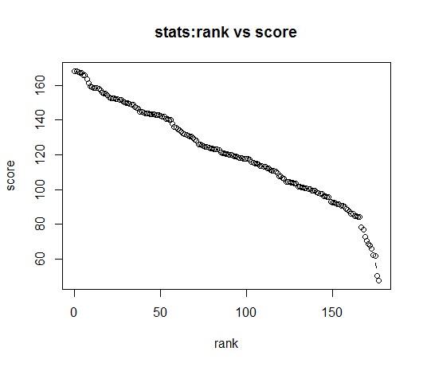
mirs’ rank with their scores
n: 178
median: 120.45
lower quartile: 101.07
upper quartile: 143.37
min: 47.72
max: 168.13
Notes:
表：178个Mir 网络大小为20（靶基因数目小于20的mir不考虑） 其网络得分按从大到小排列及其分布情况
从中可以看到排名靠前和靠后的Mir的score差异比较大

Slide 10
model_predict | family | no.targets
mir-106b | miR-17/17-5p/20ab/20b-5p/93/106ab… | 1061
mir-25 | miR-25/32/92abc/363/363-3p/367 | 835
mir-145 | miR-145 | 670
mir-101 | miR-101/101ab | 732
mir-32 | miR-25/32/92abc/363/363-3p/367 | 835
mir-202 | miR-202-3p | 756
mir-17-5p | miR-17/17-5p/20ab/20b-5p/93/106ab/… | 1061
mir-98 | let-7/98/4458/4500 | 1027
mir-181c | miR-181abcd/4262 | 976
mir-20a | miR-17/17-5p/20ab/20b-5p/93/106ab/… | 1061
mir-367 | miR-25/32/92abc/363/363-3p/367 | 835
mir-218 | miR-218/218a | 825
mir-27a | miR-27abc/27a-3p | 1084
mir-125b | miR-125a-5p/125b-5p/351/670/4319 | 1553
the first
13 mir-networks
Notes:
排名在前13个的mir及其对应的家族和靶基因数目
其中有5个靶基因已经被分子生物学实验验证过
排名靠前的Mir的靶基因数目都很多
一些mir_family家族中的成员出现的排名都比较靠前

Slide 11
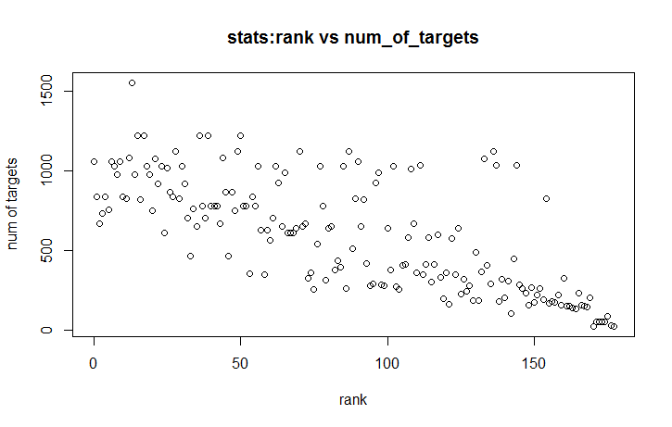
mirs with
different number of targets
Spearman’s rank correlation:
-0.749
p-value < 2.2e-16
mir_predict | rank | no.targets
mir-99a | 171 | 55
mir-191 | 172 | 53
mir-100 | 173 | 55
mir-210 | 176 | 32
Notes:
前面已经提到，每个mirs的靶基因数目差别很大
图： mir的排名与其靶基因数目的关系，从图中可以看到有比较明显的单调下降关系
spearman相关性为-0.749
表：列出排名很靠后的一些Mir，可以看到其靶基因数目很少，但这些mir都被实验验证过在肝癌中起作用

Slide 12
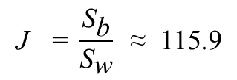
mirs from
the same mir_family
with the same targets
mir_family | rank
miR-25/32/92abc/363/363-3p/367 | 1 4 10 27 54
miR-17/17-5p/20ab/20b-5p/93/106ab/427/518a-3p/519d | 0 6 9 90
miR-34ac/34bc-5p/449abc/449c-5p | 69 80 100 124
miR-130ac/301ab/301b/301b-3p/454/721/4295/3666 | 26 45 47
miR-148ab-3p/152 | 43 72 109
miR-200bc/429/548a | 29 89 154
miR-15abc/16/16abc/195/322/424/497 | 15 17 36 39 50
let-7/98/4458/4500 | 7 18 23 30 56 62 77 85 102
miR-30abcdef/30abe-5p/384-5p | 28 49 70 87 136
miR-29abcd | 111 137 144
miR-181abcd/4262 | 8 14 19
miR-99ab/100 | 171 173 174
miR-93/93a/105/106a/291a-… | 37 40 41 42 51 52 55 78
$$\text{J} \text{=} \frac{{\text{S}}_{\text{b}}}{{\text{S}}_{\text{w}}} \text{≈} \text{115.9}$$
Notes:
所有包含两个以上mir的mir_family中成员的rank
Jensen熵：组间差异/组内差异

Slide 13
deficiencies and continuous improvement
the number of targets of one mir can effect the final result
greedy search cannot ensure the global optimal result
how to integrate the four factors more reasonable ?
is there a reasonable criteria ?

