Slide 1
Reconstrucing Dynamic MicroRNA-regulated Interaction Networks
Dongfang Wang
2013-09-12

Slide 2
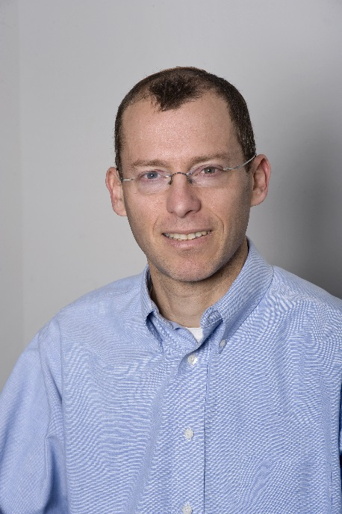

Ziv Bar-Joseph
associate professor at the Machine Learning Department and the Lane Center for Computational Biology which are part of the School of Computer Science at Carnegie Mellon University
develops computational methods for understanding the interactions, dynamics and conservation of complex biological systems
http://www.cs.cmu.edu/~zivbj/

Slide 3
Introduction
The regulation of gene expression by microRNAs is a dynamic process
Shifts in miRNA and mRNA profiles in a specific developmental stage can happen
in a sequential manner
Use dynamic activity information and time series expression data to address the
temporal dynamics of miRNA-regulated networks

Slide 4
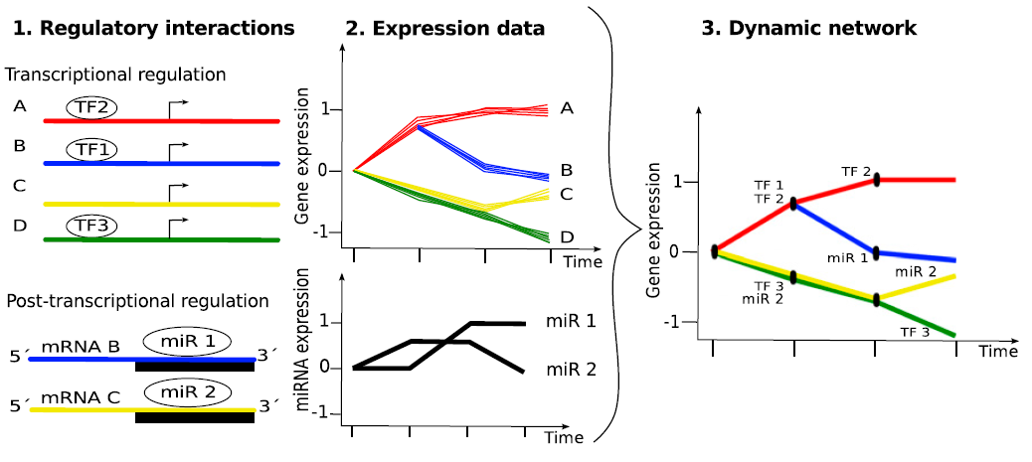
Overview:
1. data: static prediction data (TFs,miRNAs); time-series data (mRNAs and miRNAs expression data)
2. Assume coexpressed genes diverges in the time series $−>$ form a tree structure
3. for every gene, use an IOHMM model to specify the most possible path
4. annotate TFs and miRNAs for bifurcation events (different developmental stages)

Slide 5
Probabilistic Model And Computational Methods

Slide 6
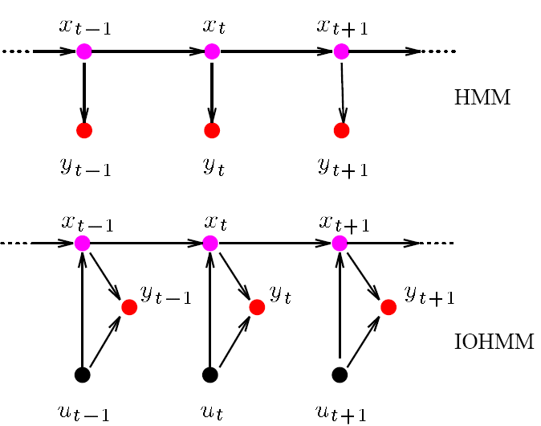


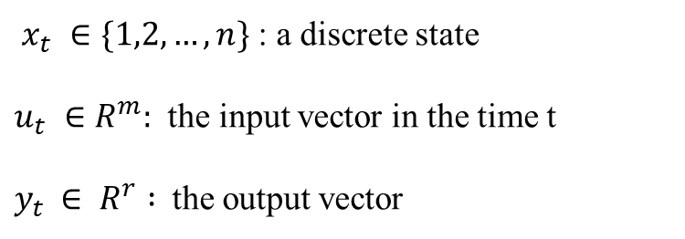
General IOHMM
Input-Output Hidden Markov Model
$$x_{t}=f(x_{t−1},u_{t})$$
$$y_{t}=g(x_{t},u_{t})$$
$x_{t} ∈\{1,2,…,n\}$ : a discrete state
$u_{t} ∈R^{m}:$ the input vector in the time t
$y_{t }∈ R^{r} :$the output vector
HMM: learn the output sequence distribution
IOHMM: learn to map the input sequence to the output sequence

Slide 7
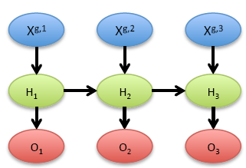

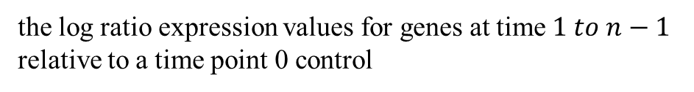
mirDREM
MIRna Dynamic Regulatory Events Miner
dynamic regulatory networks that model the effects of transcription factors (TFs)
and miRNAs on their targets over time
$$X^{g,t}=\{X_{1},X_{2},…,X_{T},{RE}_{g}^{1,t},{RE}_{g}^{2,t},…,{RE}_{g}^{R,t}\}$$
T features for TFs
R features for miRNAs
hidden states: represent a distribution of the expression
of genes
the log ratio expression values for genes at time $1 to n−1$
relative to a time point 0 control

Slide 8
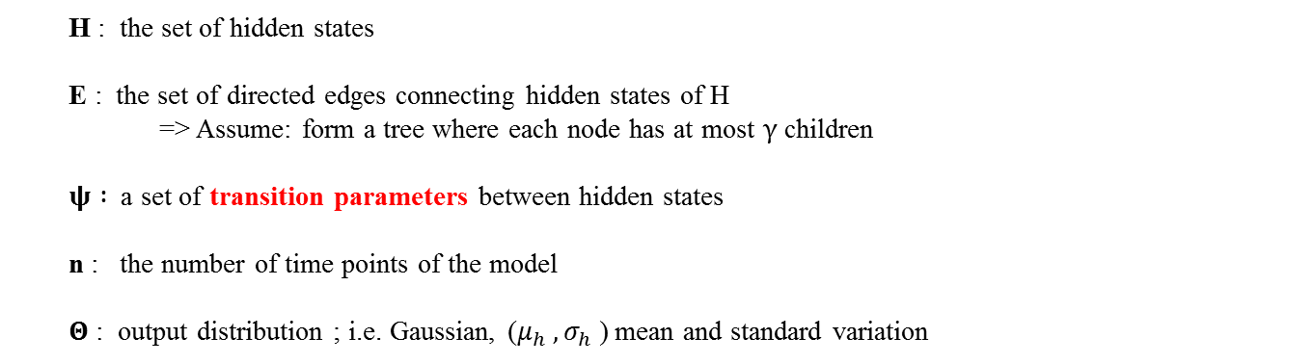
mirDREM: model IOHMM use a tuple : ( $H,E,ψ,Θ,n,γ$)
H : the set of hidden states
E : the set of directed edges connecting hidden states of H
=> Assume: form a tree where each node has at most $γ$ children
$ψ :$ a set of transition parameters between hidden states
n : the number of time points of the model
$Θ$ : output distribution ; i.e. Gaussian, ($μ_{h} , σ_{h}$) mean and standard variation
$H,E,ψ,Θ$: all unknown; structure learning; parameter learning

Slide 9




Transition Probabilities
$ψ :$ a set of transition parameters between hidden states
$φ_{h} ∈ψ$ if there exists two or more children for hidden states $h$
use an L1 logistic regression classifier to determine transition probabilities
input vector:
$$X^{g,t}=\{X_{1},X_{2},…,X_{T},{RE}_{g}^{1,t},{RE}_{g}^{2,t},…,{RE}_{g}^{R,t}\}$$
$$h ∈H$$
$$a ∈H$$
$$b ∈H$$

Slide 10


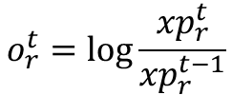

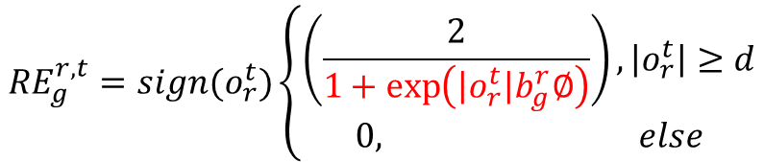

input vector:
$$X^{g,t}=\{X_{1},X_{2},…,X_{T},{RE}_{g}^{1,t},{RE}_{g}^{2,t},…,{RE}_{g}^{R,t}\}$$
1. $I_{g}=\{X_{g,1},X_{g,2},…,X_{g,T}\}$ (for a gene $g$)
the j-th element of $I_{g}$is 1 if TF $j$ is predicted to regulate $g$
static data
2. ${RE}_{g}^{r,t}$ : regulatory effect of miRNA-r
Aim : integrate the temporal expression data with the static sequence based prediction data
Key Idea:
1. miRNAs that change their expression level change their regulatory effect on target genes
$$o_{r}^{t}=\log{\frac{{xp}_{r}^{t}}{{xp}_{r}^{t−1}}}$$
${xp}_{r}^{t}:$ the expression level of miRNA $r$ at time point $t$
2. the strength of the regulatory effect for a miRNA $r$ on a target gene $g$ depends on the binding strength
$$b_{g}^{r}>0$$
$${RE}_{g}^{r,t}=sign(o_{r}^{t})\left\{\begin{aligned}\left(\frac{2}{1+\exp\left(\left|o_{r}^{t}\right|b_{g}^{r}∅\right)}\right),\left|o_{r}^{t}\right|≥d \\ 0, else\end{aligned}\right.$$
?

Slide 11
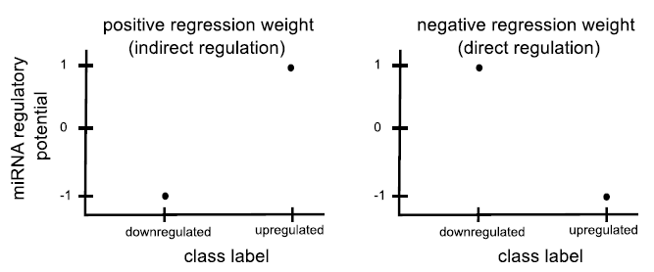



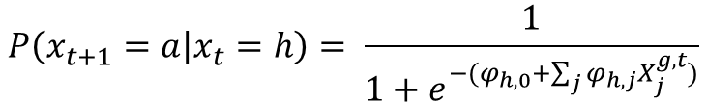



logistic regression classifier:
$γ=2$,
$$X^{g,t}=\{X_{1},X_{2},…,X_{T},{RE}_{g}^{1,t},{RE}_{g}^{2,t},…,{RE}_{g}^{R,t}\}$$
$$h ∈H$$
$$P\left(x_{t+1}=a | x_{t}=h\right)= \frac{1}{1+e^{−(φ_{h,0}+\sum_{j}{φ_{h,j}X_{j}^{g,t}})}}$$
$$φ=\{φ_{0,}φ_{1,}…,φ_{T,}φ_{T+1,}….,φ_{T+R}\}$$
$$a ∈H$$
$$b ∈H$$
negative: miRNAs inhibie their targets

Slide 12


Model Learning
parameter learning
structure learning
$$ψ,Θ$$
$$H,E$$

Slide 13
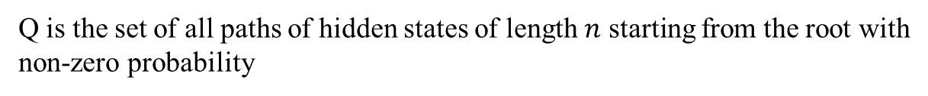
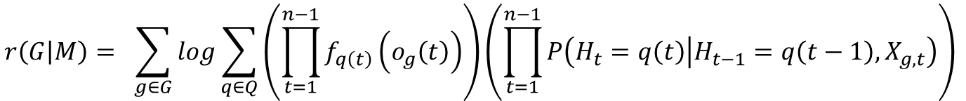
parameter learning
Likelihood function :
for a set of genes G for the model M :
$$r\left(G | M\right)= \sum_{g∈G}{log}\sum_{q∈Q}{\left(\prod_{t=1}^{n−1}{f_{q\left(t\right)}\left(o_{g}\left(t\right)\right)}\right)}\left(\prod_{t=1}^{n−1}{P\left(H_{t}=q\left(t\right) | H_{t−1}=q\left(t−1\right),X_{g,t}\right)}\right)$$
Q is the set of all paths of hidden states of length $n$ starting from the root with
non-zero probability
Baum-Welch EM algorithm

Slide 14
structure learning
what states there are and how they are connected ?
a greedy fashion
1. start from a linear model with one hidden state per time point
2. add new state at each time point (BIC score)
3. test if splits can be delayed or paths merged to simplify the model
all genes are parsed through the model and assigned to paths in the model using
Viterbi algorithm

Slide 15



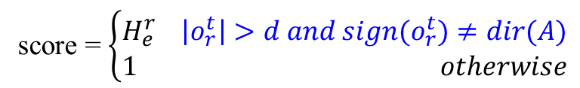
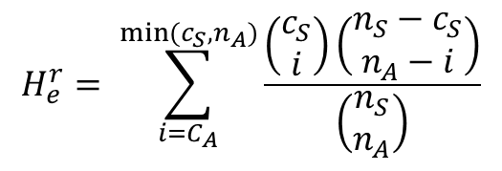
Enrichment Computation for miRNAs at Split Nodes
hypergeometric statistic
$$n_{A}$$
$$c_{A}$$
$$H_{e}^{r}= \sum_{i=C_{A}}^{min⁡(c_{S},n_{A})}{\frac{\left(\begin{matrix}c_{S} \\ i\end{matrix}\right)\left(\begin{matrix}n_{S}−c_{S} \\ n_{A}−i\end{matrix}\right)}{\left(\begin{matrix}n_{S} \\ n_{A}\end{matrix}\right)}}$$
path A
split node S
$n_{S}$ genes
$c_{S}$ regulated by miRNA r
expression conditions:
score = $\left\{\begin{aligned}H_{e}^{r} \left|o_{r}^{t}\right|>d and sign(o_{r}^{t})≠dir(A) \\ 1 otherwise\end{aligned}\right.$
score $≤0.05$

Slide 16
Results

Slide 17
A dynamic Regulatory Network for Lung Development in Mouse
temporal mRNA and miRNA expression data: 5 developmental time points (0,4,7,14, 42 d)
static TF-gene interaction data and miRNA-interaction data (Microcosm)
biggest changes occurring in the week1 to week2 transition
(rapid alveolar septation occurs between postnatal days 7 and 14)
several TFs and miRNAs have been shown to regulate lung development
up-regulated miRNAs -> downward path ...
different paths -> GO: regulate important functions in the development

Slide 18
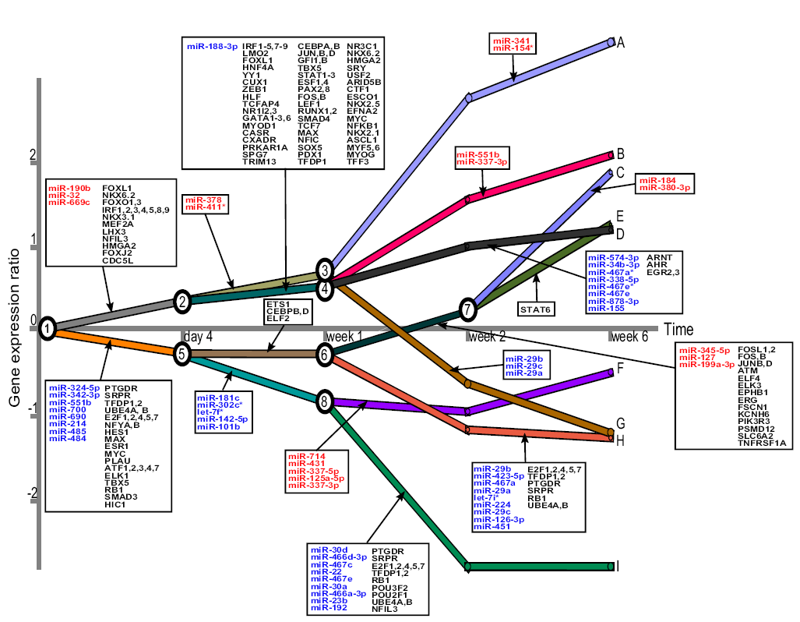

Slide 19
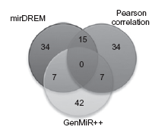
different rationales underlying the approaches
miR-30d, miR-466d
miR-21,let-7
mirDREM can accurately identify important miRNAs that are missed by other methods
GenmiR++ targets correspond to general processes;
mirDREM can be related to organ and immune response development

Slide 20
Summary
model a dynamic regulation by miRNAs
a tree structure
using IOHMM to model time series data
consider the features of regulation by miRNAs
a negative influence on expression
using expression level to reflect dynamic activity information
dynamic or global

