Slide 1
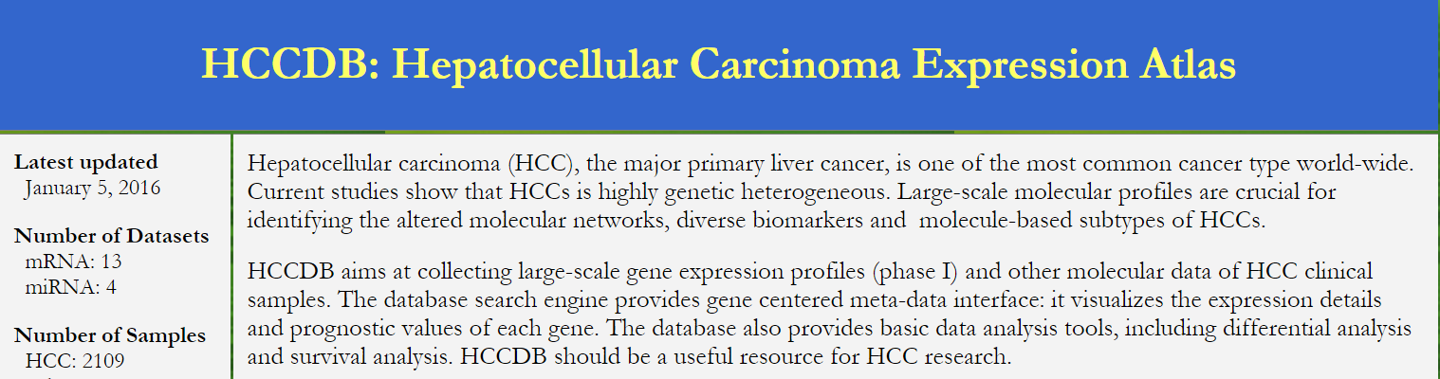
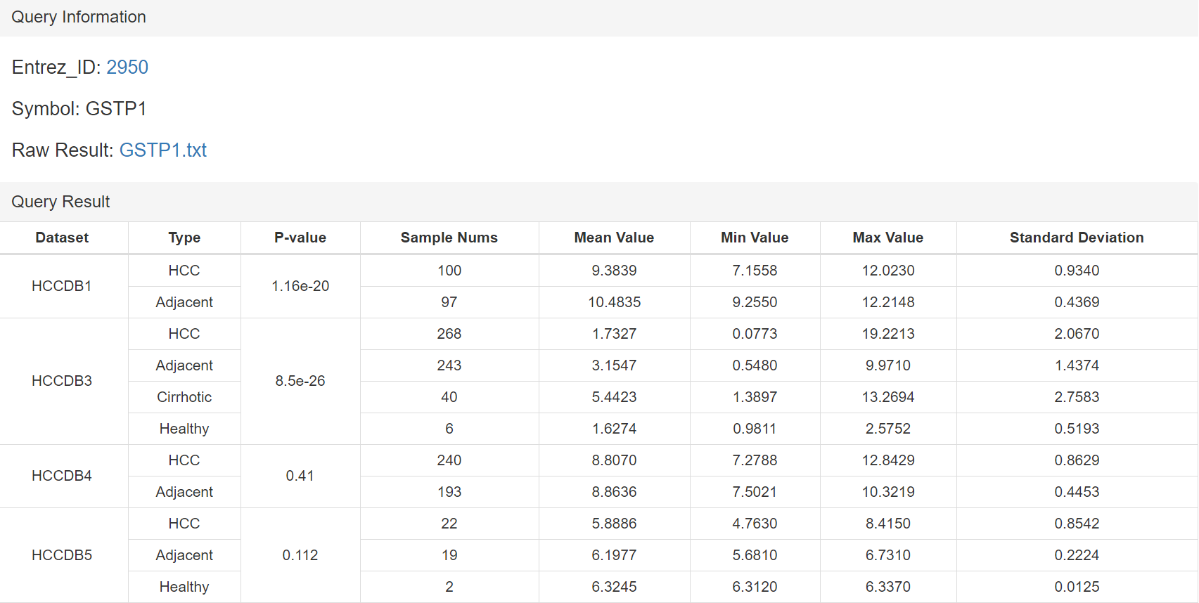
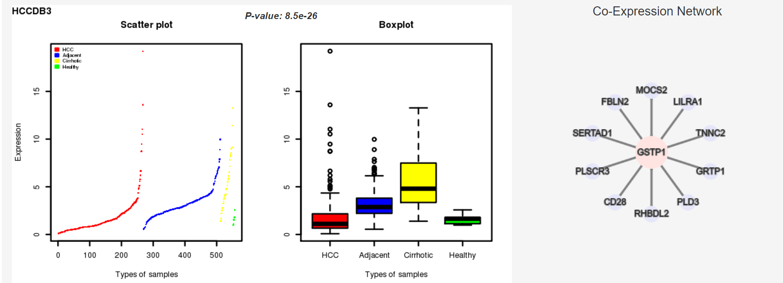
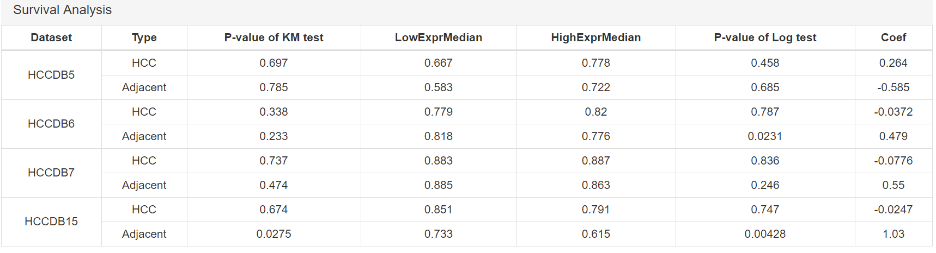
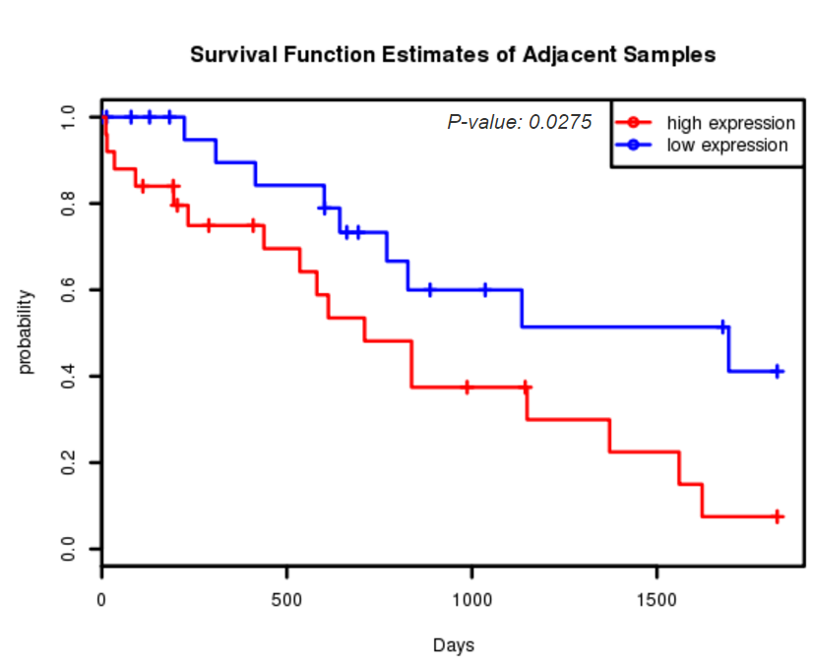
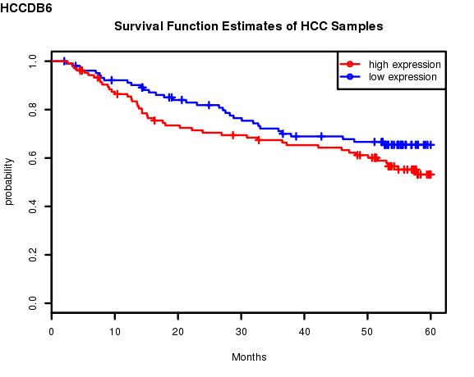
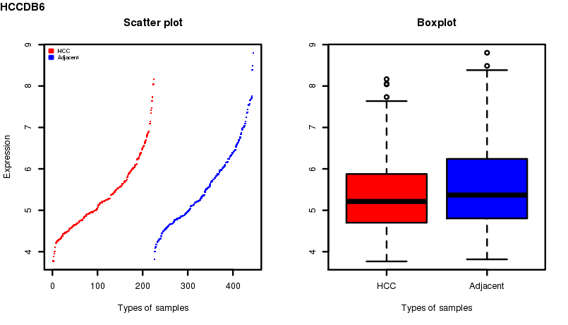
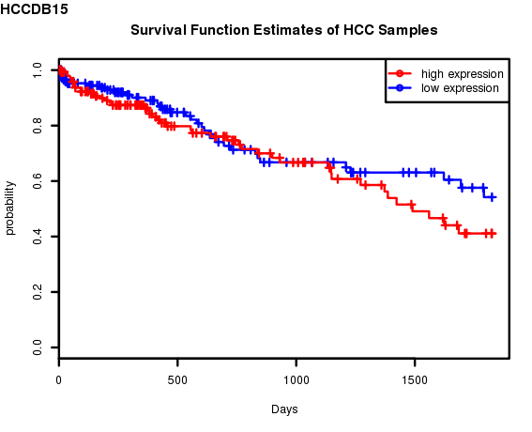
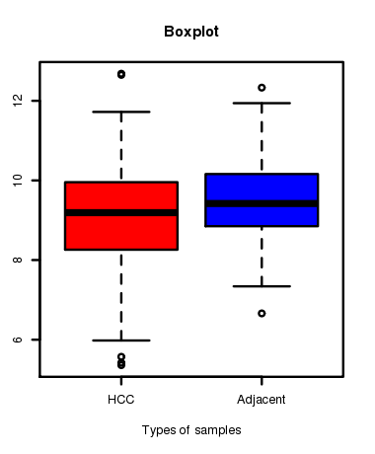


Hepatocellular Carcinoma Gene Expression Atlas:
Application to molecular-based subtyping
Dongfang Wang, Guchao Zhang, Jin Gu*
MOE Key Lab of Bioinformatics and Bioinformatics Division, TNLIST, Department of Automation, Tsinghua University, Beijing 100084, China *jgu@tsinghua.edu.cn
Abstract
Background
Hepatocellular carcinoma (HCC) is one of the most prevalent cancer types worldwide. The heterogeneity of HCC is a big challenge for disease diagnosis and treatment. The accumulation of genome-wide gene expression data provide the opportunity to classify HCCs into different subgroups based on gene expression signatures. We carefully curated more than ten public large-scale gene expression datasets of more than 2,000 clinical HCC samples.
Outlines
Statistics and meta-analysis of HCC gene expression atlas
Signature-based subtyping analysis of HCC
A web-based database HCCDB to visualize data analysis results
Signature-based meta-analysis of HCC
As shown in Figure II, firstly, for every single gene expression dataset, we performed clustering analysis after nonnegative matrix factorization (NMF). Representative genes set was then identified for each cluster .
A signatures-based network was constructed and performed network clustering. Consensus signatures across datasets were identified.
Next we made enrichment analysis for these consensus genes and used them to cluster each dataset again.
Motivation
1) Can we find consistent and replicable clusterings from curated disease-specific dataset collections?
2) What are the key features of highly heterogenous HCC samples?
Group | mRNA type | miRNA type | Total
HCC | 2031 | 625 | 2109
Adjacent | 1199 | 224 | 1277
Cirrhotic | 40 | 0 | 40
Healthy | 8 | 10 | 18
Total number of samples | 3286 | 859 | 3444
Figure II: Meta-analysis procedure
Results
We found 155 genes in cluster 1, and 71 genes in cluster 2.
Enrichment analysis was shown in Figure III.
CXCR4, RAC2, GSTP1, LAMA2, ADCY7, CXCL12, ROCK2, GNAI1 appeared most in the representative gene sets.
Table I: Number of samples in cruated HCC datasets
Differentially expressed
Number of genes associated
with overall survival
(a)
(b)
Figure III: Enrichment Analysis of signatures clusters (heat color represents negative log of p.values)
Clinical information
(b) Number of genes associated
with vascular invasion
(c) HCCDB database
Figure I: Statistics and meta-analysis of HCC expression atlas
(a)
(b)
Figure IV: CXCR4 in HCCDB6(a) and HCCDB15(b); Left: survival analysis; Right: Expression

