Slide 1

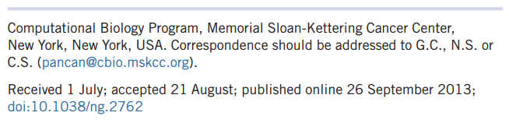
Emerging landscape of oncogenic signatures across human cancers

Slide 2
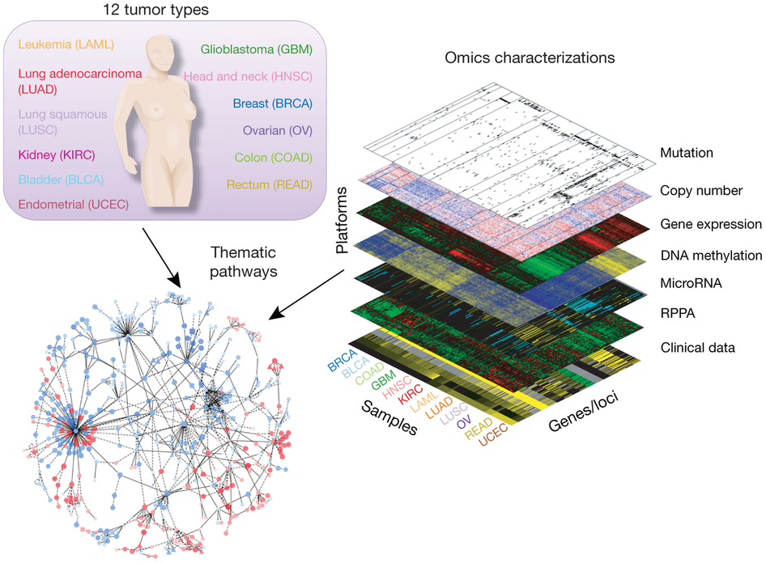
Introduction
Tumors have been classified mainly according to their organ of origin
Their molecular characteristics (oncogenic signature) have been seen to be at least as important.
TCGA Pan-Cancer project
Intracancer Heterogeneity: Tumors in the same tissue vary substantially in genomic alterations
Cross-Cancer Similarity: Similar patterns of genomic alterations are observed in tumors from different tissues of origin

Slide 3
Overview
This paper tries an alternate approach to identifying driver alterations
Classifying individual tumors based not on their tissue of origin, but rather their selected functional events
Seach common characteristics of multiple cross-tissue groups of tomors and Build a new tumor classification
Work 1: selected functional events (SFEs) – oncogenic signatures
Work 2: hierarchically stratify more than 3,000 tumors from 12 tumor types

Slide 4
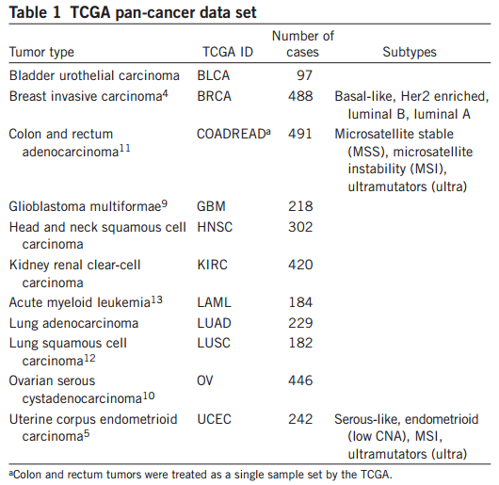
Data
Twelve cancer types with 3,299 tumor samples
breast
colorectal
endometrioid
Genomic and epigenetic changes
copy number
mutation
methylation

Slide 5
Selected Functional Events
Identify oncogetic signatures
A relatively small number of functional oncogenic alterations (driver events) are outnumbered by non-functional alterations (passenger events) that do not substantially contributes to oncogenesis and progression
479 SFEs
- 116 copy number gains
- 151 copy number losses
- 199 recurrently mutated genes
- 13 epigenetically silenced genes

Slide 6
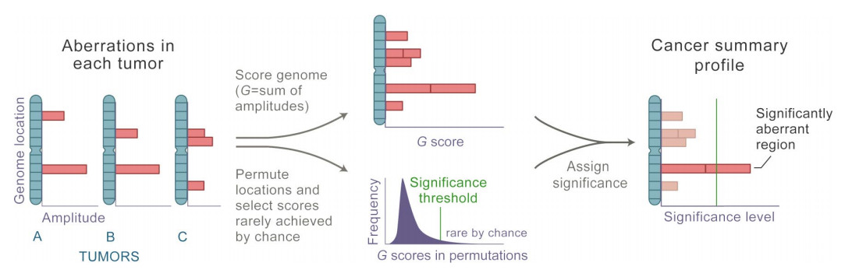
Recurrent Copy Number Change -- GISTIC
Genome Identification of Significant Targets in Cancer
Identify regions of aberration that are more likely to drive cancer pathogenesis
Frequency and magnitudes
G-score
Significant test
Beroukhim R, Getz G, Nghiemphu L, et al. Assessing the significance of chromosomal aberrations in cancer: methodology and application to glioma[J]. Proceedings of the National Academy of Sciences, 2007, 104(50): 20007-20012.
Notes:
Since passenger aberrations could occur anywhere in the genome, one may model this null distribution by recalculating the G scores across all combinations of permutations of the marker labels within each sample. Note that by assuming, in these permutations, that all observed aberrations (including driver aberrations) are passengers, we generate a conservative, high estimate of the background aberration rate.

Slide 7
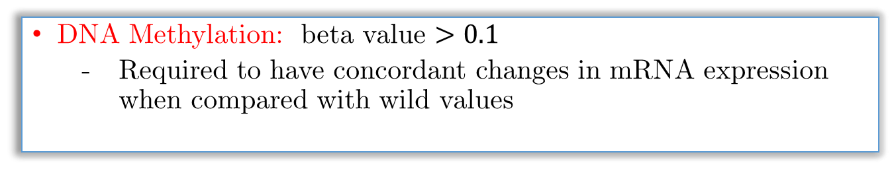
Recurrently Mutated Genes & DNA Methylation
MuSiC: Mutational Significance in Cancer
Separate the commonly abundant passenger mutations from the truly significant events
Show significantly higher mutation rate than the background mutation rate
DNA Methylation: beta value $>0.1$
Required to have concordant changes in mRNA expression when compared with wild values
The resulting set of SFEs provides a concise description of tumors, with immediate biological and clinical interpretations.

Slide 8
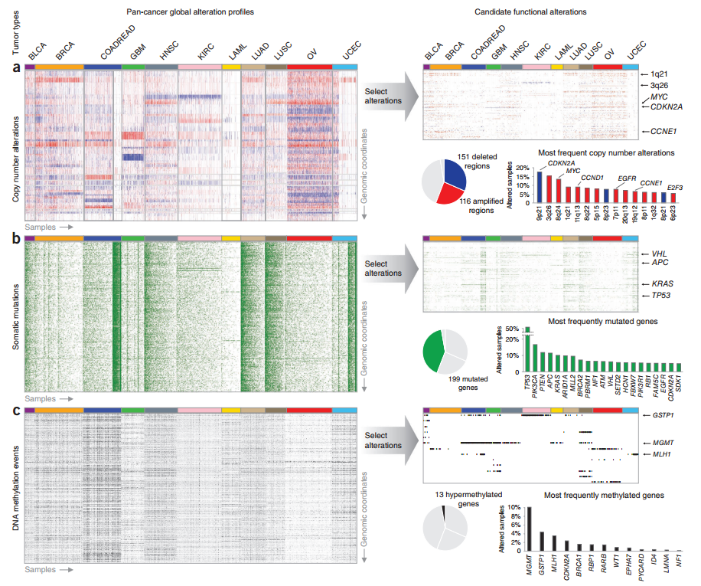
Notes:
The most recurrent selected alterations tend to involve well-known oncogenes and tumor suppressors.
CDKN2A:This gene is frequently mutated or deleted in a wide variety of tumors, and is known to be an important tumor suppressor gene
TP53:tumor protein p53 This gene encodes a tumor suppressor protein containing transcriptional activation, DNA binding, and oligomerization domains. The encoded protein responds to diverse cellular stresses to regulate expression of target genes, thereby inducing cell cycle arrest, apoptosis, senescence, DNA repair, or changes in metabolism. Mutations in this gene are associated with a variety of human cancers
MYC:The protein encoded by this gene is a multifunctional, nuclear phosphoprotein that plays a role in cell cycle progression, apoptosis and cellular transformation. It functions as a transcription factor that regulates transcription of specific target genes. Mutations, overexpression, rearrangement and translocation of this gene have been associated with a variety of hematopoietic tumors

Slide 9
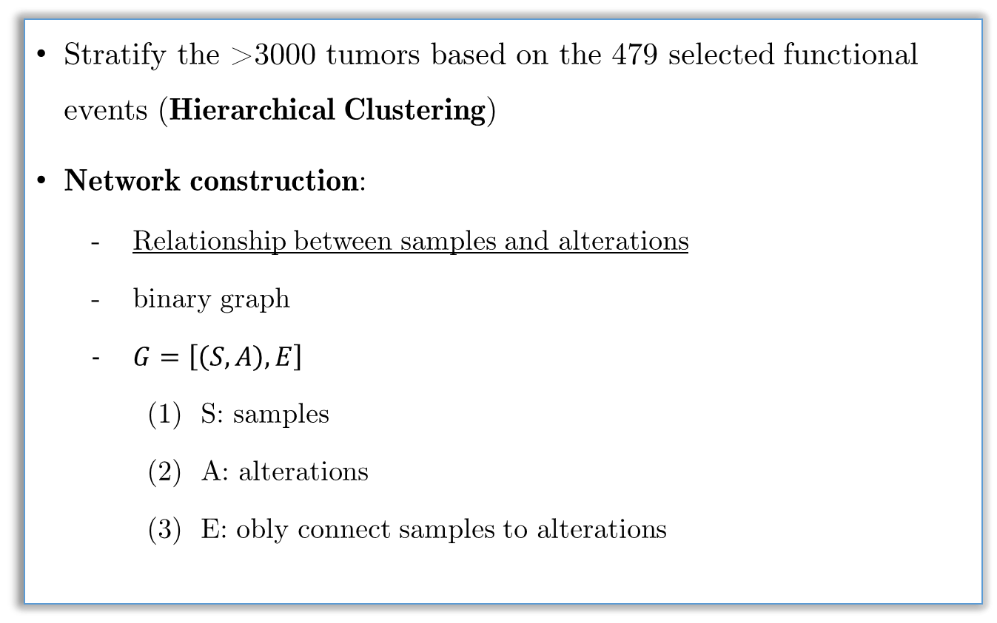
Tumor Clustering
Stratify the >3000 tumors based on the 479 selected functional events (Hierarchical Clustering)
Network construction:
Relationship between samples and alterations
binary graph
$G=\left[\left(S,A\right),E\right]$
(1) S: samples
(2) A: alterations
(3) E: obly connect samples to alterations

Slide 10
a
b
c
samples
alterations
d
e
f

Slide 11
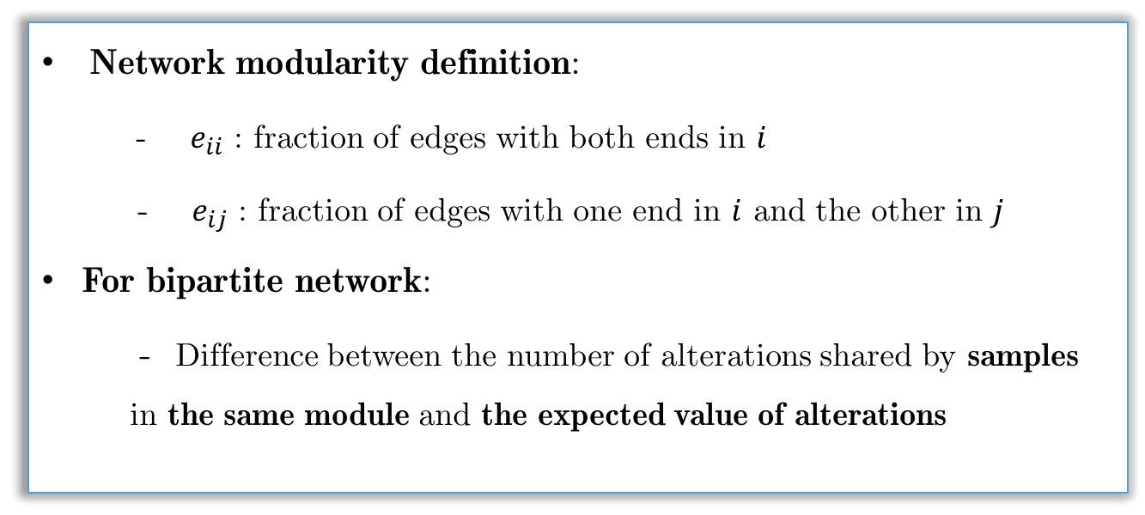
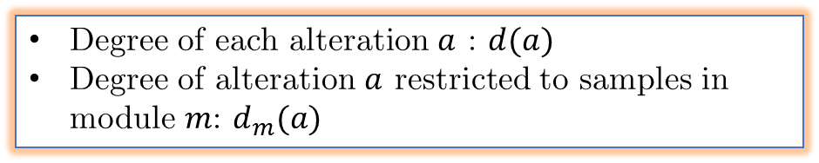
Bipartite Network Modularity
Network modularity definition:
- $e_{ii}$ : fraction of edges with both ends in $i$
- $e_{ij}$ : fraction of edges with one end in $i$ and the other in $j$
For bipartite network:
- Difference between the number of alterations shared by samples in the same module and the expected value of alterations
Degree of each alteration $a$ : $d(a)$
Degree of alteration $a$ restricted to samples in module $m$: $d_{m}(a)$

Slide 12
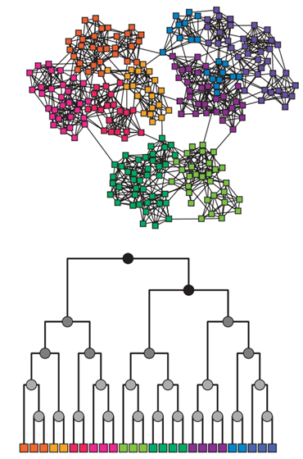
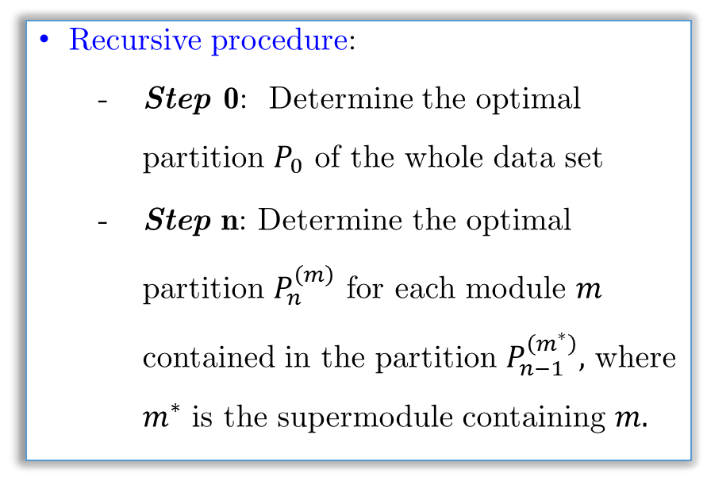
Modularity Optimization
Greedy partitioning:
Start by assigning each sample to a separate module and iteratively joining the pair of modules that produce the greatest increase in modularity
Recursive procedure:
Step 0: Determine the optimal partition $P_{0}$ of the whole data set
Step n: Determine the optimal partition $P_{n}^{\left(m\right)}$ for each module $m$ contained in the partition $P_{n−1}^{\left(m^{∗}\right)},$ where $m^{∗}$ is the supermodule containing $m.$
Notes:
Greedy partitioning tends to prefer incremental inclusions of single nodes in big modules rather than growing multiple modules simultaneously.

Slide 13
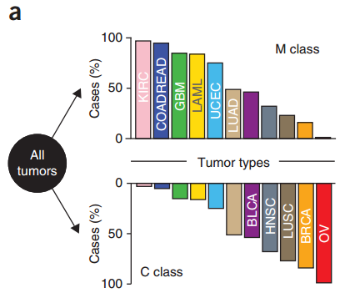
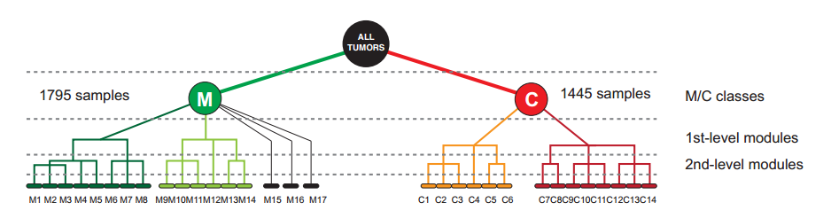
Two Main Tumor Classes
M class
KIRC, GBM, LAML,UCEC, COADREAD
C class
- OV, BRCA, LUSC,HNSC
Mix of both
LUAD, BLCA

Slide 14
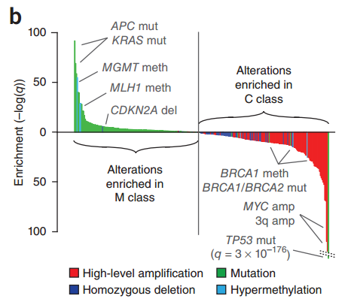
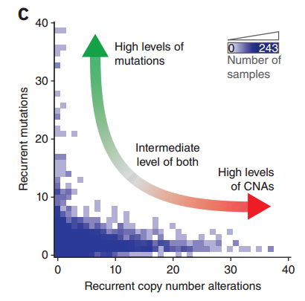
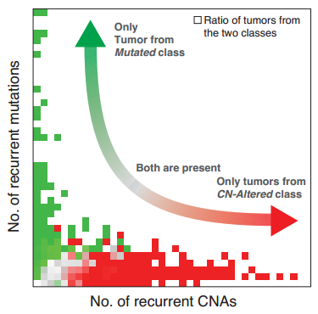
Distinct SFEs – CNV and Mutations
M class (primarily with mutations) and C class (primarily with CNV)
Cancer genome hyperbola
Inverse relationship between CNV and mutations between extremes
Highly altered tumors had either a large number of somatic mutations or a large number of copy number alterations but never both
Notes:
有很多突变的基因的样本基本不会有大量的CNV，反之亦如此

Slide 15
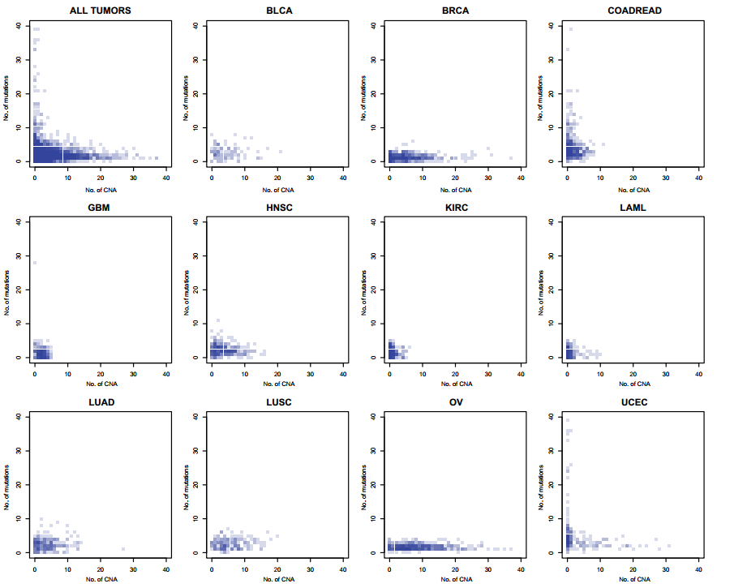

Slide 16
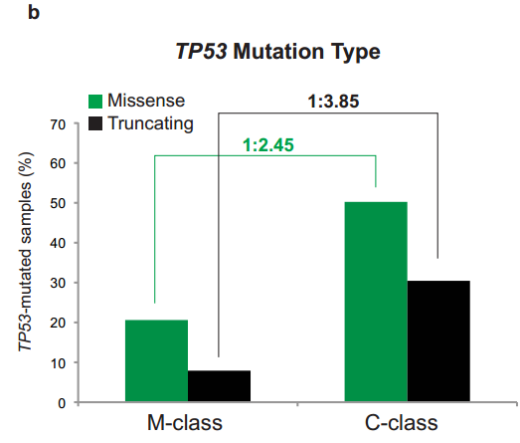
TP53 Mutation
TP53 mutations were strongly enriched in the C class
Early mutations in TP53 causing copy number genomic instability

Slide 17
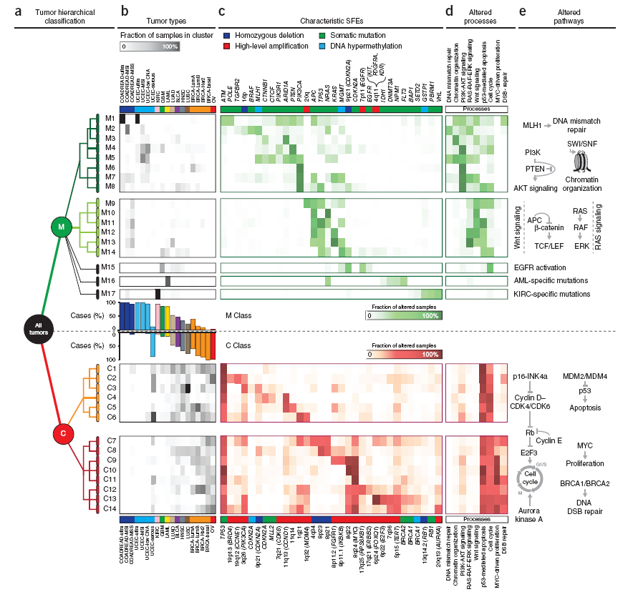
Notes:
RAS Signaling: 激酶 信号传导 which ultimately turn on genes involved in cell growth, differentiation and survival. As a result, mutations in ras genes can lead to the production of permanently activated Ras proteins. This can cause unintended and overactive signalling inside the cell, even in the absence of incoming signals.
Wnt Signaling：a group of signal transduction pathways made of proteins that pass signals from outside of a cell through cell surface receptors to the inside of the cell ；
mutations that lead to a variety of diseases, including breast and prostate cancer, glioblastoma, type II diabetes, and others
辅助活化剂 TCF/LEF family
AKT Signaling: plays a key role in multiple cellular processes such as glucose metabolism, apoptosis, cell proliferation, transcription and cell migration. intracellular signalling pathway important in apoptosis and hence cancer

Slide 18
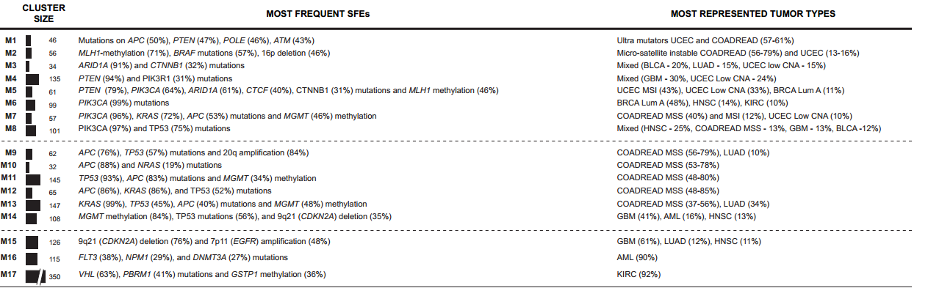
Result Analysis
Distinct mechanisms of oncogenesis as determinants of tumor subclasses
Unexpected similarities between tumors originating in different tissues and new insights into alterations shared by multiple tumor types
mixed tumor types
distinct mutational events
independent tumor types

Slide 19
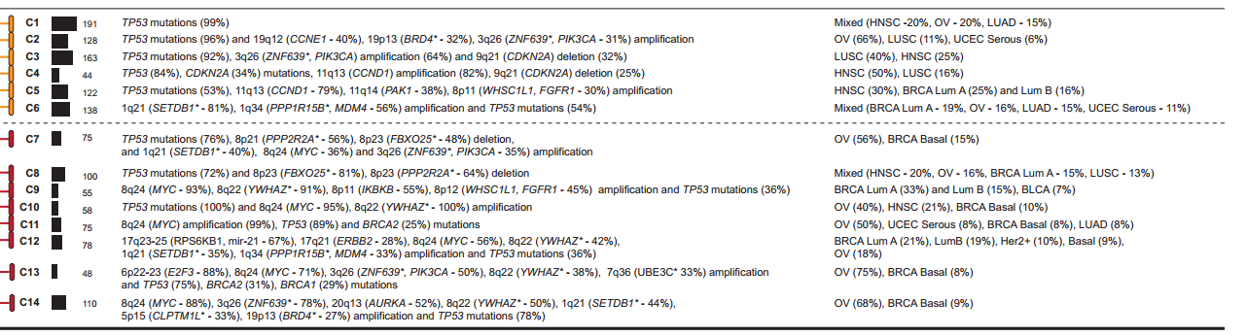
C class:
Inactivation of TP53
MYC-driven proliferation
Dysregulated cell cycle checkpoints
chromosome 8

Slide 20
From Oncogenesis to Therapy
The clinical impact of oncogenic signatures depends on the ability to selectively block the oncogenic action of these molecular alterations.
Cross-cancer distribution of targetable alterations presents an opportunity to design tumor treatments strategies tailored to subsets of tumors characterized by particular sets of functional events.

Slide 21
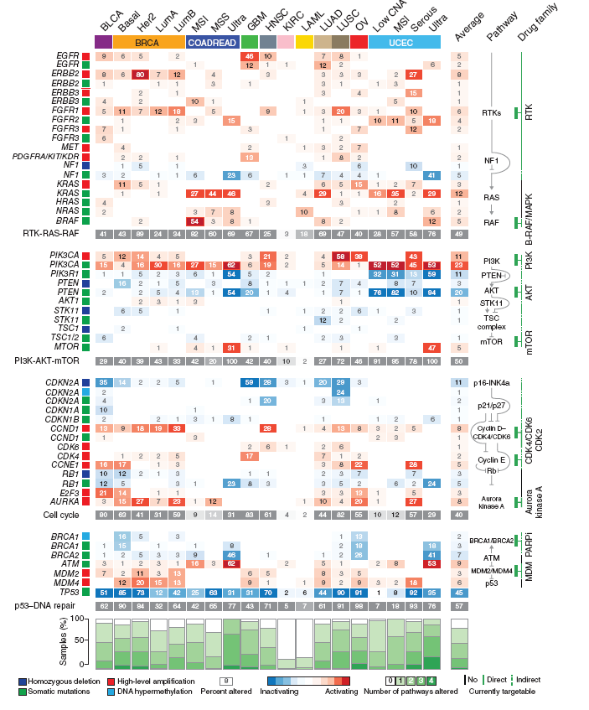
Functional Events and
Therapeutic Interventions

Slide 22
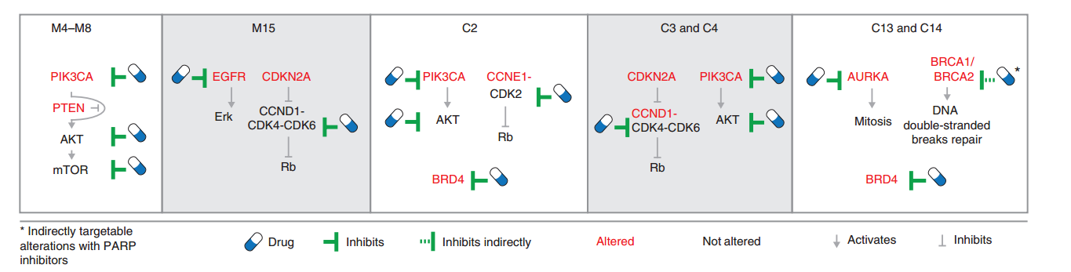
Genomic subclasses were found to be characterized not only by single
oncogenic events but also by specific combinations of events
Such concurrent alterations may be targetable by combination therapies
Notes:
Subsets of lung and head and neck squamous cell carcinomas may benefit from concurrent blockade of the cell cycle and PI3K-AKTN signaling
A systematic stratification of tumors on the basis of therapeutically actionable alterations may therefore serve as a point of departure for designing “basket” trials in with actionable oncogenic signatures are matched with targeted combination therapy for patients with diverse tumor types.

Slide 23
Summary
Select functional events from passenger events
Cross-tissue cancer classification and molecular characteristics
Distinct mechanism of oncogenesis for different subclasses
Therapeutic intervention

