Slide 1
Identification of microRNA-regulated gene networks
by expression analysis of target genes
Gennarino, Vincenzo Alessandro, et al. "Identification of microRNA-regulated gene networks by expression analysis of target genes." Genome research 22.6 (2012): 1163-1172.
Notes:
通过分析靶基因的表达识别miRNA基因调控网络

Slide 2
Co-expression based target gene network analysis:
CoMeTa: target genes recognition
COOL: infer functions of specific miRNAs
miRCos: miRNA communities; functions of synergic miRNAs
Notes:
基于共表达的靶基因网络分析方法推断miRNA的靶基因和功能，主要包括三部分的内容：
（1）
（2）
（3）miRCos: 多个miRNA综合调控某一生物过程

Slide 3
CoMeTa -- Aim
CoMeTa: Co-expression Meta-analysis of miRNA Target genes
Aim:
inference miRNA targets and miRNA-regulated networks
by integrating expression data from hundreds of cellular and tissue conditions
Notes:
CoMeTa：目的是通过整合很多细胞组织和条件下的mRNA表达数据推断miRNADe靶基因及其调控网络

Slide 4
sequence analysis of miRNA-mRNA target sites
high-throughput expression analysis
paired data sets of miRNA-mRNA expression data
mRNA transcriptome data sets
Notes:
与已有的miRNA靶基因识别方法相比较：
（1）最初只是基于miRNA与mRNA靶位点的序列分析 low specificity、、low overlap
（2）使用高通量表达数据分析改善miRNA靶基因的预测 使用成对specificy的miRNA-mRNA表达数据（inverse correlation 特定的microarray platform）
（3）CoMeTa首次只使用mRNA转录组的数据（公共数据库、成千上万数据整合多种多样的组织和条件）

Slide 5
CoMeTa -- Hypothesis
Hypothesis:
the targets of a given miRNA are co-expressed with each other
( at least in certain tissues/conditions)
they belong to the same gene regulatory network
Notes:
核心假设：同一个miRNA的靶基因互相之间在某些组织或者条件下是共表达的，属于同一个基因调控网络

Slide 6
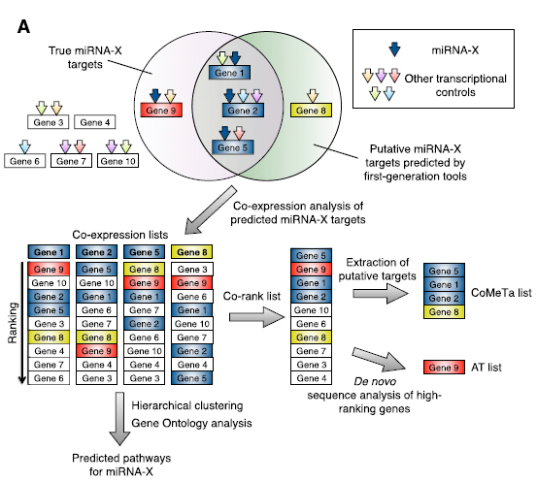
CoMeTa -- Scheme
“seed”
co-expression list
co-rank list
CoMeTa list
Notes:
CoMeTa分析的过程主要包括三步：
（1）获得分析的种子基因
（2）对所有候选基因进行共表达分析
（3）平均得到的所有共表达列表

Slide 7
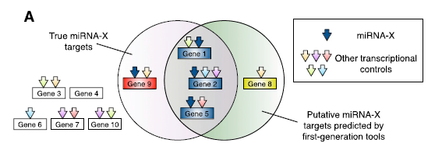
CoMeTa -- Step 1: “seeds”
seeds : predicted targets by 3 sequenced-based prediction tools
miRanda PicTar TargetScan
miRNAs: retrieved from mirBase( release 13.0; n = 675)
false negative result
not predicted
false positive result
try to find Gene 1,2,5,9 , given 1,2,5,8 and expression data
Notes:
三种工具得到的靶标 混在一起组成一个单个的预测的靶标的列表

Slide 8
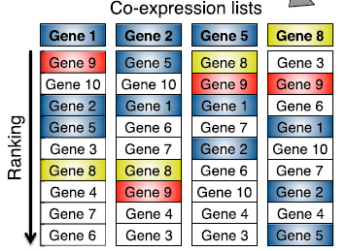
CoMeTa -- Step 2: “co-expression list”
co-expression analysis of predicted miRNA-X targets
data:
250 GEO microarray data sets (Affymetrix HG-U133A GeneChip)
(preprocessed and normalized and removed) 217 data sets
X by 1st generation tools
Notes:
少于3个array数据
丢失值超过200个的舍去

Slide 9
CoMeTa -- Step 2: “co-expression list”
co-expression list for each predicted gene:
consist of all other genes of the Affymetrix platform
ranked by Pearson correlation score relative to the expression behavior
in each single experiment
co-expression score:
its number of occurrence in the top third percentile of each ranked list,
across all expression data sets analyzed
Notes:
如何得到共表达列表？
（1）对于每一个种子基因，其列表中都包含所有在microarry平台上出现过的其他基因
（2）对每一个实验，分析基因与种子基因的Pearson相关系数
（3）整合所有分析的实验。取每个候选基因在所有实验得到列表中在前3%中出现的次数。

Slide 10
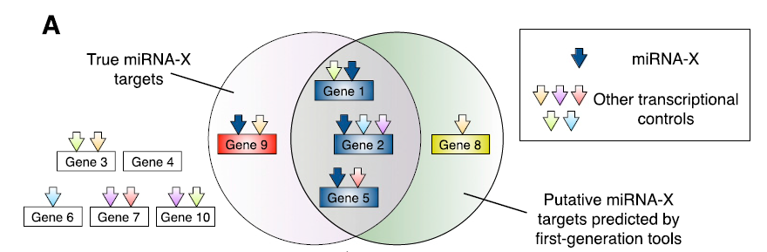
CoMeTa -- Step 2:
for one gene’s co-expression list:
genes under multiple transcriptional controls
rank top -> under the same N factors
Notes:
对于一个种子基因的共表达列表，排名高的原因可能是是其在同一调控因素下作用，这种调控因素是多种昂多样的

Slide 11
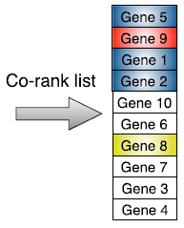
CoMeTa -- Step 3:
Co-rank list
hypothesis:
collectively enriched for the targets of the given miRNA
average the co-expression scores of all ranked genes
Notes:
将所有种子基因的候选共表达列表进行平均，得到Co-Rank列表

Slide 12
CoMeTa lists:
predicted targets ranked by expression analysis
Additional target(AT) lists:
Gene 9
De novo sequence analysis of high-ranking genes
Notes:
从中摘取出预测基因的排序和额外的靶基因

Slide 13
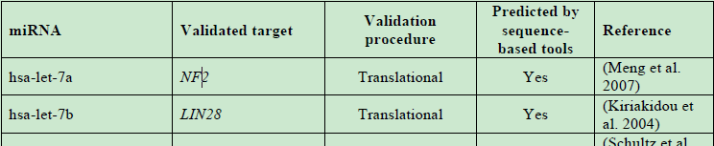
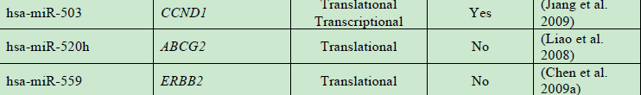
CoMeTa -- efficacy
Dataset 1:
high-confidenceexperimentally validated miRNA–target pairs
270 target genes with 84 mirs
Dataset 2:
671 targets, 8 mirs, identified through pSilac experiment
Dataset 3:
162 targets, 3 mirs , identified by transcriptome analysis
Notes:
三个独立的数据集（已经被验证过的miRNA靶基因集）
Ds1了；实验验证过的
DS2:翻译层次验证（translation level）
ds3:转录层次验证（transcript level）
miRNA-mediated regulation acts predominantly（主要地，显著地） at the transcript level

Slide 14
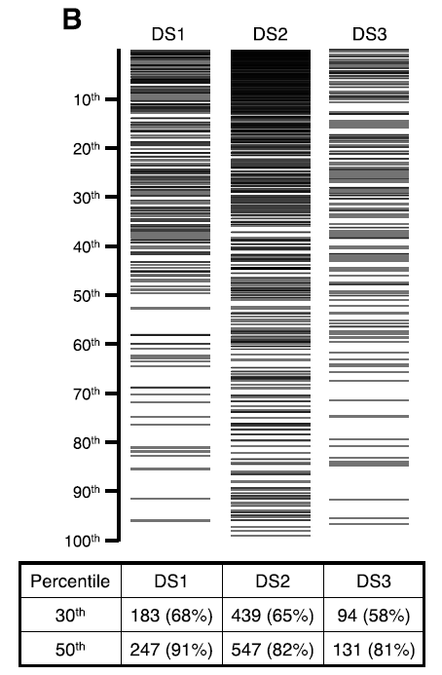

$$P<{10}^{−20}$$
Distribution of known miRNA targets within CoMeTa lists

Slide 15
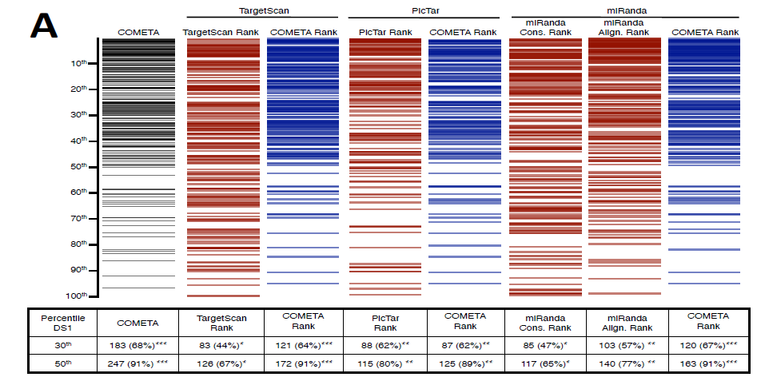

compare with other methods (DS 1)
improve the prediction efficiency
identify the validated targets that escaped recognition
by the sequence-based prediction algorithms
21 out of 25 above the 50th percentile(DS 1),
$$P<{10}^{−3}$$

Slide 16
COOL -- Hypothesis
COOL: CO-Operational Level analysis
Hypothesis:
co-expression analyses can drive the prediction of the functional pathways
controlled by miRNAs
Notes:
由共表达分析的结果预测miRNA控制的生物过程

Slide 17
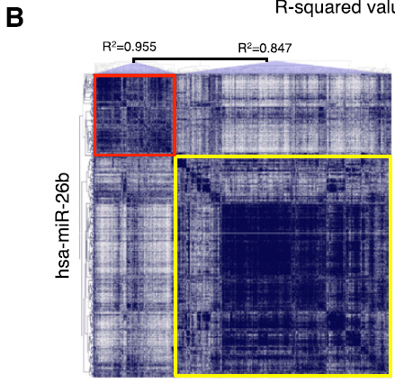
1. Hierarchical Clustering:
for each miRNA,
CoMeTa
-> collected predicted targets
-> co-expression matrix
Multiexperiment Viewer
-> two clusters
Notes:
问题：用多少靶基因进行聚类？（所有基因，根据共表达分数聚类）

Slide 18
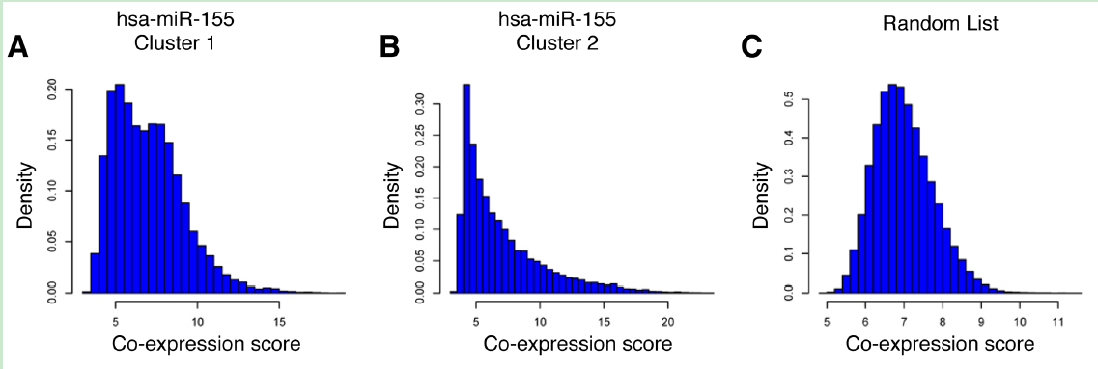
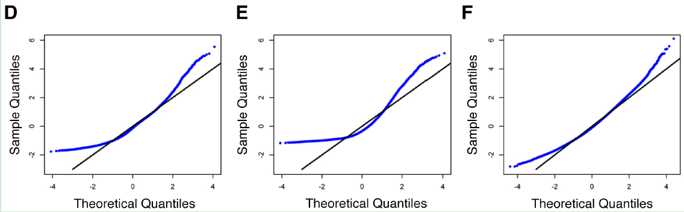
significant COOL cluster:
compare with a randomly generated gene list
Q-Q plot analysis
R-squared:
measure the deviation of
the co-rank list from normality
Notes:
得到两类

Slide 19
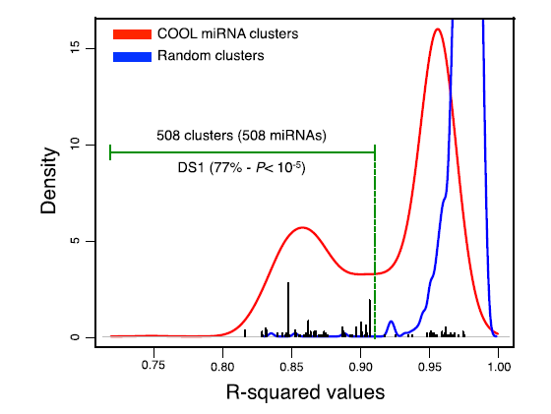

Kernel Density Estimation of R-squared values for all miRNAs
statistically significant
508 of 675
random clusters
$R^{2}$ -> all high -> similar to normality
COOL clusters: biphasic fashion (only one of the two clusters $R^{2}$ is low )
Notes:
黑线： DS1集合中的mir相关的聚类
77%的Ds1中的实验验证的靶基因被包含在这508个聚类中

Slide 20
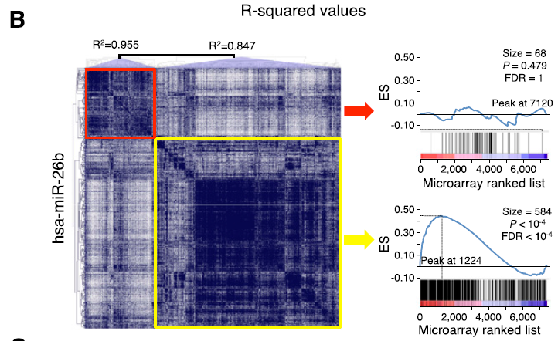
gene set enrichment analysis(GSEA)
set:
probes differentially expressed after
miR-26b transfection
GSE12091 GSE12092
microarray ranked list:
Gennarino et al. 2009,2011
rank ordering from the probe most down-regulated to the most up-regulated
one cluster: enriched for the validated miRNA targets;
enriched for down-regulated genes
Notes:
反映了假设的正确性：给定miRNA的靶基因互相之间是共表达的（co-expressed）

Slide 21
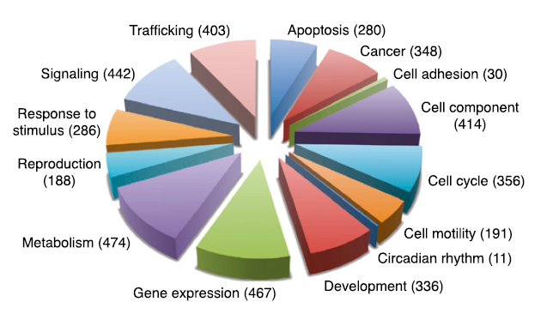
2. GO and KEGG pathway analyses of the significant COOL clusters:
assign biological functions to human miRNAs
every known functional macro category

Slide 22
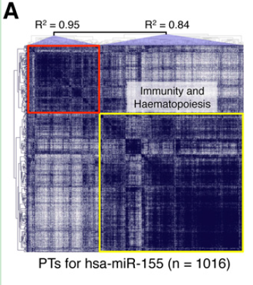
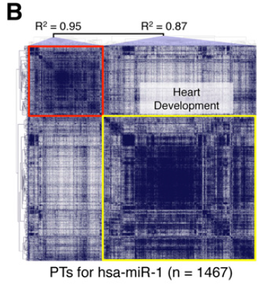
high concordance between CoMeTa COOL analysis and literature data
Notes:
functions have been determined experimentially

Slide 23
Others:
correctly distinguish between closely related members of the same family
Dozens of critical biological process were associated for the first time with
miRNA regulation

Slide 24
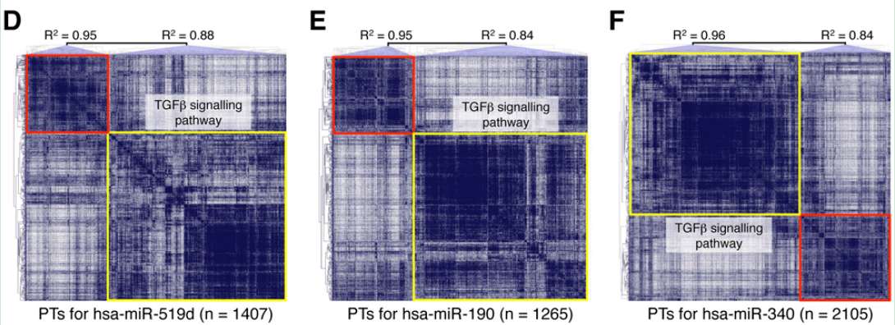

3. Test novel associations:
miR-519d miR-190 miR-340 and signaling pathway
$$TGFβ$$
Notes:
Among the miRNAs associated by COOL analysis to TGFb signaling, miR-519d,
miR-190, and miR-340 showed the most significant enrichment

Slide 25
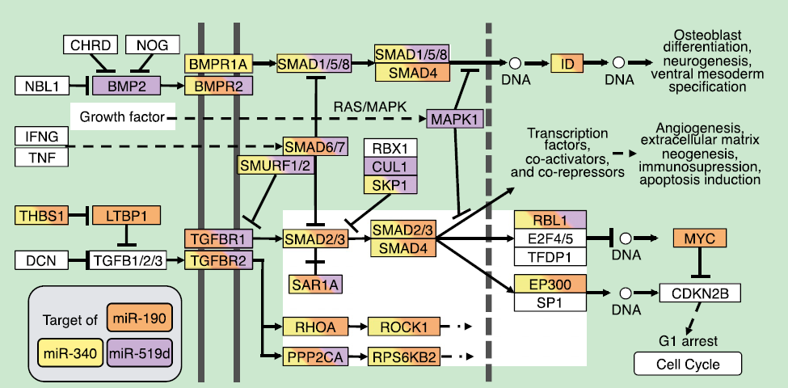

target most genes participating in the pathway
$$TGFβ$$

Slide 26
transfection:
A549 non-small cell lung carcinoma cell line
TGFB1 sensitive
trigger cell scattering and invasion
1. miR-519d miR-190 miR-340
2. positive control: miR-93 (a known inhibitor of$TGFβ$-iunduced cell cycle arrest)
3. negative control: miR-507 miR-557
4. reference: cel-miR-67 (an unrelated Caenorhabditis elegans miRNA)
miR-93,miR-519d and miR-190 antagonized the effects of TGFB1
miR-340 mimicked the actions of TGFB1 stimulation
Notes:
negative controls:COOL分析显示与TGFbeta无关

Slide 27
miRCos : miRNA communities
miRCos: groups of miRNA sharing a significant proportion of target genes
as revealed by co-expression analysis
Affinity Propagation clustering algorithm (APCluster)
Frey and Dueck, 2007

Slide 28
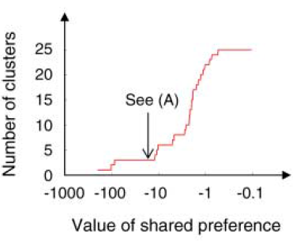
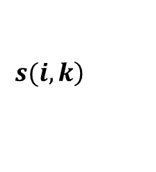
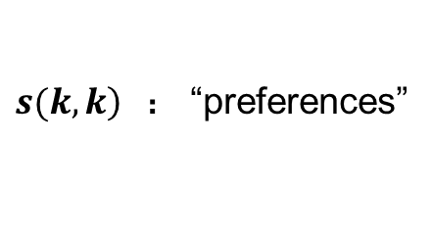

APCluster 1 -- input
input: only distance/similarity matrix
$$\left.s(i,k\right)$$
how well the data point with index k
is suited to be exemplar for data point i
$e.g. s(i,k)=−||x_{i}−x_{k}||^{2}$ , (log-)likelihood
$\left.s(k,k\right)$ ： “preferences”
larger -> more likely to be chosen as exemplars
influene the number of clusters
Notes:
Exemplar: 标本 (聚类的中心点，实际的数据点)

Slide 29
APCluster 2 -- overview
overview:
use only similarity matrix (no initial centers) ,
propagates real-valued messages ( “affinities” ) between data points,
automatically detects clusters, exemplars and number of clusters
Notes:
每个点必须选择另一个点作为它的exemplar；也可以将自己选为exemplar（自动决定clusters的个数）

Slide 30
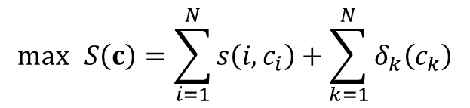
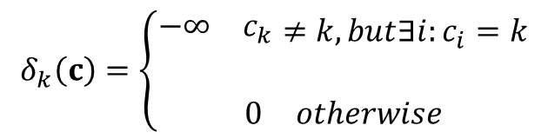

Apcluster 3 -- Theoretical Foundations
Goal：
$$\max{ }S\left(c\right)=\sum_{i=1}^{N}{s\left(i,c_{i}\right)}+\sum_{k=1}^{N}{δ_{k}\left(c_{k}\right)}$$
$c_{i}$ : the exemplar of data node i
$$δ_{k}\left(c\right)=\left\{\begin{matrix}\begin{matrix}−∞ & c_{k}\end{matrix}≠k,but∃i:c_{i}=k \\ \\ \begin{matrix}0 & otherwise\end{matrix}\end{matrix}\right.$$
Notes:
delta:惩罚项*（k的exempla不是k，但是别的点将k作为中心点）

Slide 31
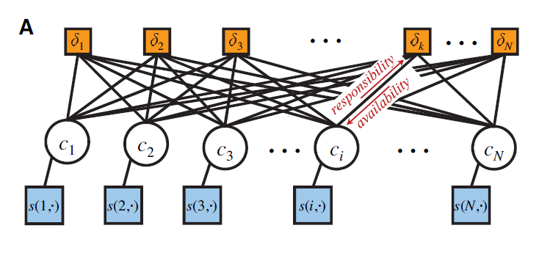
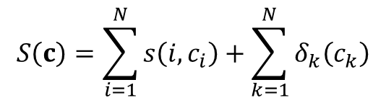
Represented as a factor graph :
$$S\left(c\right)=\sum_{i=1}^{N}{s\left(i,c_{i}\right)}+\sum_{k=1}^{N}{δ_{k}\left(c_{k}\right)}$$
function node
variable node
function node
Notes:
N个variable node（每个有N个可能的取值）
delta：function node（local factor： 无穷大或者0）
s： function node（local factor：相似性矩阵的一行或一列）

Slide 32
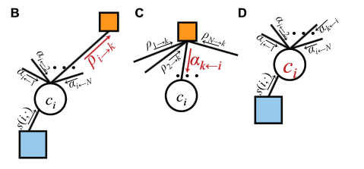
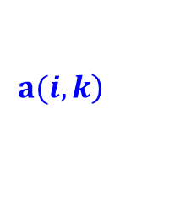
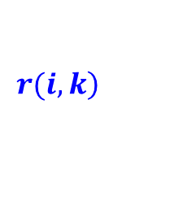
Represented as a factor graph :
variable node ---> delta function node
responsibility
$$\left.r(i,k\right)$$
how well suited is exemplar k for data point i,
compare to all other possible exemplars
function node ---> variable node
availability
$$\left.a(i,k\right)$$
how appropriate is candidate k as exemplar
for data point i, taking support from other data
points into account
loopy belief propagation in PGM( max-product inference)

Slide 33
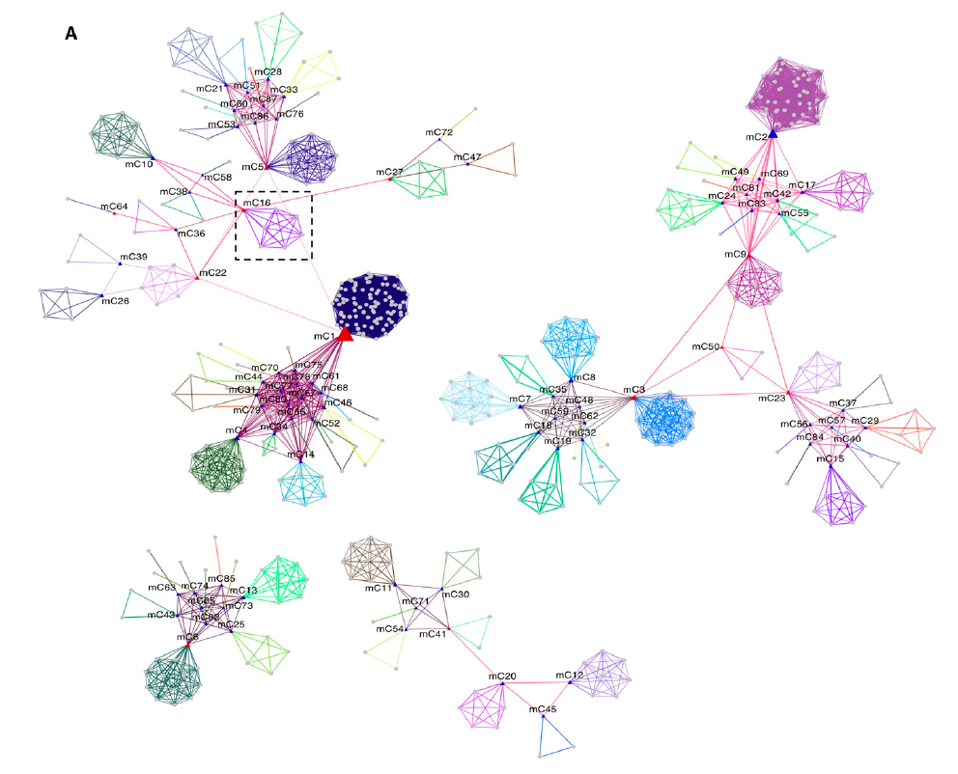
miRCos by Apcluster:
similarity: the proportion of genes shared
87 communities
exemplar

Slide 34
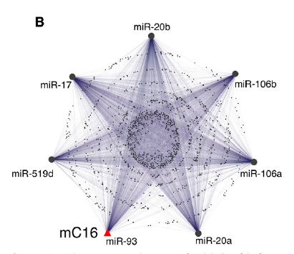
shared targets => shared biological functions:

Slide 35
hypergeometric ehrichment:
miRCos1:
DNA damage stimulus
Cell division
Cellular response to stress
miRCos49:
Methylation
O-Glycan biosynthesis
Insulin signaling pathway
Chemokine signaling pathway

Slide 36
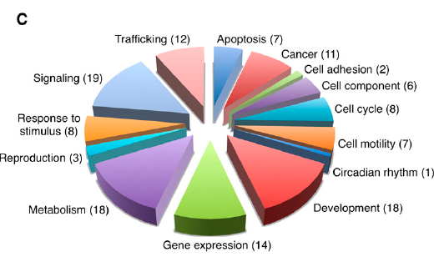
biological functions associated with each miRCos:

Slide 37
Summary
A comprehensive research about miRNA biology
elaborate the information associated with hundreds of different celluar and tissue
conditions ( capture relationships between gene regulatory dynamics )
central hypothesis: genes targeted by the same miRNA are co-expressed with each
other under multiple conditions
CoMeTa: integrate computational and expression analysis by relying on the
extraordinary resource of mRNA transcriptomke data sets
COOL: assign specific biological roles to significant co-expression clusters
miRCos: illustrated functions associated with synergic miRNA control

