Slide 1
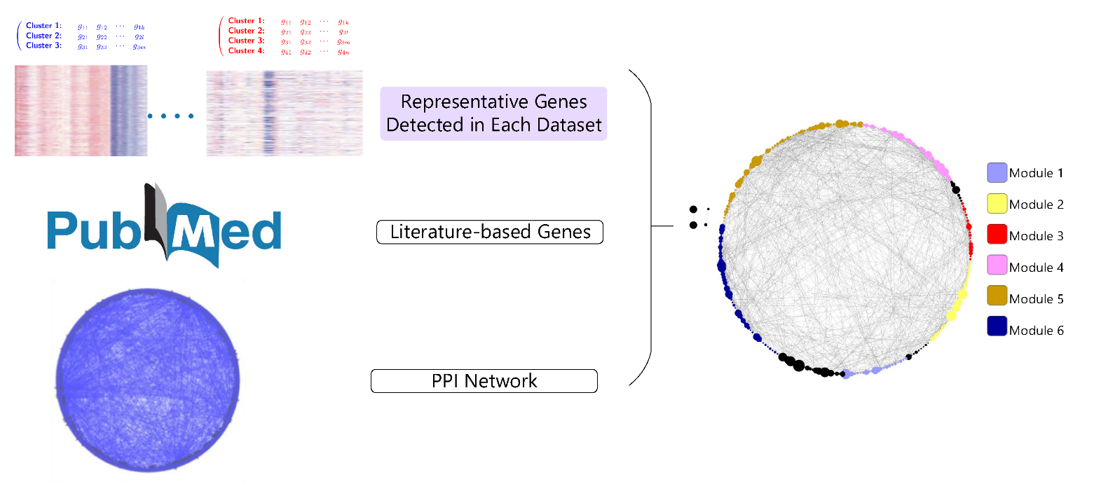
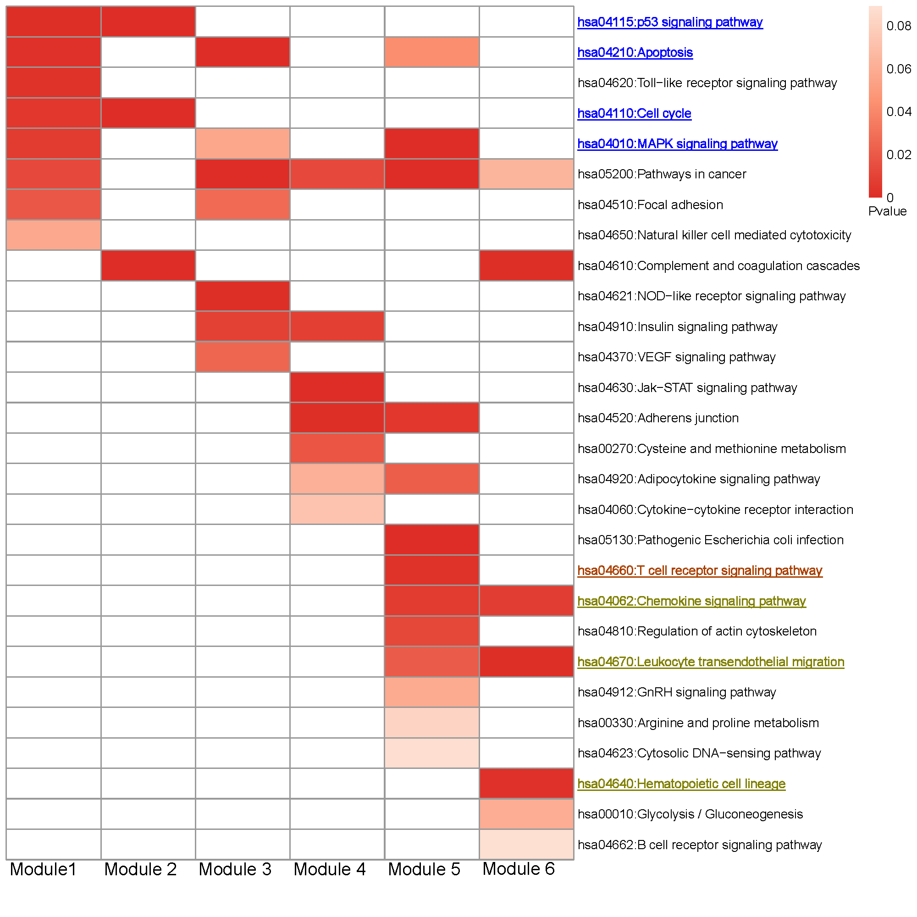
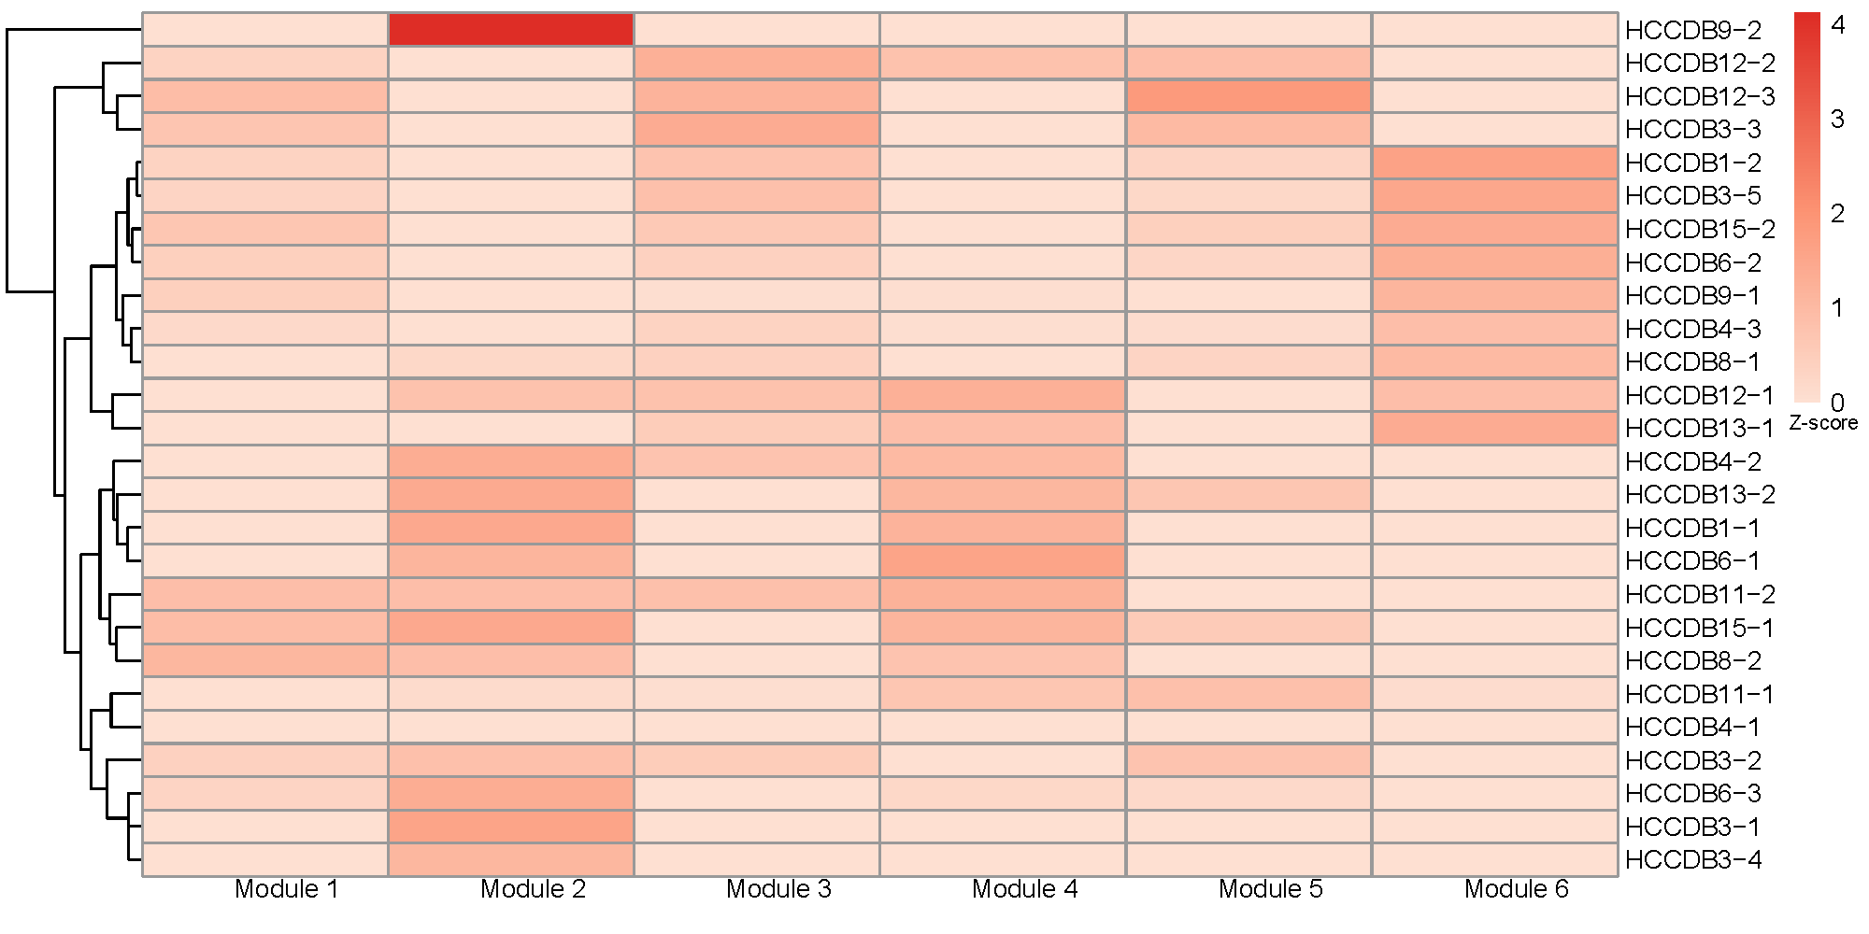
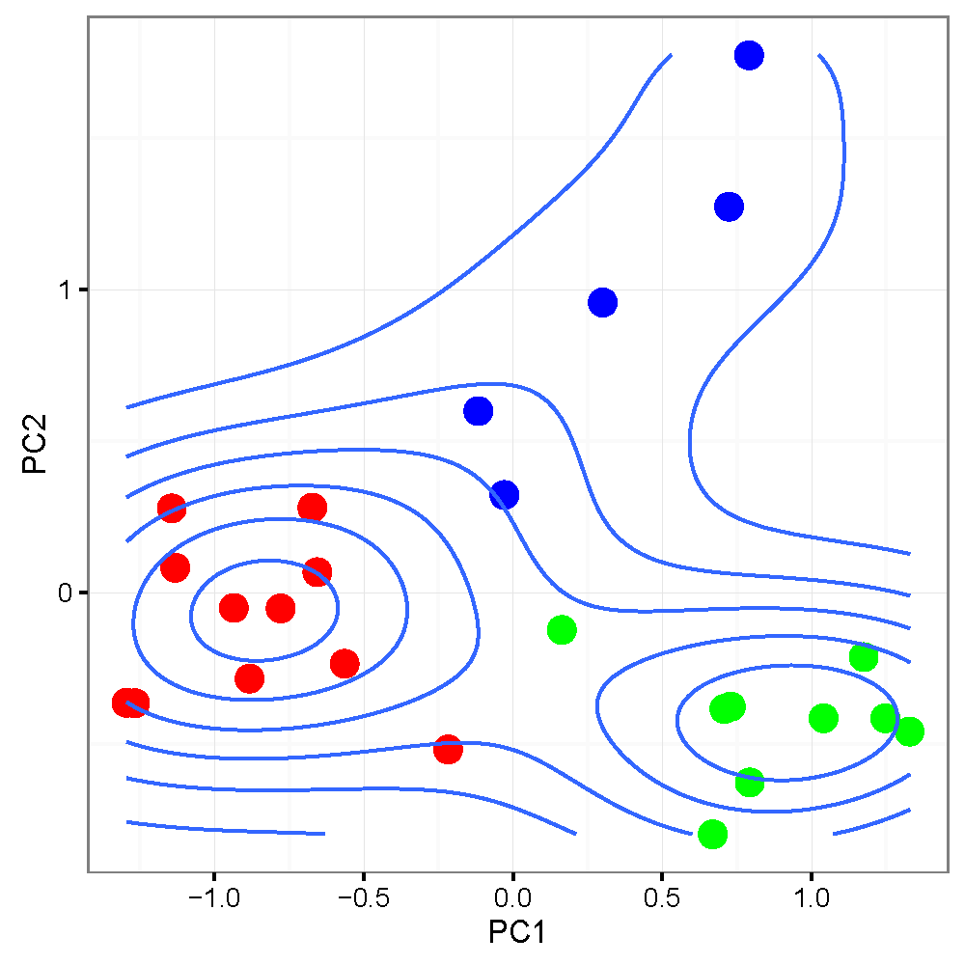
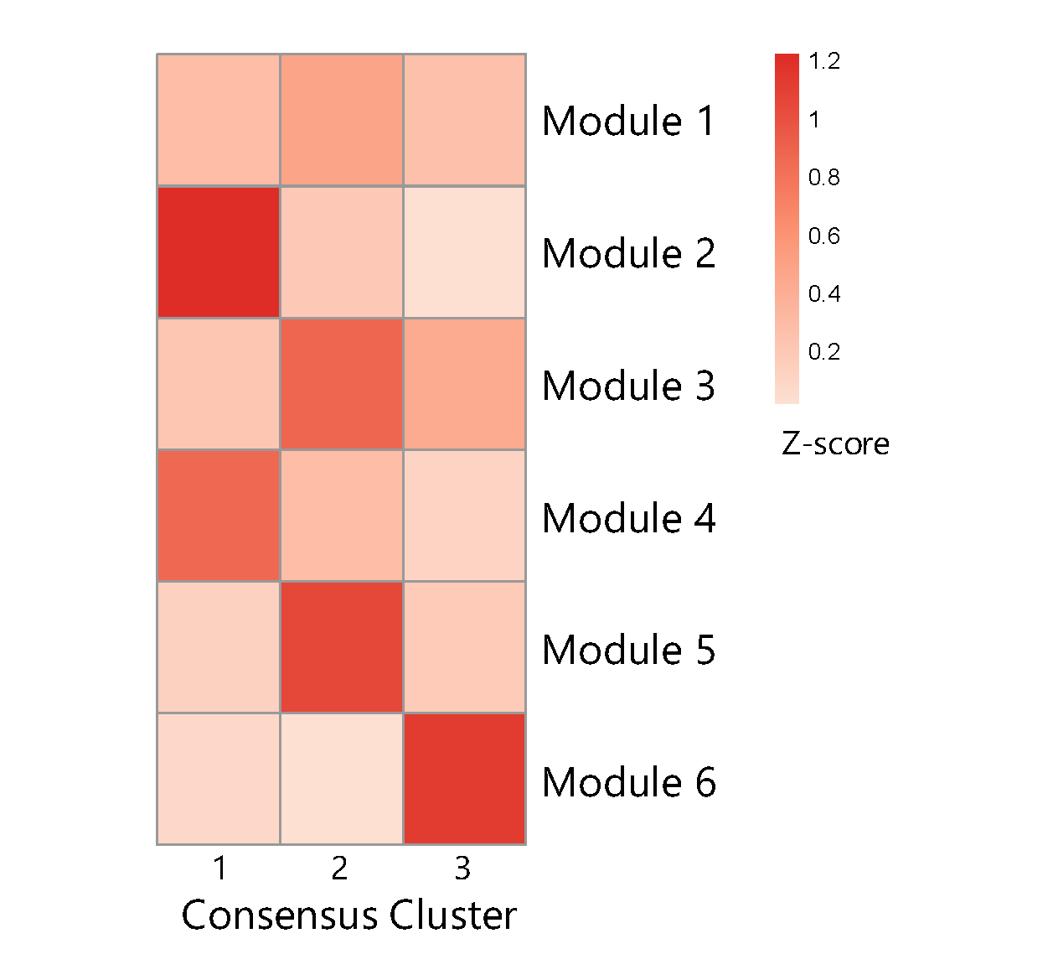


Signature-level knowledge network for cancer subtyping from the large-scale gene expression collection
Dongfang Wang, Guchao Zhang, Qiuyu Lian and Jin Gu*
MOE Key Lab of Bioinformatics and Bioinformatics Division, TNLIST, Department of Automation, Tsinghua University, Beijing 100084, China *jgu@tsinghua.edu.cn
Abstract
Background
The accumulation of genome-wide gene expression data provide the opportunity to classify cancer into different subgroups based on gene expression signatures. However, due to the heterogeneity of biological data, it is hard to normalize and adjust the batch effects of different datasets. As a reference to human intelligence, we communicate concept or knowledge rather than “data”. So, we propose a novel strategy to identify cancer subtypes based on signature-level knowledge network.
Hepatocellular carcinoma (HCC), one of the most prevalent cancer types worldwide, was taken an example. We carefully curated more than ten public large-scale gene expression datasets of more than 2,000 clinical HCC samples. Based on the curated data collection, we developed a signature-network based meta-analysis method to identify candidate HCC subtypes. A few consistent subtypes and molecular signatures were successfully identified. A web-based database HCCDB was also developed to visualize basic data analysis results of the collected datasets, including differential analysis and survival analysis.
Outlines
Review of basic strategies of cancer subtypes discovery across multiple datasets
Signature-level knowledge network for cancer subtyping
Preliminary results of HCC datasets
Results
Definition of signature-level knowledge network
Firstly, we divide every dataset into appropriate clusters, and obtain representative gene lists for each cluster of every dataset.
Then integrating with literature genes and PPI network, we define signature modules.
Figure: Discovery of signature modules across multiple datasets.
Figure: Function annotation of signature modules by DAVID.
Motivation
Can we find consistent and replicable clusterings from curated disease-specific dataset collections?
2) How to represent shared information across different datasets /studies/ cohorts?
Consensus clusters in the signature-level
For each original cluster in every dataset, we compute its perturbation of signature modules by:
(1). Compute median expression as the template.
(2). Compute z-score of each template's enrichment in all 6 modules.
Figure: Perturbation vectors of every cluster in each dataset.
Summary of current methods
Strategy 1:
Stack all datasets into one big matrix after "removing" batch
effects.
For example, J Cuinney et al., Nature Medicine, 2015;
Johnson WE et al., Biostatistics, 2007; etc.
Strategy 2:
Compare "similarity" of clusters from different datasets.
For example, Hoshida Y, et al. Cancer Research,2009;
CR Planey, et al., Genome Medicine, 2016.
Key: Similarity computation is based on signatures.
Figure: Consensus clusters of perturbation vectors.
Survival analysis
We re-classify patients based on the perturbation vectors.
Compare the survival analysis results with original clusters.
Hypothesis
People communicate concept, that is to say signatures, rather than “data”, with each other, about the subtypes of cancers.
Classification-related signature modules and their degrees of perturbation define the cancer subtypes.
Figure: Survival analysis of single clustering(Left, p=0.05) and consensus clustering (Right, p=0.008).
Reference
HCCDB: hepatocellular carcinoma expression atlas. http://bioinfo.au.tsinghua.edu.cn/database/hccdb

