Slide 1
Low-rank Based Methods to
Analyse Multiple Cancer Omics Data
王东方
2014.11.14

Slide 2
TCGA: Mission and Strategy
- Biological relevance of molecular changes in cancer
- Combined analysis of multiple different types of data
Introduction
http://www.nature.com/ng/journal/v45/n10/full/ng.2764.html

Slide 3
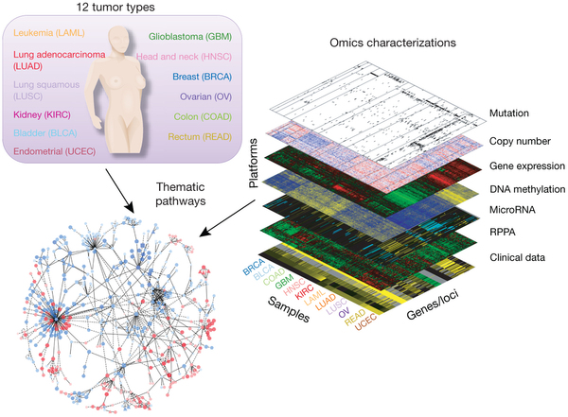
Generate, quality control, merge, analyze and interpret molecular profiles at the DNA, RNA, protein and epigenetic levels
Hundreds of clinical tumors representing various tumor types and their subtypes

Slide 4
to promote the development and application of new technologies
to detect cancer-specific molecular alterations
to make data and results freely available to the scientific community
to develop tools and standard operating procedures that can serve other large-scale profiling projects

Slide 5
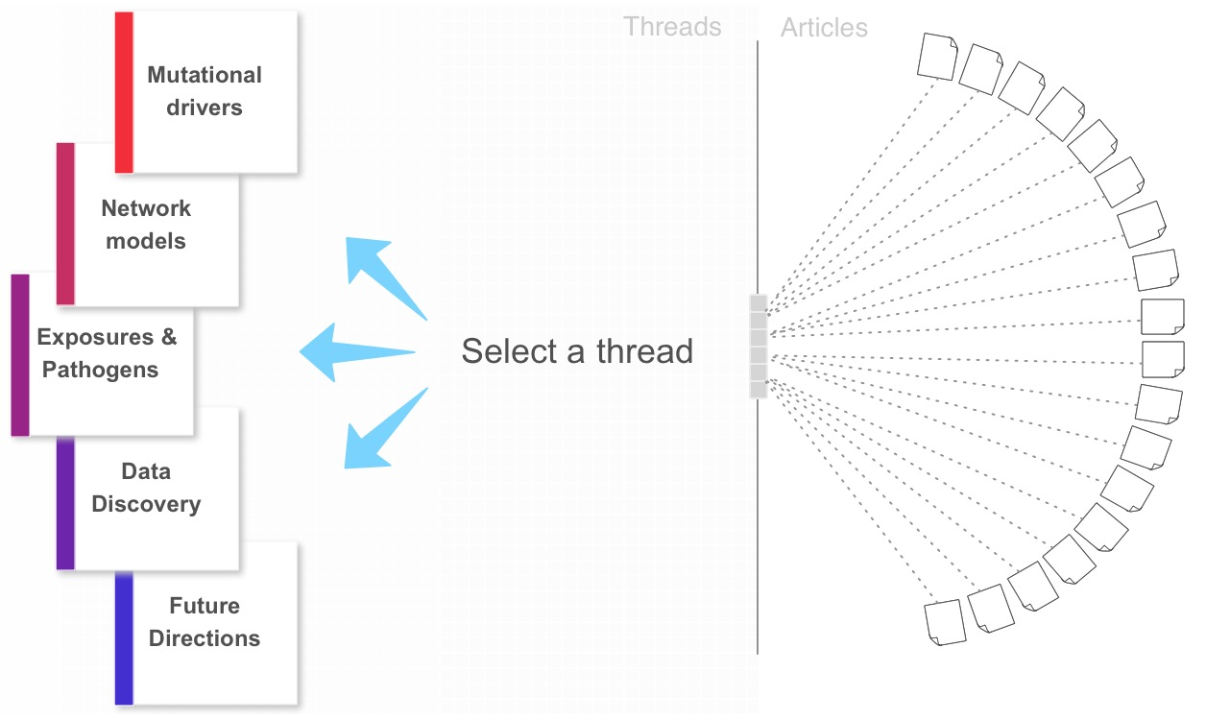

Slide 6
TCGA: Our Concerns (Methods + HCC)
- Multiple omics data: Redundancy and Heterogeneity
- How to integrate efficiently multiple omics data?
- Can we detect the intrinstic structure behind these data?
- To what extent these molecular data can help clinical application?

Slide 7
Method
A Low-rank-approximation Based Method to Analyse Multiple Omics Data
- A unified framework to analyse different types of data
- Try to detect latent structure behind cancer genomes
- Stable and fast

Slide 8
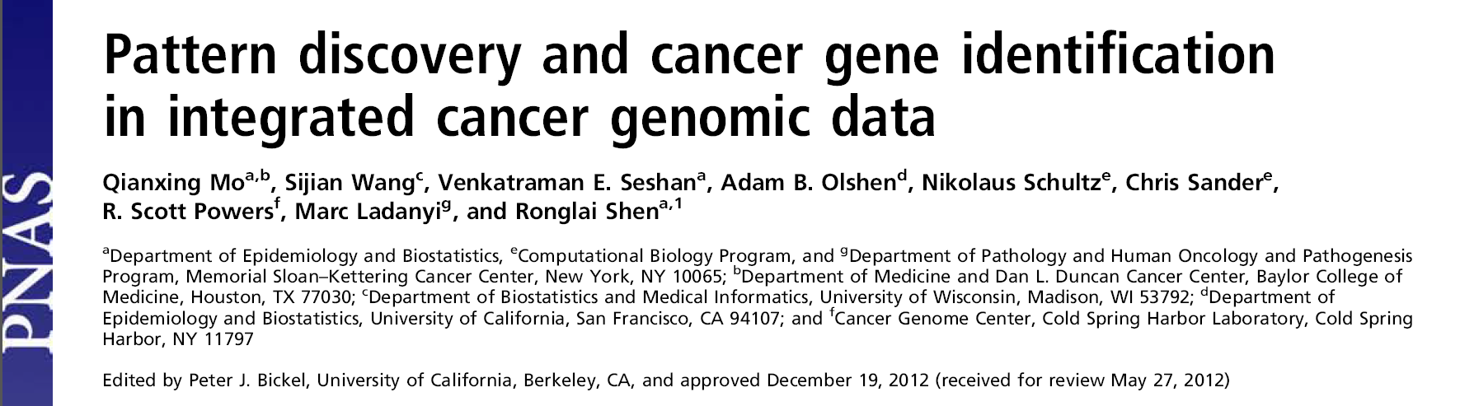
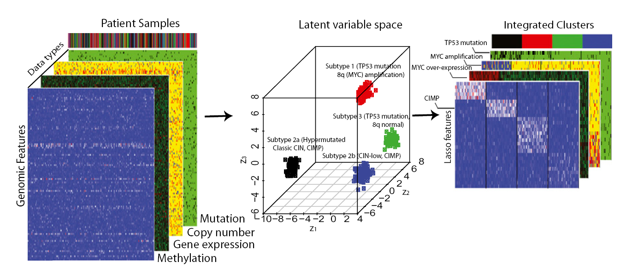

Slide 9
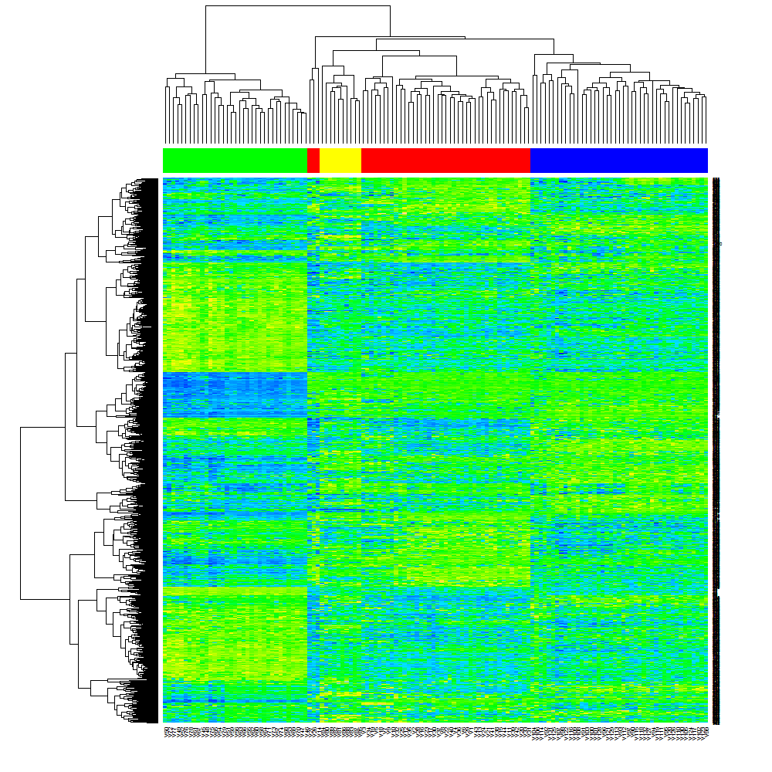
Microarray data from 4 different types of cancers: BRCA,OV,LUAD,COAD

Slide 10

How to obtain the low-rank representation?
- Rank of matrix: the number of non-zero singular values
- Convex approximation: nuclear norm

Slide 11

It’s easy to obtain the low-rank representation for real type data.
- PCA of data matrix X is the optimal solution.
- When there exists missing value or outliers, this can also be solved by efficient covex optimization methods.

Slide 12
How to find a unified framework for different types of data ?
binary (somatic mutation)
continuous (gene expression, CNV)
count (Hiseq)

Slide 13

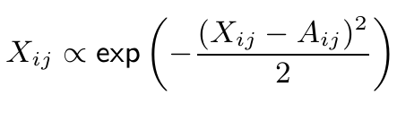
Where:
NLL means Negative log likelihood and A is the parameter matrix
- For real type data: (normal distribution)
Generalized Linear Models

Slide 14
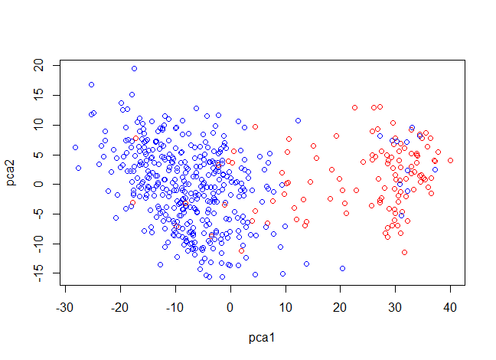
BRCA: ER+/- Microarray data

Slide 15




For count data, (Possion distribution)
Data matrix X
For Hiseq data, the “count” has been normalized. (Non-integer)
MLE for Possion distribution:

Slide 16
BRCA: ER+/- Hiseq Data
COAD: Hiseq Data

Slide 17


For binary data, (Bernoulli distribution)
Data matrix X

Slide 18
COAD: Mutation Data
most samples with the similar pattern
influential outliers

Slide 19
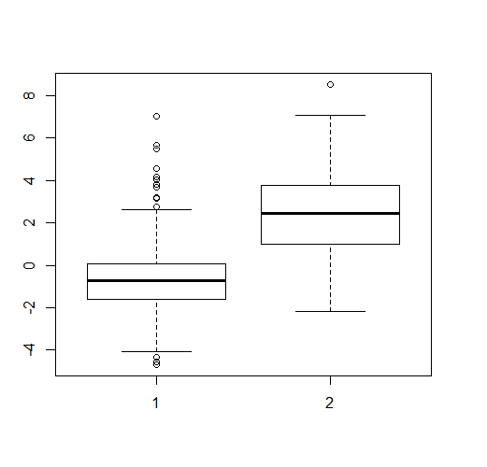
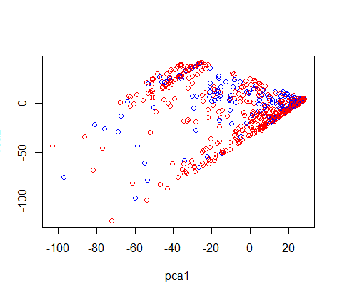
BRCA: ER+/- CNV Data

Slide 20
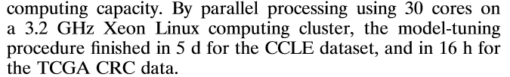
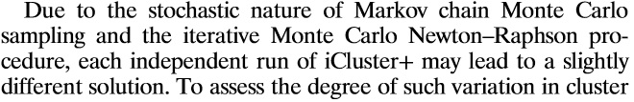
Compare with iCluster+(PNAS)
iCluster+: Nonconvex; MCMC sampling
Our methods: convex programming

Slide 21
Cluster Analysis
Consistent Analysis for Different Types of Data
Survival and other clinical data
Further Analysis

Slide 22
COAD gene expression (IlluminaHiseq) 273
COAD copy number (gistic2) 427 CNV
COAD gene-level mutation (bcm) 217 Mutation
Hiseq+Mutation | 209
Hiseq+CNV | 259
Mutation+CNV | 216
Hiseq+Mutation+CNV | 208

Slide 23
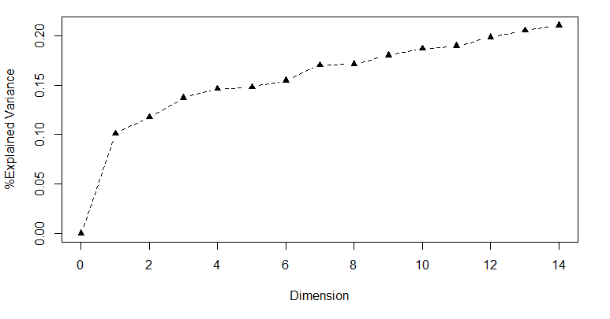
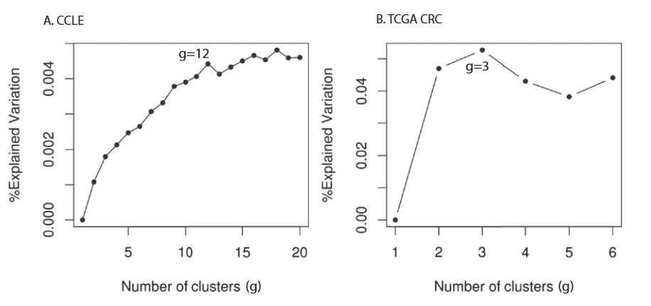
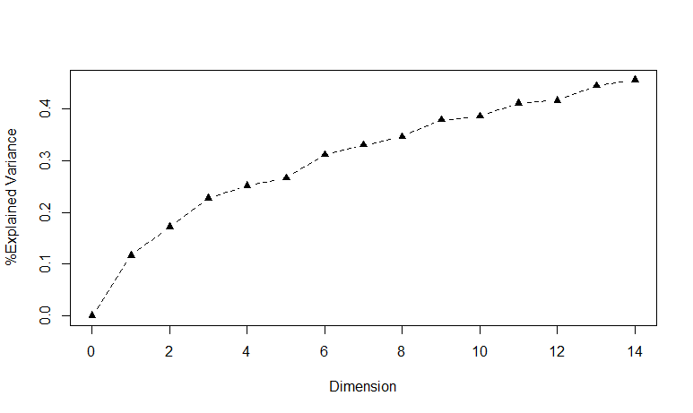
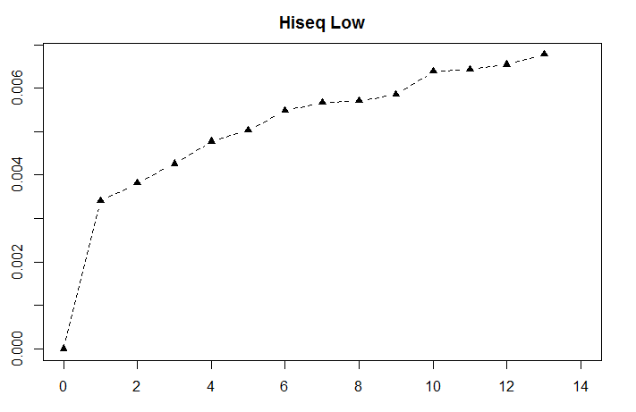
Determine the dimension
Mutation
CNV
Hiseq
(From PNAS)

Slide 24
Dimension = 3; Cluster = 3+1 = 4.
Hiseq
Mutation
CNV

Slide 25
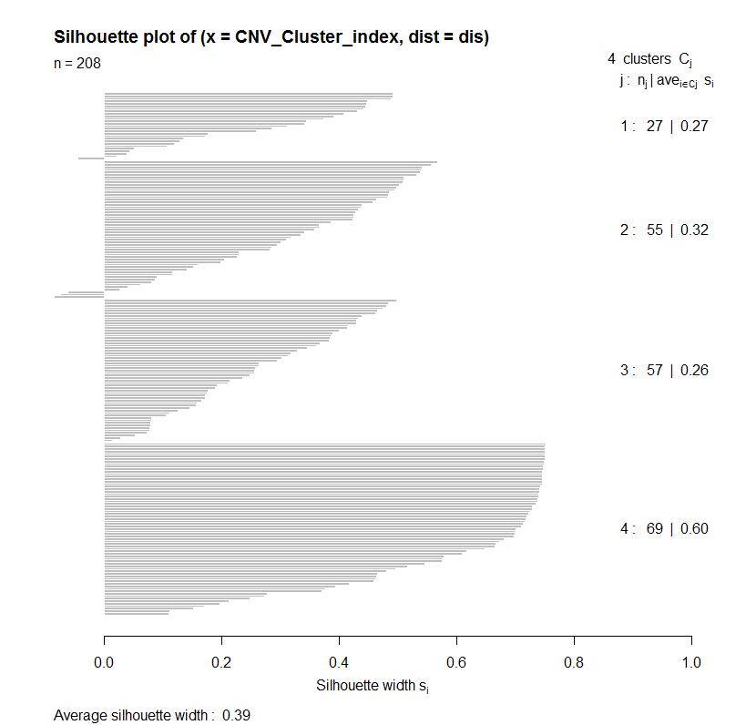

Dimension = 3; Cluster Evaluation.
b(i): The lowest average
dissimilarity to any
other cluster.
a(i): The average
dissimilarity to its
cluster.

Slide 26
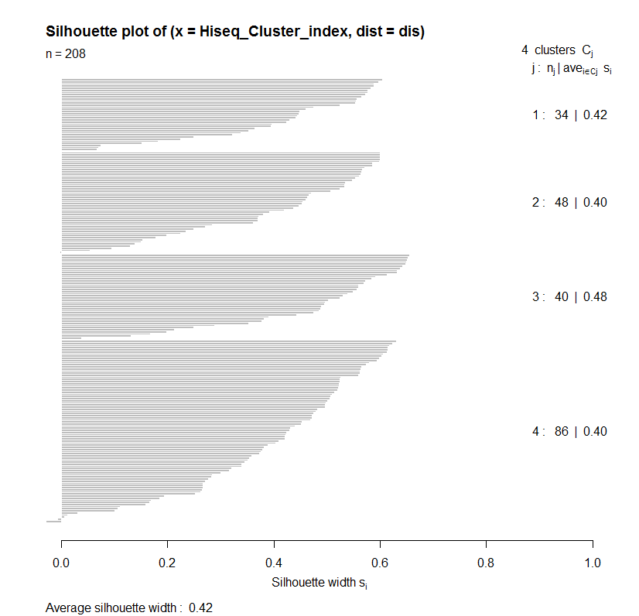
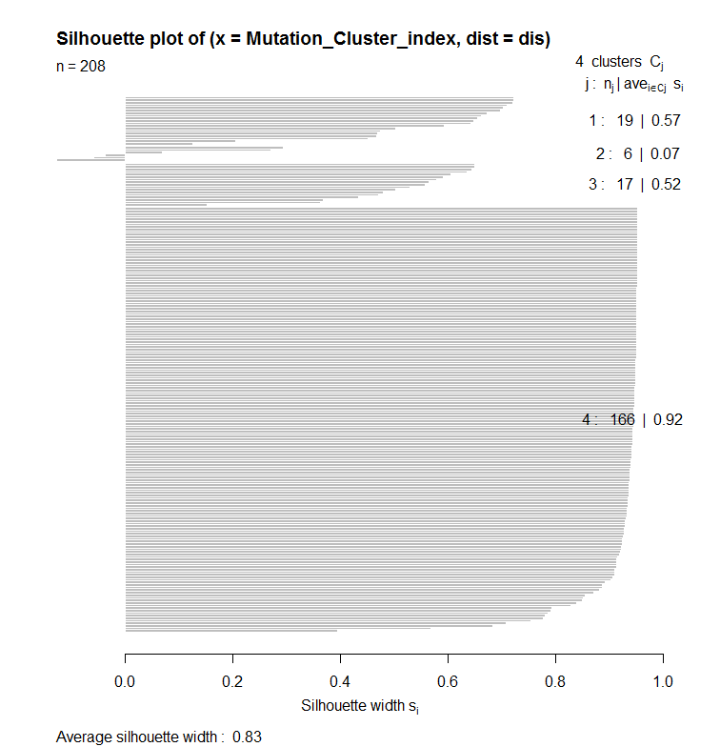

Slide 27
There exists significant cluster structure in low-dimensional space.
Most samples have similar mutation pattern in low dimensional space.
Brief Summary

Slide 28


Jaccard similarity of two sets:
row: Hiseq; col: CNV
 | 1 | 2 | 3 | 4
1 | 0.1025641 | 0.08928571 | 0.1276596 | 0.10975610
2 | 0.1235955 | 0.07142857 | 0.1320755 | 0.20689655
3 | 0.1645570 | 0.11666667 | 0.1313131 | 0.07777778
4 | 0.1694915 | 0.09708738 | 0.2640000 | 0.19166667

Slide 29


row: Mutation; col: CNV
row:Hiseq; col: Mutation
 | 1 | 2 | 3 | 4
1 | 0.07575758 | 0.06976744 | 0.07058824 | 0.07042254
2 | 0.01754386 | 0.00000000 | 0.04000000 | 0.03278689
3 | 0.06153846 | 0.04761905 | 0.08536585 | 0.05714286
4 | 0.23863636 | 0.12865497 | 0.30769231 | 0.25988701
 | 1 | 2 | 3 | 4
1 | 0.08163265 | 0.05263158 | 0.02000000 | 0.1560694
2 | 0.09836066 | 0.00000000 | 0.10169492 | 0.2022472
3 | 0.03508772 | 0.04545455 | 0.05555556 | 0.1907514
4 | 0.07142857 | 0.02222222 | 0.07291667 | 0.3846154

Slide 30
The overlap of cluster results between different type of data is moderate.
Different information is provided by different data.
Integration may offer more reliable results.
Brief Summary

Slide 31
Compare with pathologic stage (row: stage; col: cluster)
 | 1 | 2 | 3 | 4
1 | 0.044944 | 0.104575 | 0.1875 | 0.060976
2 | 0.137681 | 0.207254 | 0.186747 | 0.152672
3 | 0.048193 | 0.147887 | 0.067227 | 0.094595
4 | 0.155039 | 0.256983 | 0.166667 | 0.067164
Hiseq (298)
 | 1 | 2 | 3 | 4
1 | 0.02439 | 0.102273 | 0.013699 | 0
2 | 0.131429 | 0.310881 | 0.337209 | 0.153846
3 | 0 | 0.011494 | 0 | 0.034483
4 | 0.134615 | 0.163265 | 0.045977 | 0.018182
Mutation (208)
 | 1 | 2 | 3 | 4
1 | 0.094017 | 0.068627 | 0.111111 | 0.127451
2 | 0.103448 | 0.165289 | 0.190244 | 0.147436
3 | 0.106918 | 0.146552 | 0.1875 | 0.116438
4 | 0.142077 | 0.328889 | 0.134783 | 0.031579
CNV (417)

Slide 32
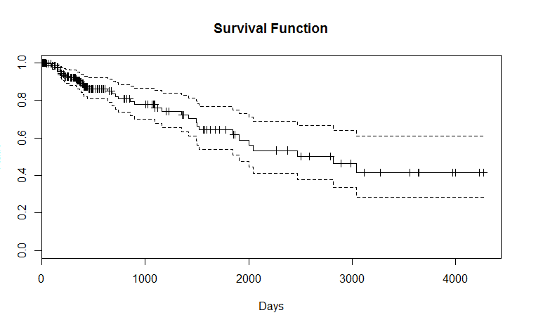

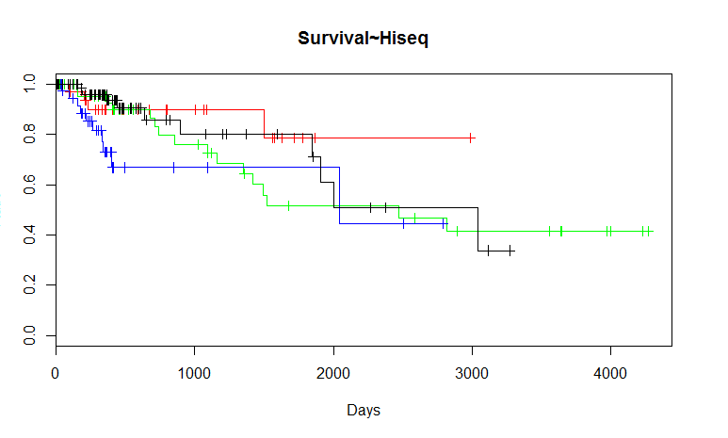
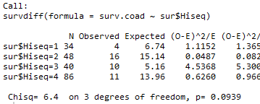

Slide 33
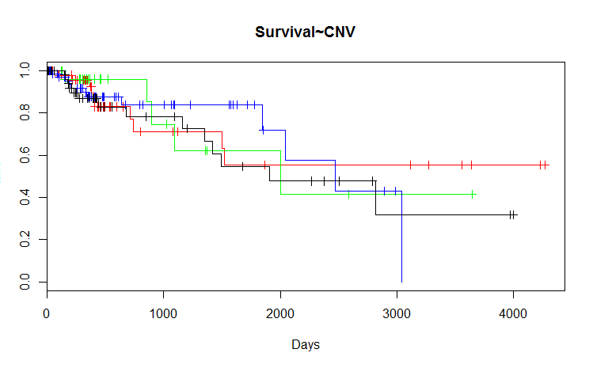
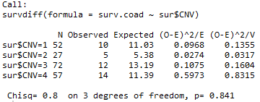
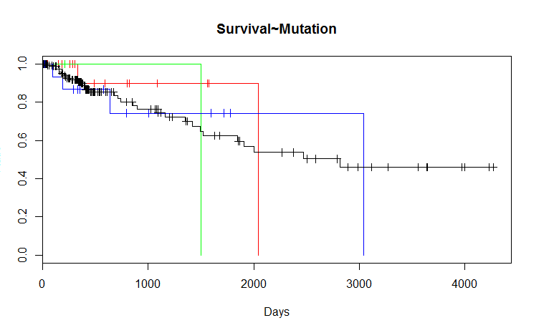
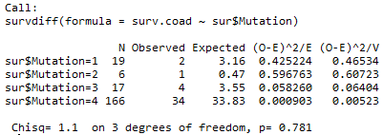

Slide 34
Whether exists true subtypes relevant to clinical data?
Whether we can predict clinical data from molecular information?
We need an more appropriate index to detect the quality of cluster.
Other Questions

Slide 35
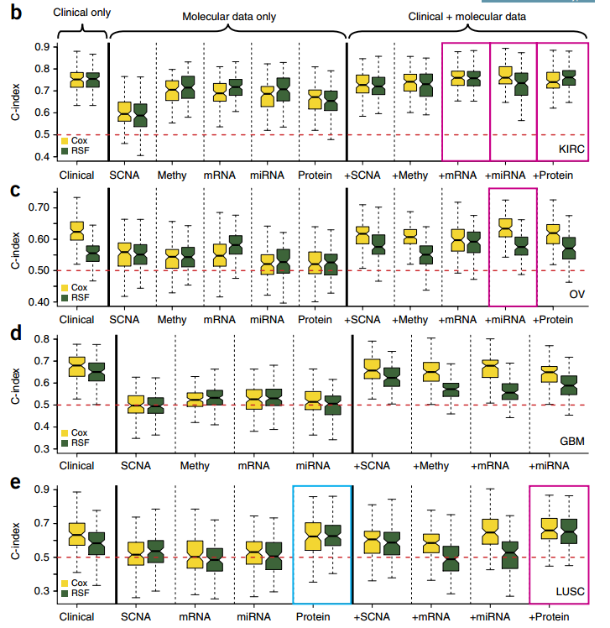
Yuan Y*, Liang H,et al
Assessing the clinical utility of cancer genomic and proteomic data across tumor types. Nature Biotechnology. 2014, 32(7): 644-652

