Slide 1
Modelling of Diffuse Scattering Effects for Outdoor Ray Tracing
Andrew Whelan, 21211056
Supervisor: Prof Conor Brennan

Slide 2
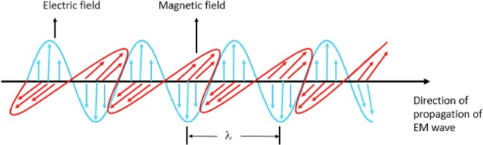
Description – Electromagnetic (EM) Propagation
Modelled well as a wave (Maxwell)
Plane polarization [1]:

Slide 3
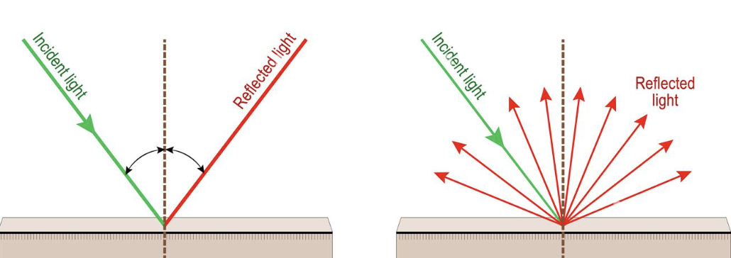
Description – Reflections
Two models (predating Maxwell) [2]:
1. Specular 2. Diffuse

Slide 4
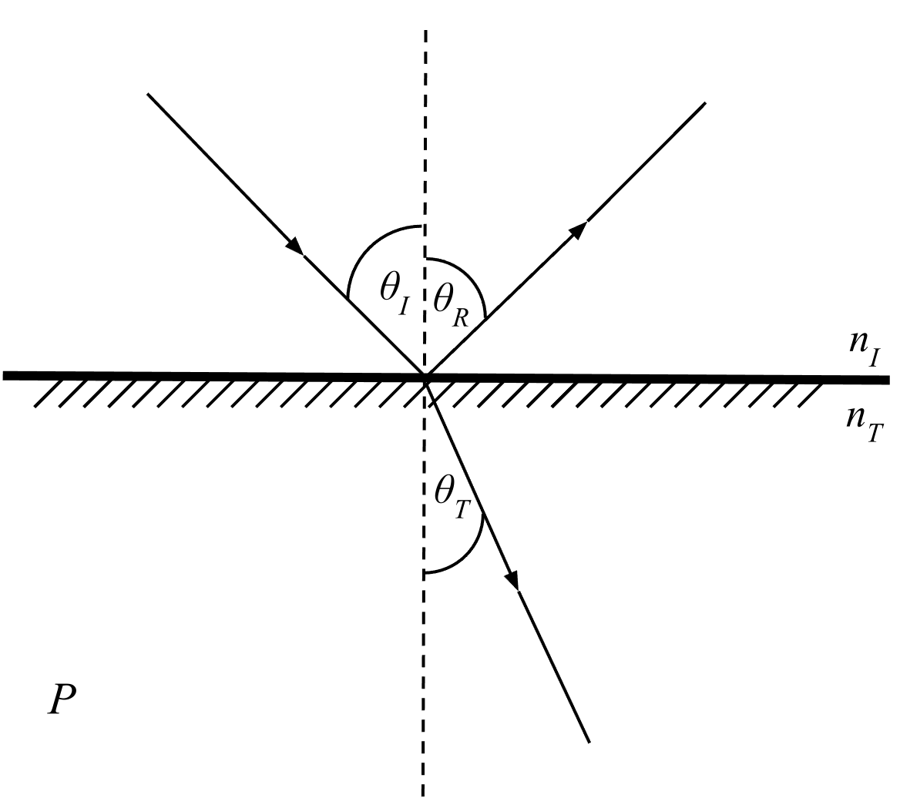

Description – Specular Reflection
$$\left(θ_{R},θ_{T}\right)=\left(θ_{I},\sin^{−1}\left(\frac{n_{I}}{n_{T}}sin⁡θ_{I}\right)\right)$$
$$\left(r_{∥},r_{⊥}\right)=\left(\frac{\tan\left(θ_{I}−θ_{T}\right)}{\tan\left(θ_{I}+θ_{T}\right)},−\frac{\sin\left(θ_{I}−θ_{T}\right)}{\sin\left(θ_{I}+θ_{T}\right)}\right)$$
Can forecast power for bouncing rays

Slide 5
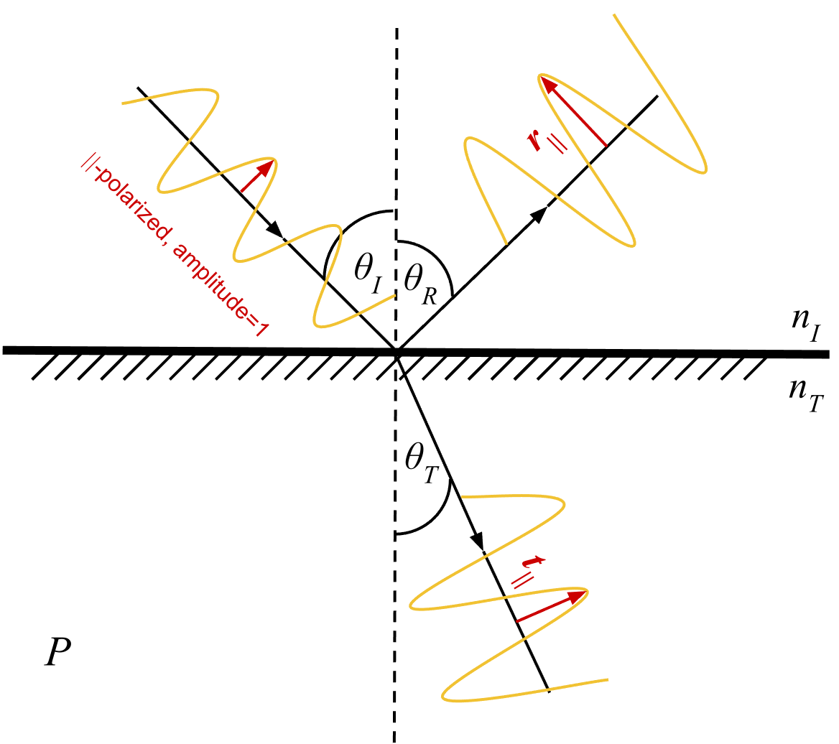

Description – Specular Reflection
$$\left(θ_{R},θ_{T}\right)=\left(θ_{I},\sin^{−1}\left(\frac{n_{I}}{n_{T}}sin⁡θ_{I}\right)\right)$$
$$\left(r_{∥},r_{⊥}\right)=\left(\frac{\tan\left(θ_{I}−θ_{T}\right)}{\tan\left(θ_{I}+θ_{T}\right)},−\frac{\sin\left(θ_{I}−θ_{T}\right)}{\sin\left(θ_{I}+θ_{T}\right)}\right)$$
Can forecast power for bouncing rays

Slide 6

Description – Specular Reflection
$$\left(θ_{R},θ_{T}\right)=\left(θ_{I},\sin^{−1}\left(\frac{n_{I}}{n_{T}}sin⁡θ_{I}\right)\right)$$
$$\left(r_{∥},r_{⊥}\right)=\left(\frac{\tan\left(θ_{I}−θ_{T}\right)}{\tan\left(θ_{I}+θ_{T}\right)},−\frac{\sin\left(θ_{I}−θ_{T}\right)}{\sin\left(θ_{I}+θ_{T}\right)}\right)$$
Can forecast power for bouncing rays

Slide 7
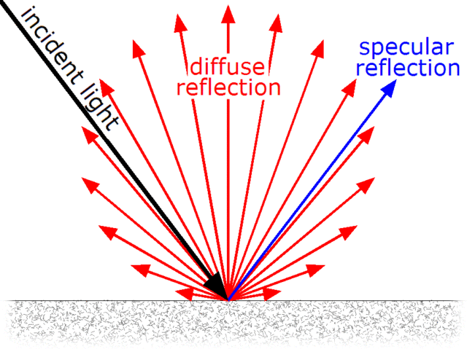
Description – Diffuse Reflection
Typical picture [3] :

Slide 8


Description – Diffuse Reflection
An ideal “matte” surface
Assuming constant power per
solid unit angle, give
Issues:
Principle: parametric assumption
Practical:
Parametrization ( for $E_{0}$ )
Computational complexity (per-bounce integral)

Slide 9

Description – Diffuse Reflection
An ideal “matte” surface
Assuming constant power per
solid unit angle, give
Issues:
Principle: parametric assumption
Practical:
Parametrization ( for $E_{0}$ )
Computational complexity (per-bounce integral)

Slide 10

Description – Diffuse Reflection
An ideal “matte” surface
Assuming constant power per
solid unit angle, give
Issues:
Principle: parametric assumption
Practical:
Parametrization ( for $E_{0}$ )
Computational complexity (per-bounce integral)

Slide 11
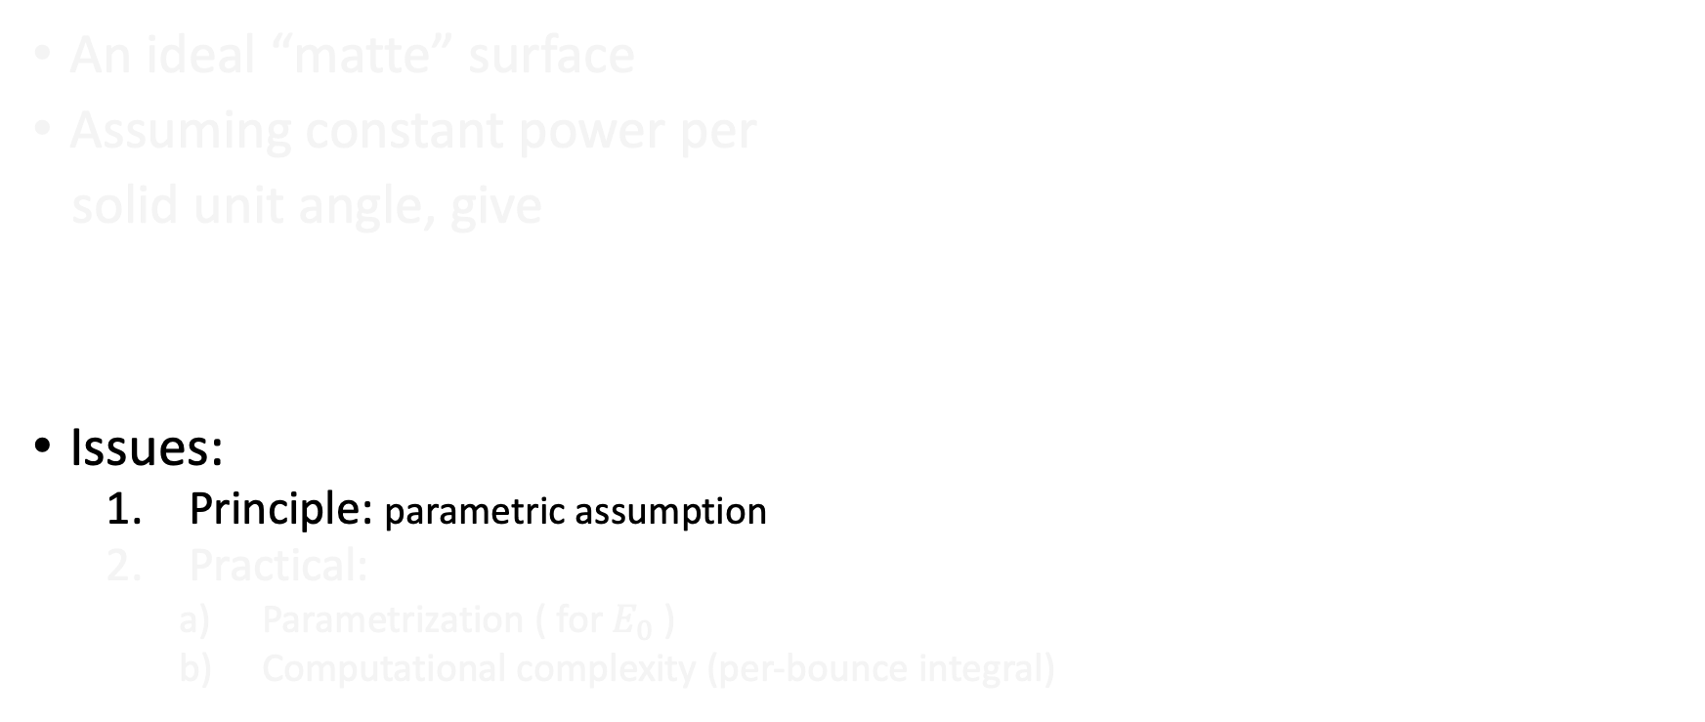
Description – Diffuse Reflection
An ideal “matte” surface
Assuming constant power per
solid unit angle, give
Issues:
Principle: parametric assumption
Practical:
Parametrization ( for $E_{0}$ )
Computational complexity (per-bounce integral)

Slide 12


Previous Work
Heuristic Models
Continue with a parametric model like $E_{S}=E_{0}\sqrt{\cos\left(θ_{s}\right)}$
Catch-all heuristic parameter encapsulating roughness peculiarities
“Plug-and-play”
“Physical” Models
Based off Maxwell’s equations
$$E_{S}=E_{0}\sqrt{\cos\left(θ_{s}\right)}$$
Multiple statistical parameters for surface roughness
Estimates needed for surface roughness

Slide 13


Previous Work
Heuristic Models
Continue with a parametric model like $E_{S}=E_{0}\sqrt{\cos\left(θ_{s}\right)}$
Catch-all heuristic parameter encapsulating roughness peculiarities
“Plug-and-play”
“Physical” Models
Based off Maxwell’s equations
$$E_{S}=E_{0}\sqrt{\cos\left(θ_{s}\right)}$$
Multiple statistical parameters for surface roughness
Estimates needed for surface roughness

Slide 14
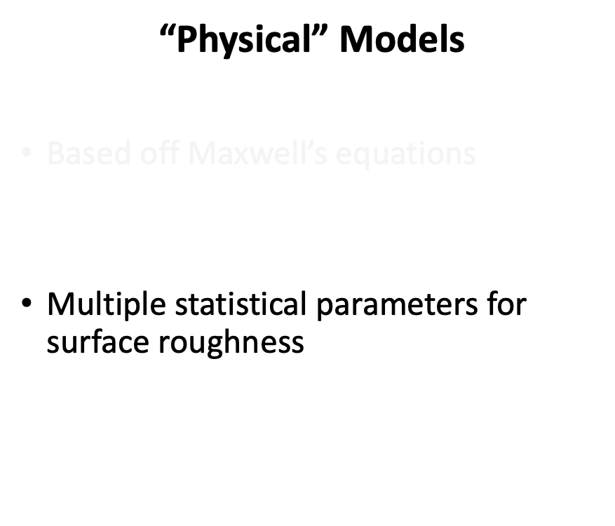
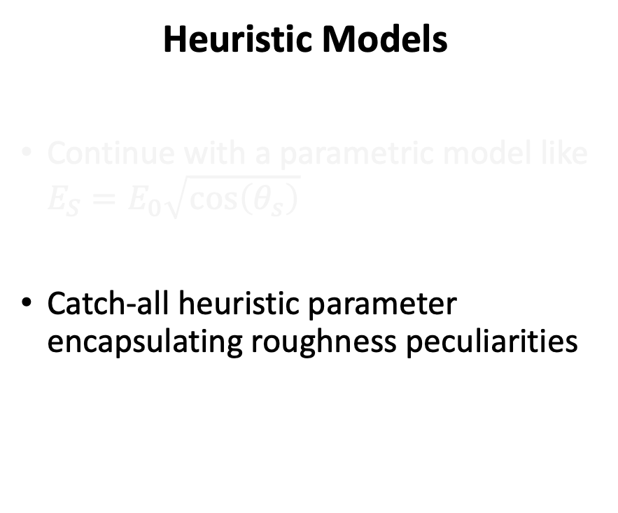
Previous Work
Heuristic Models
Continue with a parametric model like $E_{S}=E_{0}\sqrt{\cos\left(θ_{s}\right)}$
Catch-all heuristic parameter encapsulating roughness peculiarities
“Plug-and-play”
“Physical” Models
Based off Maxwell’s equations
$$E_{S}=E_{0}\sqrt{\cos\left(θ_{s}\right)}$$
Multiple statistical parameters for surface roughness
Estimates needed for surface roughness

Slide 15
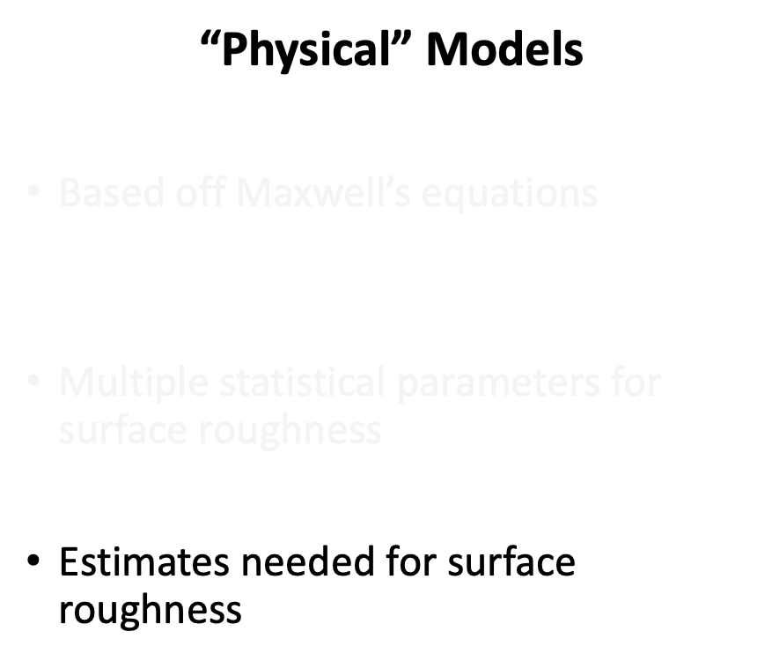
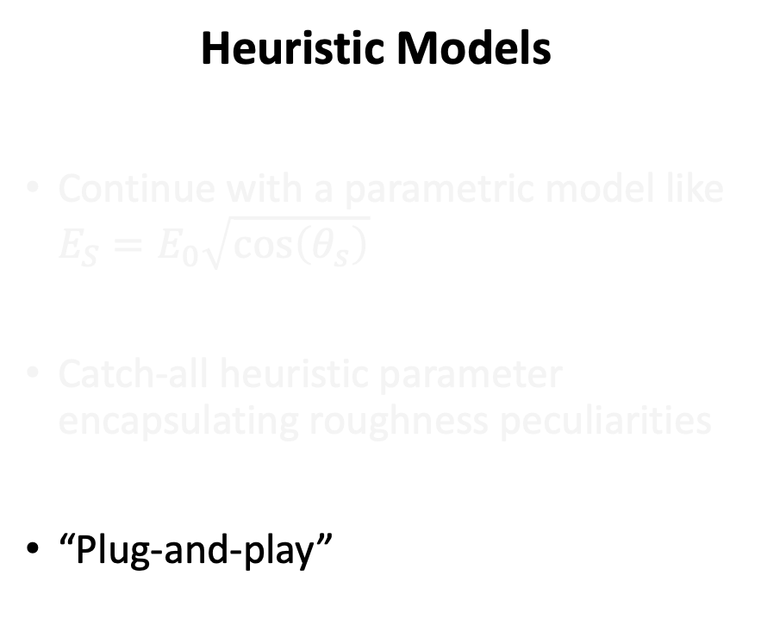
Previous Work
Heuristic Models
Continue with a parametric model like $E_{S}=E_{0}\sqrt{\cos\left(θ_{s}\right)}$
Catch-all heuristic parameter encapsulating roughness peculiarities
“Plug-and-play”
“Physical” Models
Based off Maxwell’s equations
$$E_{S}=E_{0}\sqrt{\cos\left(θ_{s}\right)}$$
Multiple statistical parameters for surface roughness
Estimates needed for surface roughness

Slide 16
Proposed Project Work
Validation of Heuristic Models vs. Full-Wave Monte-Carlo
Effective-Roughness parameter estimation
Potential numerical simplifications

Slide 17
Proposed Project Work
Validation of Heuristic Models vs. Full-Wave Monte-Carlo
Effective-Roughness parameter estimation
Potential numerical simplifications

Slide 18
Proposed Project Work
Validation of Heuristic Models vs. Full-Wave Monte-Carlo
Effective-Roughness parameter estimation
Potential numerical simplifications

Slide 19
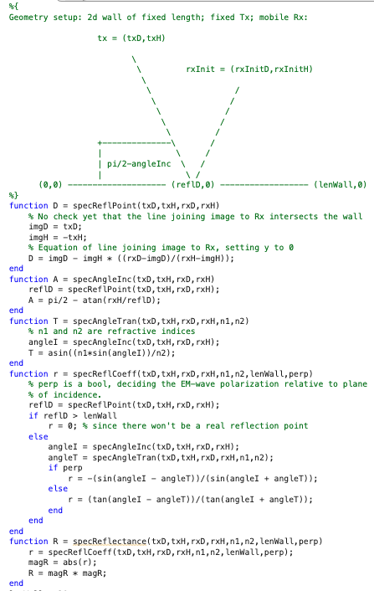
Current Work State
MATLAB code for specular reflection in simple setup:
Currently: integrating diffuse component

Slide 20
Project Calendar Deliverables
March Heuristic-model programming (simple setup)
April Full-wave Monte-Carlo programming
May Validation / Comparison of Monte-Carlo and heuristic-model
June Parameter-estimation / simplifications
July Consolidation of results
August Project write-up

Slide 21
Project Calendar Deliverables
March Heuristic-model programming (simple setup)
April Full-wave Monte-Carlo programming
May Validation / Comparison of Monte-Carlo and heuristic-model
June Parameter-estimation / simplifications
July Consolidation of results
August Project write-up

Slide 22
Project Calendar Deliverables
March Heuristic-model programming (simple setup)
April Full-wave Monte-Carlo programming
May Validation / Comparison of Monte-Carlo and heuristic-model
June Parameter-estimation / simplifications
July Consolidation of results
August Project write-up

Slide 23
Project Calendar Deliverables
March Heuristic-model programming (simple setup)
April Full-wave Monte-Carlo programming
May Validation / Comparison of Monte-Carlo and heuristic-model
June Parameter-estimation / simplifications
July Consolidation of results
August Project write-up

Slide 24
Project Calendar Deliverables
March Heuristic-model programming (simple setup)
April Full-wave Monte-Carlo programming
May Validation / Comparison of Monte-Carlo and heuristic-model
June Parameter-estimation / simplifications
July Consolidation of results
August Project write-up

Slide 25
References
[1] Mojtaba Rouhi, Zoleikha Hajizadeh, Reza Taheri-Ledari, Ali Maleki, Mohsen Babamoradi, “A review of mechanistic principles of microwave absorption by pure and composite nanomaterials”, Materials Science and Engineering: B, Volume 286, 2022.
[2] Tetiana Zhabska, “Types of reflection. Specular and Diffuse reflection. Incident light and Reflected rays. Vector illustration for education”, https://www.alamy.com/types-of-reflection-specular-and-diffuse-reflection-incident-light-and-reflected-rays-vector-illustration-for-education-image502982191.html
[3] GianniG46, CC BY-SA 3.0, <https://creativecommons.org/licenses/by-sa/3.0>, via Wikimedia Commons, https://commons.wikimedia.org/wiki/File:Lambert2.gif

