Slide 1

Pkg Management for Julia
Julia：a High Performance and dynamically typed Language.
One-Click to Install
Julia-Community-EN
JuliaHub
Julia-Community-CN
Auto Check
Julia Executor：
Load
Add
Uninstall
Upgrade
Upgrade All
Package Name
Version
Latest Version

Slide 2
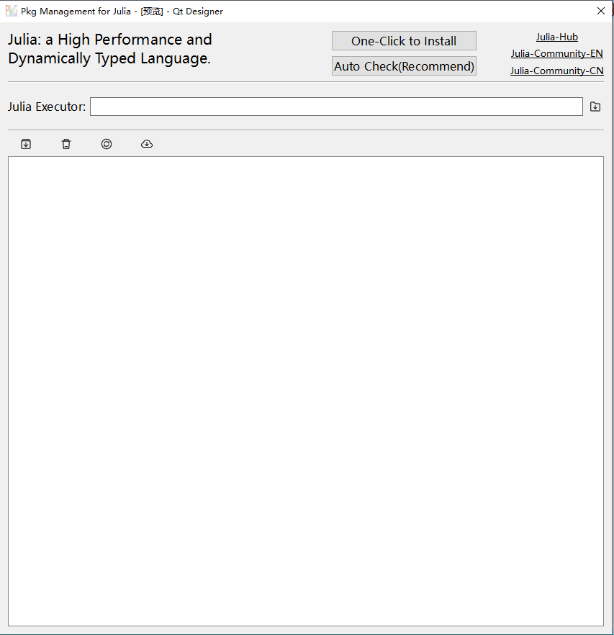
2022-04-21

