Slide 1
Different uplink/downlink ratio and resource allocation for TDD
Group 9
B04901079 周俊穎
B05901178 葉咸辰

Slide 2
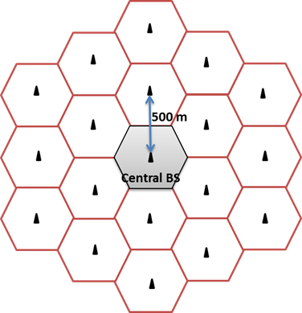
Model
19 base stations (BS) are located in an urban area with temperature 27℃
50 uniformly random distributed mobile devices in each cell
Another moving mobile initial location : (0, 0)
Moving direction : [0, 2π]
Velocity: [1m/s, 5m/s]
Mobile device moves t seconds, t=[1s,6s]

Slide 3
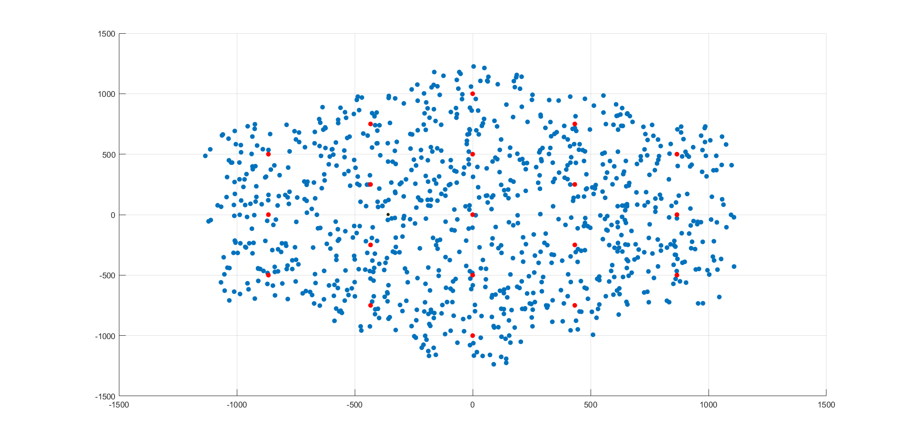

Slide 4
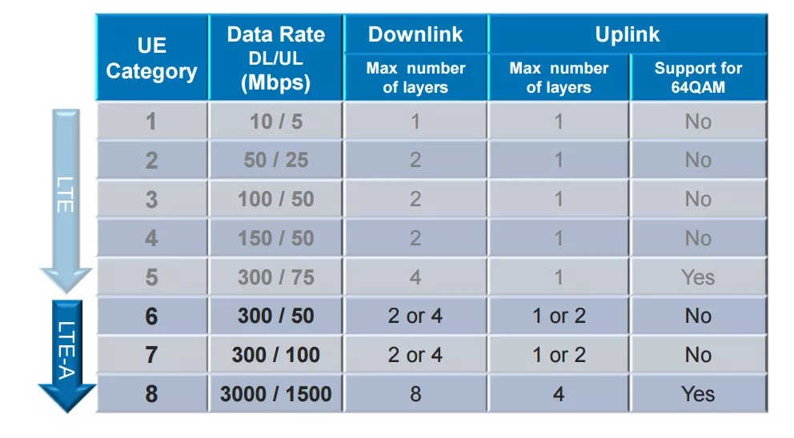
UL/DL Data Rate and UL/DL TDD ratio
3GPP release 8
DL/UL=300Mbps/75Mbps
DL/UL ratio: 1:3, 1:1, 3:1,
2:1, 7:2, 8:1, 3:5

Slide 5
Assumption
1. P_noise>P_receive, stop sending packet
2. DL/UL file size=100MB/5MB
3. No packet loss
4. Time slot=1ms
5. If handoff occurs, new BS has to resend the packets.
6. Two-ray ground model

Slide 6
1. Only UL/UL and DL/DL interference
DL/UL | Tmin | 大於Tmin 次數
1/3 | 13331 | 0
1/1 | 6666 | 0
3/1 | 4445 | 1
2/1 | 4447 | 0
7/2 | 3810 | 0
8/1 | 5333 | 4
3/5 | 8890 | 0

Slide 7
2. Flexible DL/UL Data Rate
DL/UL | 1 | 2 | 3 | 4 | 5 | 6 | 7 | 8 | 9 | 10
1/3 | 13331 | 13331 | 13331 | 13331 | 13331 | 13331 | 13331 | 13331 | 13331 | 13331
1/1 | 6666 | 6666 | 6666 | 6666 | 6666 | 6666 | 6666 | 6666 | 6666 | 6666
3/1 | 25378 | 4445 | 4445 | 4445 | 1071508 | 4445 | 4445 | 4445 | 4445 | 37813
2/1 | 4447 | 4447 | 4447 | 4447 | 4447 | 4447 | 4447 | 4447 | 4447 | 4447
7/2 | 3810 | 3810 | 3810 | 3810 | 3810 | 3810 | 6153 | 3810 | 3810 | 3810
8/1 | fail | 5333 | 6083 | 5333 | 5333 | 216493 | 5803 | 5333 | 53813 | 5333
3/5 | 8890 | 8890 | 8890 | 8890 | 8890 | 8890 | 8890 | 8890 | 8890 | 57573

Slide 8
3. UL/DL and DL/UL Interference
DL/UL | Tmin | 大於Tmin 次數
1/3 | 13331 | 0
1/1 | 6666 | 1
3/1 | 4445 | 1
2/1 | 4447 | 0
7/2 | 3810 | 0
8/1 | 5333 | 1
3/5 | 8890 | 0

Slide 9
4. UL/DL and DL/UL Interference, all mobile moving
DL/UL | Tmin | 大於Tmin 次數
1/3 | 13331 | 0
1/1 | 6666 | 1
3/1 | 4445 | 1
2/1 | 4447 | 0
7/2 | 3810 | 0
8/1 | 5333 | 1
3/5 | 8890 | 0

Slide 10
5. Different UL/DL file ratio
DL/UL | 50/5 | 50/10 | 50/12.5 | 50/15
1/3 | 6666 | 6666 | 6666 | 6666
1/1 | 3335 | 3335 | 3335 | 3999
3/1 | 2668 | 5333 | 6668 | 7998
2/1 | 2226 | 3554 | 4444 | 5333
7/2 | 2664 | 5333 | 6664 | 7994
8/1 | 5333 | 10663 | 13333 | 15993
3/5 | 4446 | 4446 | 6670 | 6670

Slide 11
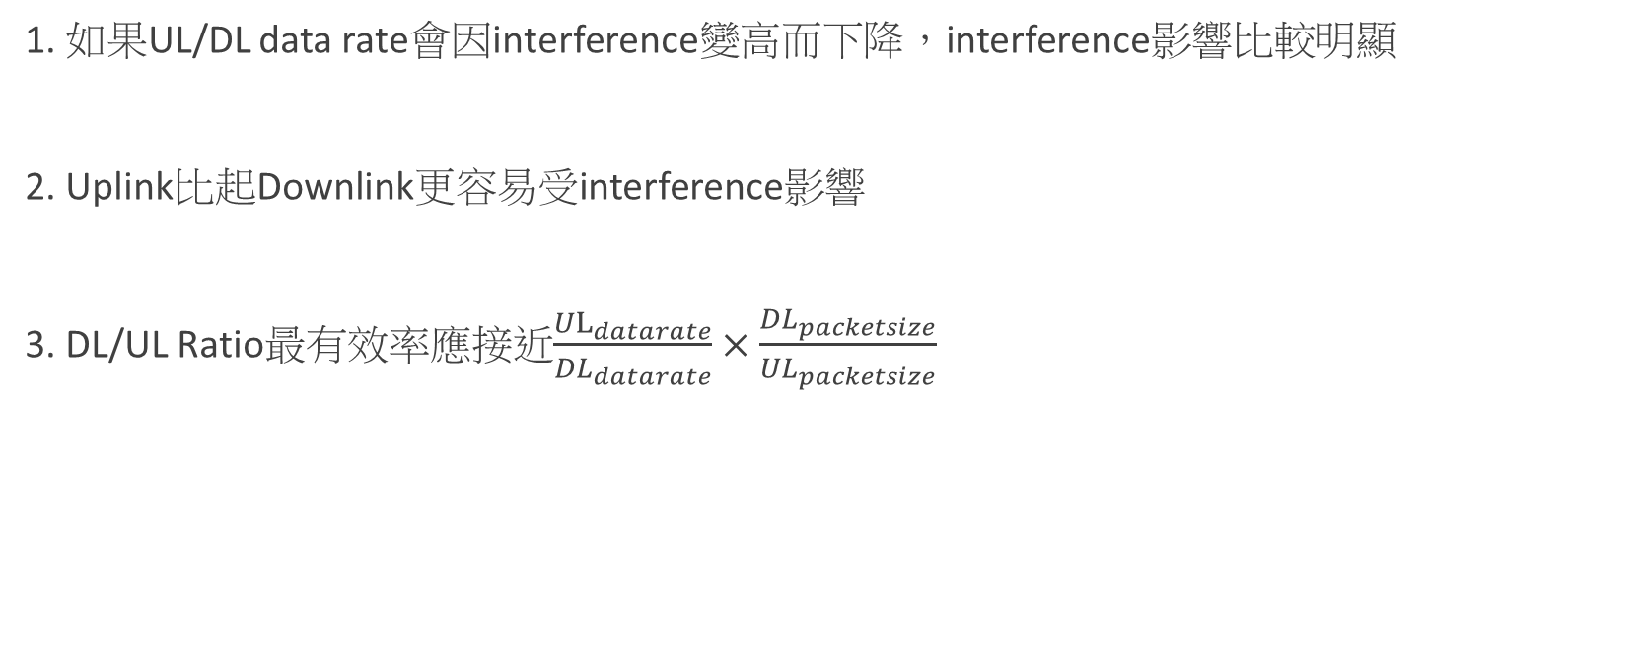
Conclusion
1. 如果UL/DL data rate會因interference變高而下降，interference影響比較明顯
2. Uplink比起Downlink更容易受interference影響
3. DL/UL Ratio最有效率應接近$\frac{{UL}_{datarate}}{{DL}_{datarate}}×\frac{{DL}_{packetsize}}{{UL}_{packetsize}}$

