Slide 1
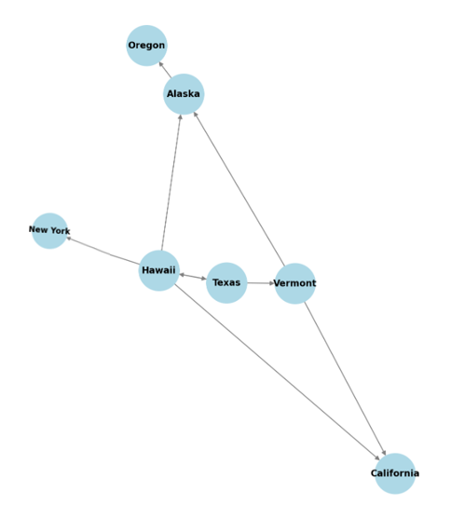
CMSC204
Kartchner
V(StateGraph) = {Oregon, Alaska, Texas, Hawaii, Vermont, NewYork, California}
E(StateGraph) = {(Alaska, Oregon), (Hawaii, Alaska), (Hawaii, Texas), (Texas, Hawaii), (Hawaii, California), (Hawaii, New York), (Texas, Vermont), (Vermont, California), (Vermont, Alaska)}
1. Draw the StateGraph
{Oregon, Alaska, Texas, Hawaii, Vermont, New York, California}
{(Alaska, Oregon),(Hawaii, Alaska),(Hawaii, Texas),(Texas, Hawaii),(Hawaii, California),(Hawaii, New York),(Texas, Vermont),(Vermont, California), (Vermont, Alaska)}
No
Yes
Texas and Alaska

Slide 2
a. Show the adjacency matrix that would describe the edges in the graph. Store the vertices in alphabetical order
States
Alaska California Hawaii New York Oregon Texas Vermont
Alaska
California
Hawaii
New York
Oregon
Texas
Vermont
0 0 0 0 1 0 0 0 0 0 0 0 0 0 1 1 0 1 0 1 0 0 0 0 0 0 0 0 0 0 0 0 0 0 0 0 0 1 0 0 0 1 1 1 0 0 0 0 0
3. b. Show the adjacency lists
that would describe the edges in the graph
Alaska: Oregon
California: no edges
Hawaii: Alaska, Texas, California, New York
New York: no edges
Oregon: no edges
Texas: Hawaii, Vermont
Vermont: California, Alaska

Slide 3
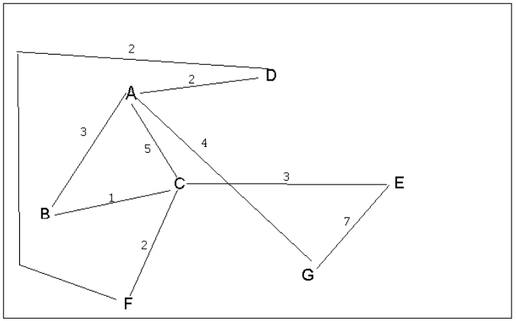
4 a. Which of the following lists the graph nodes in depth first order beginning with E?
A) E, G, F, C, D, B, A
B) G, A, E, C, B, F, D
C) E, G, A, D, F, C, B
D) E, C, F, B, A, D, G
4 b. Which of the following lists the graph nodes in breadth first order beginning at F?
A) F, C, D, A, B, E, G
B) F, D, C, A, B, C, G
C) F, C, D, B, G, A, E
D) a, b, and c are all breadth first traversals

Slide 4
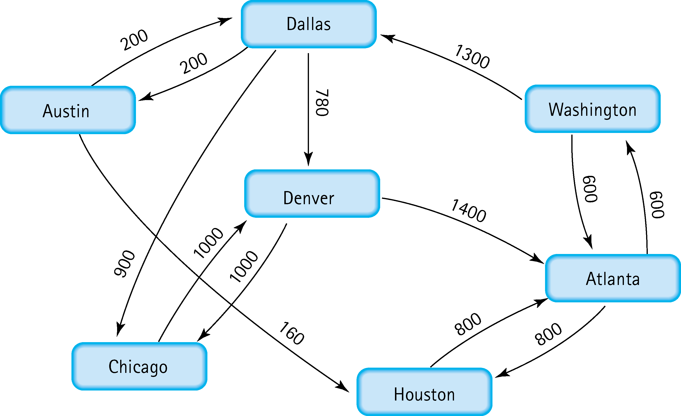
5. Find the shortest distance from Atlanta to every other city
Washington: 600
Houston: 800
Denver: 1400
Chicago: 1560
Dallas: 2180
Austin: 2380

Slide 5
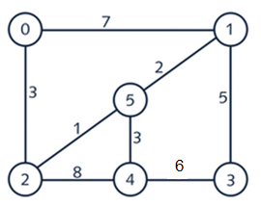
6. Find the minimal spanning tree using Prim’s algorithm. Use
0 as the source vertex . Show the steps.
0 to 2 (3)
2 to 5 (1)
5 to 1 (2)
5 to 4 (3)
1 to 3 (5)
Total weight 3+1+2+3+5 = 14

Slide 6
7. Find the minimal spanning tree using Kruskal’s algorithm.
Show the weights in order and the steps.
Total weight 1+2+3+3+5=14
2 to 5 (1)
5 to 1 (2)
0 to 2 (3)
5 to 4 (3)
1 to 3 (5)

Slide 7
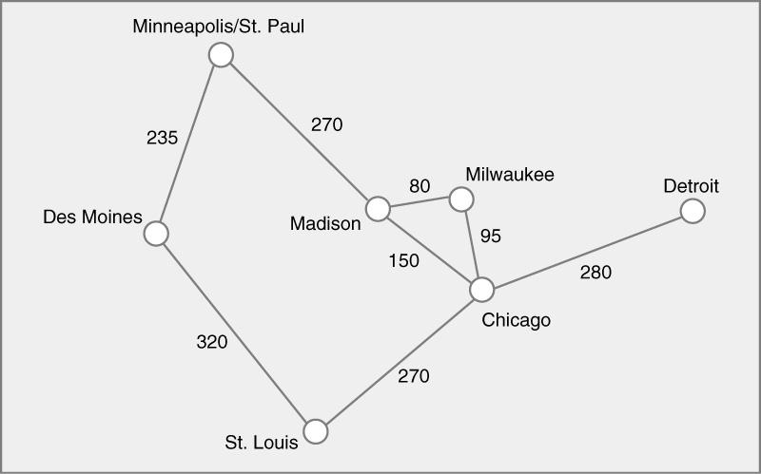
8. Find the minimal spanning tree using the algorithm you prefer. Use
Minneapolis/St. Paul as the source vertex
Minneapolis to Des Moines (235)
Minneapolis to Madison (270)
Madison to Milwaukee (80)
Milwaukee to Chicago (95)
Chicago to Detroit (280)
Chicago to St. Louis (270)
235+270+80+95+280+270 = 1230

Slide 8
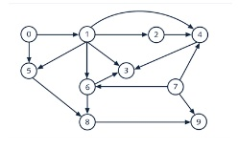
9. List the nodes of the graph in a breadth first topological ordering. Show the
steps using arrays predCount, topologicalOrder and a queue
predCount
Node 0: 0
Node 1: 1 (from 0)
Node 2: 1 (from 1)
Node 3: 1 (from 1)
Node 4: 1 (from 2)
Node 5: 1 (from 0)
Node 6: 1 (from 1)
Node 7: 2 (from 3, 4)
Node 8: 2 (from 5, 6)
Node 9: 2 (from 7, 8)
topologicalOrder: [0] Node 1: 1−1=0 Node 5: 1−1=0 Queue: [1, 5] topologicalOrder: [0, 1] Node 2: 1−1=0 Node 3: 1−1=0 Node 6: 1−1=0 Queue: [5, 2, 3, 6] topologicalOrder: [0, 1, 5] Node 8: 2−1=1 Queue: [2, 3, 6] topologicalOrder: [0, 1, 5, 2] Node 4: 1−1=0 Queue: [3, 6, 4] topologicalOrder: [0, 1, 5, 2, 3] Node 7: 2−1=12−1=12−1=1 Queue: [6, 4] topologicalOrder: [0, 1, 5, 2, 3, 6] Node 8: 1−1=0 Queue: [4, 8] topologicalOrder: [0, 1, 5, 2, 3, 6, 4] Node 7: 1−1=0 Queue: [8, 7] topologicalOrder: [0, 1, 5, 2, 3, 6, 4, 8] Node 9: 2−1=1 Queue: [7] topologicalOrder: [0, 1, 5, 2, 3, 6, 4, 8, 7] Node 9: 1−1=01 Queue: [9] topologicalOrder: [0, 1, 5, 2, 3, 6, 4, 8, 7, 9] Queue: []
[0, 1, 5, 2, 3, 6, 4, 8, 7, 9]

Slide 9

10. List the nodes of the graph in a breadth first topological ordering.
[Start, Programming 1, Discrete Math, Programming 2, Computer Organization, Algorithms, High-Level Languages, Operating Systems, Theory of Computation, Senior Seminar, Compilers, End]

