Slide 1

AN E-Publishing software

Slide 2

abstract
This project is mainly about the software development process involved in the mainstream IT industry. The company we approached is NewgenKnowledgeWorks Pvt Ltd situated in Adyar, Chennai. The topic chosen to help us learn the software development process is generating a e-pub file from a given book in word format. The total learning process was for two complete weeks of 6hours training per day by the professionals from the enterprise. The software development was integrated with the learning sessions. We were taught concepts in Visual Basic .NET which helped us immensely in creating the software. Besides learning technical details related to the software industry, we also got the opportunity to learn the ethics and various disciplines in the industry as the approach of training conducted by the company was so systematic and precise to the point.

Slide 3



INTRODUCTION
The software “ECRET” as we named it,is for creating an epub form of a book from a word file of a book. The total process is to eliminate the huge amount of manual time taken for the same. It is provided with a interactive dialog box to deal with. The files can be arranged in the actual order of the original book and need not be reordered afterwards in the epub file. The final product i.e., a ebook is in the most interactive form of a book in the web.

Slide 4
INTRODUCTION
The growing field of ebooks and apps in the IT industry demands fast and quality forms of production which is very optimal. The generation of a epub from a manual book is an important job in the publishing indutry in the present sort of trends. It constitutes a major portion of their revenue. This portion of the technical side is done,supported by thousands of their employees who expertise in parsing through the process in the fastest time possible which optimises their total processing time. The software created was thus done with a viewpoint of minimsing the duration of the total conversion process.

Slide 5
WHAT IS AN EPUB FILE???
EPUB (short for electronic publication; alternatively capitalized as ePub, ePUB, EPub, or epub, with "EPUB" preferred by the vendor) is a free and open e-book standard by the International Digital Publishing Forum (IDPF). Files have the extension .epub.
EPUB is designed for reflowable content, meaning that an EPUB reader can optimize text for a particular display device. EPUB also supports fixed-layout content. The format is intended as a single format that publishers and conversion houses can use in-house, as well as for distribution and sale. It supersedes the Open eBook standard.

Slide 6

FEATURES:
Free and open
Reflowable (word wrap) and resizable text
Inline raster and vector images
Embedded metadata
DRM support
CSS styling
Support for alternative renditions in the same file
Use of out-of-line and inline XML islands to extend the functionality of EPUB

Slide 7

PRESENT EPUBLISHING SCENARIO
The e-publishing market has been fuelled by a number of parallel technological advancements. The use of personal computers and handheld devices has grown exponentially over the years. And to top it all, there are a variety of lightweight and user-friendly e-book readers and handheld devices that make it easier to read on the move and the experience is much more like reading a real book. Changes in lifestyle, better broadband connectivity, increased prevalence of online courses and e-teaching, and a drive to get content immediately are some of the factors that are influencing the growth of this sector.

Slide 8
WHY ECRET???
The normal epub creating process takes time duration of 5-6 days with the efforts of around 100+ employees. This is so time consuming that the efficiency of the output in terms of time is very low. Hence for increasing this efficiency and by that emerging as a new force in the industry, a company has to innovate and optimize this process.
The work of our software “ECRET” is just the same. It reduces the time duration of the process to just half an hour for a book of 500 pages, which when compared to the manual process is very efficient.

Slide 9

WHY ECRET???
It provides a very interactive and easy to understand front end. It just requires pasting the files in the process box and the software runs on clicking just a button. It doesn’t require a huge amount of manual efforts too. It is way efficient than any integrated manual efforts.

Slide 10

THE PROCESS INVOLVED
The very first part of the process is to obtain an input file which is in word format alone. This process is done by an easy drag and drop option in the dialog box provided.
The next stage involves reordering the files of the book in terms of its chapter order in the correct sequence in the input to be provided.
These files can be categorized as front matter, body matter and end matter.
Once this is done, the user is supposed to enter the author name, the book’s name and the book id.

Slide 11
THE PROCESS INVOLVED
This book id is the ISBN number of the ebook. This is used for creating the folder for the final epub file.
With this the manual efforts of the user is over, the user just has to click on the convert button to start the process.
The software prompts a dialog box showing the total number of chapters we have created and proceeds on clicking the “OK” button.
Then each file is opened and the important corrections pertaining to the html section of the file is made.
These corrections are the basic steps in making the final ebook which will be discussed later.

Slide 12

THE PROCESS INVOLVED
Each file or chapter will take approximately 2-5minutes to get converted to its ebook format.
A progress bar is displayed in the bottom of the screen to show the progress of the process.
The process once completed, will create the final epub formatted book in the folder name of the book’s ISBN number.
Each chapter in the book is in the epub format containing links and the necessary formats.
The ebook once ready can be viewed on any e-book reader.

Slide 13
TECHNICAL DETAILS
Converting the word file into html format.
A text editor (like Text Editor Notepad) that can edit text files, HTML, and XML.
A program that can create .zip files (which should be built into OS X or Windows).
Alright, first you’ll need to get all of the files together that you will later put into your master .zip file (called a container).
A Closer look at ePub files (*Be aware that file names are case sensitive)
.

Slide 14
TECHNICAL DETAILS
A .epub file has at least the following files/folders in it to function:
mimetype – Typically a plain ASCII text file that has the line “application/epub+zip” in it. This file tells a reader/operating system what’s in the .ePub file. This file must be the first line in the zip file, and cannot be compressed
META-INF folder – Contains at least the container.xml file, which tells the reader software where to find the book in the container (typically in the content.opf file detailed below).
OEBPS folder – Recommended location for the book’s actual content

Slide 15
TECHNICAL DETAILS
Images folder – Contains any pictures used in your eBook.
content.opf file – An XML file that lists what’s in the container in the order they will appear, the manifest, spine section (which lists the reading order of the contents), and any metadata like author name, genre, and publisher. Any additional metadata will need tags similar to these required ones:
  dc:title – The book’s title.
  dc:language – The language the book is in (here is a list of language codes).

Slide 16
TECHNICAL DETAILS
  dc:udebtufuer- Every eBook has a unique ID code (UID). If you’re unsure what to use, try using your ISBN.
  toc.ncx file – Table of contents arranged with navpoint tags. Make sure the UID matches whatever is in your content.opf file because some readers won’t display your book properly if it doesn’t. The play order values found in this file must also be in order and will return an error if the order skips over a number.
  * XHTML files – The book’s literal contents are listed in these files which are like HTML files with closing tags associated with each element. It is up to you how you arrange your content but having a separate .xhtml file for each chapter tends to look better on e-readers.

Slide 17
TECHNICAL DETAILS
How to Make the Container File
  First create a new .zip file
  * Copy the uncompressed mimetype file into the .zip file.
  * Copy all of your other files (which should all be located in an OEBPS file) into the .zip file.
The .zip file structure should look similar to this:
  mimetype
META-INF
  container.xml

Slide 18

TECHNICAL DETAILS
How to Make the Container File
OEBPS
  images
    content.opf
  toc.ncx
  stylesheet.css
  content.xhtml
  Change the .zip file extension to .epub.
Once you are done with these steps, you should have a readable eBook in a format that works on most readers

Slide 19

EBOOK READERS
EBOOK READERS
The ebook created by our software can viewed on any of these e-book readers.
KINDLE

Slide 20

EBOOK READERS
NOOK

Slide 21
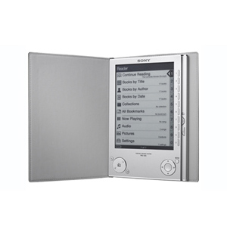

EBOOK READERS
SONY EBOOK READER
I-PAD

Slide 22
Requirements
This software “ECRET” can be used in Windows 98, Windows 2000, Windows XP and Windows NT, supported for other platforms such as Applet, Macintosh and UNIX.
Hardware Requirements
Processor : Intel Core i3, i5, i7, Pentium III 630Mhz.
RAM : min 512MB, up to 4GB.
Hard Disk : min 50GB, up to 500GB.
Monitor : 14” inches to 21” inches color monitor.
Software Requirements
Operating System : Windows XP, Windows NT, Windows 98.
Language used : Visual Basic.Net
Tools required : Tidy.dll and MS Visual Basic Framework

Slide 23

Foreseeable Modifications & Enhancements
The major enhancement to be worked upon is to make this software compatible in different operating systems like Windows 7, Linux, etc.
Another major feat that can be worked out is to develop it as an app for apple phones.

Slide 24
  Glossary
Epub.
Ebook.
Ebook reader.
Tidy
Html
Mimetype

Slide 25


ABOUT NEWGEN KNOWLEDGEWORKS PVT.LTD
Established in 1996 in Chennai, India, to cater to the pre-press publishing needs of books and journals publishers in the UK, US, and Europe, they have subsequently grown into a significant resource in the global publishing space by building both the capability and the capacity to meet the unique needs of different publishers. Our focus on talent, training, and technology has enabled us to become a complete solutions provider.
Since its inception in 2000, our copyediting and project management services have grown rapidly. In 2005 we acquired G&S Typesetters, a then 50-year-old pre-press company in Austin, Texas, to launch our US-based operations. In 2008 we began offering developmental editing services through our office in New York. We also expanded our typesetting capabilities to include services in other European and Asian languages to the multilingual, localization, and globalization market.

Slide 26

ABOUT NEWGEN KNOWLEDGEWORKS PVT.LTD
They are a leading provider of digital archiving, data conversion, electronic publishing, and large-scale e-PUB conversion services. We are committed to excellent quality, intelligent presentation, and timely delivery.

Slide 27
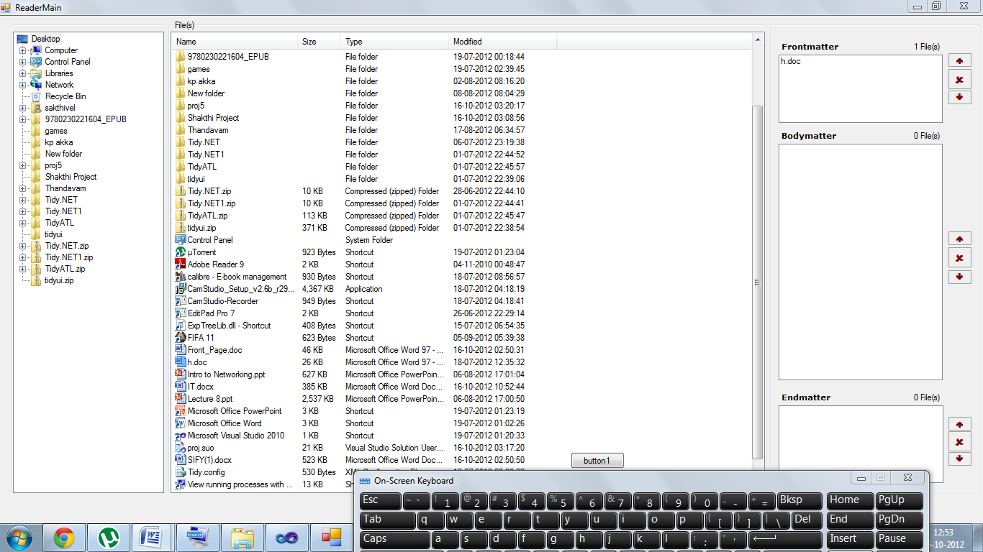
Screenshot

