Slide 1
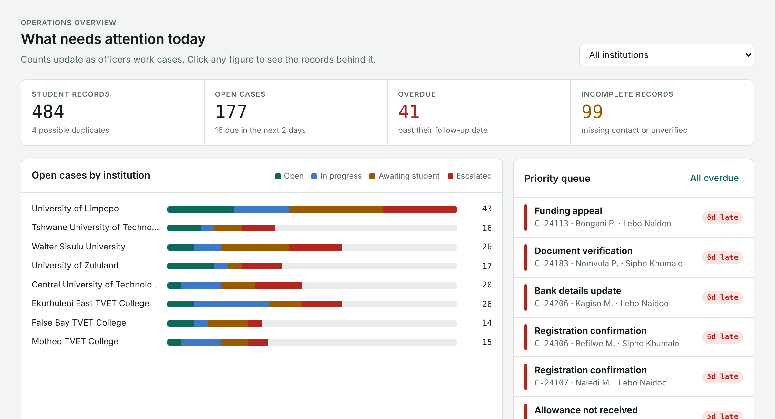
Student360
Secure student case management for NSFAS-related operations
Working prototype · Synthetic data only
Mdaka Advanced Technologies
Notes:
Student360 is a working prototype of a case management platform for NSFAS-related student data. Everything you will see uses synthetic data only. The goal: replace spreadsheet-led processes with something that controls who sees what, tracks work, and proves what happened.

Slide 2




Spreadsheets store data, not control
Copies everywhere
Everyone sees everything
Files get emailed and saved locally. Nobody knows which version is current.
Open the file and every ID number and phone number is right there.
Follow-ups rely on memory
No record of who did what
No owners or deadlines, so overdue cases go unnoticed.
Anyone can change a cell, and nothing shows it happened.
Notes:
The problem is not storage. Excel stores data fine. The problem is control: copies, no field-level permissions, manual follow-ups, and no trustworthy history.

Slide 3



One platform, three roles
Case officer
Manager
Administrator
Finds students and opens cases
Reveals an ID only with a reason
Works their own case queue
Sees the whole backlog
Reassigns overdue cases
Exports summary reports
Imports institution files
Reads the audit log
Checks the log is untampered
Can't reassign cases or export reports
Can't reveal ID numbers
Can't open student records or cases
Notes:
Three roles from the pitch deck. Each one only gets what its job needs. The "can't" line matters as much as the "can": it is enforced by the database, not by hiding buttons.

Slide 4



See what needs attention today
Live counts
Open, overdue and incomplete records update as officers work.
Priority queue
Overdue cases, oldest first, with who owns each one.
Officer workload
Spot who's overloaded and reassign their cases.
Notes:
The manager home screen. Every number is clickable and drills into the records behind it. The figures shown are from synthetic demo data, not real NSFAS numbers.

Slide 5
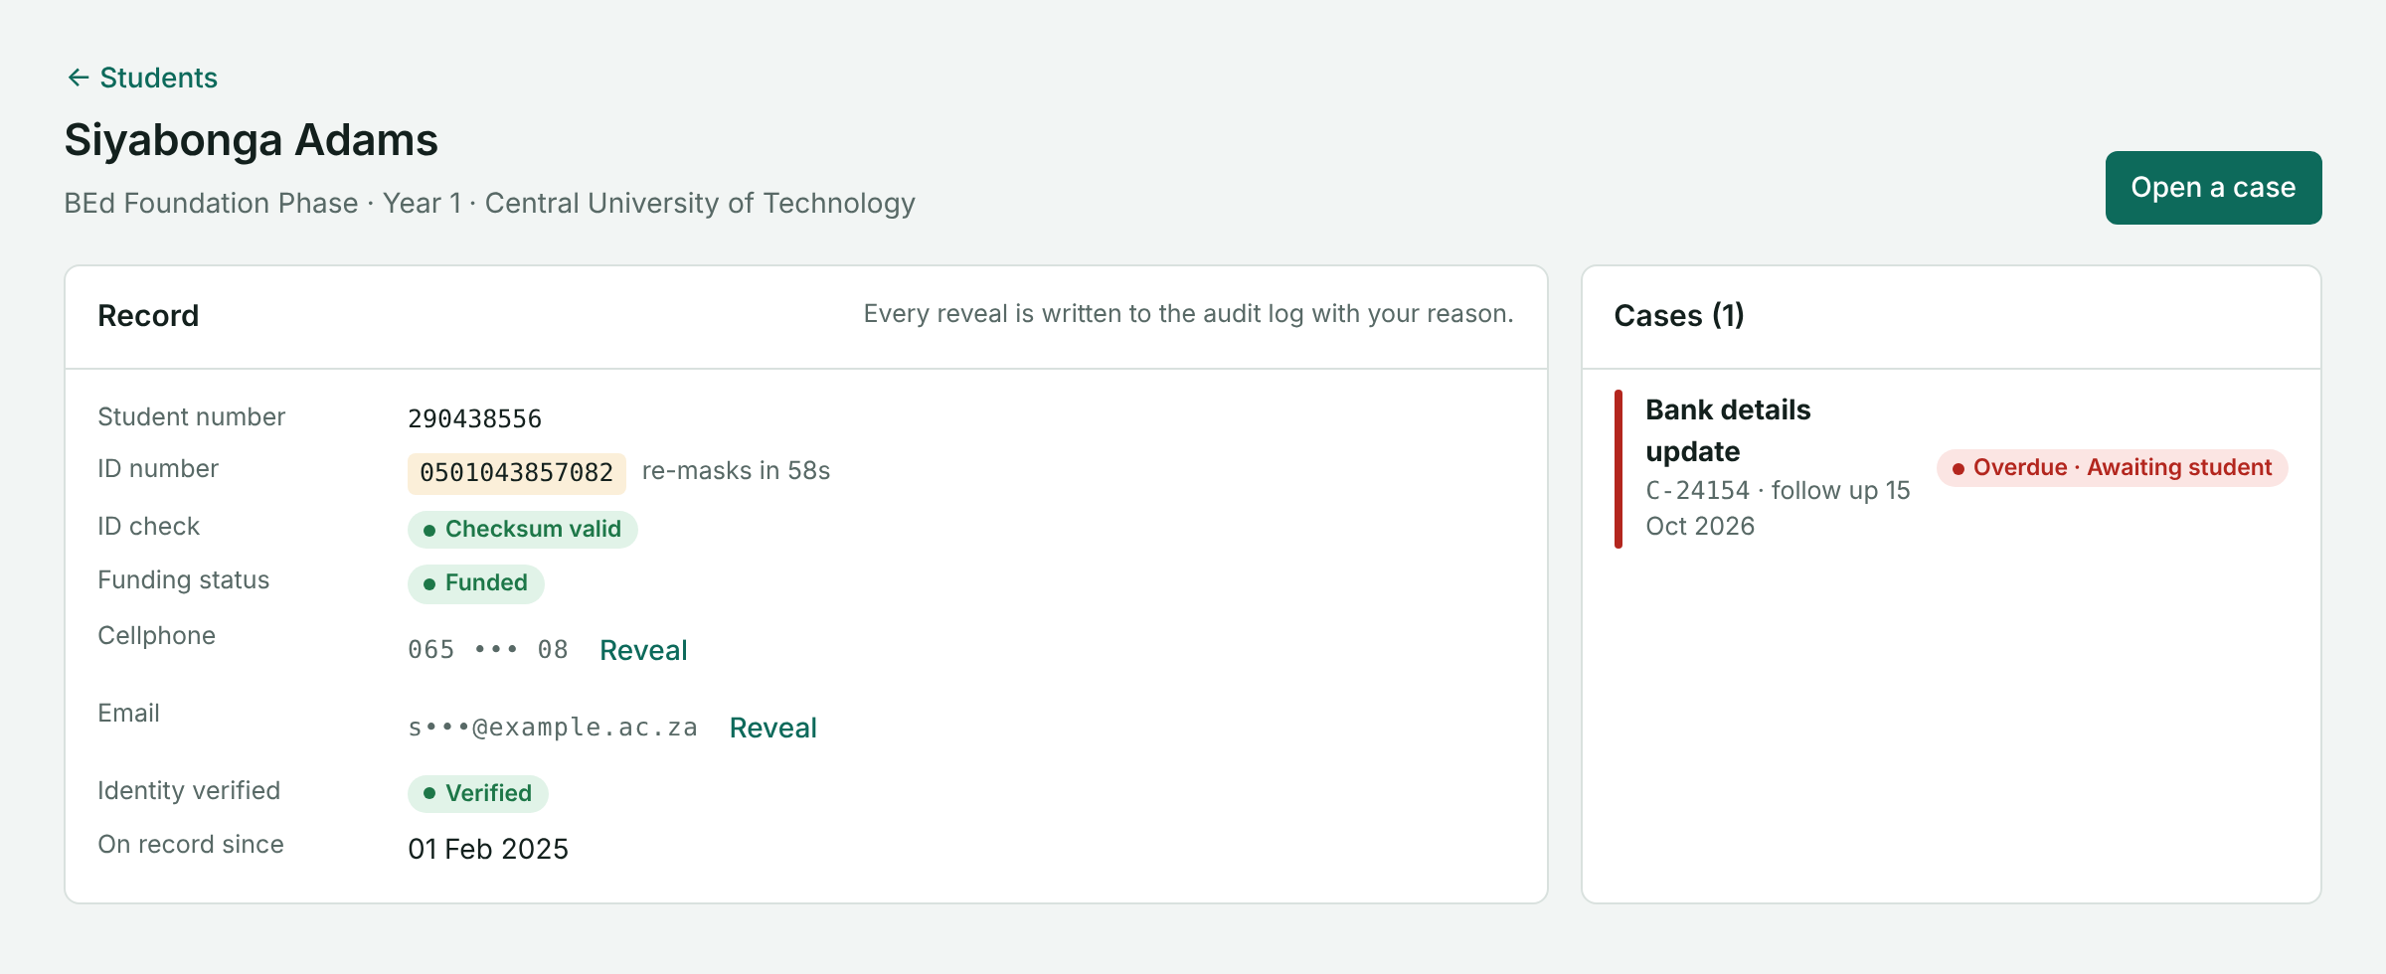
ID numbers stay hidden by default
1
Pick a reason
From a fixed list, like verifying identity on a call.
2
See it for 60 seconds
Then it hides itself again.
3
It gets logged
The database never sends a full ID number, cellphone or email to the browser unless it is revealed. Partial ID searches are blocked to stop fishing.
Name, time and reason go into the audit log.
Notes:
Demo moment: sign in as the case officer, open a student, click Reveal. A reason is required, the value shows for 60 seconds, and the action appears in the audit log immediately.

Slide 6
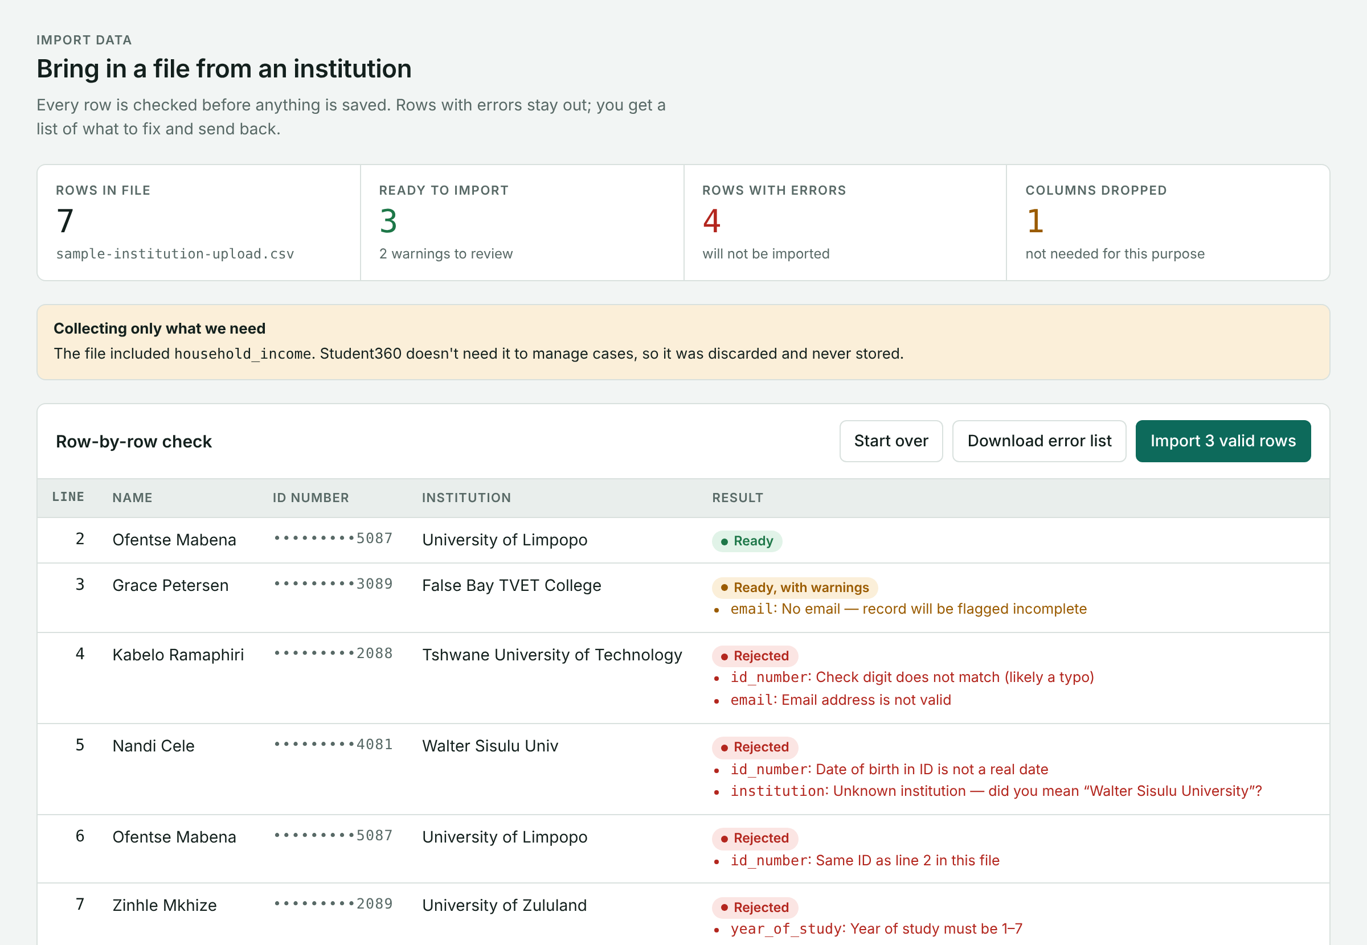

Bad data is stopped at the door
Every row is checked before anything is saved:
Wrong check digit (a typo in the ID)
A birth date that doesn't exist
The same student twice in one file
A misspelt institution, with a suggestion
Columns we don't need, like income, discarded
Sample file: 7 rows in, 3 imported, 4 sent back with reasons.
Notes:
Sign in as the administrator and click "Try the sample file". Every problem a messy institution spreadsheet typically has gets caught, explained, and kept out. Only clean rows are imported, and the server re-checks them.

Slide 7
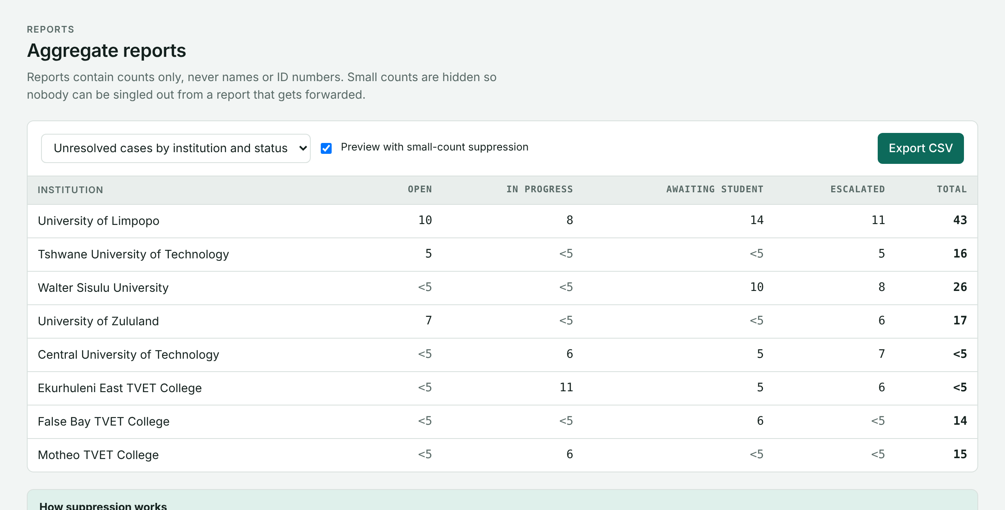
Reports that can't single anyone out
<5
Any count under 5 is hidden
Totals are hidden too when they'd let someone work out the hidden number. Reports carry counts only, never names or ID numbers. Every export is logged.
Notes:
A forwarded spreadsheet can identify a student when a cell says "1". Student360 suppresses small counts automatically, including back-calculation through row totals. Managers can preview without suppression, but exports always apply it.

Slide 8
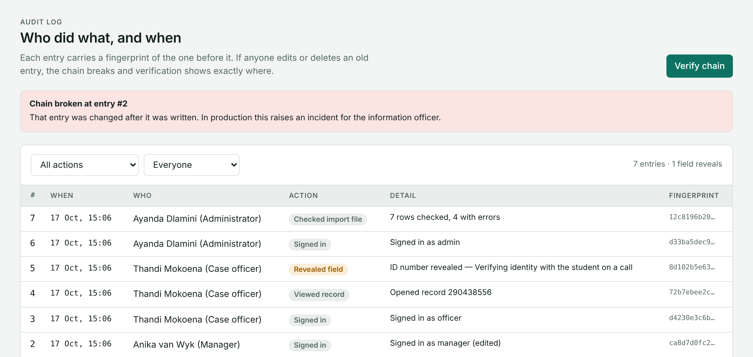
A history nobody can rewrite
Written by the database
Every view, reveal, change, import and export, by name and time.
Chained together
Each entry carries a fingerprint of the one before it.
Tampering shows
Edit an old entry and verification names the exact one.
Entry 1
Entry 2
Entry 3
Entry 4
fingerprint of entry 0
fingerprint of entry 1
fingerprint of entry 2
fingerprint of entry 3
Notes:
Demo: on the Audit log, click "Simulate someone editing entry #2", then "Verify chain". The check runs in the database and names entry 2 as altered. "Undo the edit" restores it. Outside the demo, the log rejects edits and deletes entirely.

Slide 9
Privacy designed in, not added later
Minimise
Built
Restrict
Built
Protect
Built
Import drops columns we don't need. Notes refuse ID numbers.
Each role sees only what its work needs. IDs masked by default.
Rules enforced in the database, not just hidden on screen.
Trace
Built
Govern
With client
Validate
With client
Every view, reveal, change, import and export is logged.
Retention periods, correction requests, breach response.
Lawful basis, hosting region and sign-off by the information officer.
Notes:
Mapped to the six principles in the original pitch. Four are working in the prototype. Two need the client: we do not claim "POPIA compliant" without a documented assessment and sign-off by the client's information officer.

Slide 10





How it's built
Browser
Sign-in
Database rules
Functions + log
React and TypeScript, hosted on Vercel. Shows only what it is given.
Supabase Auth. Every staff member has their own account and role.
Row Level Security and column permissions decide what each role reads.
Every change runs through a role-checked function that writes the log.
Someone who bypasses the app hits the same rules. The browser can't skip the audit log, and it never holds a full ID number.
Notes:
The key design decision: security lives in the database. The front end is just a view. Supabase (Postgres) enforces Row Level Security per role, column privileges hide personal fields, and all writes go through SQL functions that check the role and write the audit entry in the same transaction.

Slide 11
Why not just Excel?
What the team needs | Excel | Student360
Hide ID numbers from some staff, not others | No | Masked by default, revealed with a reason
Owners and deadlines on every case | Manual | Overdue cases flagged automatically
Stop bad rows on import | No | ID checks, duplicates and typos caught
Reports that protect individuals | Manual | Counts under 5 hidden
Prove nobody changed the history | No | Fingerprinted audit log
One current version | Copies | One database
Notes:
Be fair to Excel: it is great for analysis. The gap is everything around the data: who can see a field, who owns a follow-up, what got imported, and whether the history can be trusted.

Slide 12
What's next
1
Confirm users, pain points and success measures with the client
2
Add MFA, session timeouts and per-institution access
3
Agree a hosting region (Supabase has no South African region yet)
4
Run a POPIA assessment with the client's information officer
5
Pilot with authorised users before any real data goes in
Notes:
Close on the path from prototype to pilot. The prototype proves the workflow and the safeguards; these steps turn it into something a client can sign off.

