Slide 1
Segregation of human faces from image sequences using Machine Learning techniques
By
Aneek Ghosh(510818039)
Ankan Halder(510818008)
Pranjal Sharma(510818089)
Guided by Dr. Arindam Biswas
Department of Information Technology ( 5th semester )
IIEST, Shibpur

Slide 2
Motivation & Objective of the project
In this digital era,everyday actions are increasingly being handled electronically.So face detection from images using machine learning can help us automate many working processes.
In this post covid-19 era wearing mask becomes a necessity.So we have thought to extend our project by building a face-mask detector web application that will help greatly to the society in this hard time.

Slide 3
Content
About OpenCV & Face Detection
Face Detection in images,videos,web camera
Face mask detection model
Training our model
Face mask detector web application
Applications, challenges and conclusion

Slide 4
About OpenCV
Open Source Computer Vision
It is an open- source library of programming functions mainly aimed at real-time computer vision ,originally developed by Intel.
We have used this library in out project for implementing computer vision.

Slide 5
About Face Detection
Face detection is a computer technology that determines the locations and sizes of human faces in arbitrary(digital) images.
Haar-Cascade is a robust and quick,real-time operated face detection technique with 95% accuracy devised by Paul Viola and Michael Jones in 2001.
It uses a method called AdaBoost for training and feature selection. (A long and exhaustive training process)

Slide 6
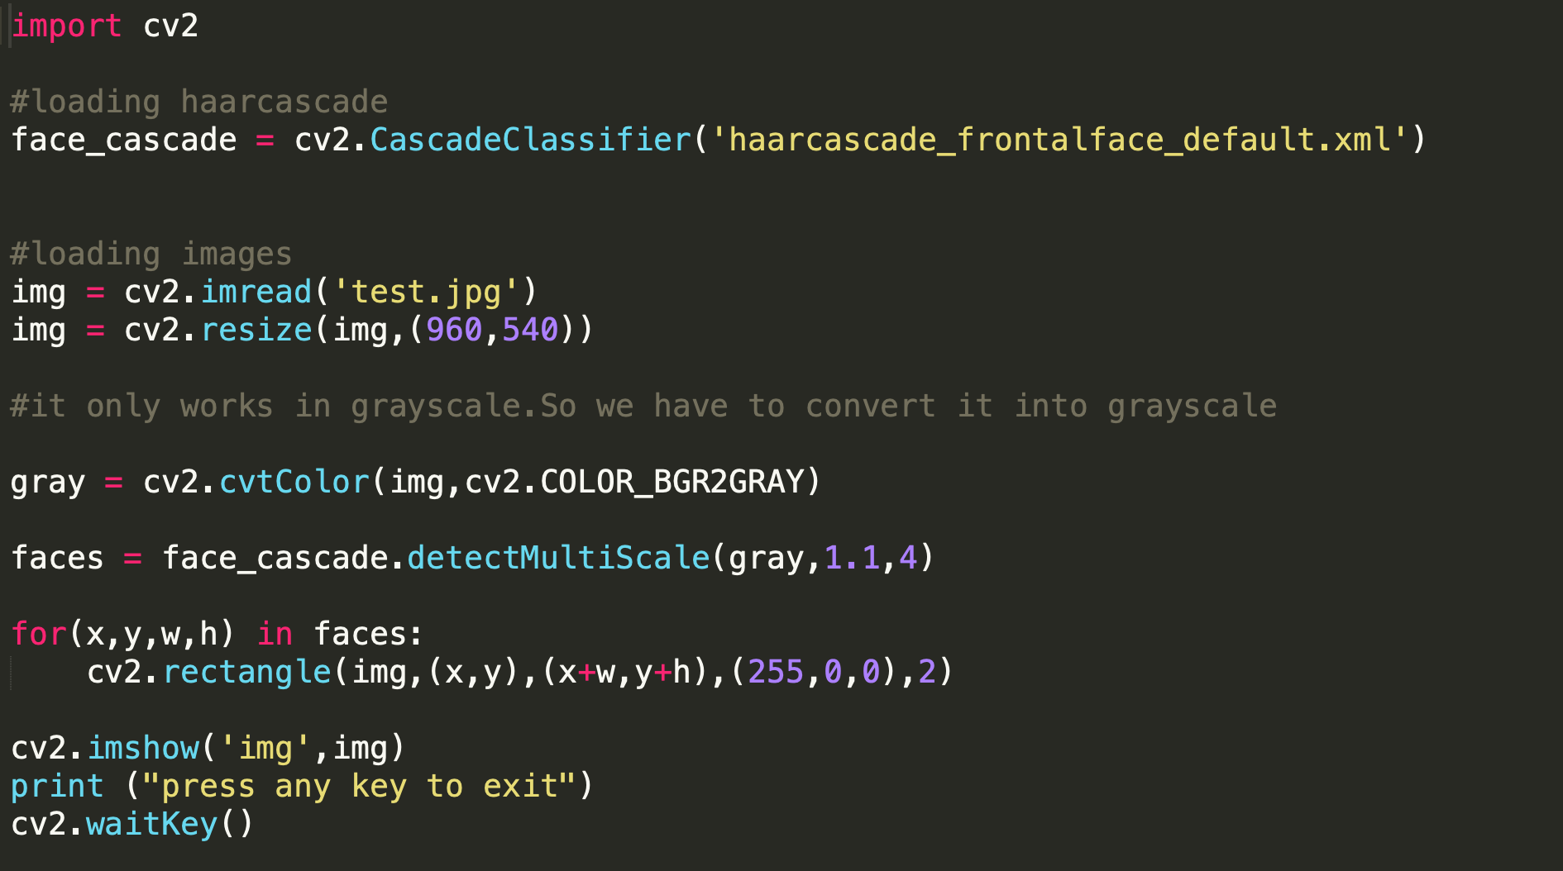

Face Detection in Images

Slide 7
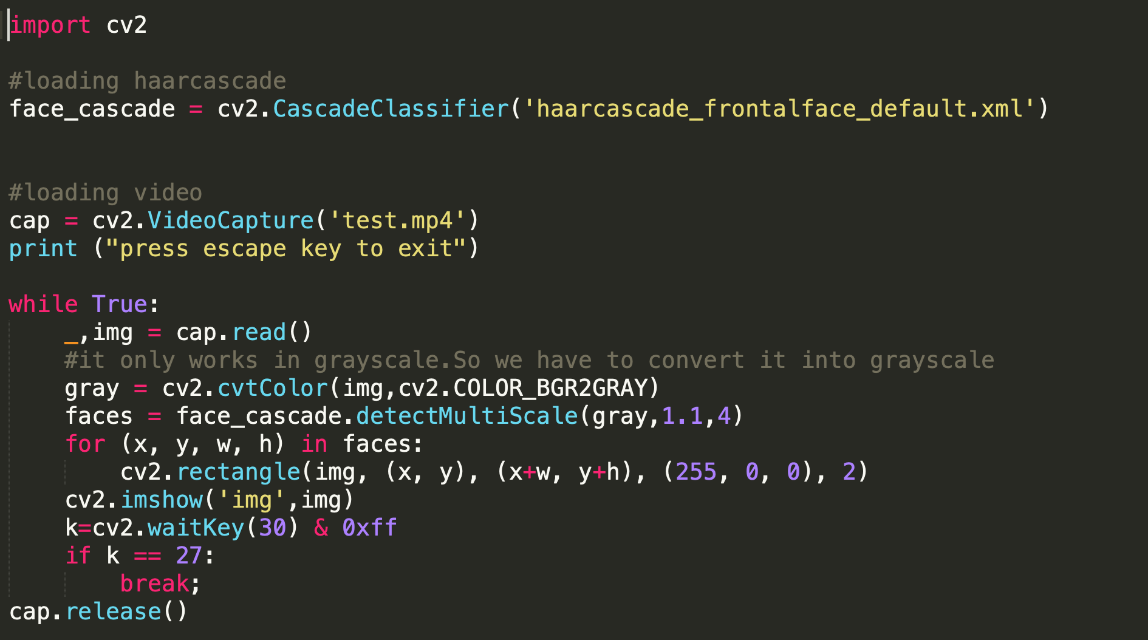
Face Detection in Videos

Slide 8
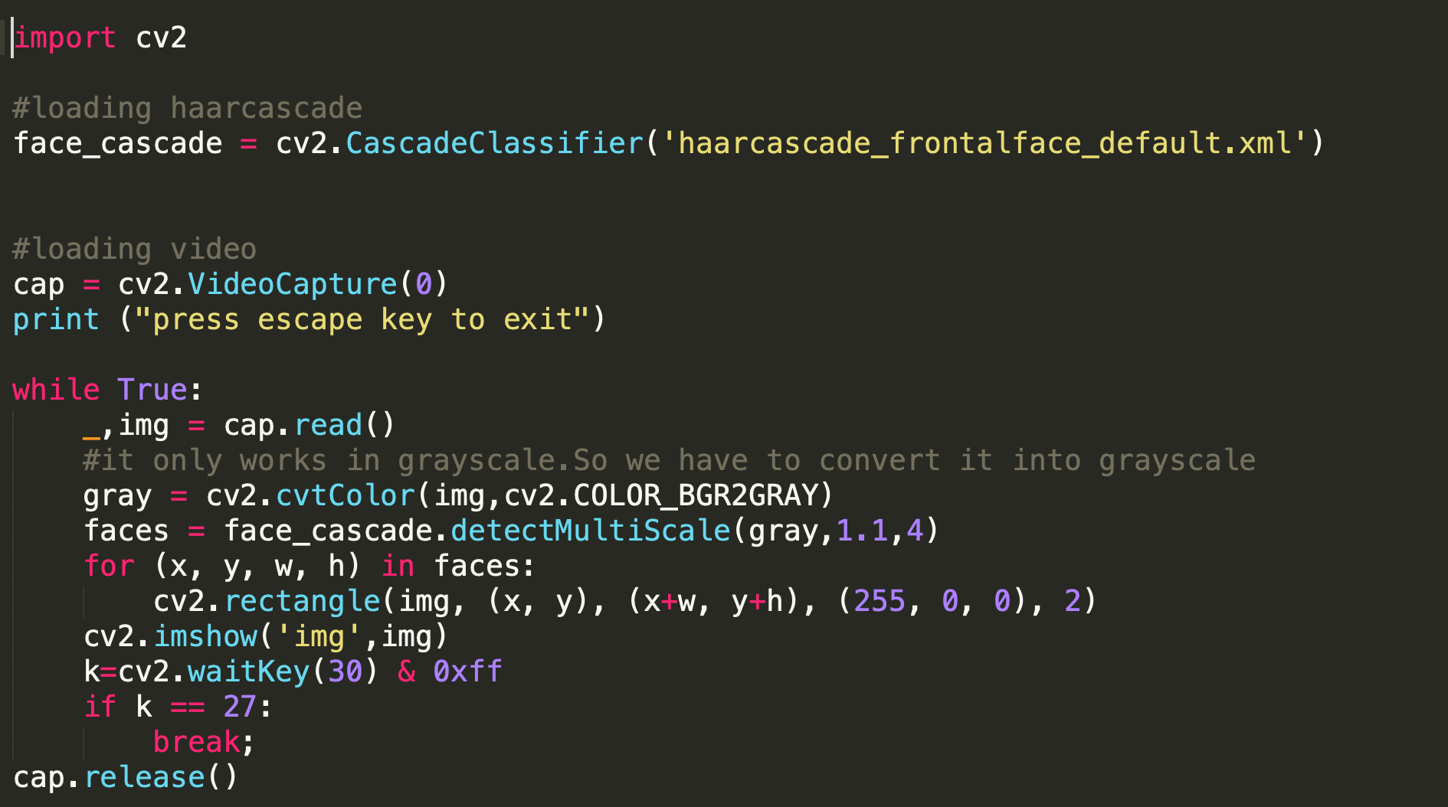
Face Detection using Web Camera

Slide 9
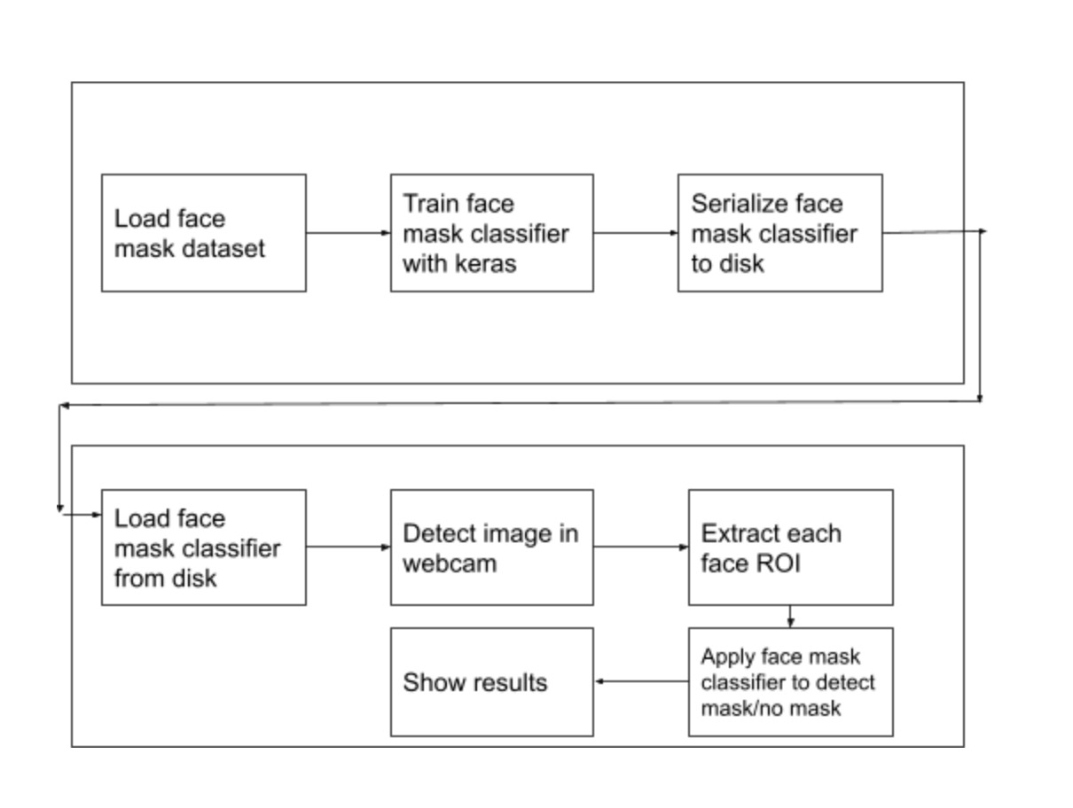
Face Mask detection model
Our model is integration between deep learning and classical machine learning techniques with opencv, tensorflow and keras.

Slide 10
Data pre-processing
Pre-processing steps were applied to all the raw input images to convert them into clean versions, which could be fed to a convolutional neural network machine learning model.The steps are :
Applying the color filtering (RGB) over the channels.
Scaling images using the standard mean.
Center cropping the image with the pixel value of 224x224x3.
Finally converting them into NumPy array.

Slide 11
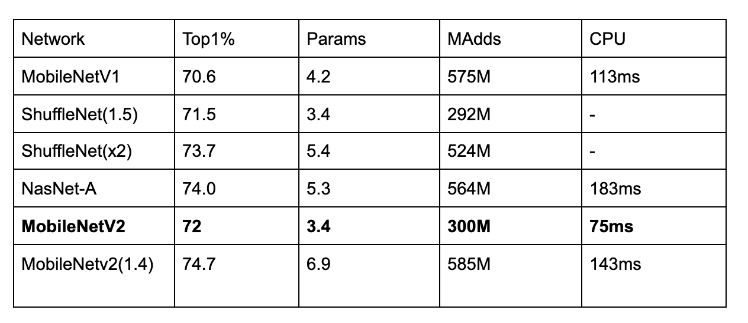
Details about model ( MobileNetV2 )
CNN (Convolutional Neural Network) has many versions of pre-trained and well architected networks for example AlexNet, ResNet, Inception, LeNet, MobileNet and so on. In our case we have chosen the MobileNetV2 due to its lightweight and very efficient mobile oriented model.
Comparison between different models:

Slide 12
Training our model with Face Mask
First we have partitioned the data into training and testing portion using 80% of the data for training and the remaining 20% for testing.
Then we have constructed the imagedatagenerator function for data augmentation.
We have run 20 Epochs and the learning rate is 1e-4 and the batch size is 32.
Now loading base model using the MobileNetV2 network, ensuring the top layer sets are made false.

Slide 13
Training our model with Face Mask ( contd… )
After that we have used the corresponding layers on the top layer of MobileNetV2.The layers are Average Pooling 2D layer with 7×7 weights,Linear layer with ReLu activation function,Dropout Layer, Linear layer with Softmax activation function
It gives the final result of two values each one represents the classification of “mask” or “not mask”.
The validation accuracy of the model is 99.89%.
Saving the trained model file in “h5” file format ( mymodel.h5 ).

Slide 14
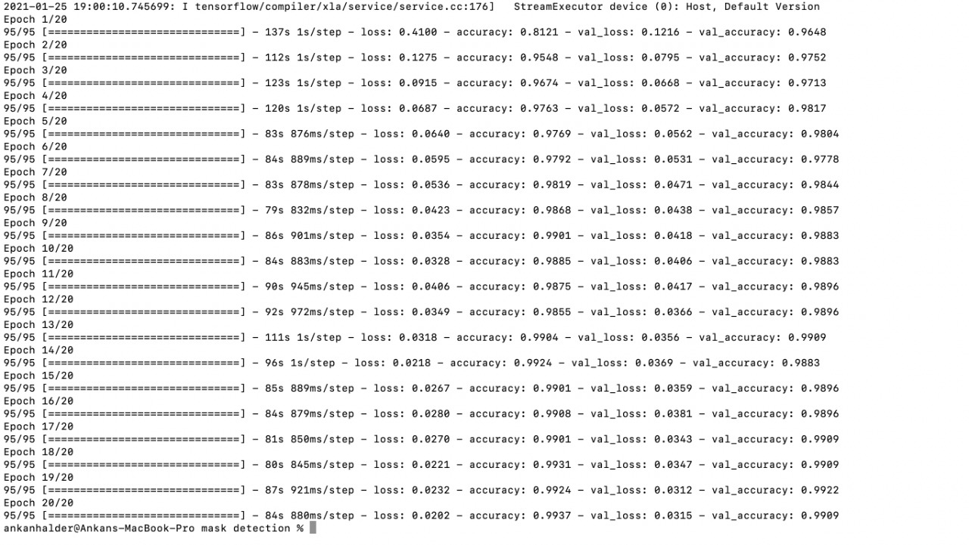
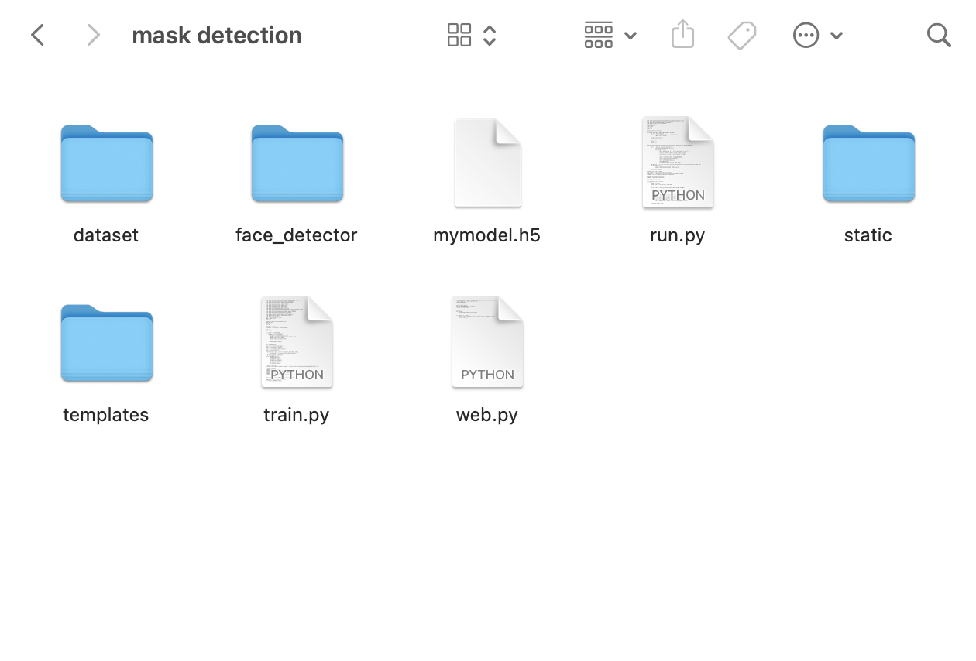
Running the training model code ( train.py )

Slide 15


Face Mask detection in Web App
To integrate our keras model to the web interface we have used tensorflow converter which will convert mymodel.h5 to model.json and save it along with binary weight files in the model directory.
Then we have used face detector model to segregate faces from the entire stream which is live captured by the camera.
Next we have fed that image to our mask_model to predict the “mask” or “no-mask” condition.

Slide 16
Deploying the application on a live server
We have used git as the version control system.
For the deployment purpose we have used heroku live server which provides free cloud platform.

Slide 17
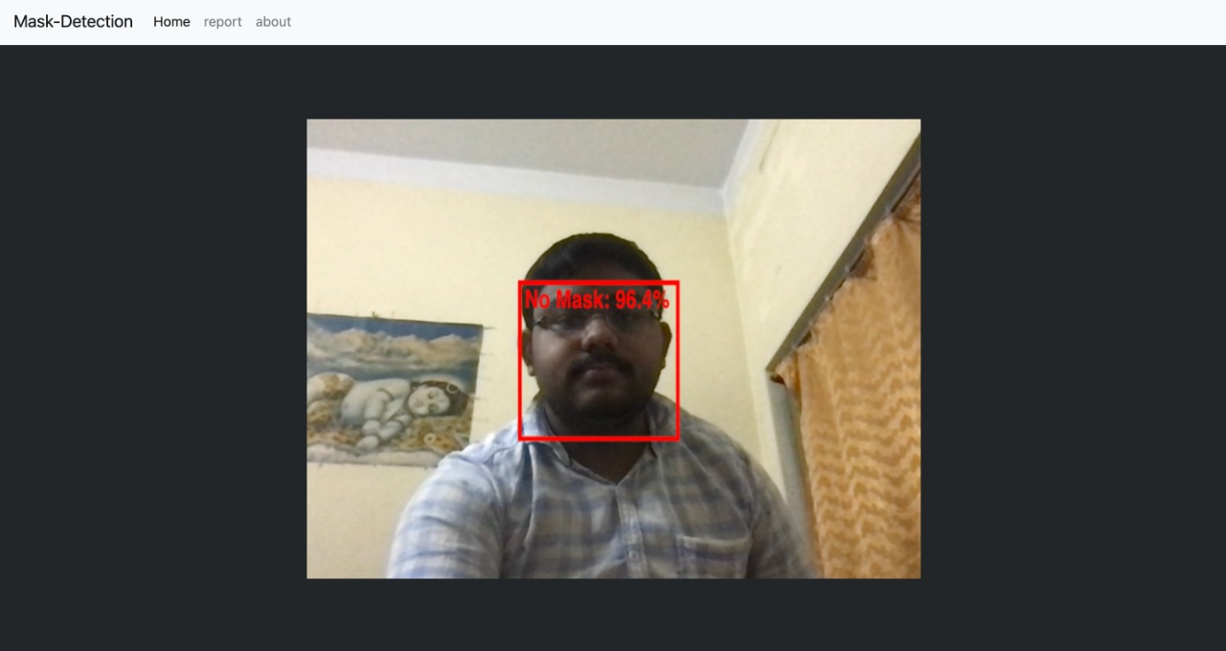
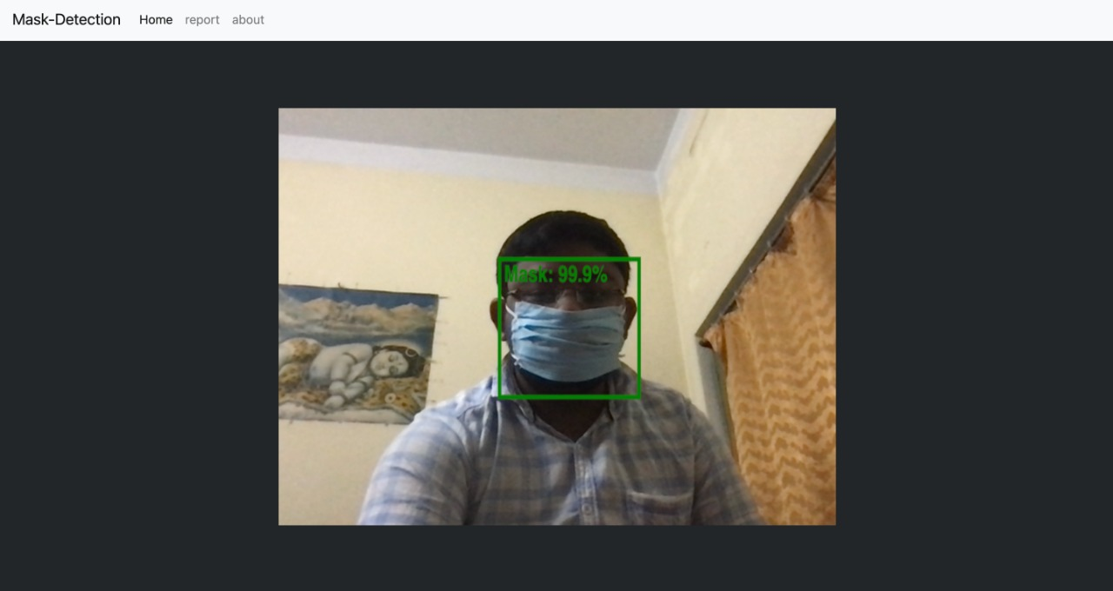
Snapshot of Web Application

Slide 18
Applications & Future scopes
Offices
Hospitals/healthcare organizations
Airports and railway stations
Sports venues
Entertainment and hospitality industry
Densely populated areas.
Basically everywhere in the post Covid-19 era

Slide 19
Challenges
One of the challenges that we faced in the whole project is finding a suitable dataset to make this mask-detector model.There is really scarcity of dataset in this particular topic as the situation is completely unpredictable and extraordinary.
Another challenge was to integrate our python model to the web interface.

Slide 20
Conclusion
The architecture consists of MobileNetV2 as the backbone which can be used for high and low computation scenarios.We have used OpenCV Library, tensorflow, keras frameworks and MobileNetV2 CNN model to detect masks on faces.
We have deployed our project on a live server so that it can be easily accessed with a single URL. Also it can be extended and used in a lot of scenarios with very minimal effort which can be of great use in this pandemic situation.

Slide 21
References
https://www.kaggle.com/
https://github.com/opencv
https://keras.io/
https://www.tensorflow.org/
https://ai.googleblog.com/2018/04/mobilenetv2-next-generation-of-on.html

Slide 22
Thank you!
Special thanks to Dr. Arindam Biswas(sir) for support and encouraging us.

