Slide 1
Promotions & Price Elasticity
Intelligence System
Using Excel, SQL, Python and Power BI
RETAIL ANALYTICS · PROMOTIONS & PRICE ELASTICITY
Presented by -Anees P
Batch code BMAI-S-WE-T-B49

Slide 2
01 · BUSINESS CONTEXT
Project Overview
This project builds a data-driven analytics solution that can:
Measure promotion effectiveness across stores, brands and products
Estimate price elasticity using regression analysis
Identify which brands or products should continue running promotions
Analyse sales and profit trends across time, stores and categories
Visualize insights and KPIs through an interactive Power BI dashboard
Domain | Table | Description
Sales | POS_Data | 114,478 point-of-sale transactions across 5 stores, 52 weeks of 2023
Product | Products | 9 SKUs across 3 categories (TV, Laptop, Headphones)
Brand | Brands | 3 electronics brands: Volt Tech, Nova Sound, Clearview
Promotion | Promo_plan_2023 | Weekly promotional plan, price tier per product per week
Pricing | Promo_prices | 5 price tiers per product: SDV, MRP, P1–P4
Store | Stores | 5 stores, 2 formats (Large-format Retailers, Mall Outlets)
2

Slide 3
01 · BUSINESS CONTEXT
The Problem Statement
KEY BUSINESS QUESTIONS
An electronics manufacturing company sells TVs, Laptops and Headphones under three brands, through multiple retail stores. It runs frequent promotional campaigns — but management cannot clearly see how those promotions affect sales performance and profitability.
Which promotions and discount levels drive the most sales?
1
2
Which products are price elastic vs inelastic?
3
How much sales uplift occurs during promotional weeks?
3
5
9
52
How do discounts affect profit margins by brand and product?
4
Brands
Stores
SKUs(products) across
3 categories
weeks of 2023 POS data (114,478 transactions)
Which categories and brands are most profitable?
5
6
Which are the top-selling stores and products?
2

Slide 4
02 · Tools
Four-Phase Approach
01
02
03
04
Excel
SQL
Python
Power BI
Clean & validate data, confirm pricing hierarchy (SDV<P4<P3<P2<P1<MRP), pivot exploration
→
Relational schema, ER diagram, analytical queries, 6 views for Power BI
→
Log-log regression per product: log(Units) = a + b·log(Price)
→
KPI dashboard, DAX measures, slicers, storytelling across 7 pages
3

Slide 5
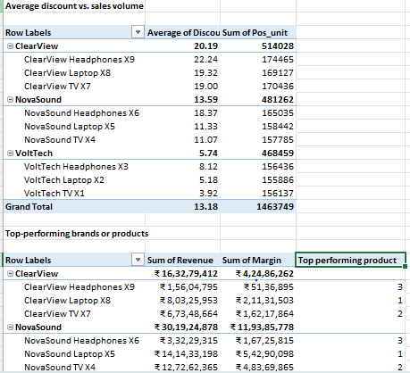
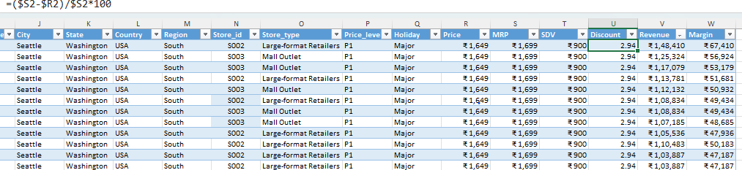
04 · EXCEL
Data Preparation & Exploration
PIVOT TABLES
Loaded Products, Brands, Promotions, Stores and POS datasets
Checked for missing values and duplicate entries
Verified pricing hierarchy: SDV < P4 < P3 < P2 < P1 < MRP
Built pivot tables: sales by product/brand/store, discount vs. volume, top performers
DERIVED METRICS
Flagged zero-unit sales rows (4,863 rows) for downstream handling
DERIVED METRICS
Discount % = (MRP − Price) / MRP × 100
Revenue = POS_Units × Price
Margin = (Price − SDV) × POS_Units
5

Slide 6
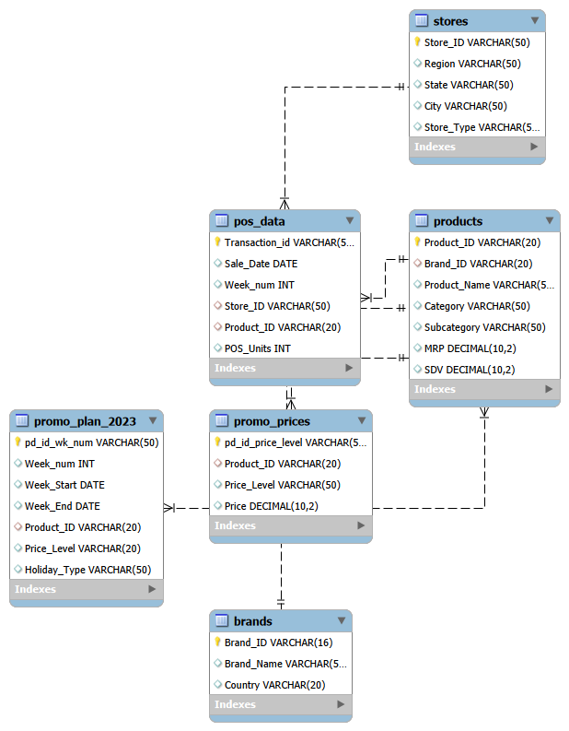
03 · DATA MODELLING-MYSQL
Relational Schema (ER Diagram)
6 source tables
Brands Brand_ID, Brand_Name, Country
Stores Store_ID, Region, State, City, Store_Type
Products Product_ID, Brand_ID (FK), Category, Subcategory, MRP, SDV
Promo_prices Product_ID, Price_Level (SDV/MRP/P1-P4), Price
Promo_plan_2023 Week_num, Week_Start/End, Product_ID, Price_Level, Holiday_Type
POS_data Transaction_id, Sale_Date, Week_num, Store_ID, Product_ID, POS_Units
4

Slide 7
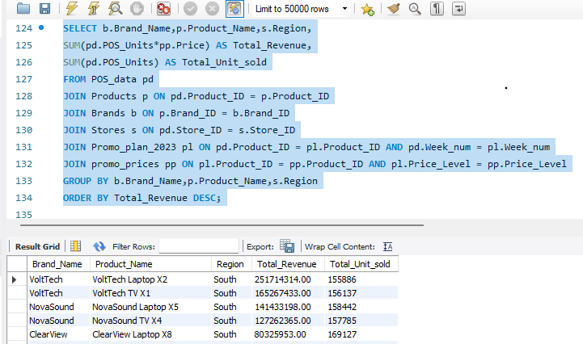
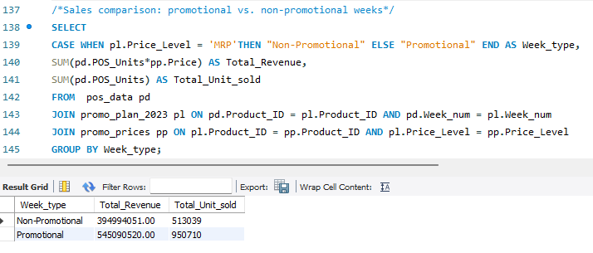
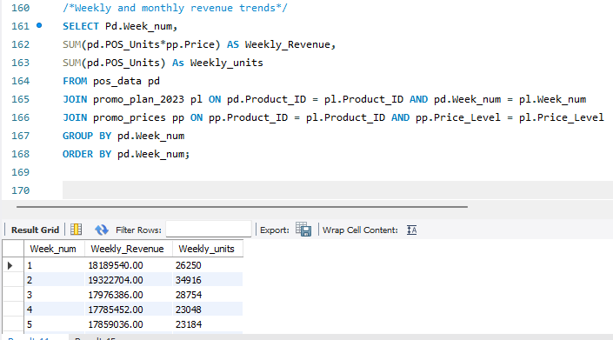
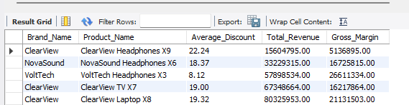
05 · SQL
Relational Modelling & Analytical Queries
Sales performance by product, region and brand
VoltTech Laptop X2 tops revenue: ₹25.17 Cr (1,55,886 units)
VoltTech TV X1 second: ₹16.53 Cr
All records show Region = South (single-region dataset)
Promotional vs Non-Promotional Weeks
Promotional weeks: ₹54.51 Cr revenue, 9,50,710 units
Non-promotional weeks: ₹39.50 Cr revenue, 5,13,039 units
Note: 30 promo weeks vs 22 non-promo weeks — raw totals, not per-week
Average Discount, Revenue & Gross Margin
VoltTech Headphones X3: lowest discount (8.12%), highest margin (₹2.66 Cr)
ClearView Headphones X9: highest discount (22.24%), still nets ₹51.4 L margin
Weekly Revenue Trend
Revenue steady: ₹1.78–1.93 Cr per week (weeks 1-5 shown)
Units fluctuate more than revenue week to week
vw_sales_full, vw_sales_by_product_region_brand, vw_promo_vs_nonpromo, vw_weekly_revenue_trend, vw_discount_revenue_margin, vw_monthly_revenue_trend .All 6 views table connected directly to Power BI Integration
6

Slide 8
06 · PYTHON REGRESSION
Price Elasticity Estimation
Model: log(Units Sold) = a + b · log(Price) → elastic if β < −1, inelastic if β > −1
Product_ID | Product_Name | Intercept_a | Beta_b | R_squared | Elasticity_Type
P103 | VoltTech Headphones X3 | 31.729 | -4.0368 | 0.1908 | Elastic
P301 | ClearView TV X7 | 15.8 | -1.31 | 0.1258 | Elastic
P203 | NovaSound Headphones X6 | 14.8928 | -1.3037 | 0.1962 | Elastic
P201 | NovaSound TV X4 | 15.9226 | -1.2026 | 0.0402 | Elastic
P202 | NovaSound Laptop X5 | 13.6507 | -0.8401 | 0.0394 | Inelastic
P302 | ClearView Laptop X8 | 13.0438 | -0.8215 | 0.0842 | Inelastic
P303 | ClearView Headphones X9 | 11.3272 | -0.7591 | 0.0312 | Inelastic
P102 | VoltTech Laptop X2 | 11.9412 | -0.5556 | 0.0017 | Inelastic
P101 | VoltTech TV X1 | 10.3117 | -0.3406 | 0.0011 | Inelastic
Key Findings
4 products are price-elastic (β < −1) — mostly Headphones & TVs. A price cut meaningfully lifts their volume.
5 products are inelastic — notably both VoltTech Laptop X2 and TV X1, the brand's top revenue earners.
Recommendation
Promote the elastic products
Avoid deep discounts on inelastic products
Prioritize promotions by ROI, not by discount depth .
7

Slide 9
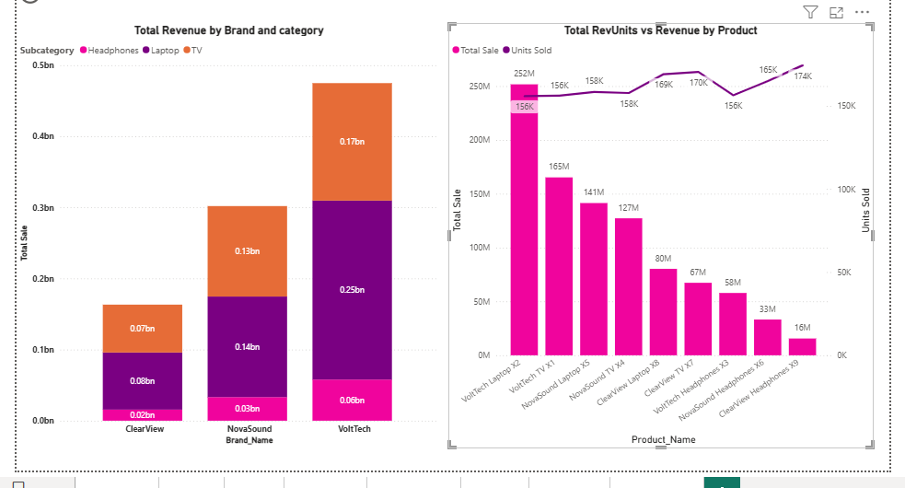
DASHBOARD · PRODUCT
Category & Brand Insights
Key Findings
Value leader: VoltTech Laptop X2 — ₹25.2 crore revenue
Volume leader: ClearView Headphones X9 — most units, but only ₹1.6 crore revenue
Takeaway: the highest-volume product is not the highest-value one — it's the cheap, heavily discounted line.
9

Slide 10
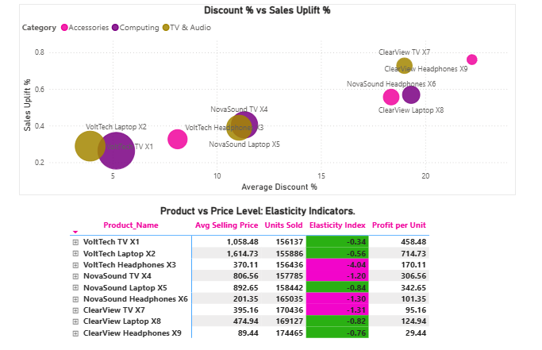
DASHBOARD · PROMOTION
Elasticity & Promotion Analysis
Key Findings
ClearView (top-right) discounts 19-22% and gets the biggest uplift — but the lowest margins.
VoltTech (bottom-left) barely responds to discounting at all.
Matrix: pink rows = price-sensitive SKUs (β < −1) — the best candidates for targeted promotions.
Promotions & Price Elasticity Intelligence System
10

Slide 11
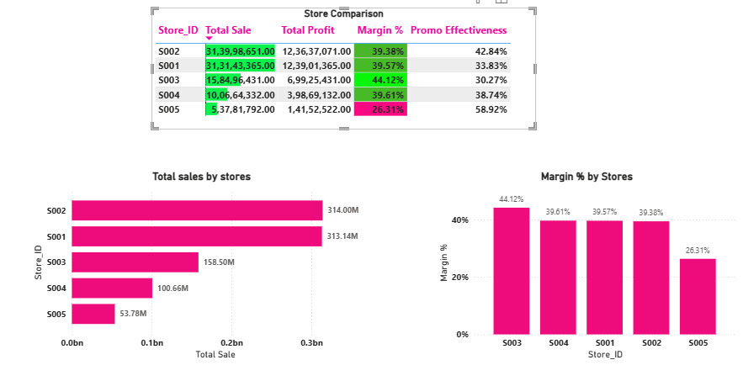
DASHBOARD · STORE
Store Performance View
Key Findings
S001 & S002 (Large-format) drive ~67% of total revenue.
S003 has the best margin at 44.1%.
S004 sits in the middle on both sales (₹10.07 Cr) and margin (39.6%) — a stable, unremarkable performer.
S005 has the weakest margin (26.3%) but the strongest promo response — its discounting should be reviewed for cost, not just volume.
Promotions & Price Elasticity Intelligence System
11

Slide 12
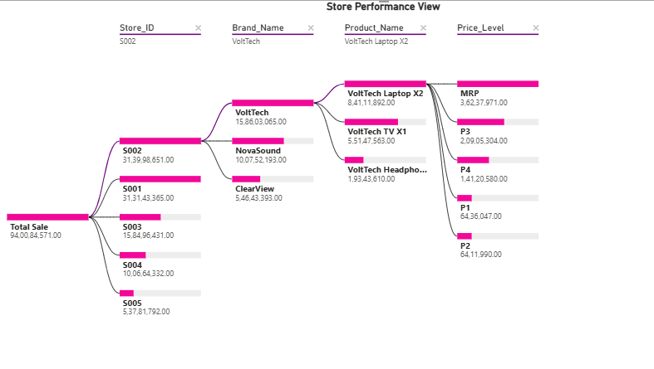
DASHBOARD · PROFITABILITY
Decomposition & Top Performers
TOP 3 PRODUCTS BY PROFIT
Product | Profit (₹)
VoltTech Laptop X2 | 11,14,16,914
VoltTech TV X1 | 7,15,85,233
NovaSound Laptop X5 | 5,42,90,098
TOP 3 STORES BY SALES UPLIFT
Store | Uplift %
S005 | 58.92%
S002 | 42.84%
S004 | 38.74%
Key Findings
S002 → VoltTech → Laptop X2 is the single biggest profit chain — ₹8.41 crore from this one path alone
VoltTech dominates — it holds 2 of the top 3 products by profit (Laptop X2 and TV X1)
43% of VoltTech Laptop X2's profit comes at full MRP — no discount needed to earn it
S005 has the lowest sales but the highest promo uplift (58.92%) — its growth depends on discounting, not organic demand
Profit is concentrated in the Store → Brand → Product path led by S002 → VoltTech → Laptop X2.
12

Slide 13
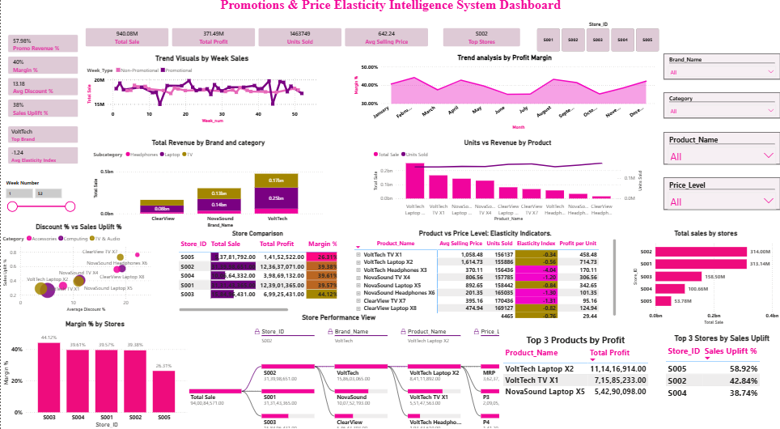
POWER BI DASHBOARD
Dashboard Overview
Promotions & Price Elasticity Intelligence System
8

Slide 14
07 · INSIGHTS
Key Findings
Recommendation
Sales & Promotion Behavior
Product / Brand | Weekly Units | Weekly Revenue | Weekly Profit | Recommendation
VoltTech TV X1 / Laptop X2 | +1% | -5% to -7% | -13% to -17% | Stop promoting
VoltTech Headphones X3 | +11% | -3% | -16% | Pilot only
NovaSound Headphones X6 | +59% | +14% | -16% | Continue, shallow discount
NovaSound TV X4 / Laptop X5 | +22-24% | +2-3% | -23% | Reduce depth
ClearView (all 3) | +64-96% | +15-29% | -39% to -54% | Cut discount depth
Promotions lift units ~36%/week, but revenue rises only ~1%/week
Weekly profit falls ~23% during promotions; margin drops 45.8% → 34.9%
Price Elasticity
4 of 9 products are elastic (β < −1) — respond well to discounting
5 of 9 are inelastic, incl. VoltTech's two biggest earners (Laptop X2, TV X1)
Brand & Product Performance
VoltTech Laptop X2 is the top performer — ₹25.2 Cr revenue, 43% at full MRP
ClearView discounts deepest (19-22%) but has the lowest margins of any brand
Store Performance
S001 & S002 drive ~67% of total revenue
S003 has the best margin (44.1%); S005 the weakest (26.3%) but strongest uplift (58.9%)
BOTTOM LINE
On this data, no product's promotions raise weekly profit. Promotions lift units (~+36%/week) but barely move revenue (~+1%/week), while weekly profit falls ~23%. Keep promotions only for share/volume goals, limit them to elastic SKUs at shallow tiers, and stop deep discounting on VoltTech's Laptop and TV.
13

Slide 15
Thank you

