Slide 1






1.36 Million
LCH

Slide 2



I can
help!
LCH

Slide 3
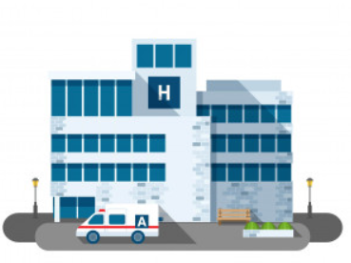

LCH
DEMAND
OFFERS
SOTI

Slide 4
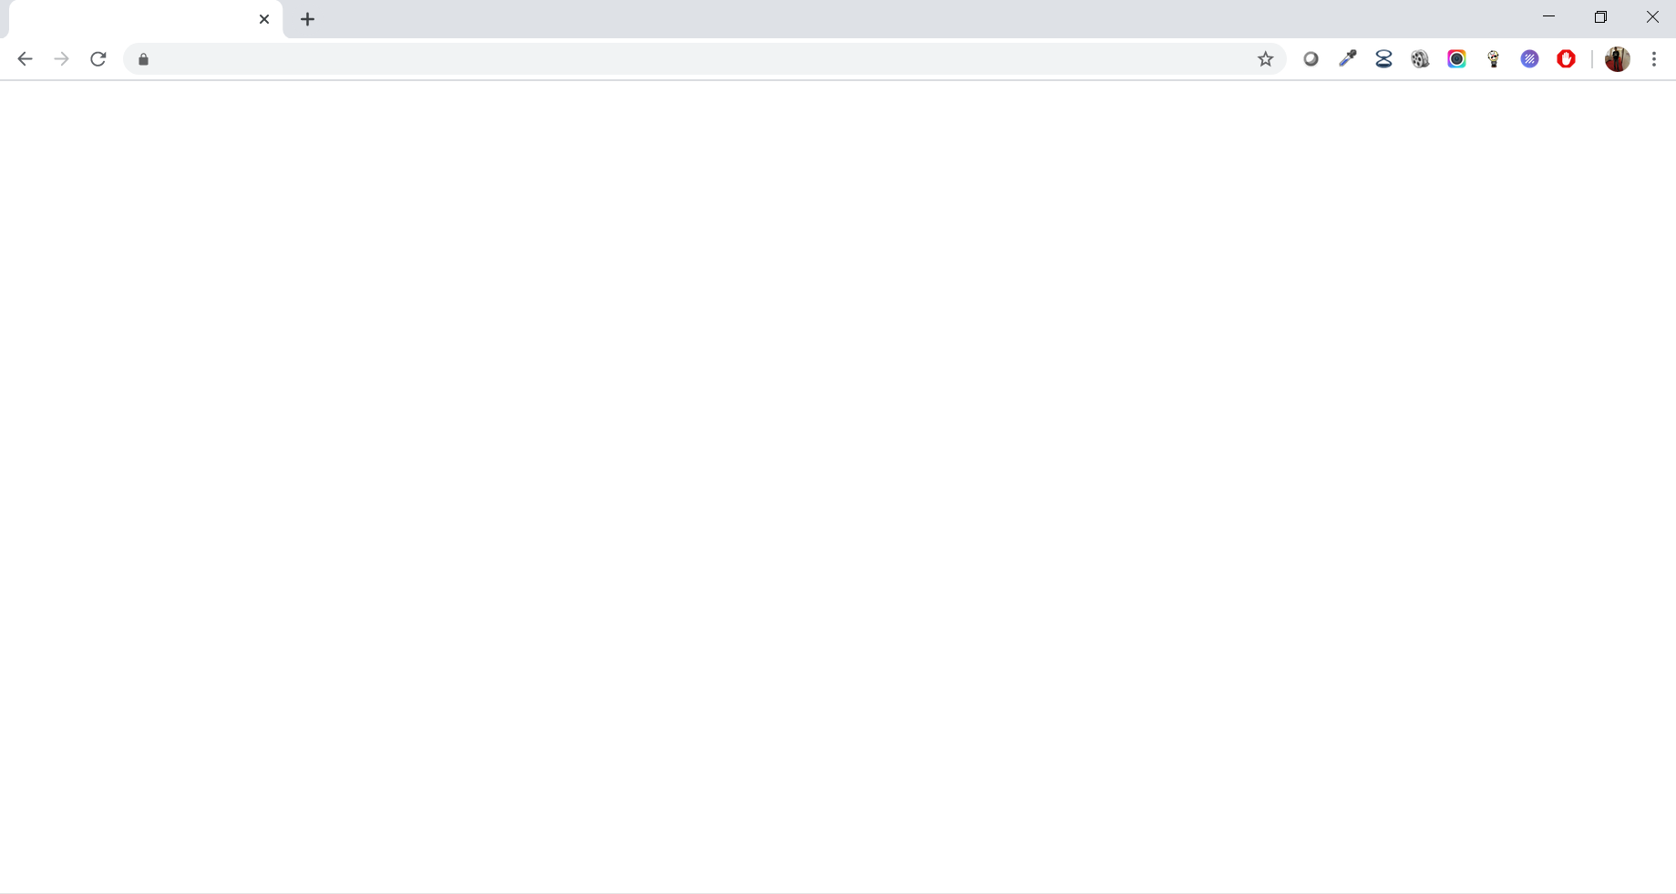
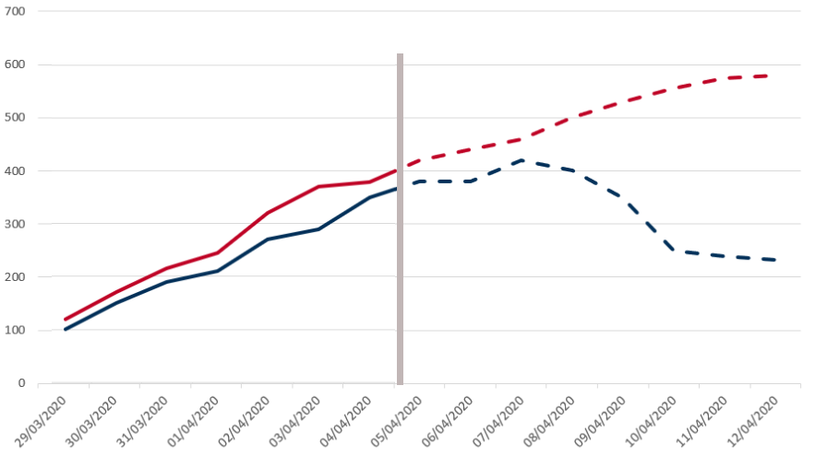
Hospital A
Number of masks needed
Hospital B
DEMAND
Past

Slide 5
Hospital A
Number of masks needed
Hospital B
DEMAND
Past
Future

Slide 6
Hospital A
Number of masks needed
Hospital B
DEMAND
Past
Future

Slide 7

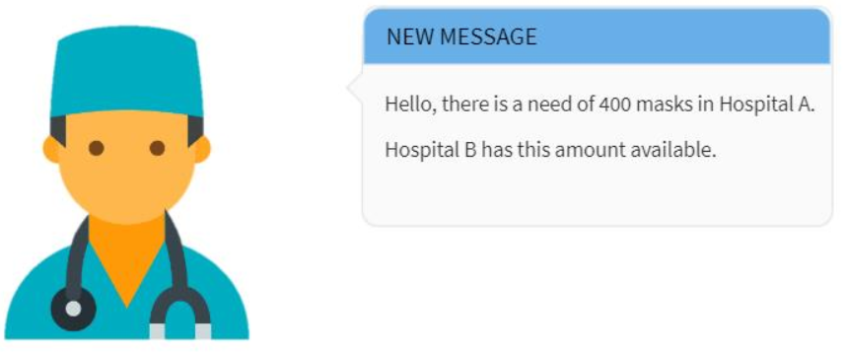
Hospital A
Number of masks needed
Hospital B
DEMAND
Past
Future

Slide 8

I can
help!
OFFERS

Slide 9



E- Tender
LCH
OFFERS

Slide 10
WHY SOTI?
Early intervention through predictive modelling
Involves small businesses
Integrates three main parties and
thousands of people

Slide 11

SOTI connects them all
LCH

