Slide 1
Alard College of Engineering and Management B.E. Computer Engineering Academic Year 2023-24
Presentation on
“ EV Charging Slot Booking Application "
By
Gagde Vyanktesh Narsing
Rahul Yadav
Sahare Aneesh Vijay
Sanket Vatane
Guided By:-
“Prof. Sujata Gaikwad ”

Slide 2
Contents
Abstract
Introduction
Motivation
Problem Statement
Objectives of the Project
Literature Survey
Algorithm
Conclusion
Future enhancements
references

Slide 3
Abstract
The growing adoption of electric vehicles(EVs) demands efficient charging infrastructure management to reduce congestion and enhance user convenience. This paper introduces an Electric Vehicle Charging Slot Booking Application designed to streamline real-time reservation of charging station centric interface. The system employs smart scheduling algorithms to prevent slot overlaps, integrated with cross-platform accessibility, and real-time availability updates.

Slide 4
Introduction
With the growing adoption of electric vehicles (EVs), the demand for an efficient and well-managed charging infrastructure is increasing. However, one of the major challenges faced by EV users is the unavailability of charging slots, leading to long wait times and inefficient resource utilization. To address this issue, our project, "EV Charging Station Slot Booking Application," provides a smart and user-friendly solution for reserving charging slots in advance. This application enables EV users to check real-time slot availability, book their preferred time slots, and make digital payments seamlessly.

Slide 5
Motivation
The rising adoption of electric vehicles (EVs) increases the demand for efficient charging solutions.
Limited charging infrastructure leads to long wait times and inefficiencies.
A lack of proper slot management results in congestion at charging stations.
Encouraging sustainable transportation by making EV charging hassle-free

Slide 6
Problem Statement
EV users face difficulties in finding available charging slots, leading to inconvenience.
Unorganized booking systems result in long queues and wastage of time.
Lack of real-time updates on slot availability at charging stations.
The absence of a centralized platform for booking and managing charging slots

Slide 7
Objectives of the Project
Develop a user-friendly application for booking EV charging slots in advance.
Provide real-time information about slot availability at charging stations.
Enable seamless digital payments and reservation management.
Optimize station usage to reduce waiting times and improve efficiency.
Promote green energy adoption by simplifying EV charging access

Slide 8
Literature Survey
Existing EV charging management solutions and their limitations.
Studies on the impact of digital booking platforms on reducing congestion.
Comparative analysis of smart grid-based vs. traditional charging networks.
Case studies of cities or countries implementing smart EV charging solutions.

Slide 9
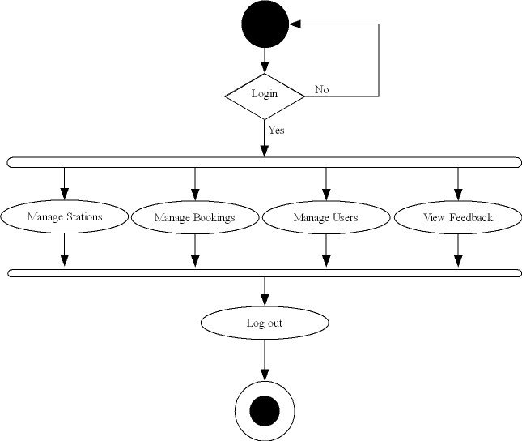
Algorithm
Admin :

Slide 10
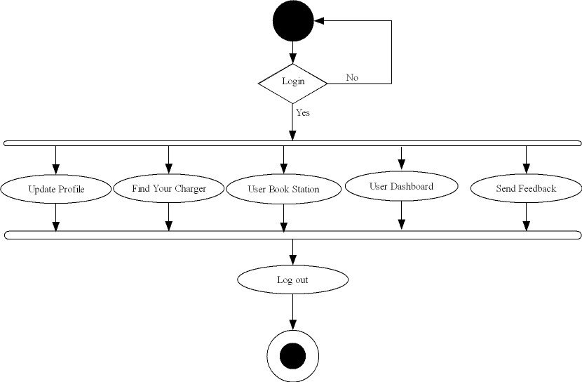
Algorithm
User :

Slide 11
Software Requirements
Programming language - Python
IDE - VS Code
Front End - HTML,CSS, JAVASCRIPT
Framework - Flask
Database - MySQL

Slide 12
Hardware Requirements
Laptop or PC
Windows 7 or higher
I3 processor system or higher
2 GB RAM or higher
100 GB ROM or higher
Android Phone (6.0 and above)

Slide 13
Conclusion
The project aims to enhance EV user experience by providing an efficient slot booking system.
It reduces waiting time, ensures optimal utilization of charging stations, and encourages EV adoption.
A centralized application will help both users and station owners manage resources effectively.
Future scope includes integrating AI-based demand prediction, renewable energy optimization, and IoT-enabled smart charging

Slide 14
Future Enhancements
Notifications:
Implement email/SMS notifications for booking status, charging progress, and slot updates.
Bookmark Feature:
Introduce a bookmark option for quick access to preferred charging stations.
Geolocation Integration:
Replace dropdown menus with geolocation services for simplified station selection.
Nearest Station Locator:
Automatically suggest nearest charging stations based on user's location.
Account Verification:
Implement email-based account verification for enhanced security and data integrity.
Advanced Payment Gateway:
Integrate a secure payment gateway for advance slot payments, reducing on-site queues.

Slide 15
Reference
https://www.w3schools.com/
https://www.python.org/
https://www.geeksforgeeks.org/vgg-16-cnn-model/
https://medium.com/
https://codepen.io
https://codewithrandom.com
https://developer.mozilla.org/en-US
https://overapi.com/css

