Slide 1
End-to-End Retail Performance & Behavioral Analytics
Presented by: Aneesh Kari

Slide 2
Problem Statement & Objectives
Problem Statement
Retail businesses generate large volumes of sales and customer data
Lack of consolidated analytics makes it difficult to:
Track sales performance
Understand customer behavior
Identify product and store inefficiencies
Project Objectives
Analyze sales performance across time, region, and channel
Segment customers based on demographics and value
Evaluate product profitability and return behavior
Assess store-level performance and operational efficiency
Build interactive dashboards for decision-making

Slide 3
Data & Methodology
Data Sources
Sales data
Customer data
Product data
Store data
Returns data
Methodology
Data cleaning and preprocessing using Excel & Python
Exploratory Data Analysis (EDA)
Relational database design using SQL Server
SQL-based business analysis
Interactive dashboard creation using Power BI

Slide 4
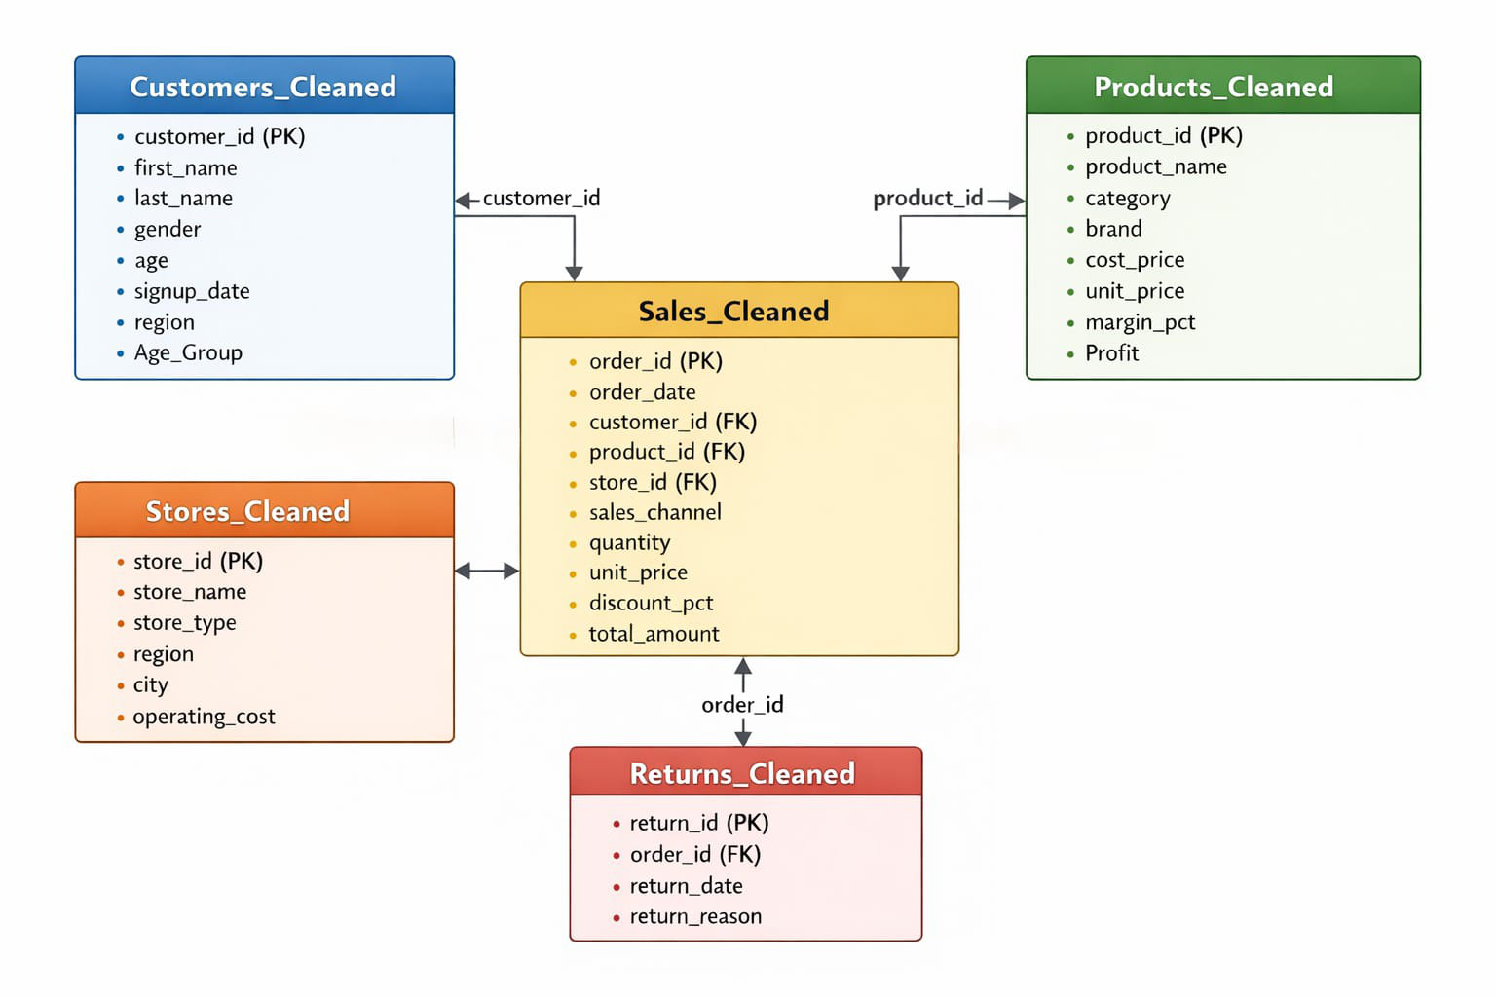
Database Design (ER Diagram)
Sales table acts as the central fact table
Dimension tables: Customers, Products, Stores, Returns
Primary and foreign keys ensure referential integrity

Slide 5
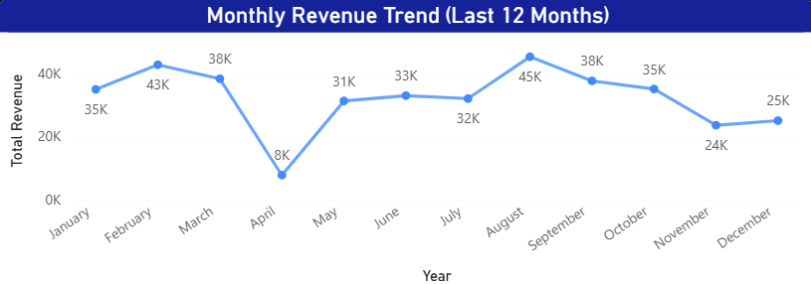
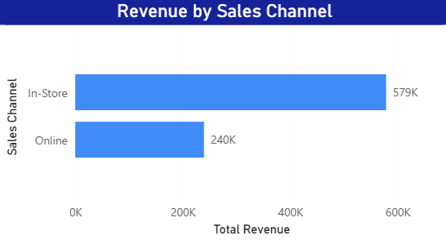
Sales Overview Insights
Revenue shows variation across time with visible trends
In-store sales contribute more revenue than online sales
Channel-level analysis highlights growth opportunities

Slide 6
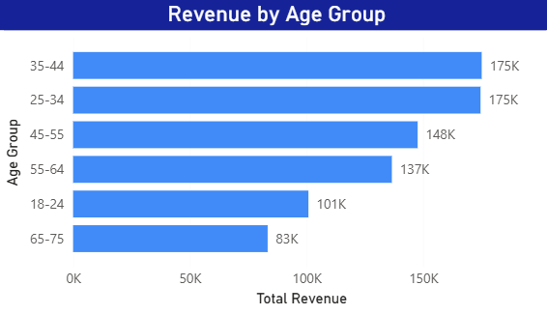
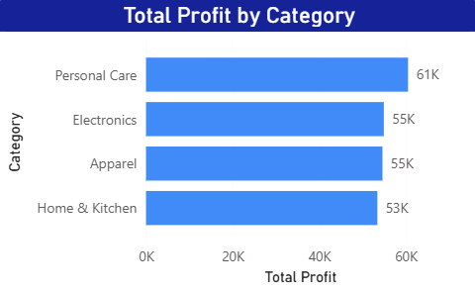
Customer & Product Insights
Certain age groups contribute significantly higher revenue
Customer segmentation helps identify high-value customers
Product categories vary in profitability and return behavior

Slide 7
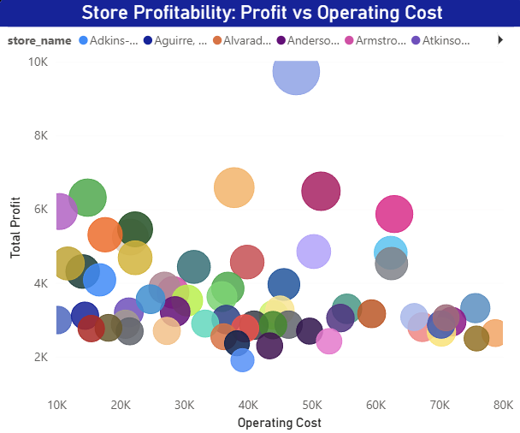
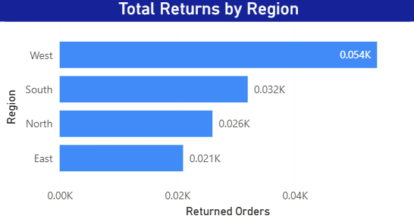
Store & Return Analysis
Store profitability varies significantly across locations
Some stores incur high operating costs with lower profit
Return trends help identify quality and operational issues

Slide 8
Key Findings
Revenue shows noticeable variation across time with seasonal trends
In-store sales contribute a higher share of revenue than online sales
Certain customer age groups generate significantly higher revenue
A small number of stores contribute a large portion of total profit
Product profitability and return rates vary across categories
Return behavior differs by region, indicating operational differences

Slide 9
Recommendations
Focus marketing efforts on high-value customer age groups
Strengthen in-store strategies while improving online channel performance
Optimize underperforming stores with high operating costs
Review products with high return rates for quality or pricing issues
Use data-driven dashboards for continuous performance monitoring

Slide 10
Conclusion
Developed an end-to-end retail analytics solution using SQL and Power BI
Analyzed sales performance, customer behavior, product profitability, and returns
Created interactive dashboards to support data-driven decision-making
The solution provides a scalable foundation for future business analysis

Slide 11
Thank you for your time and attention
Any Questions ?

