Slide 1
Notes for Embedded Verano Project

Slide 2
Installing on VirtualBox
Once the software is downloaded and command_line_tools are installed → error = it thinks command line tools are not installed
Solution: download and install the latest Jlink from Segger’s website: https://www.segger.com/downloads/jlink/JLink_Linux_V782_x86_64.deb

Slide 3
Starting up Multipass/Segger
Go to terminal and type: multipass list
If the instance is not running, type: multipass start IoT-Verano-nRF
Else, type in the terminal: ssh -X ubuntu@10.226.90.20 (ssh into the instance to use the segger IDE, this should be the fixed IP)

Slide 4
Creating a VM on multipass
Type in terminal: multipass launch -c 2 -m 2G -d 30G -n IoT-Verano-nRF
To allow for ssh →
  In normal terminal, type: cat .ssh/id_rsa.pub
  Copy all the output
  Go in vm shell and type: nano .ssh/authorized_keys
  Paste the output into the vm shell nano authorized_keys file

Slide 5
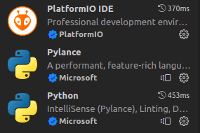
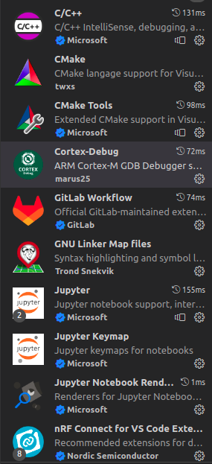
Building Application
Install VS Code
Install the extensions:
Required installations:
  Git

Slide 6
Serial Communication (UART)
Use GTKTerm and select a port (usually /dev/ttyACMO)
Make sure to disable the terminal on VS Code (it will try to connect but fail)

