Slide 1
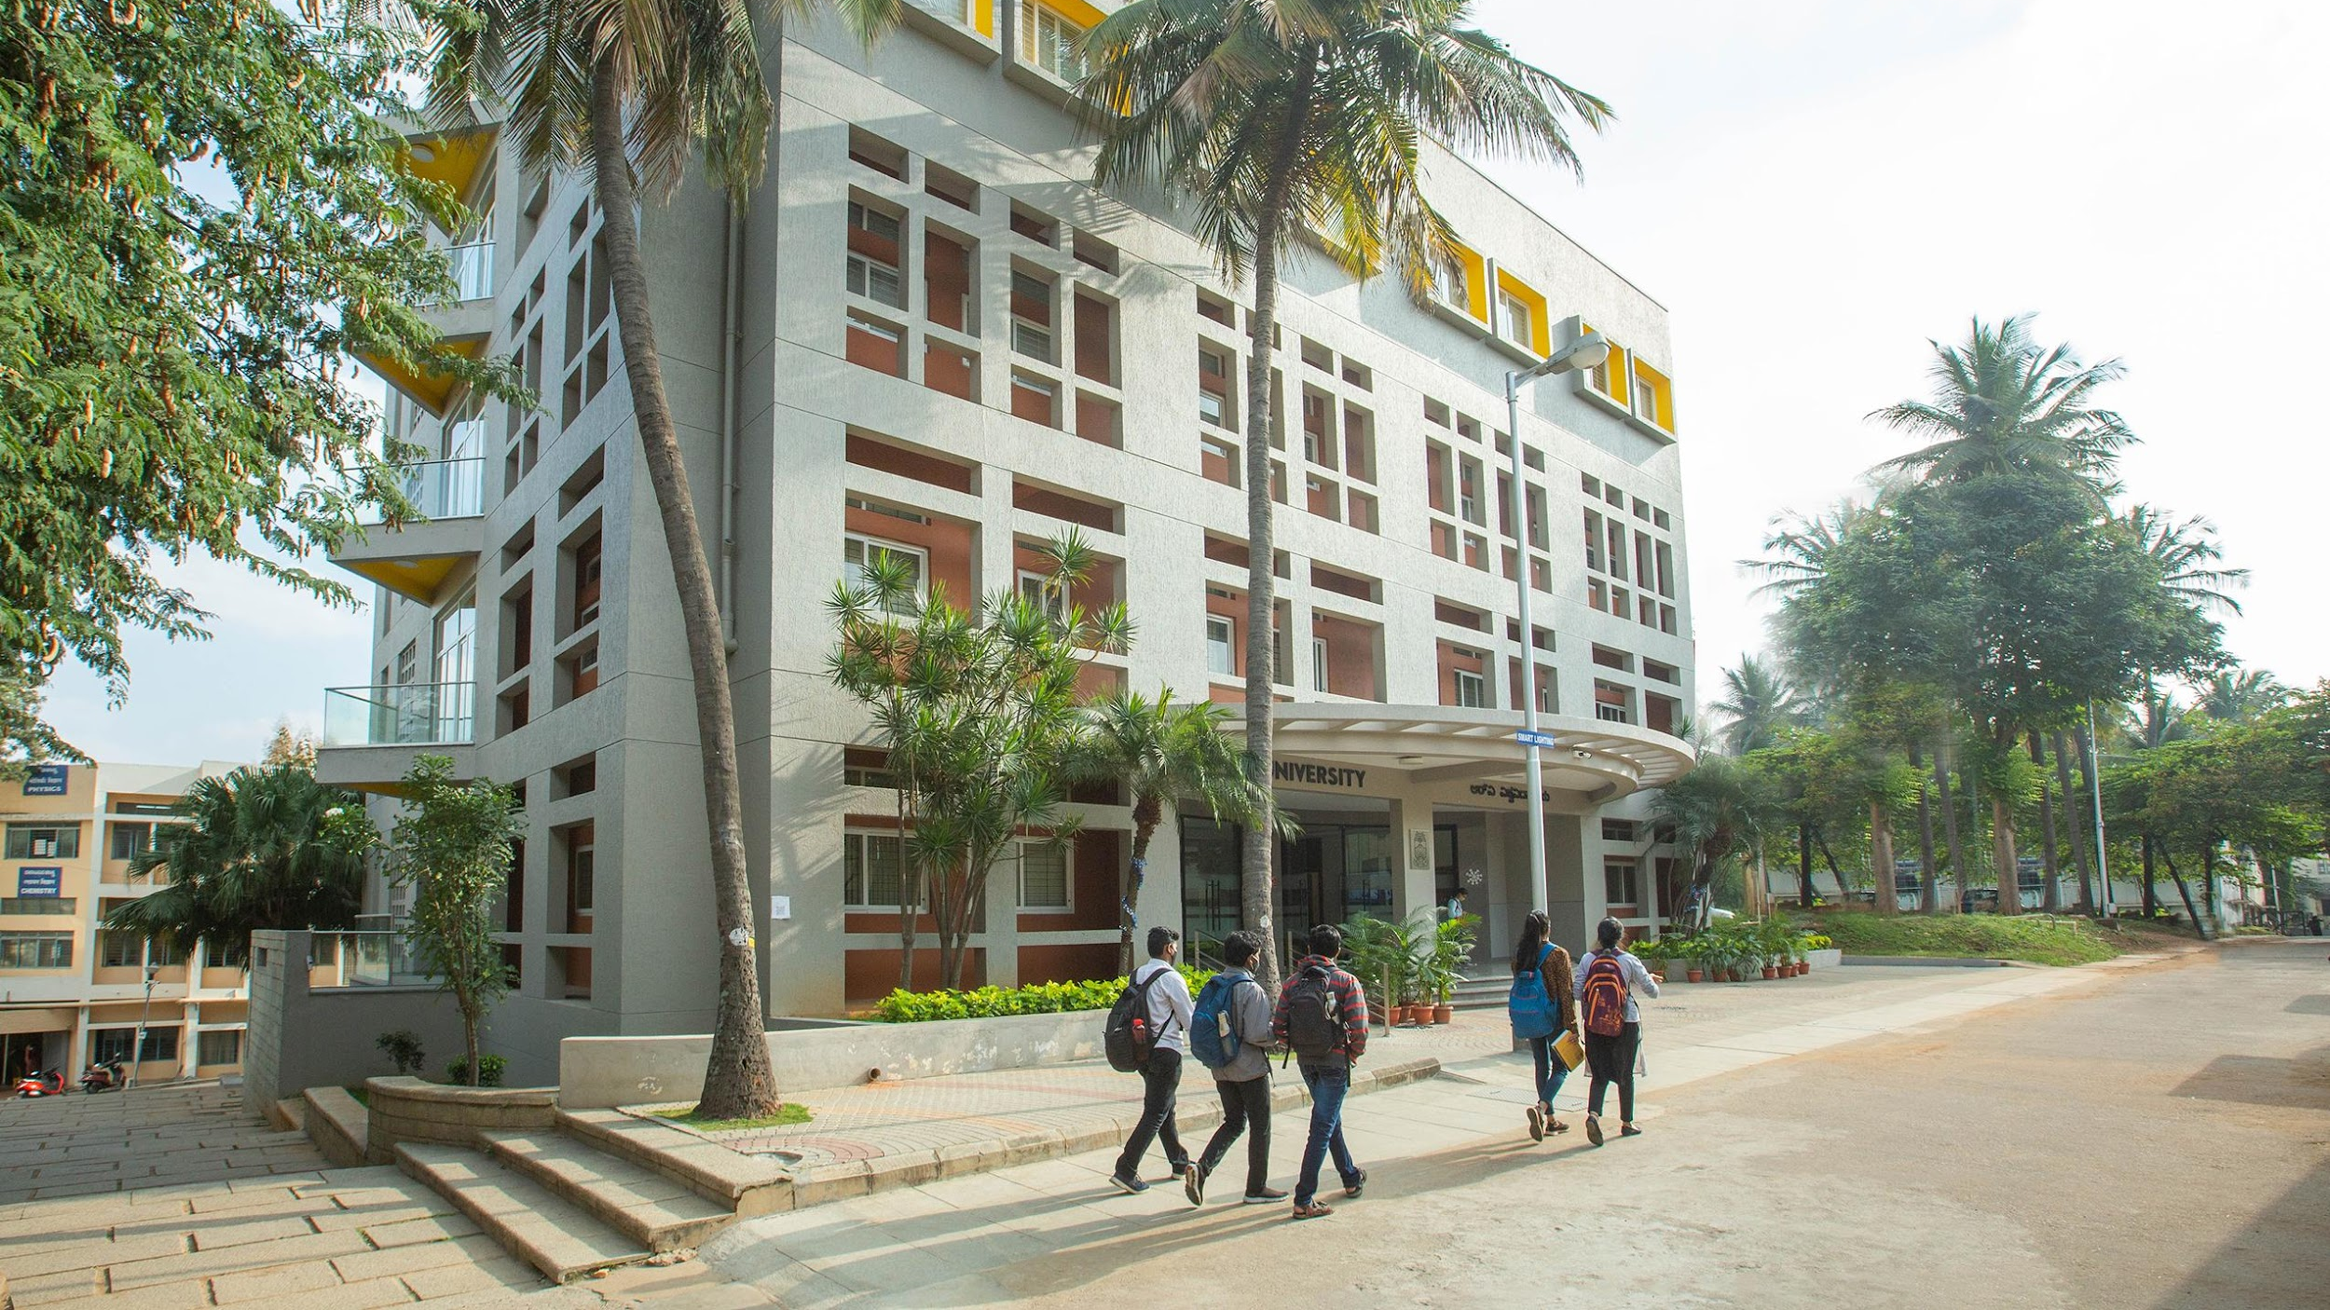

PROJECT TOPIC: Smart Waste Bin using IoT Sensors & Machine Learning
Guide:
Name: Prof. Monesh N
School: RV University
Presentation By:
Name1: Aneesh Adithya SR USN1:1RVU23CSE054
Name2: Amogh Madhu Kashyap USN2:1RVU23CSE045
Name3: Rajath D Kudur USN3:1RVU23CSE366
Name4:Vaibhav M Chittakki USN4:1RUA24CSE7019

Slide 2
AGENDA
INTRODUCTION
PROBLEM DEFINITION
OBJECTIVES OF PROJECT
METHODOLOGY
INNOVATIONS OF THE PROJECT
LITERATURE REVIEW
SOFTWARE & HARDWARE REQUIREMENTS
CONCLUSION
REFERENCES

Slide 3
INTRODUCTION
This project presents an IoT-based Smart Waste Bin integrated with AI-powered waste classification to enhance waste segregation and management. The system uses an ESP32-S3 microcontroller connected with ultrasonic, gas, and moisture sensors to monitor bin fill level and detect wet waste. A machine-learning model running on the server classifies organic waste using real-time camera input. The data is displayed on a live dashboard, and alerts are triggered through LEDs and a buzzer when wet waste or a full bin is detected. This solution supports cleaner urban environments and smart-city automation.
Notes:
Efficient waste management is a major challenge in modern cities due to rapid population growth and improper disposal habits. Manual monitoring of dustbins is inefficient, unhygienic, and leads to overflowing bins, foul odour, and increased environmental pollution. To address these issues, this project implements an automated Smart Waste Bin that integrates IoT sensing, real-time data monitoring, and machine-learning-based waste classification.
The system uses an ESP32-S3 microcontroller equipped with ultrasonic, gas, and moisture sensors. The ultrasonic sensor measures the bin's fill-level, while the moisture and gas sensors detect wet or decomposing waste. When the bin is full or wet waste is detected, the system triggers LED and buzzer alerts and simultaneously updates the dashboard. The buzzer can also be remotely controlled through the web interface.
Additionally, a deep-learning model is integrated to classify organic waste through the device’s camera feed. Every few seconds, the model analyzes frames and determines whether the visible waste is organic. If confirmed, the system sends a signal to treat the waste as wet waste, improving segregation accuracy.
All sensor readings and model outputs are displayed live on a web dashboard using Flask. This approach ensures hygiene, reduces human involvement, prevents overflow situations, encourages proper segregation, and contributes toward smart-city waste automation and sustainable urban living.

Slide 4
PROBLEM DEFINITION
Traditional waste management systems lack automation, resulting in overflowing bins, delayed collection, and improper waste segregation. Manual monitoring increases labour, time, and health risks, especially when handling wet and decomposing waste. Most existing bins only collect trash but do not classify or report bin status. This leads to environmental pollution, odour, unhygienic surroundings, and inefficient resource usage. The problem is to design an intelligent, automated system that detects bin fullness, identifies wet waste accurately, provides live monitoring, and alerts authorities efficiently, ensuring cleaner and smarter waste handling.
Notes:
Waste collection in many cities still follows manual or scheduled routines, where garbage collectors visit bins without knowing whether they are full or empty. This outdated approach wastes time and resources and causes bins to overflow before collection arrives. Overflowing bins not only result in bad odour and unhygienic surroundings but also attract insects, stray animals, and contribute to environmental pollution. Wet waste in particular decomposes quickly, producing harmful gases and unpleasant smells, posing a health hazard for nearby residents and sanitation workers.
Another major issue is the lack of proper waste segregation at the source. Citizens often mix organic and recyclable waste, making recycling difficult and reducing its effectiveness. Most dustbins only serve as passive storage containers without intelligence to identify and sort waste. Without real-time monitoring, municipal authorities do not receive timely alerts, leading to late collection and inefficient waste transportation planning.
Therefore, there is a need for a smart, automated waste monitoring and classification system that can:
Detect waste type (organic vs dry)
Monitor bin fill level
Give real-time alerts
Trigger alarms for timely action
Prevent overflow situations
Improve hygiene and reduce manual dependency
This project aims to solve these problems using IoT sensors, AI vision, and real-time dashboard monitoring, enabling cleaner and more efficient waste management systems.

Slide 5
OBJECTIVES OF THE PROJECT
This project aims to build an intelligent waste bin that automatically detects wet or organic waste, monitors bin fill levels in real time, and alerts users when the bin is full. The system integrates IoT sensors with machine learning to classify waste through a camera and ensure smart waste handling. It provides live data to a dashboard, supports buzzer alerts, and improves hygiene by reducing manual monitoring. Overall, the objective is to create an efficient, automated, and tech-driven waste management solution.
Notes:
The primary objective of this project is to automate waste monitoring and classification to make waste management smarter, cleaner, and more efficient. Traditional bins cannot differentiate between waste types or indicate when they are full. Our smart bin focuses on solving this by using sensor-based detection and AI classification.
First, the bin uses an MQ-135 gas sensor, capacitive moisture sensor, and ultrasonic sensor to identify wet waste and measure the garbage level. The goal is to classify waste at the source and avoid health hazards caused by decomposition gases and liquid leakage.
Second, a machine learning model and webcam detect organic waste visually. This cross-verification strengthens accuracy, ensuring even if one sensor fails, the bin still identifies wet waste correctly.
Third, by connecting the bin to a Wi-Fi-enabled ESP32-S3 microcontroller, the system sends real-time data to a web dashboard. Authorities or users can monitor gas levels, moisture, bin fullness, and waste type through a clean UI.
Another objective is to alert users when intervention is needed. A buzzer and LED system provides immediate notification for full bins or wet waste detection, ensuring timely disposal and maintaining hygiene.
Lastly, the aim is to build a platform that can scale for smart homes, institutions, and smart cities, reducing waste-collection inefficiency and encouraging better waste segregation habits.

Slide 6
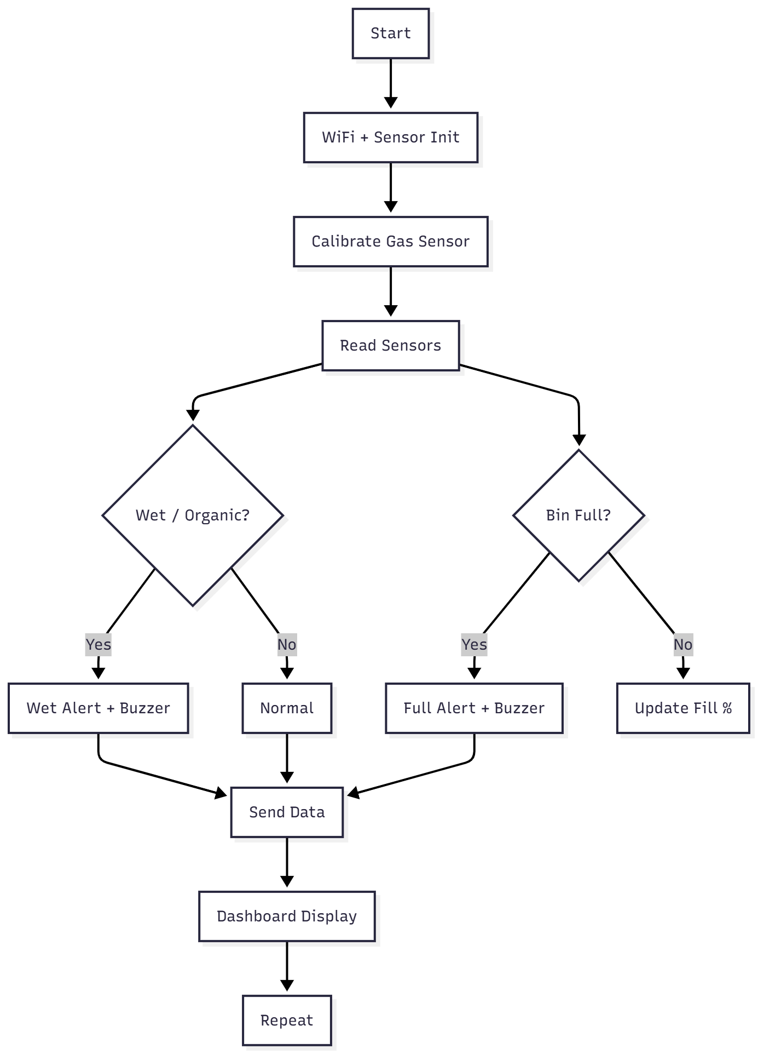
METHODOLOGY
The proposed system follows a layered methodology combining hardware sensing, machine learning inference, and IoT communication. Sensors first collect environmental and waste-related data, including gas levels, moisture, and distance. Simultaneously, a webcam captures waste images and a deep learning model classifies waste as organic or recyclable. The ESP32-S3 processes sensor readings, triggers alerts, and pushes data to a Flask-based web dashboard via Wi-Fi. The dashboard displays real-time waste status and allows user control of the buzzer. Continuous sensor feedback ensures accurate monitoring and intelligent alerts.
Notes:
The methodology of this smart waste bin system integrates IoT sensing, machine learning classification, and real-time web monitoring. The process begins with sensor data acquisition: the MQ-135 gas sensor detects harmful gases released by wet or decomposing waste, the capacitive moisture sensor identifies liquid content, and the ultrasonic sensor calculates the bin fill level based on distance measurements. These values form the first layer of decision-making for classifying waste as wet or dry and determining whether the bin is full.
Parallel to this, a webcam captures images of incoming waste, which are processed every few seconds using a deep learning CNN model trained on organic vs recyclable waste. The combination of visual classification and physical sensors increases reliability by cross-verifying decisions.
The ESP32-S3 microcontroller acts as the system hub — reading sensor inputs, interpreting logic, and sending structured JSON data to a Flask server hosted on a computer. This server updates a real-time dashboard, where the user can view metrics like gas levels, moisture, fill percentage, bin status, and ML prediction results. The UI also provides buzzer control to temporarily disable alerts.
When wet waste or full bin conditions are detected, LED indicators and a buzzer provide immediate audible and visual alerts. This structured pipeline ensures continuous sensing, AI-based classification, and real-time cloud connectivity, making the system efficient, intelligent, and scalable for smart city waste management.

Slide 7
INNOVATIONS OF THE PROJECT
This project introduces a hybrid waste-classification system combining IoT sensors and machine learning for increased accuracy and automation. Unlike traditional smart bins that rely only on single sensors, this system fuses ultrasonic, gas, and moisture readings with real-time webcam-based classification. Intelligent calibration ensures adaptability to different environments, while an interactive web dashboard provides live monitoring and buzzer control. The design enables automated wet waste detection, real-time bin-fill alerts, and cloud-based reporting. This integrated multi-sensor + AI approach enhances smart-city waste management efficiency and environmental hygiene.
Notes:
Our project brings innovation by merging IoT sensing and deep learning-based waste detection, unlike most existing smart bins that depend on a single sensor. We use gas sensors, moisture sensors, ultrasonic measurement, and a machine-learning vision model to cross-verify waste type and bin status, improving reliability even in real-world messy waste scenarios.
An auto-calibration mechanism helps the device adapt to different waste bins and environments without manual tuning. The web dashboard shows live values, waste classification results, and even lets users control the buzzer remotely — a feature typically missing in small-scale IoT bins.
Together, these components create a more intelligent, accurate, and interactive smart-waste system, ready for smart campus and smart-city use.

Slide 8
LITERATURE REVIEW
# | Source / Year | Focus | Method / Hardware | Findings | Limitation | How We Used It
1 | Trident3, Kaggle Waste Classification Notebook (2023) | Image-based classification of organic vs recyclable waste | CNN model (Transfer Learning), image preprocessing, H5 model export | Achieved high accuracy classifying waste images using deep learning | Works best with clean dataset images; real-world lighting/noise can affect prediction | We adopted model architecture & integrated webcam inference into smart bin system
2 | Capacitive Soil Moisture Sensor Instruction Manual | Moisture-based detection of organic/ wet material | Capacitive moisture sensor (analog output) | Detects moisture content reliably, corrosion-free design vs resistive sensors | Needs calibration & values vary with environment | Used to detect moisture in waste to identify wet/organic waste
3 | MQ135 Air Quality & Gas Sensor Datasheet / Tutorials | Odor & gas-based detection | MQ-135 sensor with baseline calibration | Detects VOCs & ammonia gases associated with organic waste | Raw values unstable without baseline; influenced by environment ventilation | Used baseline auto-calibration logic to detect odor & confirm wet waste
4 | Smart Bin Ultrasonic Waste Level Detection Projects (IoT Research 2020-2024) | Bin-fill monitoring using distance sensor | Ultrasonic sensor HC-SR04 | Accurate fill-level estimation, works in enclosed bins | Reflection issues on curved or soft trash surfaces | Added distance-based % fill + overflow & near-sensor limit logic
Notes:
Our system is built using a hybrid of machine learning and sensor fusion. We referenced a Kaggle CNN notebook for deep learning-based waste classification and combined it with real-world moisture, gas, and ultrasonic sensor methods. Capacitive sensor manuals helped us configure moisture thresholds reliably, and MQ135 tutorials provided gas baseline calibration logic. Finally, prior smart-bin ultrasonic works guided our bin fill detection and alert logic. This fusion approach improves accuracy and handles real-world waste conditions better than single-sensor systems.

Slide 9
SOFTWARE REQUIREMENTS
Category | Tool / Technology | Purpose | Notes
Programming Language | Python | ML model & Flask backend | Used for inference + server
Microcontroller Language | C/C++ (Arduino) | ESP32 firmware | Sensor reading + WiFi + buzzer control
Framework | Flask | Web dashboard & ESP32 API | Real-time monitoring
ML Library | TensorFlow / Keras | Deep learning model loading & prediction | H5 waste classification model
Computer Vision | OpenCV | Webcam capture & frame processing | Real-time detection every 5s
UI Library | HTML, CSS, JavaScript | Dashboard UI | Live updates via fetch polling

Slide 10
HARDWARE REQUIREMENTS
Category | Component | Purpose | Notes
MCU | ESP32-S3 | Main controller, Wi-Fi + sensor hub | High-speed, AI-ready microcontroller
Camera | USB / Laptop Webcam | ML waste classification | Captures images every 5s
Gas Sensor | MQ-135 | Detects harmful gases from organic waste | Baseline-calibrated detection
Moisture Sensor | Capacitive Soil Moisture Sensor | Detects wet waste | Corrosion-proof, accurate
Ultrasonic Sensor | HC-SR04 | Waste level detection | Measures bin fill %
Buzzer | Piezo Buzzer | Alerts for wet waste / bin full | Pattern-based alerts
Indicator LEDs | Green & Yellow LEDs | Visual waste status + bin full | User feedback system
Power Supply | USB cable / 5V supply | ESP32 power source | Stable DC input required
Connectors | Jumper wires & resistors | Circuit connections | Safe & stable wiring
Dust Bin | Physical model | Waste container housing sensors | Prototype demonstration unit

Slide 11
CONCLUSION
This project successfully demonstrates a smart waste-management system that detects wet waste, monitors bin fill level, and enables real-time alerts using sensors, machine learning, and IoT. By combining automation and AI, the system improves waste segregation accuracy and encourages efficient disposal with minimal human involvement.
Notes:
Our project integrates IoT sensors with machine learning to automate waste detection and bin-monitoring. The system continuously checks moisture, gas levels, and distance to identify wet waste and detect when the bin is full. Meanwhile, a deep-learning model analyzes images from a camera to recognize organic waste. All this information is transmitted wirelessly to a real-time dashboard, and alerts are triggered through LEDs and a buzzer.
This setup reduces human effort, improves waste segregation accuracy, and enables smarter, more efficient waste-management in public and household environments. The project demonstrates how AI and IoT together can support cleaner surroundings and encourage responsible waste handling.

Slide 12
REFERENCES
Kaggle Notebook — Waste Classification with CNN (H5 Model).
Available at: https://www.kaggle.com/code/trident3/waste-classification-with-cnn-with-h5-model
Datasheet & Application Guide — Capacitive Soil Moisture Sensor v2.0
(DFRobot / Generic Module Documentation)
Espressif Systems — ESP32-S3 Official Technical Reference Manual, 2024.
Available at: https://www.espressif.com

