Slide 1



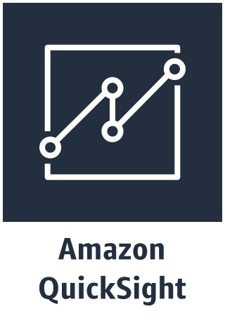

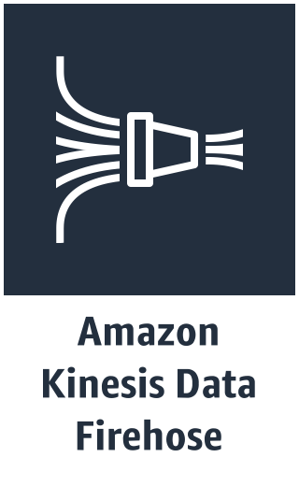

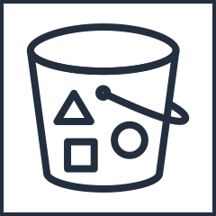
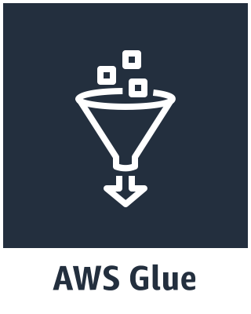
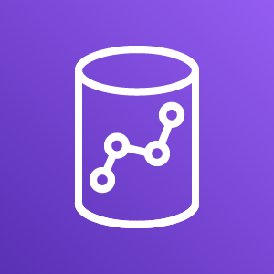

Lab Architecture https://github.com/vikasomer/serverless-datalake-on-aws
Data
Ingest
Store + Catalog + Transform
Analyze
AWS Glue Data Catalog
Raw
Data
Crawlers
Crawlers
Kinesis Data Generator
Any
Application
Amazon S3
(Raw & Reference data)
Amazon
Lambda
Amazon S3
(Processed data)
Reference
File
Amazon Redshift
Redshift Query Editor

Slide 2
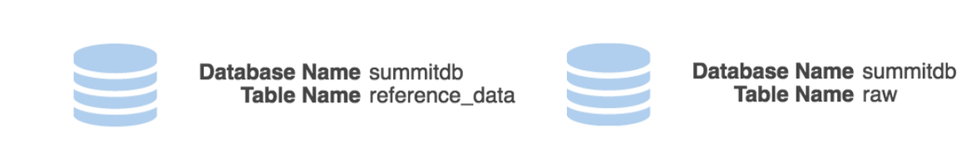

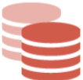
Redshift flow
Import Libraries
In this notebook we will be using the following classes, here are some of the important ones
SparkContext - Main entry point for Spark functionality. A SparkContext represents the connection to a Spark cluster, and can be used to create RDDs, accumulators and broadcast variables on that cluster.
GlueContext - Wraps the Apache SparkSQL SQLContext object, and thereby provides mechanisms for interacting with the Apache Spark platform
awsglue - AWS's pyspark library which provides the needed
Transform Name: Map.Apply
Transform Name: ApplyMapping
Transform Name: Drop field
Transform Name: ApplyMapping
Redshift (Connection: redshift_lab)

