Slide 1
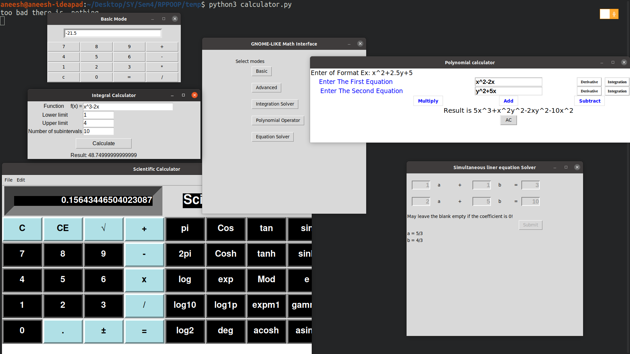
RPPOOP PROJECT
GNOME-LIKE MATHEMATICAL INTERFACE
Project Contributors :
Prathamesh Bhilare: 112003029
Aneesh Damle: 112003032
SY COMPUTER DIV : 1

Slide 2
INFORMATION OF PROJECT
Programming Paradigm
Object Oriented Programming :
Object-oriented programming is a programming paradigm based on the concept of "objects", which can contain data and code: data in the form of fields, and code, in the form of procedures. A common feature of objects is that procedures are attached to them and can access and modify the object's data fields.
OOP Principles:
1] Abstraction
2] Encapsulation
3] Inheritance
4] Polymorphism
Graphics User Interface(GUI)
Tkinter Python:
Tkinter is the Python interface to the Tk GUI toolkit shipped with Python.

Slide 3
MODES OF MATHEMATICAL INTERFACE
Basic
  BODMAS Operations
Advanced
  Trigonometric Operations
  Modulus Operations
  Exponential Operations
  Logarithmic Operations
Polynomial
  Polynomial Operations: Addition, Subtraction ,Multiplication (Sympy library)
  Integration Of Polynomial Functions (d/dx, d/dy)
  Derivation Of Polynomial Functions (d/dx, d/dy)
Definite Integral Calculator
  Using Simpson’s Method (Subintervals) (Expression Tree)
Equation Solver
  Simultaneous equations (using Numpy library)

Slide 5
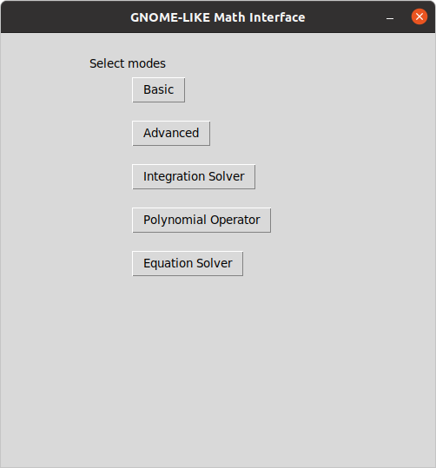
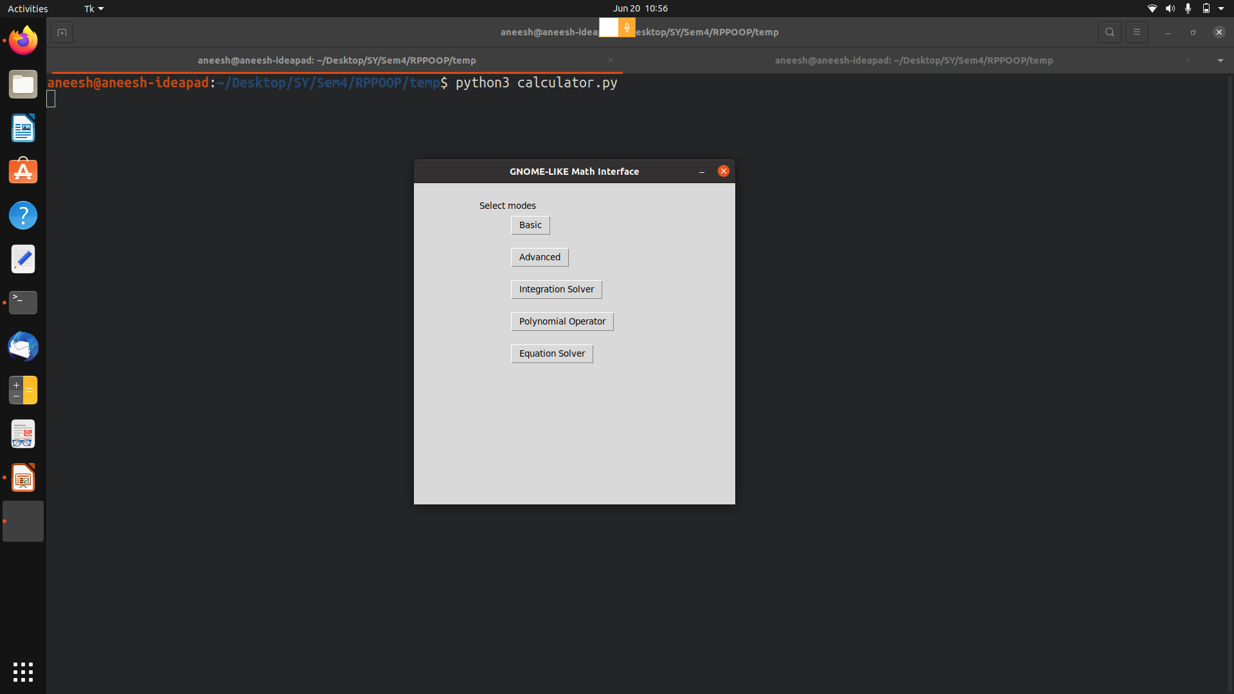
MAIN INTERFACE

Slide 6
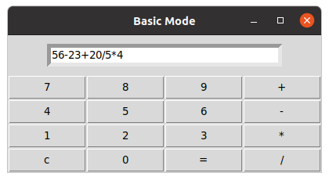
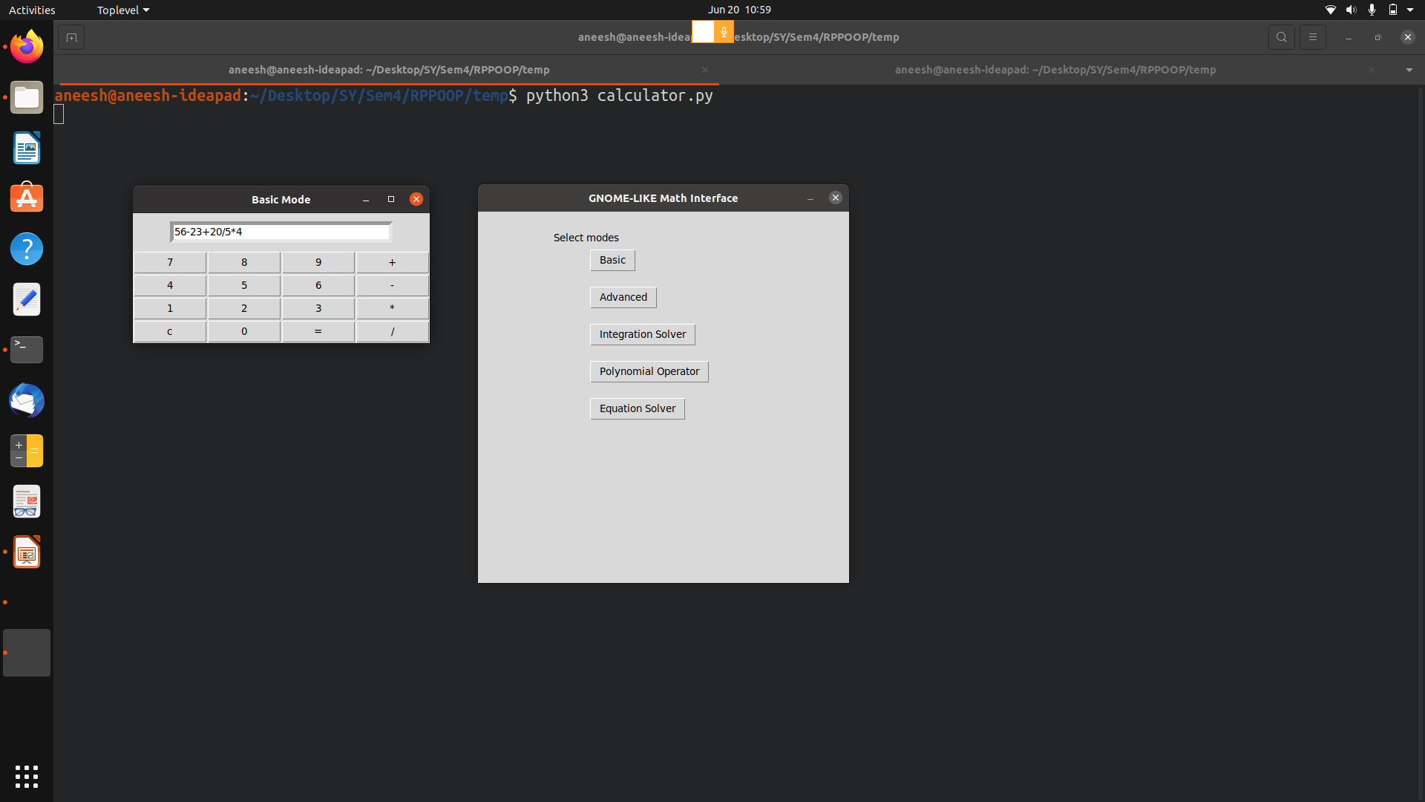
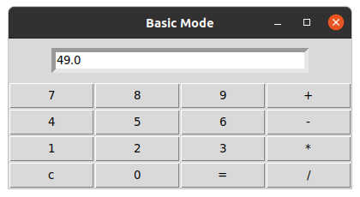
THE BASIC MODE

Slide 7
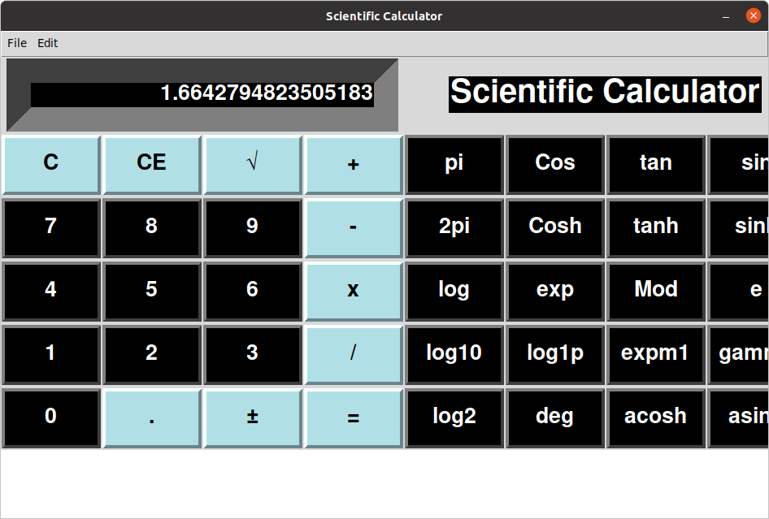
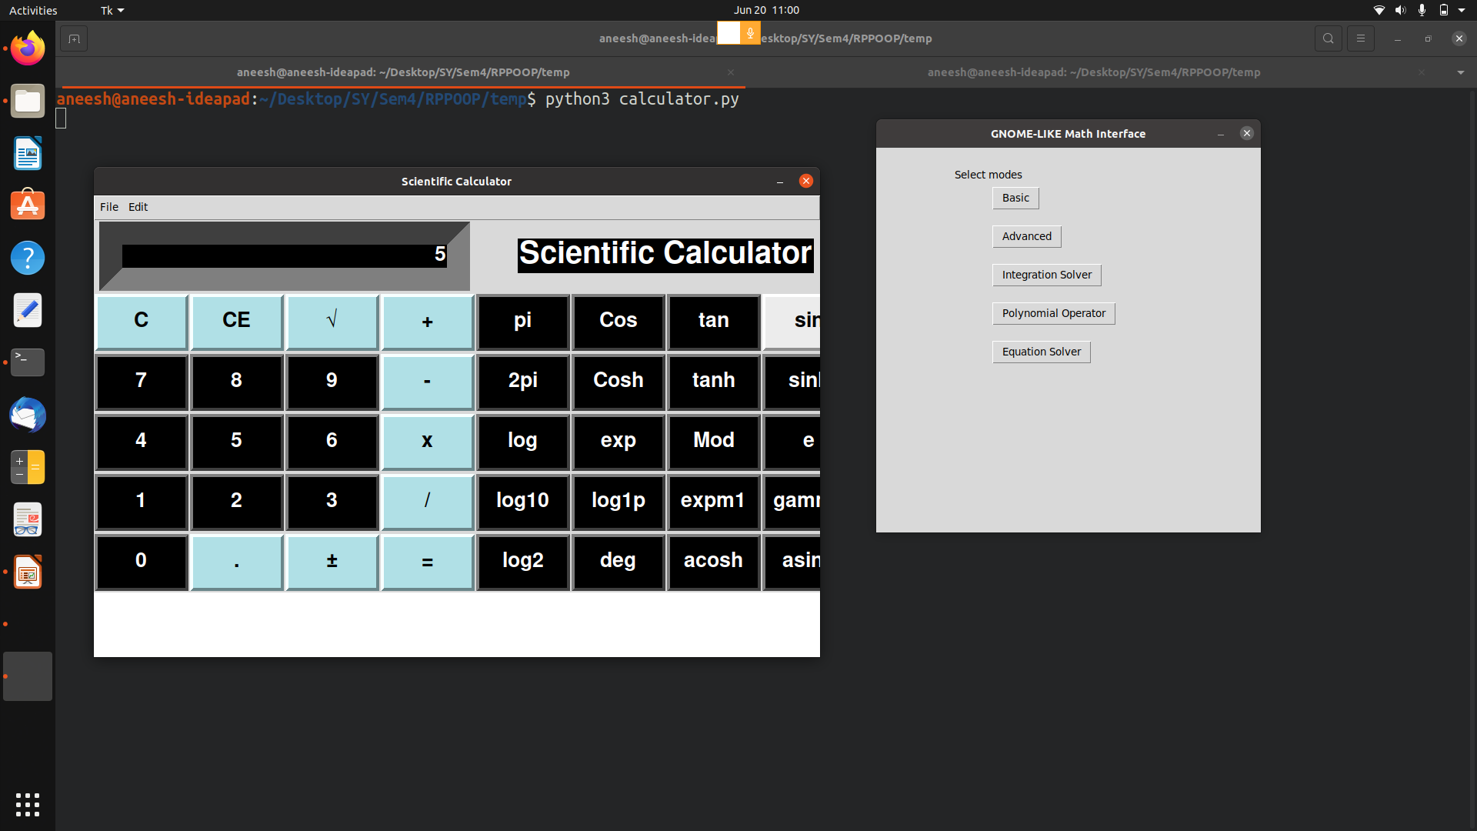
ADVANCED MODE

Slide 8
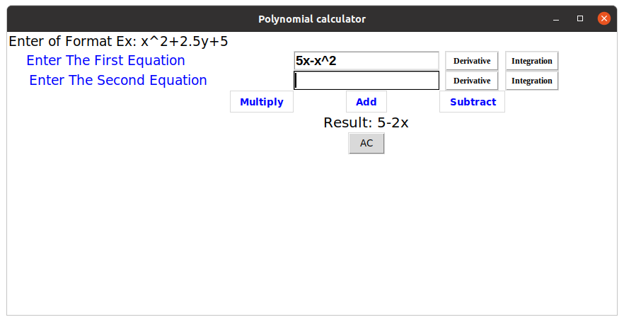
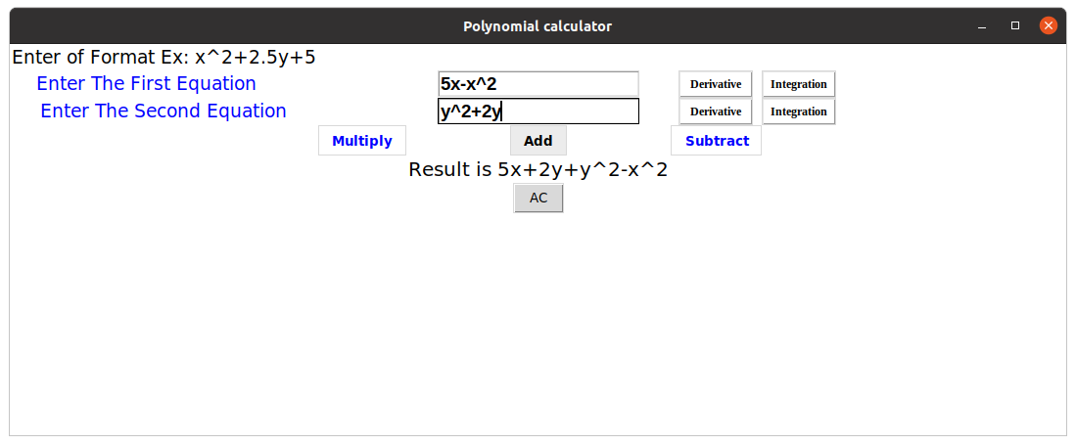
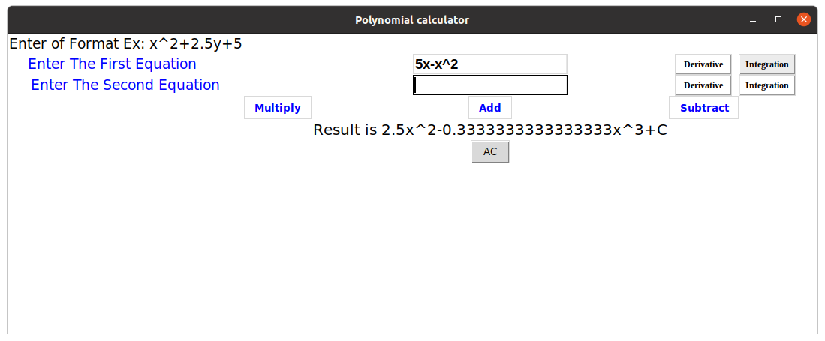
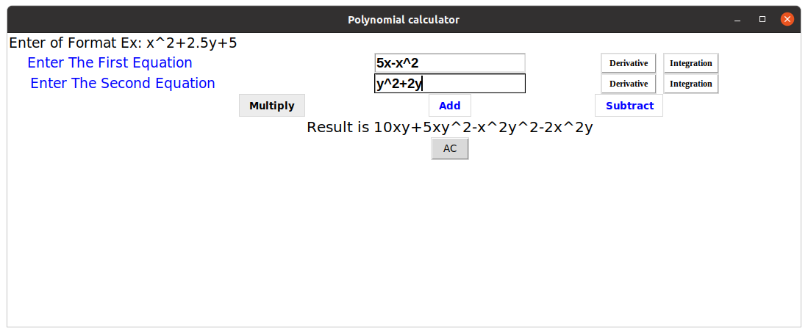
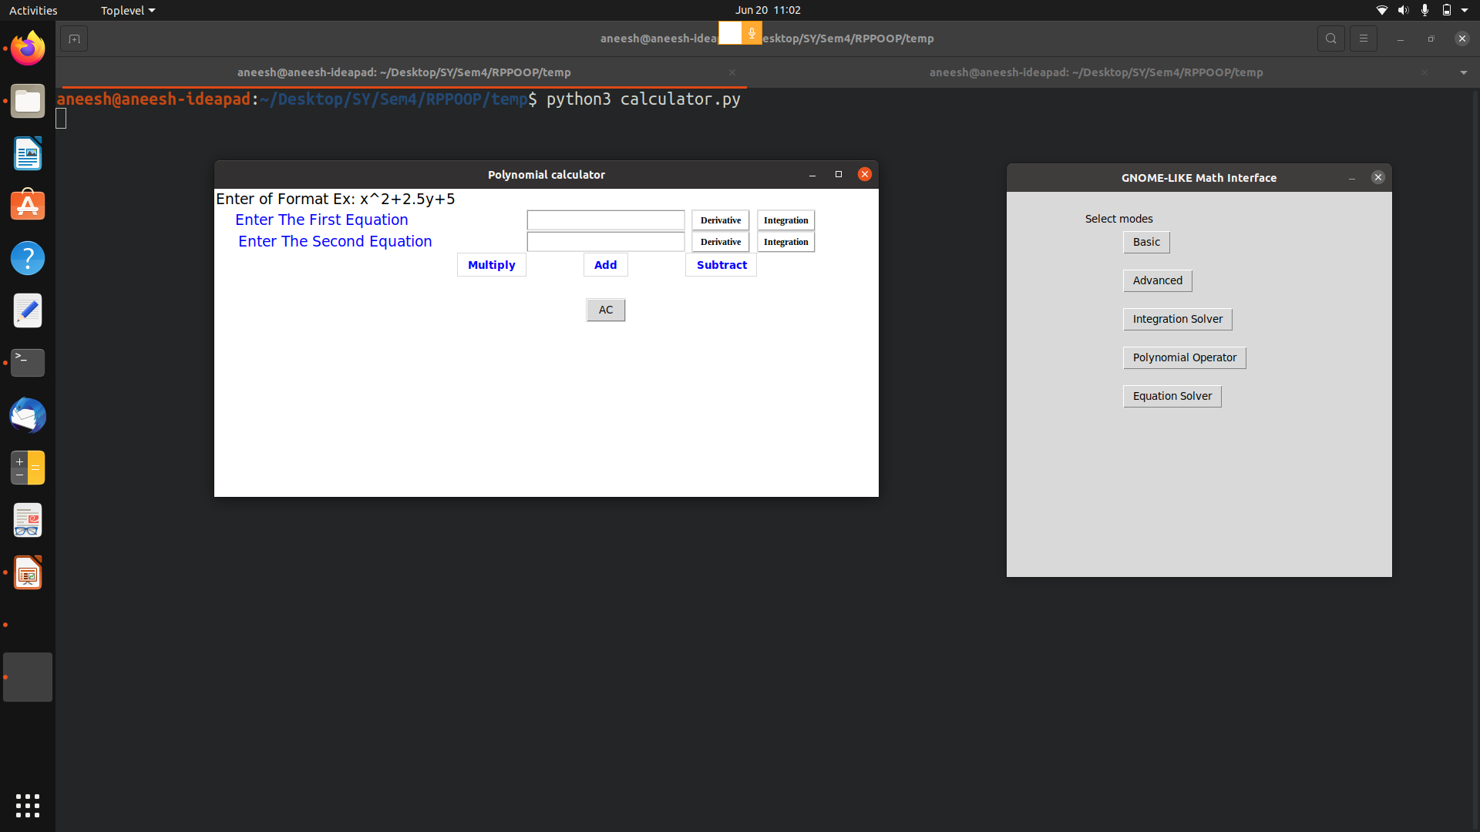
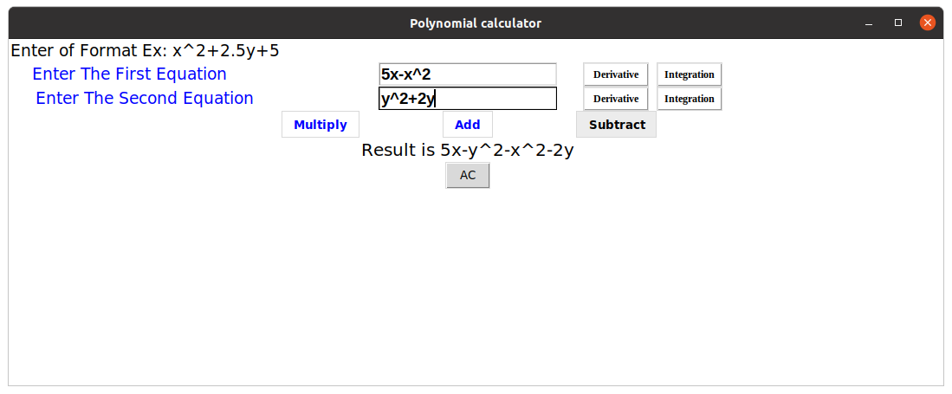
POLYNOMIAL MODE

Slide 9
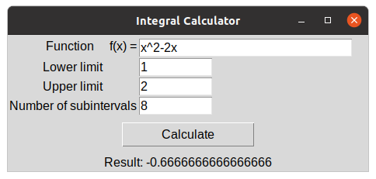
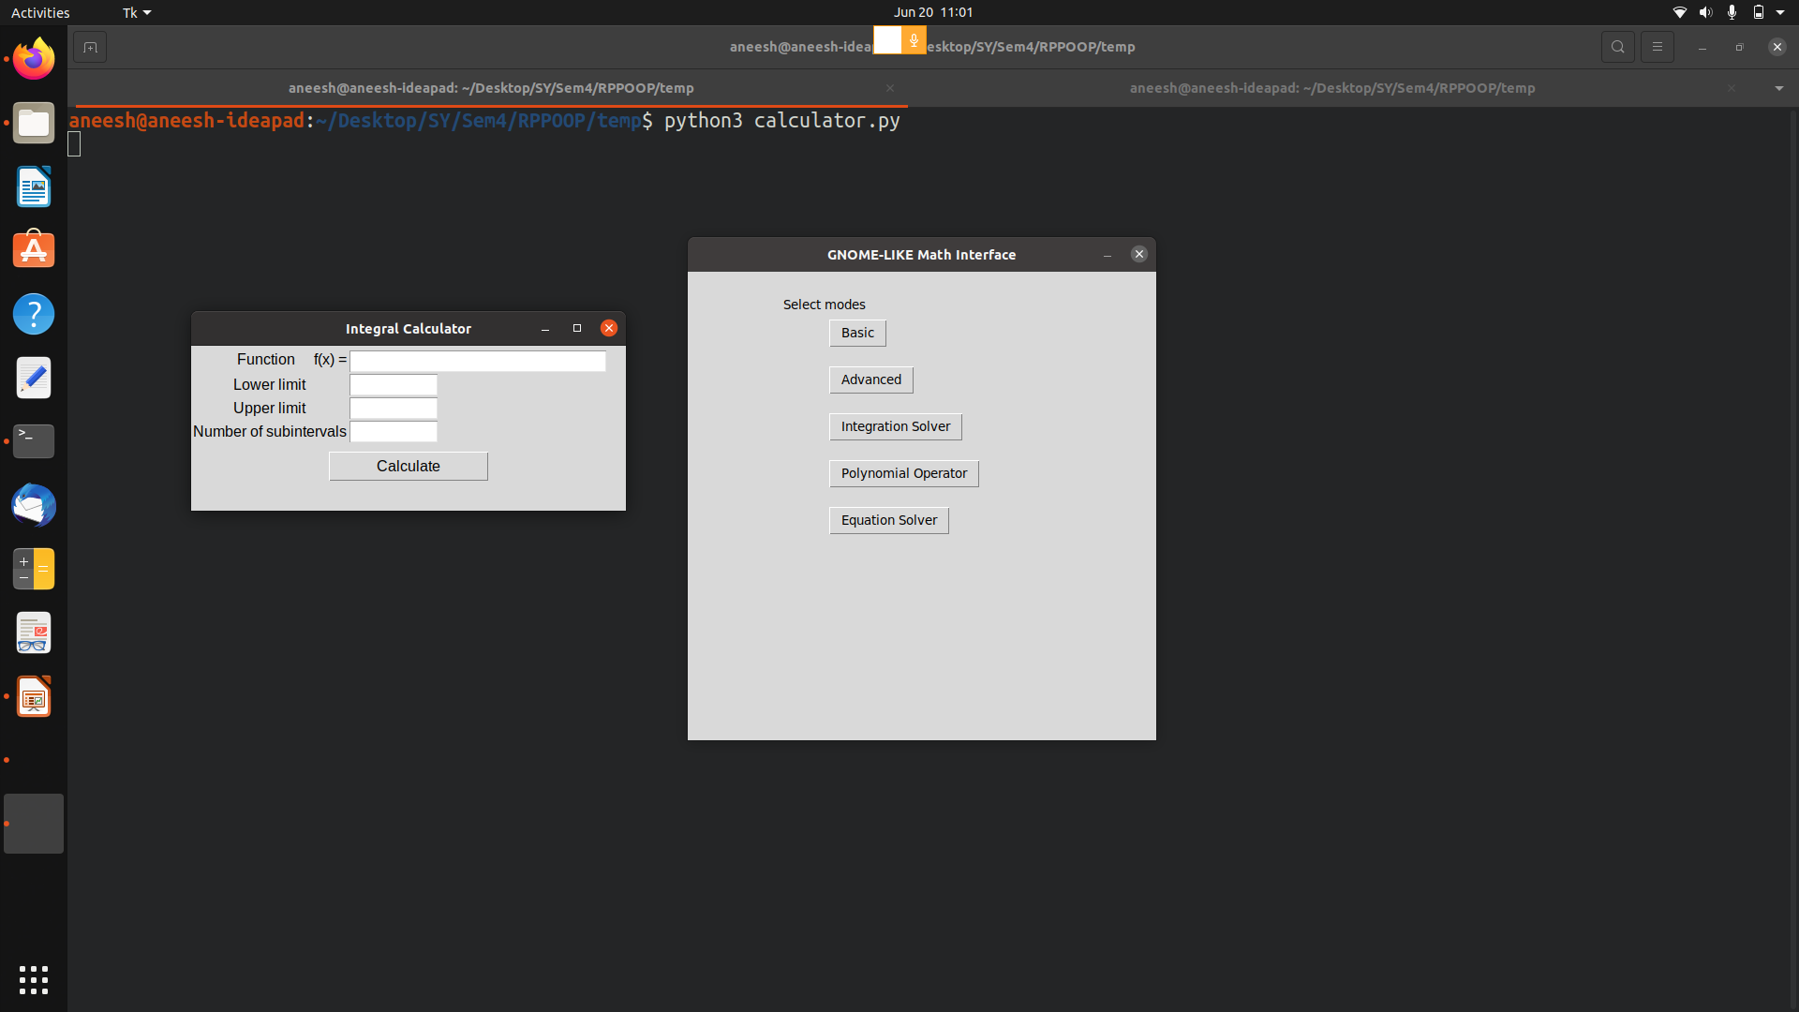
DEFINITE INTEGRAL MODE

Slide 10
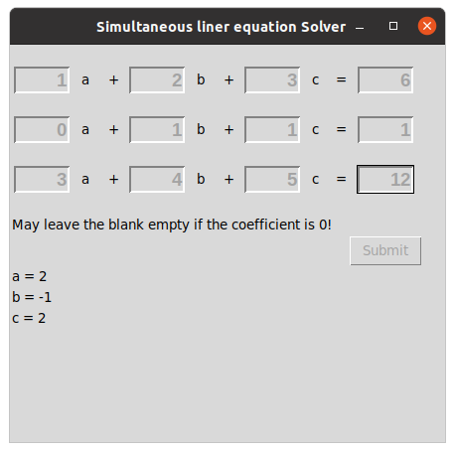
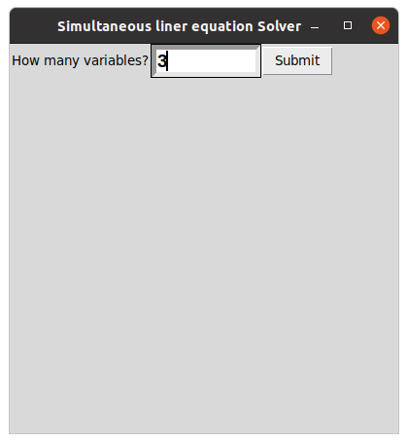
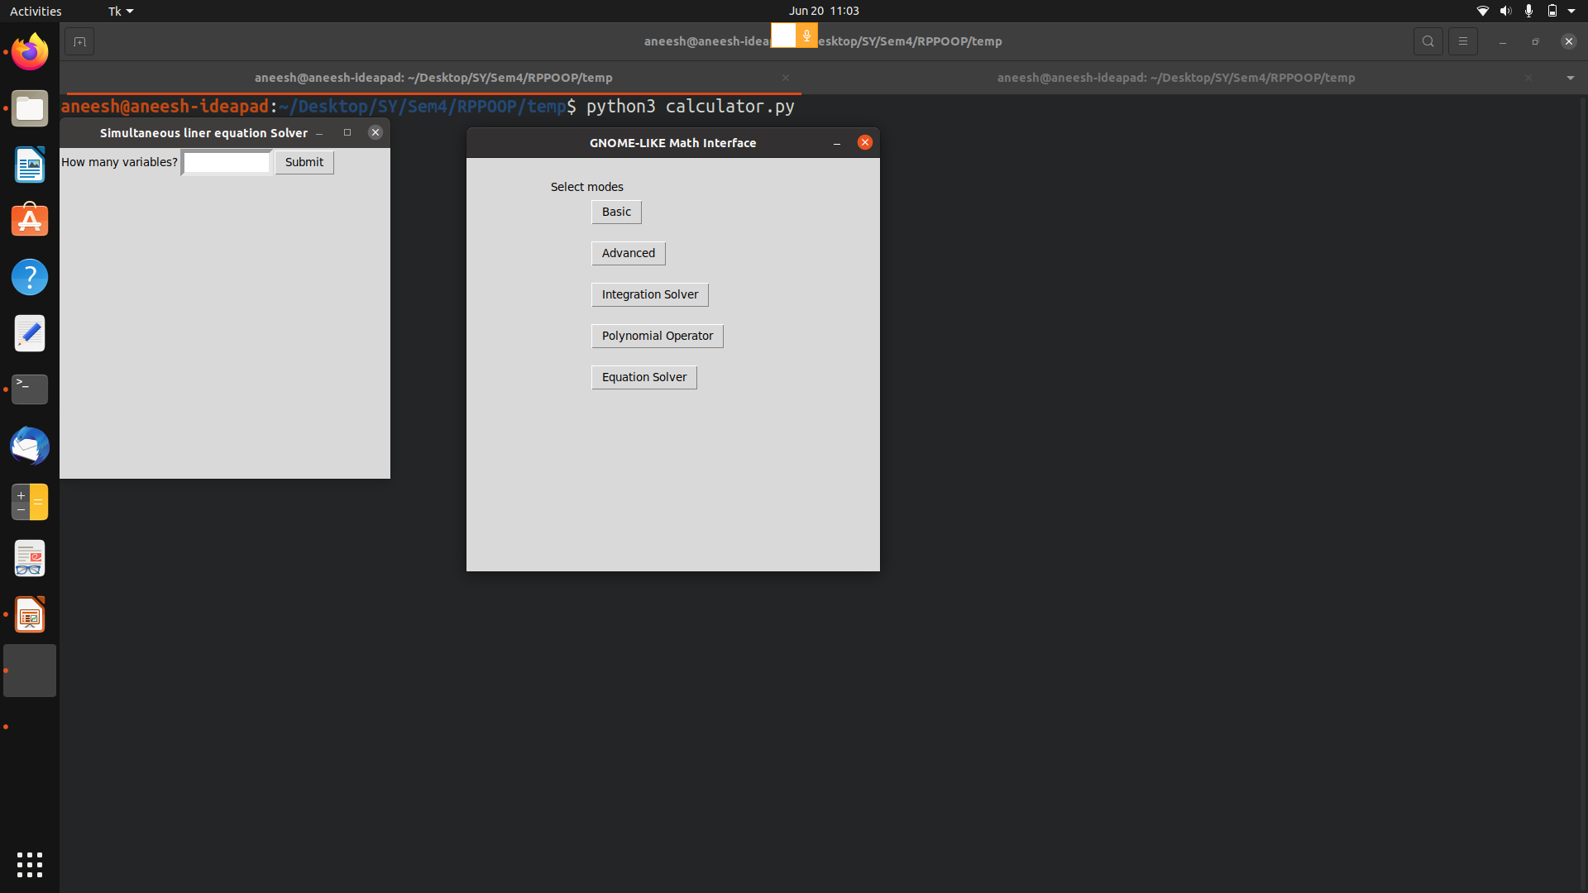
EQUATION SOLVER (SYSTEM OF LINEAR EQUATION)

Slide 11
THANKYOU!

