Slide 1

Chapter 1
Introduction to Financial Management
McGraw-Hill/Irwin

Slide 2
Key Concepts and Skills
Know the basic types of financial management decisions and the role
of the financial manager
Know the financial implications of the different forms of business organization
Know the goal of financial management
Understand the conflicts of interest that
can arise between owners and managers
Understand the various types of financial markets

Slide 3

Chapter Outline
Finance and
the Financial Manager
Forms of Business Organization
The Goal of Financial Planning
The Agency Problem and Control
of the Corporation
Financial Markets
and the Corporation
Notes:
1.<number>
www: This is a good place to show the students the web site that accompanies the book, including the various features that they can access for study purposes (study guide, quizzes, web links, etc.). Click on the “web surfer” icon to go directly to the site (www.mhhe.com/rwj).

Slide 4
Corporate Financial Management
Some important questions that
are answered using finance:
  What long-term investments should the firm take on?
  Where will we get the long-term financing to pay for the investment?
  How will we manage the everyday financial activities of the firm?
Notes:
1.<number>
Emphasize that “business finance” is just another name for “corporate finance” mentioned under the four basic types. Students often get confused by the terminology, especially when different terms are used to refer to the same thing.

Slide 5
Financial Manager
Financial managers try to answer some or all of these questions
The top financial manager within a firm is usually the Chief Financial Officer (CFO)
  Treasurer – oversees cash management, credit management, capital expenditures, and financial planning
  Controller – oversees taxes, cost accounting, financial accounting and data processing
Notes:
1.<number>

Slide 6
Financial Management Decisions
Capital budgeting
  What long-term investments or projects should the business take on?
Capital structure
  How should we pay for our assets?
  Should we use debt or equity?
Working capital management
  How do we manage the day-to-day finances of the firm?
Notes:
1.<number>
Provide some examples of capital budgeting decisions: what product or service will the firm sell, should we replace old equipment with newer, more advanced equipment, etc.
Be sure to define debt and equity.
Provide some examples of working capital management: who should we sell to on credit, how much inventory should we carry, when should we pay our suppliers, etc.

Slide 7
Forms of Business Organization
Three major forms in the United States
  Sole Proprietorship
  Partnership
    General
    Limited
  Corporation
    Limited Liability Company
Notes:
1.<number>
www: Clicking on the “web surfer” will take you to a web site (www.nolo.com) that will provide a discussion about which form of business may be appropriate for an entrepreneur. The following pages will provide links to specific pages on the web site that provide additional information about the legal aspects of each form of business, as well as a discussion of the advantages and disadvantages.

Slide 8
Sole Proprietorship
Advantages
  Easiest to start
  Least regulated
  Single owner keeps all the profits
  Taxed once as personal income
Disadvantages
  Limited to life
  of owner
  Equity capital limited to owner’s personal wealth
  Unlimited liability
  Difficult to sell ownership interest
Notes:
1.<number>
www: Click on the “web surfer” for more information about sole proprietorships. If you click on the “> Sole Proprietors” link, you will be taken to an index that will provide a link to information about husband and wife sole proprietorships.

Slide 9
Partnership
Advantages
  Two or more owners
  More capital available
  Relatively easy to start
  Income taxed once as personal income
Disadvantages
  Unlimited liability
  Partnership dissolves when one partner dies or wishes to sell
  Difficult to transfer ownership
Notes:
1.<number>
www: Click on the “web surfer” for more information about partnerships. If you click on the “> Partnerships” link, you will go to an index that provides links to additional information about limited partnerships, partnership agreements, and buy-sell agreements.
Note that unlimited liability applies to all partners in a general partnership but only to the general partners in a limited partnership.
Written agreements are essential due to the unlimited liability.
Limited partners cannot be involved in the business or else they may be deemed as general partners.

Slide 10
Corporation
Advantages
  Limited liability
  Unlimited life
  Separation of ownership and management
  Transfer of ownership is easy
  Easier to raise capital
Disadvantages
  Double taxation (income taxed at the corporate rate and then dividends taxed at the personal rate)
Notes:
1.<number>
www: Click on the “web surfer” to go to a page that discusses corporations. If you click on the “> Corporations” link it will take you back to an index that provides links to additional information on corporations as well as limited liability corporations.
Discuss how separation of ownership and management can be both an advantage and a disadvantage:
Advantages
You can benefit from ownership in several different businesses (diversification)
You can take advantage of the expertise of others (comparative advantage)
Easier to transfer ownership
Disadvantage
Agency problems if management goals and owner goals are not aligned
A pertinent discussion is the implementation of Sarbanes-Oxley and the effect it has had. Although increased information flow is good for shareholders, it has come at a cost. In fact, some firms have chosen to “go dark,” while others have avoided going public altogether.

Slide 11
Goal of Financial Management
What should be the goal of a corporation?
  Maximize profit?
  Minimize costs?
  Maximize market share?
  Maximize the current value of the company’s stock?
Does this mean we should do anything and everything to maximize owner wealth?
Notes:
1.<number>
Try to have the students discuss each of the goals above and the inherent problems of the first three goals:
Maximize profit – Are we talking about long-run or short-run profits? Do we mean accounting profits or some measure of cash flow?
Minimize costs – We can minimize costs today by not purchasing new equipment or delaying maintenance, but this may not be in the best interest of the firm or its owners.
Maximize market share – This was a strategy of many of the “dot.com” companies. They issued stock and then used it primarily for advertising to increase the number of “hits” to their web sites. Even though many of the companies had a huge market share, they still did not have positive earnings and their owners were not happy.
Maximize the current value of the company’s stock
There is no short run vs. long run here. The stock price should incorporate expectations about the future of the company and consider the trade-off between short-run profits and long-run profits.
The purpose of a for-profit business should be to make money for its owners. Maximizing the current stock price increases the wealth of the owners of the firm.
This is analogous to maximizing owners’ equity for firms that do not have publicly traded stock.
Non-profits can also follow the same principle, but their “owners” are the constituencies that they were created to help.
Also be sure to note that this goal is not specific to corporations, but is generally applied to any form of business, including not-for-profits.

Slide 12
The Agency Problem
Agency relationship
  Principal hires an agent to
  represent his/her interests
  Stockholders (principals) hire
  managers (agents) to run the company
Agency problem
  Conflict of interest between
  principal and agent
Management goals and agency costs
Notes:
1.<number>
A common example of an agency relationship is a real estate broker – in particular if you break it down between a buyer’s agent and a seller’s agent. A classic conflict of interest is when the agent is paid on commission, so they may be less willing to let the buyer know that a lower price might be accepted or they may elect to only show the buyer homes that are listed at the high end of the buyer’s price range.
Direct agency costs – the purchase of something for management that can’t be justified from a risk-return standpoint, and monitoring costs.
Indirect agency costs – management’s tendency to forgo risky or expensive projects that could be justified from a risk-return standpoint.

Slide 13
Managing Managers
Managerial compensation
  Incentives can be used to align
  management and stockholder interests
  The incentives need to be structured carefully
  to make sure that they achieve their goal
Corporate control
  The threat of a takeover may result in better management
Other stakeholders
Notes:
1.<number>
Incentives – discuss how incentives must be carefully structured. For example, tying bonuses to profits might encourage management to pursue short-run profits and forego projects that require a large initial outlay. Stock options may work, but there may be an optimal level of insider ownership. Beyond that level, management may be in too much control and may not act in the best interest of all stockholders. The type of stock can also affect the effectiveness of the incentive. A relatively recent issue with the backdating of options also seems to run counter to the purpose of aligning incentives.
Corporate control – ask the students why the threat of a takeover might make managers work toward the goals of stockholders.
Other groups also have a financial stake in the firm. They can provide a valuable monitoring tool, but they can also try to force the firm to do things that are not in the owners’ best interests.

Slide 14
Financial Markets
Cash flows to and from the firm
Primary vs. secondary markets
  Dealer vs. auction markets
Notes:
1.<number>
Discuss the cash flows to and from the firm. You might have students turn to Figure 1.2 in their book to see an illustration of the cash flows. The main point is that cash comes into the firm from the sale of debt and equity. The money is used to purchase assets. Those assets generate cash that is used to pay stakeholders, reinvest in additional assets, repay debtholders, and pay dividends to stockholders.
Students are often confused by the fact that the NASDAQ is an OTC market. Explain that the NASDAQ market site is just a convenient place for reporters to show how stocks are moving, but that trading does not actually take place there.
You may wish to note the evolution of these particular markets, e.g., moving to publicly traded firms, emergence of electronic trading, and increased industry consolidation.
www: Click on the NYSE and NASDAQ hyperlinks to go to their respective web sites

Slide 15

End of Chapter

Slide 16
Key Concepts and Skills
Know the difference between book value and market value
Know the difference between accounting income and cash flow
Know the difference between average and marginal tax rates
Know how to determine a firm’s cash flow from its financial statements
2-<number>

Slide 17
Chapter Outline
The Balance Sheet
The Income Statement
Taxes
Cash Flow
2-<number>

Slide 18
Balance Sheet
The balance sheet is a snapshot of the firm’s assets and liabilities at a given point in time
Assets are listed in order of decreasing liquidity
  Ease of conversion to cash
  Without significant loss of value
Balance Sheet Identity
  Assets = Liabilities + Stockholders’ Equity
2-<number>
Notes:
2.<number>
Liquidity is a very important concept. Students tend to remember the “convert to cash quickly” component of liquidity, but often forget the part about “without loss of value.” Remind them that we can convert anything to cash quickly if we are willing to lower the price enough, but that doesn’t mean it is liquid.
Also, point out that a firm can be TOO liquid. Excess cash holdings lead to overall lower returns.

Slide 19
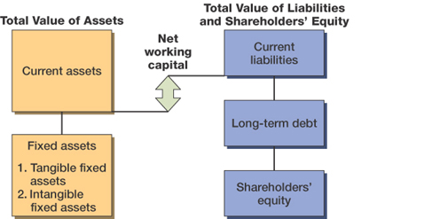
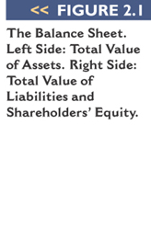
The Balance Sheet
Figure 2.1
2-<number>
Notes:
2.<number>
The left-hand side lists the assets of the firm. Current assets are listed first because they are the most liquid. Fixed assets can include both tangible and intangible assets, and they are listed at the bottom because they generally are not very liquid. These are a direct result of management’s investment decisions. (Please emphasize that “investment decisions” are not limited to investments in financial assets.)
Note that the balance sheet does not list some very valuable assets, such as the people who work for the firm.
The liabilities and equity (or ownership) components of the firm are listed on the right-hand side. This indicates how the assets are paid for. Since the balance sheet has to balance, total equity = total assets – total liabilities. The portion of equity that can most easily fluctuate to create this balance is retained earnings. The right-hand side of the balance sheet is a direct result of management’s financing decisions.
Remember that shareholders’ equity consists of several components and that total equity includes all of these components, not just the “common stock” item. In particular, remind students that retained earnings belong to the shareholders.

Slide 20
Net Working Capital and Liquidity
Net Working Capital
  = Current Assets – Current Liabilities
  Positive when the cash that will be received over the next 12 months exceeds the cash that will be paid out
  Usually positive in a healthy firm
Liquidity
  Ability to convert to cash quickly without
  a significant loss in value
  Liquid firms are less likely to experience financial distress
  But liquid assets typically earn a lower return
  Trade-off to find balance between liquid and illiquid assets
2-<number>
Notes:
2.<number>
After a basic accounting class, students may believe a higher current ratio (or, similarly, more cash on hand) is always better. So, it is good to remind students that a cash balance is a use of funds and has an opportunity cost.

Slide 21
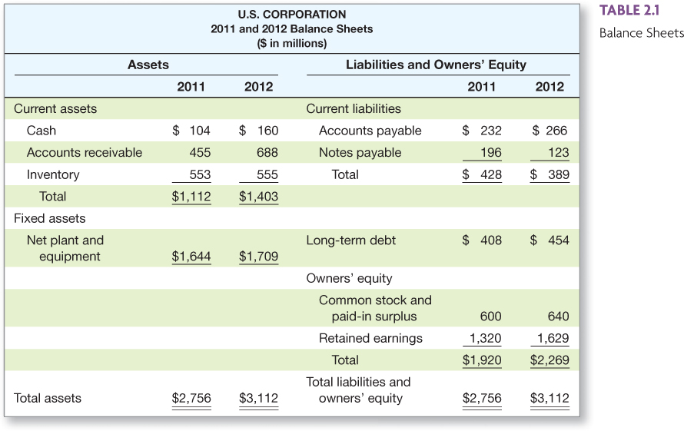

US Corporation Balance Sheet Table 2.1
Place Table 2.1 (US Corp Balance Sheet) here
2-<number>
Notes:
2.<number>
The first example computing cash flows has a link to the information in this table. The arrow in the corner is used to return you to the example.
Here is an example of a simplified balance sheet. Many students make it through business school without ever seeing an actual balance sheet, particularly those who are not majoring in finance or accounting. I encourage you to bring in some annual reports and let the students see the differences between the simplified statements they see in textbooks and the real thing.
This is a good place to talk about some of the specific types of items that show up on a balance sheet and remind the students what accounts receivable, accounts payable, notes payable, etc. are.

Slide 22
Market Value vs. Book Value
The balance sheet provides the book value of the assets, liabilities, and equity.
Market value is the price at which the assets, liabilities, or equity can actually be bought or sold.
Market value and book value are often very different. Why?
Which is more important to the decision-making process?
2-<number>
Notes:
2.<number>
Current assets and liabilities generally have book values and market values that are very close. This is not necessarily the case with the other assets, liabilities, and equity of the firm.
Assets are listed at historical costs less accumulated depreciation – this may bear little resemblance to what they could actually be sold for today. The balance sheet also does not include the value of many important assets, such as human capital. Consequently, the “Total Assets” line on the balance sheet is generally not a very good estimate of what the assets of the firm are actually worth.
Liabilities are listed at face value. When interest rates change or the risk of the firm changes, the value of those liabilities change in the market as well. This is especially true for longer-term liabilities.
Equity is the ownership interest in the firm. The market value of equity (stock price times number of shares) depends on the future growth prospects of the firm and on the market’s estimation of the current value of ALL of the assets of the firm.
The best estimate of the market value of the firm’s assets is market value of liabilities + market value of equity.
Market values are generally more important for the decision making process because they are more reflective of the cash flows that would occur today.

Slide 23
Example 2.2
Klingon Corporation
KLINGON CORPORATION
Balance Sheets
Market Value versus Book Value
 | Book | Market |  | Book | Market
Assets |  |  | Liabilities and Shareholders’ Equity
NWC | $ 400 | $ 600 | LTD | $ 500 | $ 500
NFA | 700 | 1,000 | SE | 600 | 1,100
 | 1,100 | 1,600 |  | 1,100 | 1,600
2-<number>
Notes:
2.<number>
Shareholders are the ones that benefit from increases in the market value of a firm’s assets. They are also the ones that bear the losses of a decrease in market value. Consequently, managers need to consider the impact of their decisions on the market value of assets, not on their book value. Here is a good illustration:
Suppose that the MV of assets declined to $700 and the market value of long-term debt remained unchanged. What would happen to the market value of equity? It would decrease to 700 – 500 = 200.
The market-to-book ratio, which compares the market value of equity to the book value of equity, is often used by analysts as a measure of valuation for a stock. It is generally a bad sign if a company’s market-to-book ratio approaches 1.00 (meaning market value = book value) because of the GAAP employed in creating a balance sheet. It is definitely a bad sign if the ratio is less than 1.00.
GAAP does provide for some assets to be marked-to-market, primarily those assets for which current market values are readily available due to trading in liquid markets. However, it does not generally apply to long-term assets, where market values and book values are likely to differ the most.

Slide 24
Income Statement
The income statement is more like a video of the firm’s operations for a specified period of time.
You generally report revenues first and then deduct any expenses for the period
Matching principle – GAAP says to show revenue when it accrues and match the expenses required to generate the revenue
2-<number>
Notes:
2.<number>
Matching principle – this principle leads to non-cash deductions like depreciation. This is why net income is NOT a measure of the cash flow during the period.
Consider discussing that the top half of the income statement addresses investment decisions, whereas the bottom half deals with financing.

Slide 25
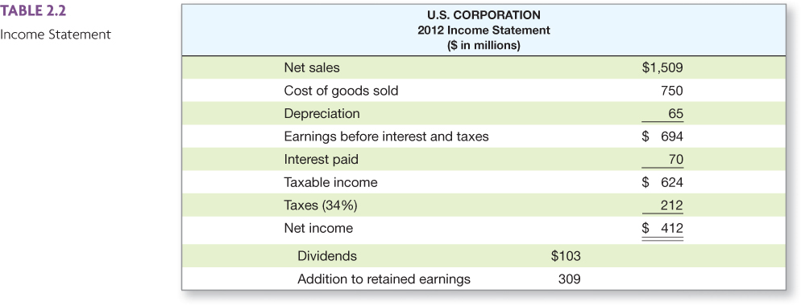
US Corporation Income Statement – Table 2.2
Insert new Table 2.2 here (US Corp Income Statement)
2-<number>
Notes:
2.<number>
The first example computing cash flows has a link to the information in this table. The arrow in the corner is used to return you to the example.
Remember that these are simplified income statements for illustrative purposes.
Earnings before interest and taxes is often called operating income.
COGS would include both the fixed costs and the variable costs needed to generate the revenues.
Analysts often look at EBITDA (earnings before interest, taxes, depreciation, and amortization) as a measure of the operating cash flow of the firm. It is not true in the strictest sense because taxes are an operating cash flow as well, but it does provide a reasonable estimate for analysis purposes.
It is important to point out that depreciation expense is often figured two different ways, depending on the purpose of the financial statements. If we are computing the taxes that we will owe, we use the depreciation schedule provided by the IRS. In this instance, the “life” of the asset for depreciation purposes may be very different from the useful life of the asset. Statements that are prepared for investors often use straight-line depreciation because it will tend to have a lower depreciation charge than MACRS early in the asset’s life. This reduces the “expense,” and thus increases the firm’s reported EPS. This is a good illustration of why it is important to look at a firm’s cash flow and not just its EPS.

Slide 26
Taxes
The one thing we can rely on with taxes is that they are always changing
Marginal vs. average tax rates
  Marginal tax rate – the percentage
  paid on the next dollar earned
  Average tax rate – the tax bill / taxable income
  Average tax rates vary widely across different companies and industries
Other taxes
2-<number>
Notes:
2.<number>
Point out that taxes can be a very important component of the decision making process, but what students learn about tax specifics now could change tomorrow. Consequently, it is important to keep up with the changing tax laws and to utilize specialists in the tax area when making decisions where taxes are involved.
www: Click on the web surfer icon to go to the IRS web site for the most up-to-date tax information.
It is important to point out that we are concerned with the taxes that we will pay if a decision is made. Consequently, the marginal tax rate is what we should use in our analysis.
Students can view the average tax rates for various industries in Table 2.5.
Point out that the tax rates discussed in the book are just federal taxes. Many states and cities have income taxes as well, and those taxes should figure into any analysis that we conduct.

Slide 27
The Concept of Cash Flow
Cash flow is one of the most important pieces of information that a financial manager can derive from financial statements
The statement of cash flows does not provide us with the same information
that we are looking at here
We will look at how cash is generated from utilizing assets and how it is paid to those that finance the purchase of the assets
2-<number>

Slide 28
Cash Flow From Assets
Cash Flow From Assets (CFFA) = Cash Flow to Creditors + Cash Flow to Stockholders
Cash Flow From Assets = Operating Cash Flow – Net Capital Spending – Changes in NWC
2-<number>
Notes:
2.<number>
The first equation is how the cash flow from the firm is divided among the investors who financed the assets.
The second equation is the cash flow that the firm receives from its assets. This is an important equation to remember. We will come back to it and use it again when we do our capital budgeting analysis. We want to base our decisions on the timing and risk of the cash flows we expect to receive from a project.

Slide 29
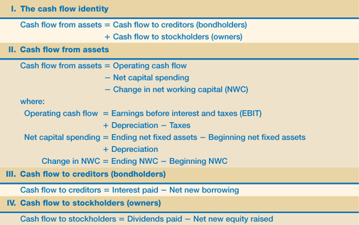
Cash Flow Summary - Table 2.6
2-<number>
Notes:
2.<number>
This provides a summary for the various cash flow calculations. It is a good place to refer back when working on cash flows in the capital budgeting section.

Slide 30
Comprehensive Problem
Current Accounts
  2012: CA = 4,400; CL = 1,500
  2011: CA = 3,500; CL = 1,200
Fixed Assets and Depreciation
  2012: NFA = 3,400; 2011: NFA = 3,100
  Depreciation Expense = 400
Long-term Debt and Equity (R.E. not given)
  2012: LTD = 4,000; Common stock & APIC = 400
  2011: LTD = 3,950; Common stock & APIC = 400
Income Statement
  EBIT = 2,000; Taxes = 300
  Interest Expense = 350; Dividends = 500
Compute the CFFA
2-<number>
Notes:
2.<number>
OCF = $2,000 + $400 – $300 = $2,100
NCS = $ 3,400 – $3,100 + $400 = $700
Changes in NWC = ($4,400 – $1,500) – ($3,500 – $1,200) = $600
CFFA = $2,100 – $700 - $600 = $800
CF to Creditors = $350 – ($4,000 – $3,950) = $300
CF to Stockholders = $500
CFFA = $300 + $500 = $800

Slide 31
Chapter 3
Financial Statement Analysis
McGraw-Hill/Irwin
Copyright © 2013 by The McGraw-Hill Companies, Inc. All rights reserved.
Notes:
3.<number>

Slide 32
Key Concepts and Skills
Understand sources and uses of cash and the Statement of Cash Flows
Know how to standardize financial statements for comparison purposes
Know how to compute and interpret important financial ratios
Understand the problems and pitfalls in financial statement analysis
3-<number>
Notes:
3.<number>
Digital Equipment’s CEO stated: “Make your numbers or I’m sure your successor will.”

Slide 33
Chapter Outline
Cash Flow and Financial Statements: A Closer Look
Standardized Financial Statements
Ratio Analysis
The Du Pont Identity
Using Financial Statement Information
3-<number>

Slide 34
Sample Balance Sheet
 | 2012 | 2011 |  | 2012 | 2011
Cash | 696 | 58 | A/P | 307 | 303
A/R | 956 | 992 | N/P | 26 | 119
Inventory | 301 | 361 | Other CL | 1,662 | 1,353
Other CA | 303 | 264 | Total CL | 1,995 | 1,775
Total CA | 2,256 | 1,675 | LT Debt | 843 | 1,091
Net FA | 3,138 | 3,358 | C/S | 2,556 | 2,167
Total Assets | 5,394 | 5,033 | Total Liab. & Equity | 5,394 | 5,033
Numbers in millions of dollars
3-<number>
Notes:
3.<number>

Slide 35
Sample Income Statement
Revenues | 5,000
Cost of Goods Sold | (2,006)
Expenses | (1,740)
Depreciation | (116)
EBIT | 1,138
Interest Expense | (7)
Taxable Income | 1,131
Taxes | (442)
Net Income | 689
EPS | 3.61
Dividends per share | 1.08
Numbers in millions of dollars, except EPS & DPS
3-<number>
Notes:
3.<number>
The net income figure and EPS are based on income from continuing operations. There are 190.9 million shares outstanding.

Slide 36
Statement of Cash Flows
Statement that summarizes the sources and uses of cash
Changes divided into three major categories
  Operating Activity – includes net income and changes in most current accounts
  Investment Activity – includes changes in fixed assets
  Financing Activity – includes changes in notes payable, long-term debt, and equity accounts, as well as dividends
3-<number>

Slide 37
Sample Statement of Cash Flows
Cash, beginning of year | 58 | Financing Activity
Operating Activity |  | Decrease in Notes Payable | -93
Net Income | 689 | Decrease in LT Debt | -248
Plus: Depreciation | 116 | Decrease in C/S (minus RE) | -94
Decrease in A/R | 36 | Dividends Paid | -206
Decrease in Inventory | 60 | Net Cash from Financing | -641
Increase in A/P | 4
Increase in Other CL | 309 | Net Increase in Cash | 638
Less: Increase in other CA | -39
Net Cash from Operations | 1,175 | Cash End of Year | 696
Investment Activity
Sale of Fixed Assets | 104
Net Cash from Investments | 104
Numbers in millions of dollars
3-<number>
Notes:
3.<number>
Investment activity: change in net fixed assets + depreciation (have to add back depreciation because it was deducted from the fixed asset account to get the net fixed asset figure). If the number is positive, then we acquired fixed assets; if it’s negative, then we sold fixed assets.
3138 – 3358 + 116 = -104 so we sold 104 million worth of fixed assets
Remind students that part of the increase in the C/S account shown on the balance sheet is the increase in Retained Earnings. That is already incorporated in the net income under operating activity.
Dividends paid = 190.9*1.08 = 206 million
Additions to RE = 689 – 206 = 483
Change in C/S = 2556 – 2167 – 483 = -94

Slide 38
Ratio Analysis
Ratios allow for better comparison
through time or between companies
As we look at each ratio, ask yourself
what the ratio is trying to measure and why that information is important
Ratios are used both internally and externally
3-<number>
Notes:
3.<number>
Lecture Tip: Be sure that your students understand that “real-world” financial statements are not as straightforward as the simplified ones presented in the textbook. Actually reviewing some financial statements of companies with which they are familiar may help.

Slide 39
Categories of
Financial Ratios
Short-term solvency or liquidity ratios
Long-term solvency or financial leverage ratios
Asset management or turnover ratios
Profitability ratios
Market value ratios
3-<number>
Notes:
3.<number>
The ratios in the following slides will be computed using the 2012 information from the Sample Balance Sheet and Income Statement.
Lecture Tip: Remind students that the point of the analysis is not simply the ability to compute the ratios, but rather the ability to interpret them.

Slide 40
Computing Liquidity Ratios
Current Ratio = CA / CL
  2,256 / 1,995 = 1.13 times
Quick Ratio = (CA – Inventory) / CL
  (2,256 – 301) / 1,995 = .98 times
Cash Ratio = Cash / CL
  696 / 1,995 = .35 times
B/S
I/S
3-<number>
Notes:
3.<number>
The firm is just barely able to cover current liabilities with its current assets. A short-term creditor might find this a bit disconcerting and may reduce the likelihood that they would lend money to the company. The ratio should be compared to the industry – it’s possible that this industry has a substantial amount of cash flow and that they can meet their current liabilities out of cash flow instead of relying solely on the liquidation of current assets that are on the books. Also, the CR for 2011 was .94, so the company has improved from the previous year.
The quick ratio is quite a bit lower than the current ratio, so inventory seems to be an important component of current assets.
This company carries a low cash balance, although the cash ratio has increased substantially from the previous year (.03 in 2011). This may be an indication that they are aggressively investing in assets that will provide higher returns. We need to make sure that we have enough cash to meet our obligations, but too much cash reduces the return earned by the company.
The NWC to TA measure seems relatively low, but is consistent with the current ratio.
The Interval Measure indicates that the company can meet average daily expenses with current assets for almost 220 days.
Lecture Tip: Remind students that a high current ratio may actually be a negative, as current assets generally produce a lower return than fixed assets. To build on this understanding, make students evaluate the interaction among ratios. For example, suggest a scenario in which the current ratio exhibits no change over a two- or three-year period, while the quick ratio experiences a steady decline. How could this occur?

Slide 41
Computing Long-term Solvency Ratios
Total Debt Ratio = (TA – TE) / TA
  (5,394 – 2,556) / 5,394 = 52.61%
Debt/Equity = TD / TE
  (5,394 – 2,556) / 2,556 = 1.11 times
B/S
I/S
3-<number>
Notes:
3.<number>
Note that these are often called leverage ratios and that this group of ratios measures two aspects of leverage: level of indebtedness and the ability to service this debt.
TE = total equity, and TA = total assets. The numerator in the total debt ratio could also be found by adding all of the current and long-term liabilities.
The firm finances almost 53% of its assets with debt. This is down from about 57% from the previous year.
Another way to compute the D/E ratio if you already have the total debt ratio:
D/E = Total debt ratio / (1 – total debt ratio) = .5261 / (1 - .5261) = 1.11
The EM is one of the ratios that is used in the Du Pont Identity as a measure of the firm’s financial leverage.
The Long-term debt ratio is down from 33.49% in 2011.

Slide 42
Computing Coverage Ratios
Times Interest Earned = EBIT / Interest
  1,138 / 7 = 162.57 times
B/S
I/S
3-<number>
Notes:
3.<number>
Even though the company is financed with over 52% debt, they have a substantial amount of operating income available to cover the required interest payments.
Remember that depreciation is a non-cash deduction. A better indication of a firm’s ability to meet interest payments may be to add back the depreciation to get an estimate of cash flow before taxes.
Lecture Tip: The importance of coverage ratios is sometimes overlooked, particularly when one considers their importance to all types of creditors.

Slide 43
Computing Inventory Ratios
Inventory Turnover = Cost of Goods Sold / Inventory
  2,006 / 301 = 6.66 times
Days’ Sales in Inventory = 365 / Inventory Turnover
  365 / 6.66 = 55 days
B/S
I/S
3-<number>
Notes:
3.<number>
Inventory turnover can be computed using either ending inventory or average inventory when you have both beginning and ending figures. It is important to be consistent with whatever benchmark you are using to analyze the company’s strengths or weaknesses.
It is also important to consider seasonality in sales. If the balance sheet is prepared at a time when there is a large inventory build-up to meet seasonal demand, then the inventory turnover will be understated and you might believe that the company is not performing as well as it is. On the other hand, if the balance sheet is prepared when inventory has been drawn down due to seasonal sales, then the inventory turnover would be overstated and the company may appear to be doing better than it really is. Averages using annual data may not fix this problem. If a company has seasonal sales, you may want to look at quarterly averages to get a better indication of turnover.
Lecture Tip: You may wish to mention that there may be significant inconsistencies in the methods used to compute ratios by financial advisory firms. When using ratios supplied by others, it is important to be aware of the exact financial items used. A manufacturer would typically consider inventory at cost, and thus, relate inventory to cost of goods sold. However, a retailer might maintain its inventory level based on retail price. In the latter case, inventory should be related to sales to compute inventory turnover. The markup would cancel in the numerator and denominator and give an accurate indication of turnover based on cost. Furthermore, some analysts use average inventory over some period instead of ending inventory. The same is true for the other assets used in the various turnover ratios.

Slide 44
Computing
Receivables Ratios
Receivables Turnover = Sales / Accounts Receivable
  5,000 / 956 = 5.23 times
Days’ Sales in Receivables =
365 / Receivables Turnover
  365 / 5.23 = 70 days
B/S
I/S
3-<number>
Notes:
3.<number>
Technically, the sales figure should be credit sales. This is often difficult to determine from the income statements provided in annual reports. If you use total sales instead of credit sales, you will overstate your turnover level. You need to recognize this bias when credit sales are unavailable, particularly if a large portion of the sales are cash sales.
As with inventory turnover, you can use either ending receivables or an average of beginning and ending.
You also run into the same seasonal issues as discussed with inventory.
Probably the best benchmark for days’ sales in receivables is the company’s credit terms. If the company offers a discount (1/10 net 30), then you would like to see days’ sales in receivables less than 30. If the company does not offer a discount (net 30), then you would like to see days’ sales in receivables close to the net terms. If days’ sales in receivables is substantially larger than the net terms, then you first need to look for biases, such as seasonality in sales. If this does not provide an explanation for the difference, then the company may need to take another look at its credit policy (who it grants credit to and its collection procedures).
Lecture Tip: Be sure to remind students that ratio analysis is a means to an end, not an end in itself. The results of the analysis provide us with red flags or items for additional investigation.
Lecture Tip: Students also need to realize that comparisons across industries can be problematic.

Slide 45
Computing Total
Asset Turnover
Total Asset Turnover = Sales / Total Assets
  5,000 / 5,394 = .93
  It is not unusual for TAT < 1, especially if a firm has a large amount of fixed assets
Fixed Asset Turnover = Sales / NFA
  5,000 / 3,138 = 1.59 times
B/S
I/S
3-<number>
Notes:
3.<number>
Having a TAT of less than one is not a problem for most firms. Fixed assets are expensive and are meant to provide sales over a long period of time. This is why the matching principle indicates that they should be depreciated instead of immediately expensed.
This is one of the ratios that will be used in the Du Pont identity.

Slide 46
Computing Profitability Measures
Profit Margin = Net Income / Sales
  689 / 5,000 = 13.78%
Return on Assets (ROA) = Net Income / Total Assets
  689 / 5,394 = 12.77%
Return on Equity (ROE) = Net Income / Total Equity
  689 / 2,556 = 26.96%
B/S
I/S
3-<number>
Notes:
3.<number>
You can also compute the gross profit margin and the operating profit margin.
GPM = (Sales – COGS) / Sales = (5,000 – 2,006) / 5,000 = 59.88%
OPM = EBIT / Sales = 1,138 / 5,000 = 22.76%
Profit margin is one of the components of the Du Pont identity and is a measure of operating efficiency. It measures how well the firm controls the costs required to generate the revenues. It tells how much the firm earns for every dollar in sales. In the example, the firm earns almost $0.14 for each dollar in sales.
Note that the ROA and ROE are returns on accounting numbers. As such, they are not directly comparable with returns found in the marketplace. ROA is sometimes referred to as ROI (return on investment). As with many of the ratios, there are variations in how they can be computed. The most important thing is to make sure that you are computing them the same way as the benchmark you are using.
ROE will always be higher (in absolute terms) than ROA as long as the firm has debt. The greater the leverage the larger the difference will be. ROE is often used as a measure of how well management is attaining the goal of owner wealth maximization. The Du Pont identity is used to identify factors that affect the ROE.

Slide 47
Why Evaluate Financial Statements?
Internal uses
  Performance evaluation – compensation
  and comparison between divisions
  Planning for the future – guide in
  estimating future cash flows
External uses
  Creditors
  Suppliers
  Customers
  Stockholders
3-<number>
Notes:
3.<number>
Lecture Tip: Discuss with students that the ratios that are most important to a firm are those that best represent their business. So, whereas inventory turnover may be relevant for a retailer or manufacturer, it is less important for a service firm. The best ratios may be those that are uniquely developed for the business under review.

Slide 48
Potential Problems
There is no underlying theory, so there is no way to know which ratios are most relevant
Benchmarking is difficult for diversified firms
Globalization and international competition makes comparison more difficult because of differences in accounting regulations
Varying accounting procedures, i.e. FIFO vs. LIFO
Different fiscal years
Extraordinary events
3-<number>

Slide 49
Chapter 4
Financial Management and Growth
McGraw-Hill/Irwin
Copyright © 2013 by The McGraw-Hill Companies, Inc. All rights reserved.

Slide 50
Key Concepts and Skills
Understand the financial planning process and how decisions are interrelated
Be able to develop a financial plan using the percentage of sales approach
Be able to compute external financing needed and identify the determinants
of a firm’s growth
Understand the four major decision areas involved in long-term financial planning
Understand how capital structure policy and dividend policy affect a firm’s ability
to grow
4-<number>

Slide 51
Chapter Outline
What Is Financial Planning?
Financial Planning Models:
A First Look
External Financing and Growth
Some Caveats Regarding Financial Planning Models
4-<number>

Slide 52
Elements of Financial Planning
Investment in new assets – determined by capital budgeting decisions
Degree of financial leverage – determined by capital structure decisions
Cash paid to shareholders – determined by dividend policy decisions
Liquidity requirements – determined by net working capital decisions
4-<number>

Slide 53
Financial Planning Process
Planning Horizon - divide decisions into short-run decisions (usually next 12 months) and long-run decisions (usually 2 – 5 years)
Aggregation - combine capital budgeting decisions into one large project
4-<number>
Notes:
The time period used in the financial planning process is called the planning horizon.
Lecture Tip: Many students assume that only a single variable need be changed for best- and worst-case scenarios. However, it is often the confluence of several events. For example, consider mid-2008 when commodity prices were increasing dramatically, while at the same time the economy in the U.S. was slowing. This caused many firms to see input prices rise, while demand and pricing power fell on the output side.
In addition, many students may suggest aggregation is unrealistic; however, remind them we are not producing a detailed financial plan. Rather, we are highlighting general relationships. In recent times, most large firms have adopted ERP systems to help with this planning process.
The discussion of scenario analysis is a good precursor for capital budgeting.

Slide 54
Role of Financial Planning
Examine interactions – help management see the interactions between decisions
Explore options – give management a systematic framework for exploring its opportunities
Avoid surprises – help management identify possible outcomes and plan accordingly
Ensure feasibility and internal consistency – help management determine if goals can be accomplished and if the various stated (and unstated) goals of the firm are consistent with one another
4-<number>
Notes:
Committing a plan to paper forces managers to think seriously about the future.

Slide 55
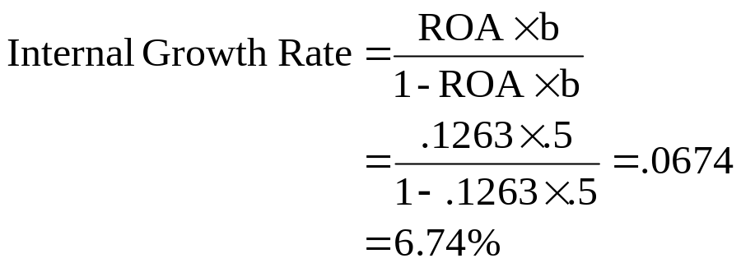
The Internal Growth Rate
The internal growth rate tells us how much the firm can grow assets using retained earnings as the only source of financing.
Using the information from Tasha’s Toy Emporium
  ROA = 1200 / 9500 = .1263
  Retention Ratio (b) = .5
4-<number>
Notes:
This firm could grow assets at 6.74% without raising additional external capital.
Relying solely on internally generated funds will increase equity (retained earnings are part of equity) and assets without an increase in debt. Consequently, the firm’s leverage will decrease over time. If there is an optimal amount of leverage, as we will discuss in later chapters, then the firm may want to borrow to maintain that optimal level of leverage. This idea leads us to the sustainable growth rate.

Slide 56
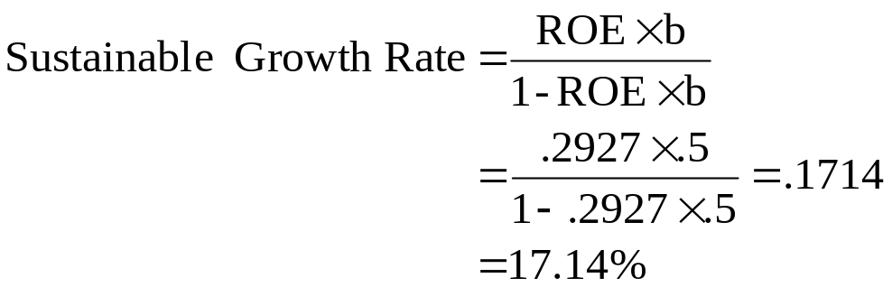
The Sustainable Growth Rate
The sustainable growth rate tells us how much the firm can grow by using internally generated funds and issuing debt to maintain a constant debt ratio.
Using Tasha’s Toy Emporium
  ROE = 1200 / 4100 = .2927
  b = .5
4-<number>
Notes:
Note that no new equity is issued.
The sustainable growth rate is substantially higher than the internal growth rate. This is because we are allowing the company to issue debt as well as use internal funds.
Lecture Tip: Some students will wonder why managers would wish to avoid issuing equity to meet anticipated financing needs. This is a good opportunity to bring in concepts from previous chapters (stockholder/bondholder conflicts of interest and agency costs), as well as to introduce topics to be covered in future chapters (information asymmetry and signaling, flotation costs, high cost of equity and corporate governance).
Many texts refer to the sustainable growth rate as b x ROE. This simpler formula assumes that ROE is computed using beginning (rather than ending) equity balances.

Slide 57
Comprehensive Problem
XYZ has the following financial information for 2012:
Sales = $2M, Net Inc. = $0.4M, Div. = $0.1M
C.A. = $0.4M, F.A. = $3.6M
C.L. = $0.2M, LTD = $1M, C.S. = $2M, R.E. = $0.8M
What is the sustainable growth rate?
4-<number>
Notes:
ROE = net income / shareholders’ equity = $.4M / ($2M + $.8M) = .1429
Payout ratio = dividends/net income = .1M/.4M = .25
Plowback ratio (b) 1 – payout ratio = 1 - .25 = .75
Sustainable growth rate = ROE X b / 1 – ROE X b = .1429 X .75 / (1 – (.1429 X .75)) = .12
Profit margin = net income/sales = .4M/2M = .2
Projected net income = profit margin X projected sales = .2 X $2.4M = $.48M
Projected addition to retained earnings = projected net income X (1 – payout ratio) = $.48M X (1-.25) = $.48M X .75 = $.36M
% change in sales = ($2.4M - $2M)/$2M = .2
2012 total assets = $.4M + $3.6M = $4M
Projected total assets = $4M X 1.2 = $4.8M
Projected C.L. = $.2M X 1.2 = $.24M
Projected R.E. = 2012 R.E. + projected addition to R.E. = $.8M + $.36M = $1.16M
Projected liabilities and owners’ equity = projected C.L. + LTD + C.S. + projected R.E. = $.24M + $1M + $2M + $1.16M = $4.4M
External Financing Needed = projected assets – projected liabs. and OE = $4.8M - $4.4M = $.4M

Slide 58
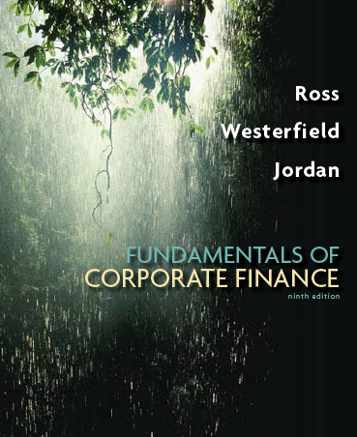
Chapter 5
Capital Budgeting
McGraw-Hill/Irwin
Copyright © 2013 by The McGraw-Hill Companies, Inc. All rights reserved.

Slide 59
Key Concepts and Skills
Be able to compute payback and discounted payback and understand their shortcomings
Understand accounting rates of return and their shortcomings
Be able to compute internal rates of return (standard and modified) and understand their strengths and weaknesses
Be able to compute the net present value and understand why it is the best decision criterion
Be able to compute the profitability index and understand its relation to net present value
9-<number>

Slide 60
Chapter Outline
Net Present Value
The Payback Rule
The Average Accounting Return
The Profitability Index
9-<number>
Notes:
8.<number>
Lecture Tip: A logical prerequisite to the analysis of investment opportunities is the creation of investment opportunities. Unlike the field of investments, where the analyst more or less takes the investment opportunity set as a given, the field of capital budgeting relies on the work of people in the areas of engineering, research and development, information technology and others for the creation of investment opportunities. As such, it is important to remind students of the importance of creativity in this area, as well as the importance of analytical techniques.

Slide 61
Net Present Value
The difference between the market value of a project and its cost
How much value is created from undertaking an investment?
  The first step is to estimate the expected future cash flows.
  The second step is to estimate the required return for projects of this risk level.
  The third step is to find the present value of the cash flows and subtract the initial investment.
9-<number>
Notes:
8.<number>
We learn how to estimate the cash flows and the required return in subsequent chapters.
The NPV measures the increase in firm value, which is also the increase in the value of what the shareholders own. Thus, making decisions with the NPV rule facilitates the achievement of our goal in Chapter 1 – making decisions that will maximize shareholder wealth.
Lecture Tip: Although this point may seem obvious, it is often helpful to stress the word “net” in net present value. It is not uncommon for some students to carelessly calculate the PV of a project’s future cash flows and fail to subtract out its cost (after all this is what the programmers of Lotus and Excel did when they programmed the NPV function). The PV of future cash flows is not NPV; rather, NPV is the amount remaining after offsetting the PV of future cash flows with the initial cost. Thus, the NPV amount determines the incremental value created by undertaking the investment.

Slide 62
Project Example Information
You are reviewing a new project and have estimated the following cash flows:
  Year 0: PVCO = -165,000
  Year 1: PVCI = 63,120; NI = 13,620
  Year 2: PVCI = 70,800; NI = 3,300
  Year 3: PVCI = 91,080; NI = 29,100
  Average Book Value = 72,000
Your required return for assets of this risk level is 12%.
9-<number>
Notes:
8.<number>
This example will be used for each of the decision rules so that the students can compare the different rules and see that conflicts can arise. This illustrates the importance of recognizing which decision rules provide the best information for making decisions that will increase owner wealth.

Slide 63
NPV – Decision Rule
If the NPV is positive, accept the project
A positive NPV means that the project is expected to add value to the firm and will therefore increase the wealth of the owners.
Since our goal is to increase owner wealth, NPV is a direct measure of how well this project will meet our goal.
9-<number>
Notes:
8.<number>
Lecture Tip: Here’s another perspective on the meaning of NPV. If we accept a project with a negative NPV of -$2,422, this is financially equivalent to investing $2,422 today and receiving nothing in return. Therefore, the total value of the firm would decrease by $2,422. This assumes that the various components (cash flow estimates, discount rate, etc.) used in the computation are correct.
Lecture Tip: In practice, financial managers are rarely presented with zero NPV projects for at least two reasons. First, in an abstract sense, zero is just another of the infinite number of values the NPV can take; as such, the likelihood of obtaining any particular number is small. Second, and more pragmatically, in most large firms, capital investment proposals are submitted to the finance group from other areas for analysis. Those submitting proposals recognize the ambivalence associated with zero NPVs and are less likely to send them to the finance group in the first place.

Slide 64
Computing NPV for the Project
Using the formulas:
  NPV = (63,120+ 70,800+ 91,080) -165,000 = 60,000
Do we accept or reject the project?
9-<number>
Notes:
8.<number>
Again, the calculator used for the illustration is the TI BA-II plus. The basic procedure is the same; you start with the year 0 cash flow and then enter the cash flows in order. F01, F02, etc. are used to set the frequency of a cash flow occurrence. Many calculators only require you to use this function if the frequency is something other than 1.
Since we have a positive NPV, we should accept the project.

Slide 65
Payback Period
How long does it take to get the initial cost back in a nominal sense?
Computation
  Estimate the cash flows
  Subtract the future cash flows from the initial cost until the initial investment has been recovered
Decision Rule – Accept if the payback period is less than some preset limit
9-<number>

Slide 66
Computing Payback
Assume we will accept the project if it pays back within two years.
  Year 1: 165,000 – 63,120 = 101,880 still to recover
  Year 2: 101,880 – 70,800 = 31,080 still to recover
  Year 3: 31,080 – 91,080 = -60,000 project pays back in year 3
Do we accept or reject the project?
9-<number>
Notes:
8.<number>
The payback period is year 3 if you assume that the cash flows occur at the end of the year, as we do with all of the other decision rules.
If we assume that the cash flows occur evenly throughout the year, then the project pays back in 2.34 years.
Either way, the payback rule would say to reject the project.

Slide 67
Computing Average Accounting Return (AAR)
Assume we require an average accounting return of 25%
Average Net Income:
  (13,620 + 3,300 + 29,100) / 3 = 15,340
AAR = 15,340 / 72,000 = .213 = 21.3%
Do we accept or reject the project?
9-<number>
Notes:
8.<number>
Students may ask where you came up with the 25%. Point out that this is one of the drawbacks of this rule. There is no good theory for determining what the return should be. We generally just use some rule of thumb.
This rule would indicate that we reject the project.

Slide 68
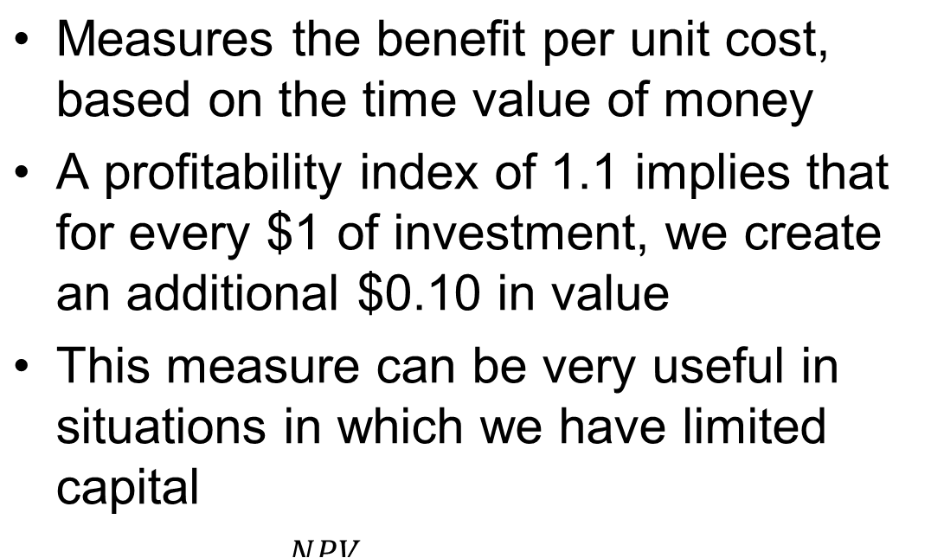
Profitability Index
9-<number>

Slide 69
End of Chapters
9-<number>

